Slide 1















Notes:
Để nguyên trang bìa như này, chỉ thay đổi tên bài trong quá trình làm. Logo của sách Wonderful World

Slide 2




Unit 1: My family
and friends
Lesson 1. Task 1 2 3

Slide 3

1
Warm Up
Guess “Who“?

Slide 4


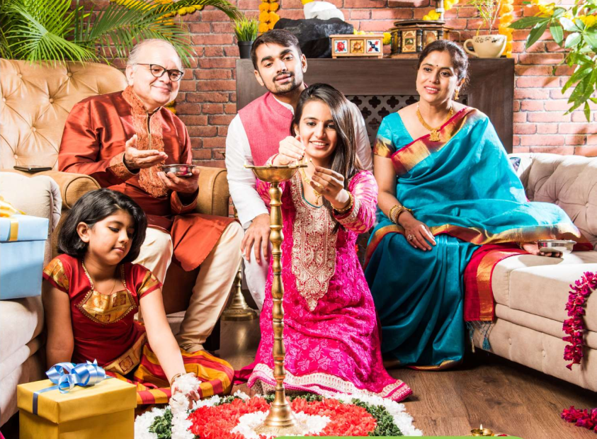



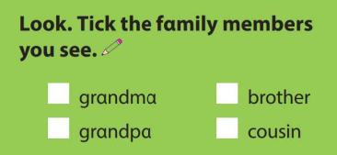
✓
✓
A happy Indian family celebrating festivals.
Notes:
Lead in: Photo time! “ Hidden faces”
Teacher shows the picture with hidden faces and give students some questions : Are they Vietnamese ? Are they at school / at home ? Are they friends ?
Is (No 1 ) the boy or the girl ? / Is she young or old ?-→ Who is she ?
Then , Sts can guess the members of the India and recall the learnt vocabulary like “ young, old, grandma, grandpa, sister, father….”

Slide 5
Presentation
2

Slide 6



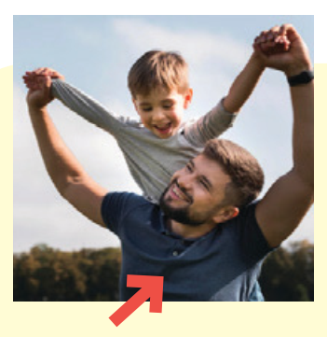
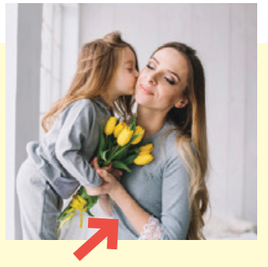
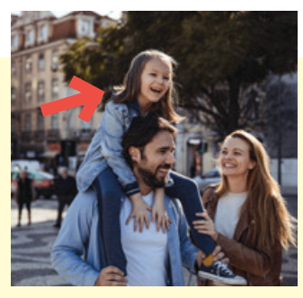


1 Listen and point. Repeat.
father
mother
daughter
son
twins

Slide 7
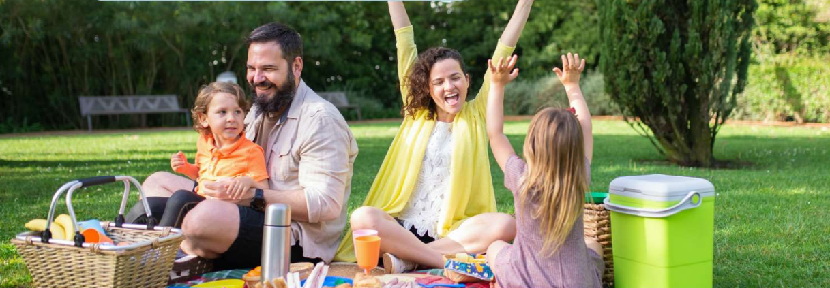
2 Listen and read. Write.
Tom: Look! This is my family.
We’re going on a picnic in the park.
Jack: That’s great! Who is he ?
Tom: He’s my father.
Jack: And who is she ?
Tom: She’s my mother.
Jack: Wow! She’s young.

Slide 8
2. Listen and read. Write.
There are people in the photo:
a mother, a , a son and a daughter.
four/4
father
Notes:
Đề bài và audio đọc khác tiêu đề - KT lại xem bản cập nhập SGK

Slide 9
3
Practice

Slide 10

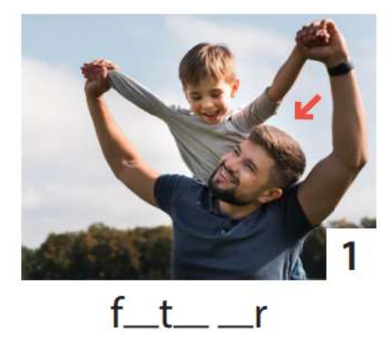
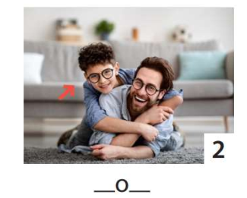
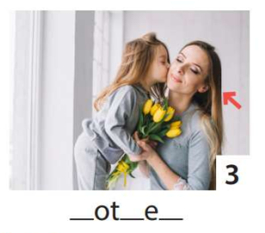
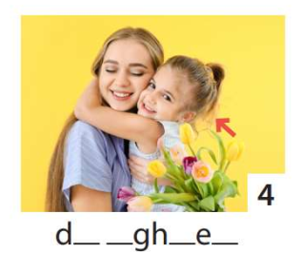
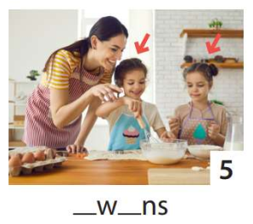
3 Write. Point and say.
1
2
3
4
5
He’s my father.
He’s my son.
She’s my daughter.
She’s my mother.
They’re twins.

Slide 11
UNIT 1: Family and Friends
LESSON 1 – PERIOD 1
What we learnt today
Vocabulary:
father
mother
son
daughter
twins
Structure:
She‘s my mother.
He’s my father.

