Slide 1





















Slide 2

Unit 9:
My Favourite Food
Lesson 3 – Task 1, 2, 3

Slide 3


PRESENTATION
Task 4 Listen and repeat.

Slide 4
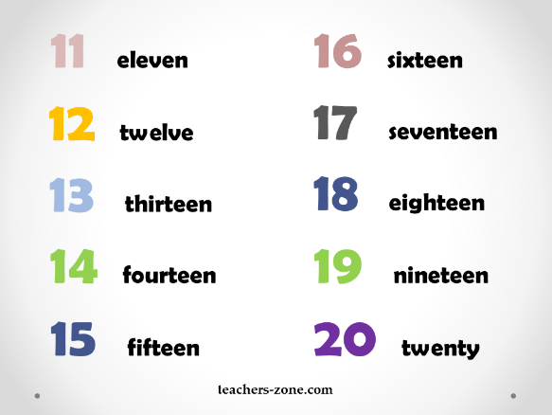
Listen and repeat.

Slide 5

PRACTICE
Task 5 Look and say.

Slide 6
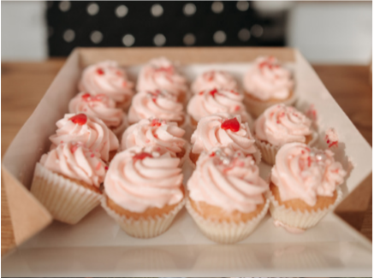
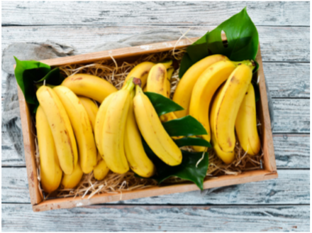
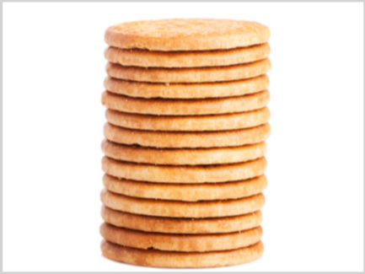
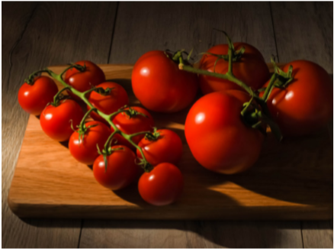
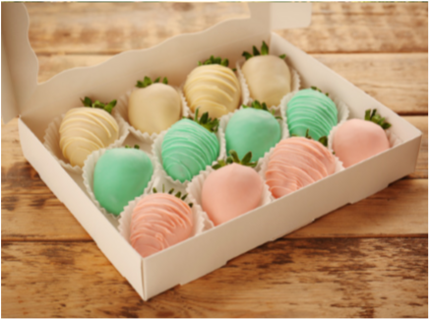
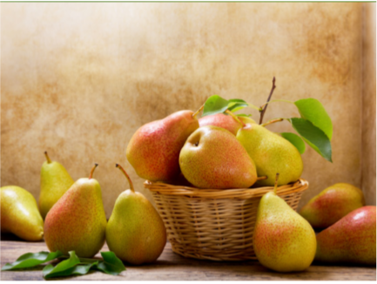
1. sweets / 15
2. bananas /16
3. biscuits /14
4. tomatoes /13
5. sweets / 12
6. pears / 11

Slide 7

PRODUCTION
Task 6 Listen and chant.

Slide 8

Let’s go to the market!
Let’s buy some food!
Let’s buy 12 apples and 15 pears!
How many apples?
How many pears?
Let’s buy 12 apples and 15 pears!

