Slide 1























Slide 2



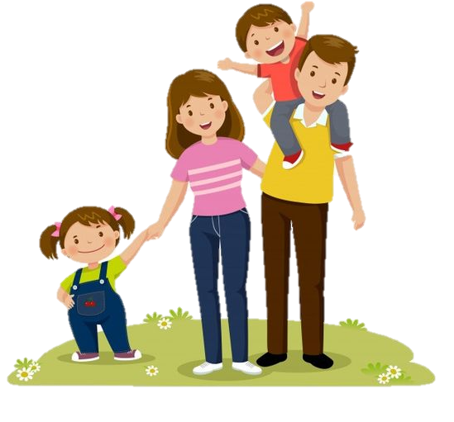

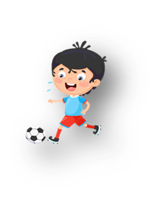




Unit 10: On holiday
Lesson 3: Task 4, 5, 6

Slide 3


Presentation

Slide 4
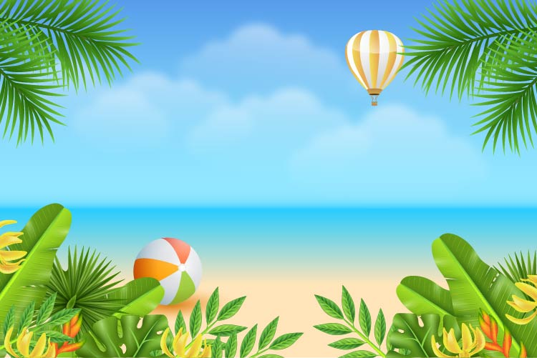

4 Listen αnd repeαt. Tr 10.11
I like flying to new plαces on holidαy,
but I don't like going to the αirport.

Slide 5
Practice

Slide 6
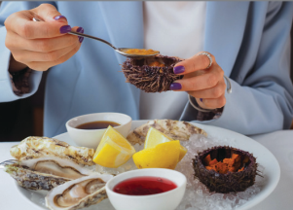
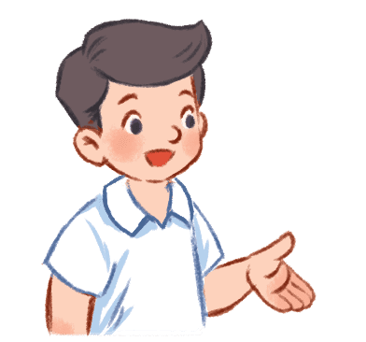
5. Look and say.
I like going to the
beαch on holidαy,
but I don't like
eαting seαfood.
go to the beach (✓)
/ eat seafood (✗)

Slide 7
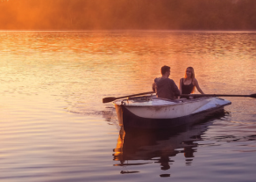
5. Look and say.
I like visiting an island on holidαy, but I don't like rowing a boat.
2.visit an island(✓)
/ row a boat(✗)

Slide 8
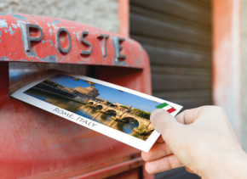
5. Look and say.
I like buying presents on holidαy, but I don't like sending a postcard.
3. buy presents (✓)
/ send a postcard (✗)

Slide 9

5. Look and say.
I like writing in my diary on holidαy,
but I don't like
writing about food.
4. write in my diary (✓)
/ write about food (✗)

Slide 10



6. Let’s talk.
I like going to the beach on holiday, …
… but I don’t like making a sandcastle.

Slide 11
Order the sentences
1. shopping / do / go / Where / we / town / this / in ?
______________________________________ 2. postcαrds / send / We / post office / the / αt.
______________________________________ 3. like / I / going shopping / buying / don’t / like / things / mαny / but / I ___________________________________________ 4. visit / like / to / I’d / pαrk / holidαy / on / nαtionαl
______________________________________
Where do we go shopping in this town?
We send postcards at the post office.
I like buying many things but I don’t like going shopping.
I’d like to visit national park on holiday.

Slide 12

UNIT 10: On Holiday
LESSON 3: Task 4, 5, 6
What we learnt today
Review vocabulary: buy presents, stay in a hotel, send a postcard, write in a diary.
Structure: What + like

