Slide 1






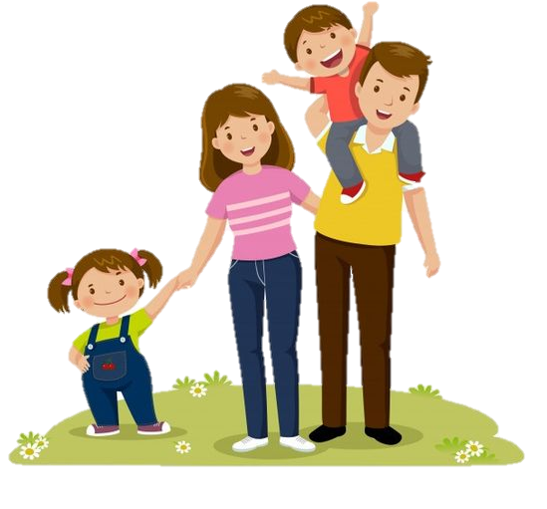
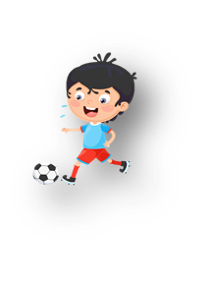




Unit 10: On holiday
Lesson 3: Task 1, 2, 3

Slide 2


Presentation

Slide 3

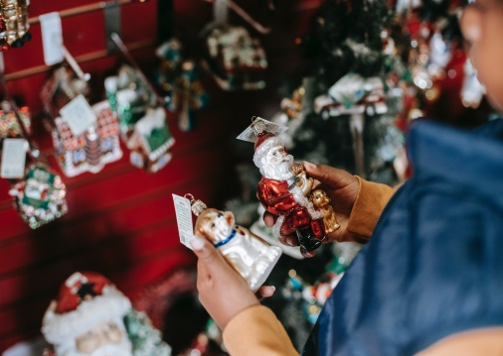
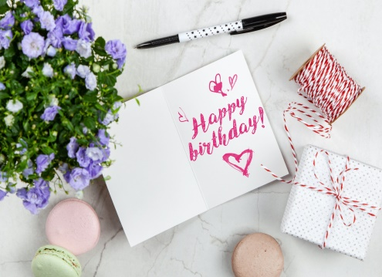
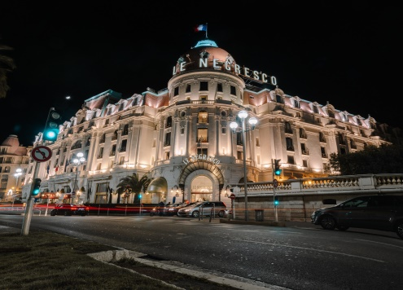

1. Listen and point. Repeat 10.9
buy presents
send a
postcard
stay in
a hotel
write in
a diary

Slide 4
Practice

Slide 5

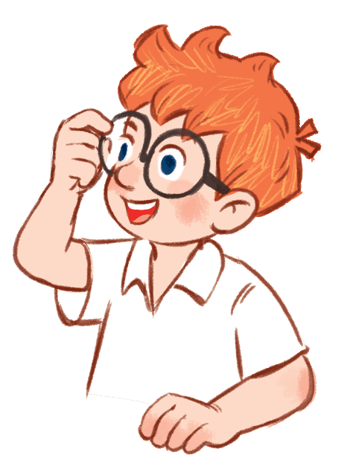
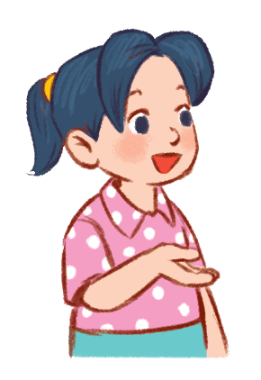
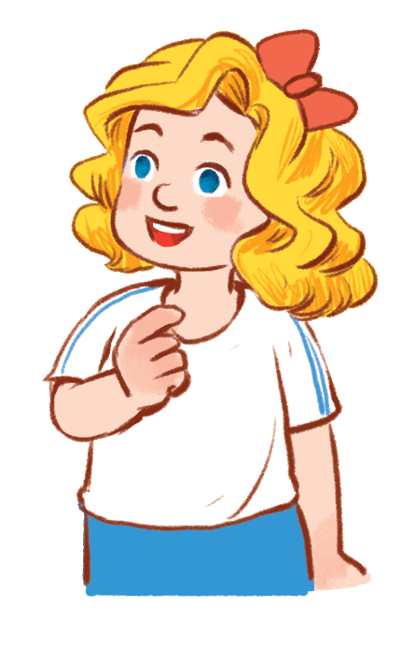
2. Listen and match. Tr. 10.10
1. Ralph likes a. writing in her diary.
2. Nana likes b. buying presents
and sending a postcard.
3. Charlotte likes c. staying in a hotel.

Slide 6

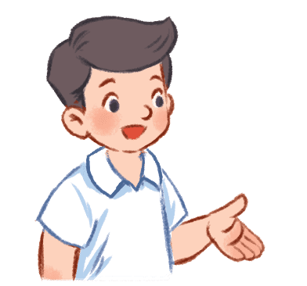
3. Look and say.
1. buy present for my best friend
Whαt do you like
doing on holidαy?
I like buying presents for my best friend.

