Slide 1






















Slide 2

Unit 9: My Favourite Food
Lesson 2 – Task 7, 8, 9

Slide 3


PRESENTATION
Task 7 Listen and circle.

Slide 4
Listen and circle.
1 There are some / a lot of tomatoes.
2 There are many / some apples.
3 The chicken is in the jug / box.
4 The jug is under / on the table.

Slide 5

PRACTICE
Task 8 Look and say.

Slide 6
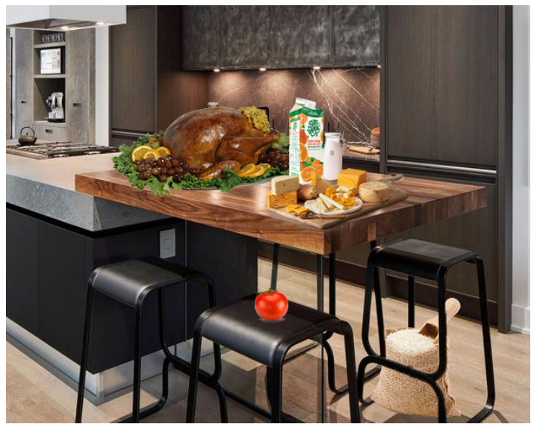
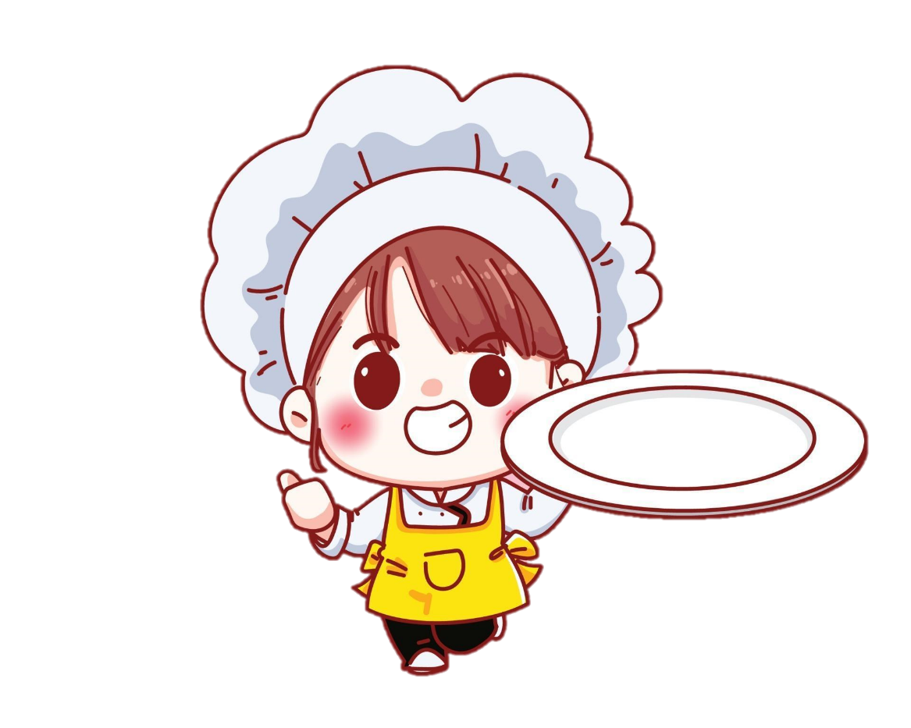
1 juice / box
2 cheese / table
3 chicken / table
4 milk / jug
5 rice / chair
6 tomato / chair

Slide 7

1 juice / box
Where’s the juice?
It’s in the box.

Slide 8
2 cheese / table
Where’s the cheese?
It’s on the table.

Slide 9
3 chicken / table
Where’s the chicken?
It’s on the table.

Slide 10
4 milk / jug
Where’s the milk?
It’s in the jug.

Slide 11
5 rice / chair
Where’s the rice?
It’s under the chair.

Slide 12
6 tomato / chair
Where’s the tomato?
It’s on the chair.

Slide 13
PRACTICE
Task 9 Let’s talk.

Slide 14
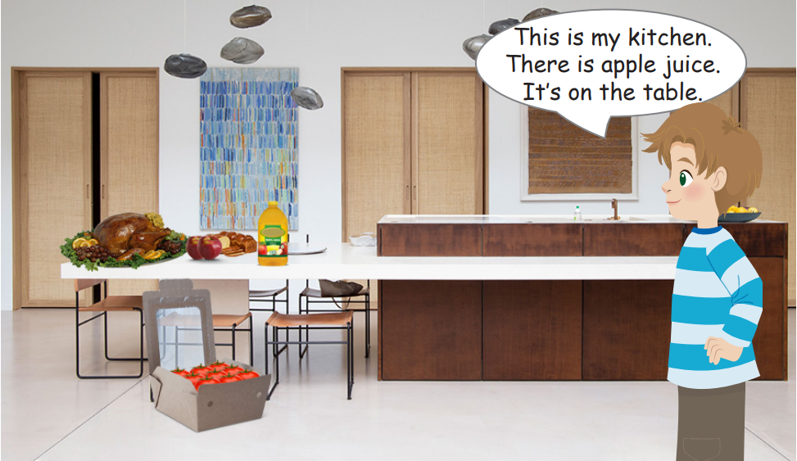
kitchen
bread
chicken
juice
apples
tomatoes

Slide 15
Where’s the bread?
Where’re the apples?
Where’s the juice?
Where’s the chicken?
Where’re the tomatoes?
They’re in the box.
They’re on the table.
It’s on the table.
It’s on the table.
It’s on the table.

