Slide 1
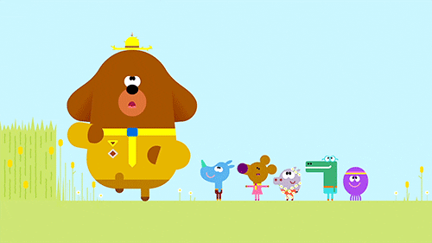

Unit 6:
Outdoor activities
Lesson 2
Task 1, 2, 3

Slide 2

1. WARM UP
Catch the word
Notes:
Catch the words game
Each team will stand in lines. The first SS will be given a word and they must draw a picture according to that word.
After finishing, the picture will be passed down to the next one to re-draw. The last SS will write down the answer on the paper. Each turn will last for 1’30s.

Slide 3
2. PRESENTATION

Slide 4

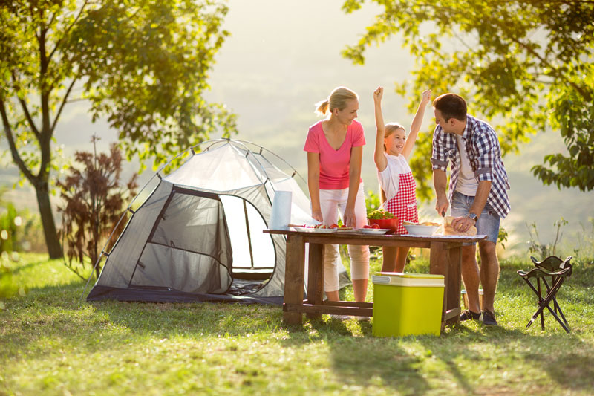
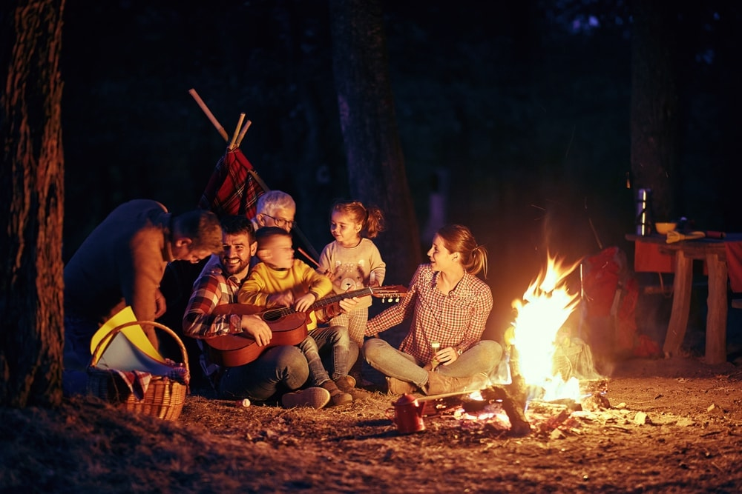
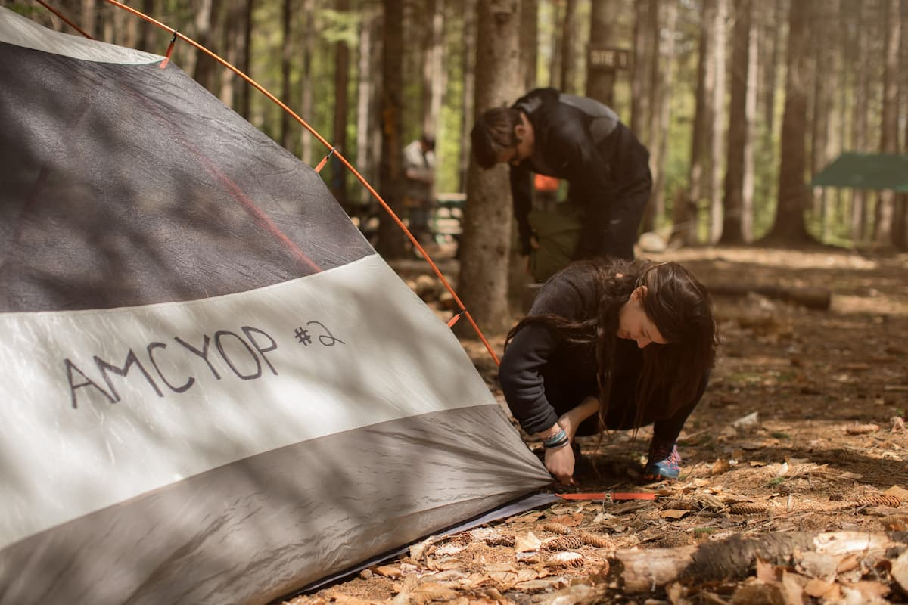
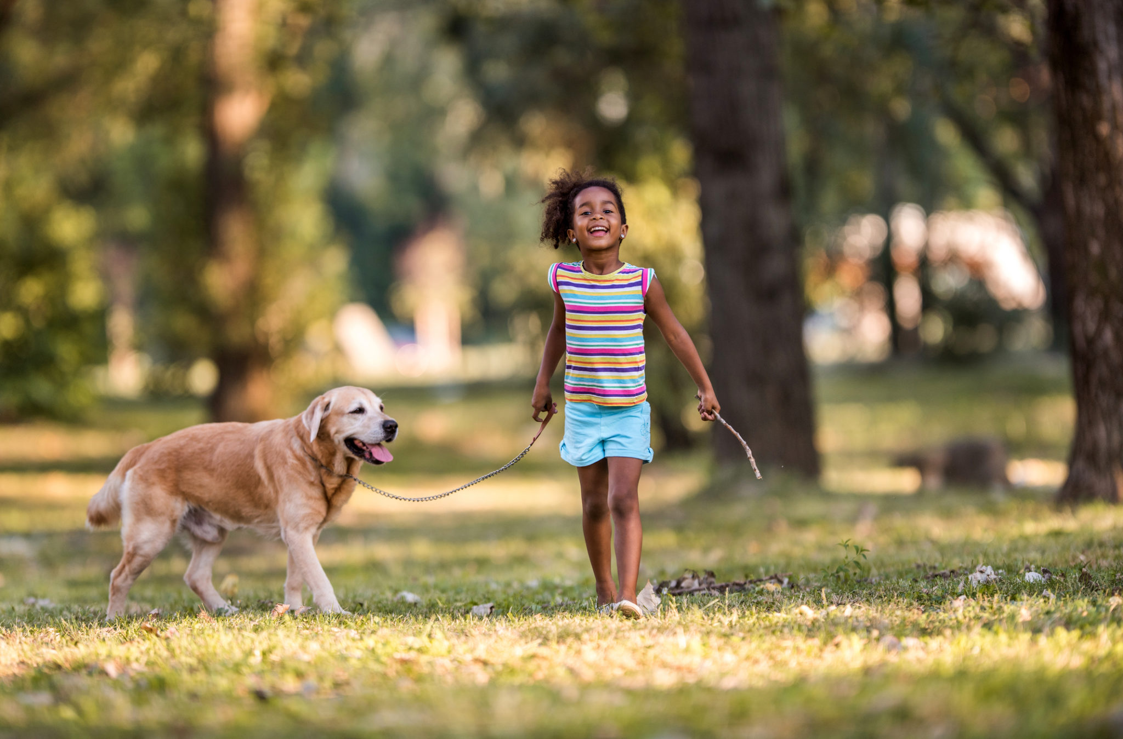
pitch a tent
make a campfire
walk the dog
go camping

Slide 5
3. PRACTICE

Slide 6
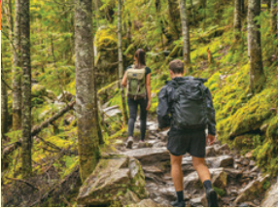
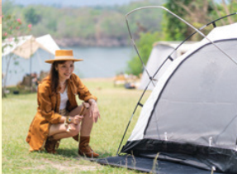
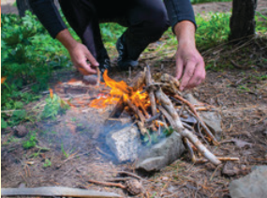
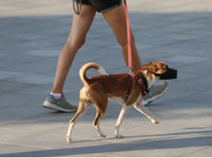
1. Listen and point. Repeat.
go camping
pitch a tent
make a campfire
walk the dog

Slide 7
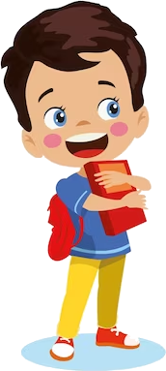


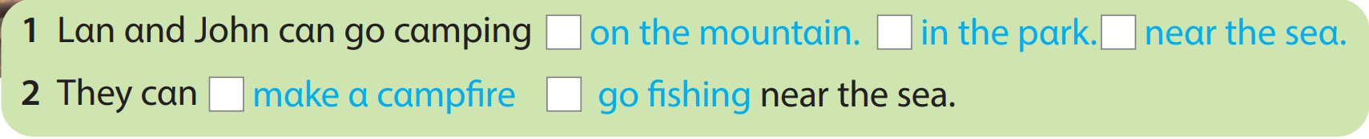
2. Listen and read. Tick.
Lan: Where can we go camping, John?
John: We can go camping on the mountain or near the sea.
Lan: I like the sea. We can go camping on the mountain, but we can’t go swimming.
John: That’s right. Let’s go to the sea. We can go swimming and make a campfire near the sea.
Lan: That sounds fun!

Slide 8




Thank you & goodbye!

