Slide 1


















UNIT 6: OUTDOOR ACTIVITIES
Lesson 1
Period 1 – Task 1,2,3 (P.63, 64)

Slide 2
01
WARM-UP

Slide 3
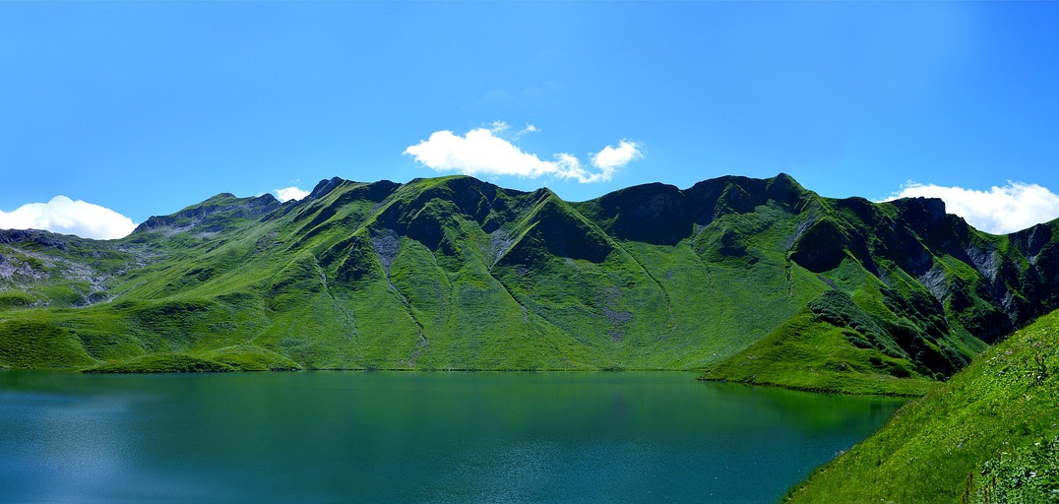

NEW WORDS
mountain

Slide 4

NEW WORDS
go fishing

Slide 5
Task 1.
Listen and point. Repeat.
Notes:
Dấu câu

Slide 6
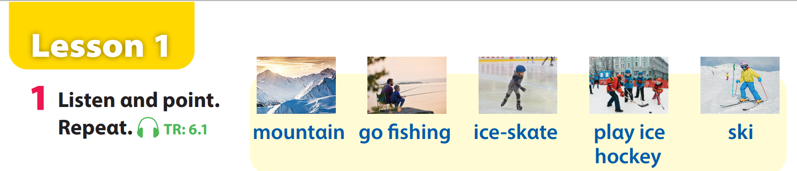
Unit 6 – Lesson 1 – Activity 1 (page 64)

Slide 7
Task 2.
Listen and read. Tick.
Notes:
Dấu câu

Slide 8
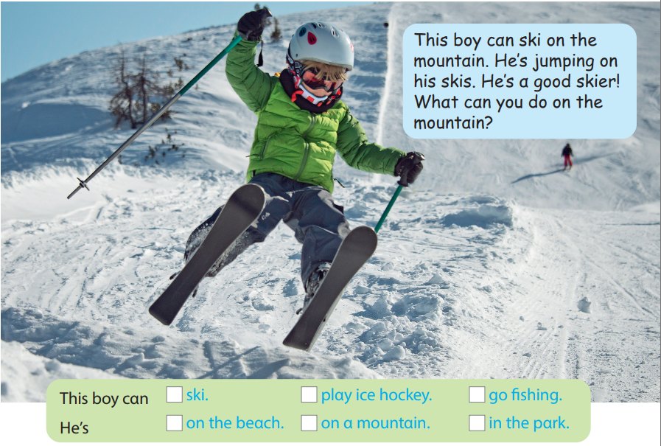

Task 2. Listen and read. Tick.
This boy can ski on the mountain.
He’s jumping on his skis.
He’s a good skier!
What can you do on the mountain?

Slide 9
Task 3.
Look and say.
Notes:
Dấu câu

Slide 10
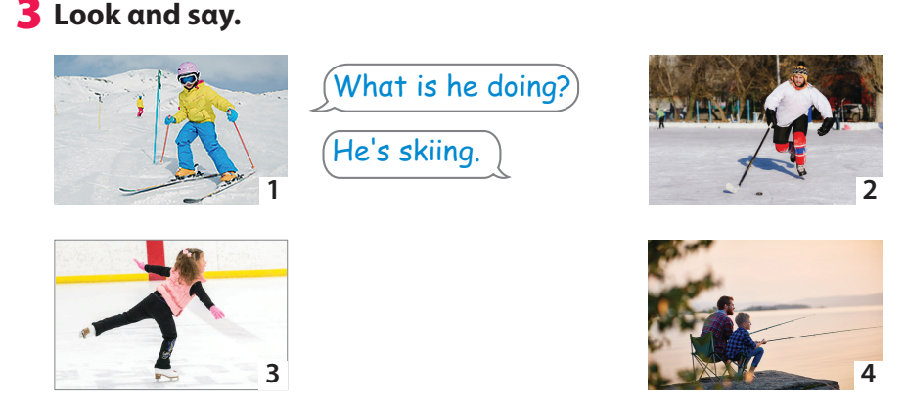
Task 3 – Look and say (page 64)
Notes:
Dấu câu

Slide 11




Thank you & goodbye!

