Slide 1





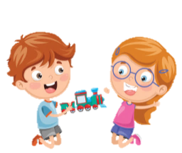
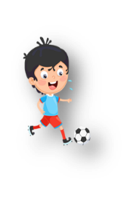

Unit 5: Leisure time
Lesson 1: Task 4, 5, 6

Slide 2

1
Presentation

Slide 3



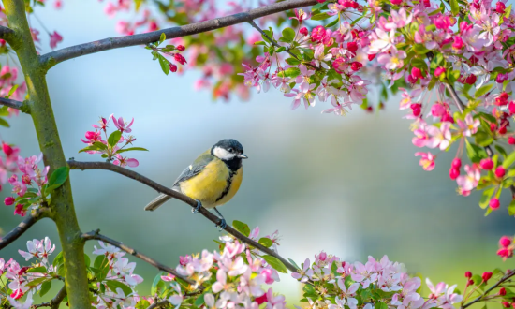

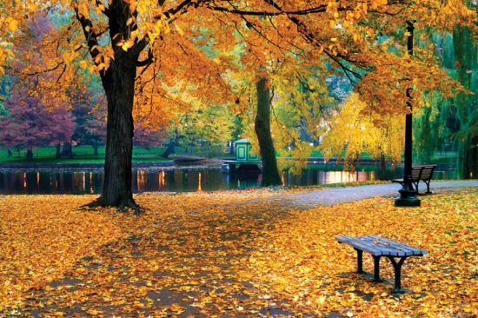
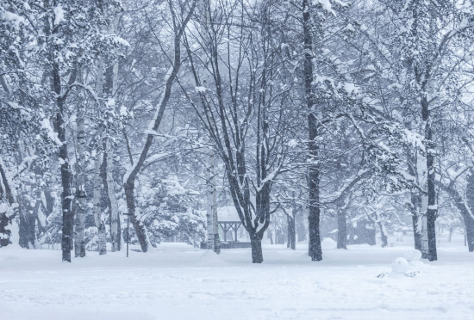
SEASONS
spring
summer
autumn
winter

Slide 4



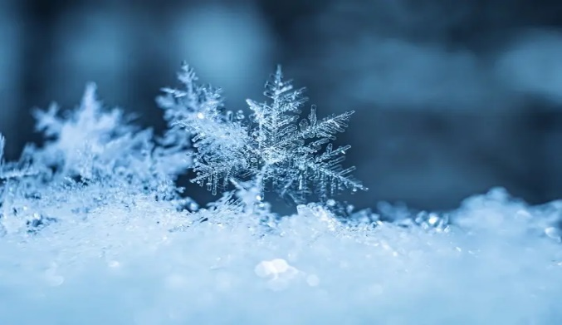
What’s the weather like in winter?
It’s cold.

Slide 5

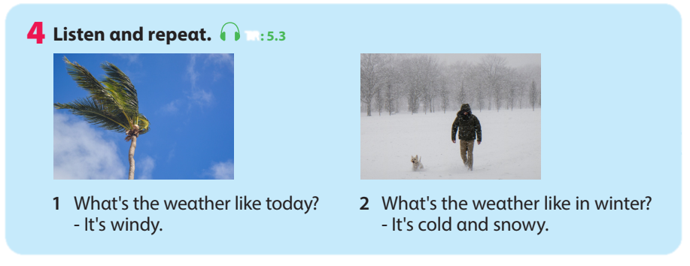


4. Listen and repeat.
What’s the weather like today?
2. What’s the weather like in winter?
- It’s windy.
- It’s cold and snowy.

Slide 6
2
Practice

Slide 7
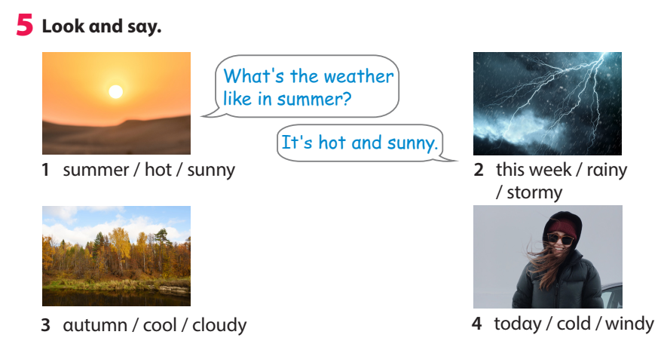
5. Look and say.
1. summer/ hot/ sunny
2. this week/ rainy/ stormy
3. autumn/ cool/ cloudy
4. today/cold/ windy
Notes:
Task 5: Look and say.
- Ask SS to identify names of pictures and words under them.
- Ask SS to look at the board and call a student to role- play with T, then ask SS to work in pairs in 3 min.
- Let SS work in pairs and present in front of the class by spinning the circle to choose which picture they say.
- Call SS to present in front the class and give them comments.

Slide 8
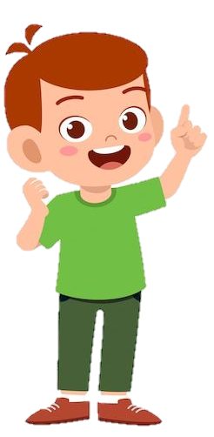
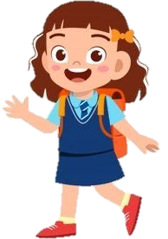
Whαt's the weαther like in summer?
It's hot αnd sunny.
1. summer/ hot/ sunny

Slide 9

5. Look and say.
1. summer/ hot/ sunny
2. this week/ rainy/ stormy
3. autumn/ cool/ cloudy
4. today/cold/ windy

Slide 10
4
Production

Slide 11
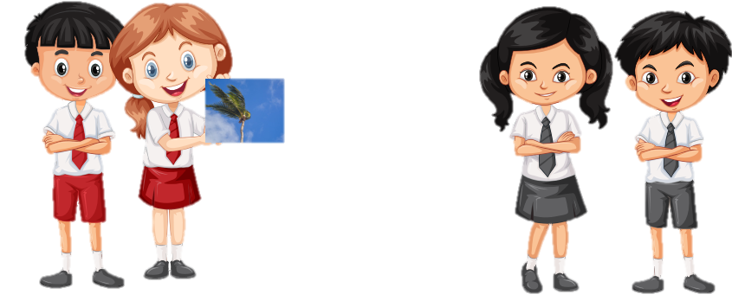
6. Let’s play.
Work in pαirs. Pick α flαshcαrd. Αsk αnd αnswer.
Whαt's the weαther like?
It's windy.
Notes:
6. Let’s play.
- Work in pairs.
- Ask SS to look at the board and call a student to make a converstion.
- Ask SS to prepare a pen and paper to draw the weather. Then ask them to work in pairs to ask and answer.
- Call pairs to present in front of the class.
- Check and give feedback.

Slide 12
5
Assessment

Slide 13
Think and find the answers.
winter
1. Which season is very cold?
2. Which seasons begin with letter S?
3. Which season is between summer and winter?
4. “What are the weather like ?” Find a mistake.
5. “What’s the weather like in summer? It’s hot and cold.” Find a mistake.
spring and summer
autumn
are
cold -> sunny

Slide 14
UNIT 5: LEISURE TIME
LESSON 1 – PERIOD 2
What we learnt today
Vocabulary
spring
summer
autumn
winter
What’s the weather like in autumn?
It’s cool and cloudy.
Structure

