Slide 1









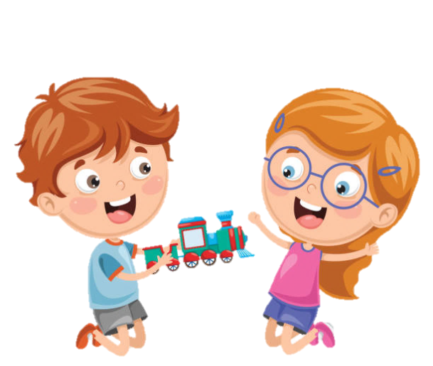




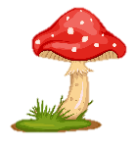
Notes:
Để nguyên trang bìa như này, chỉ thay đổi tên bài trong quá trình làm. Logo của sách Wonderful World

Slide 2
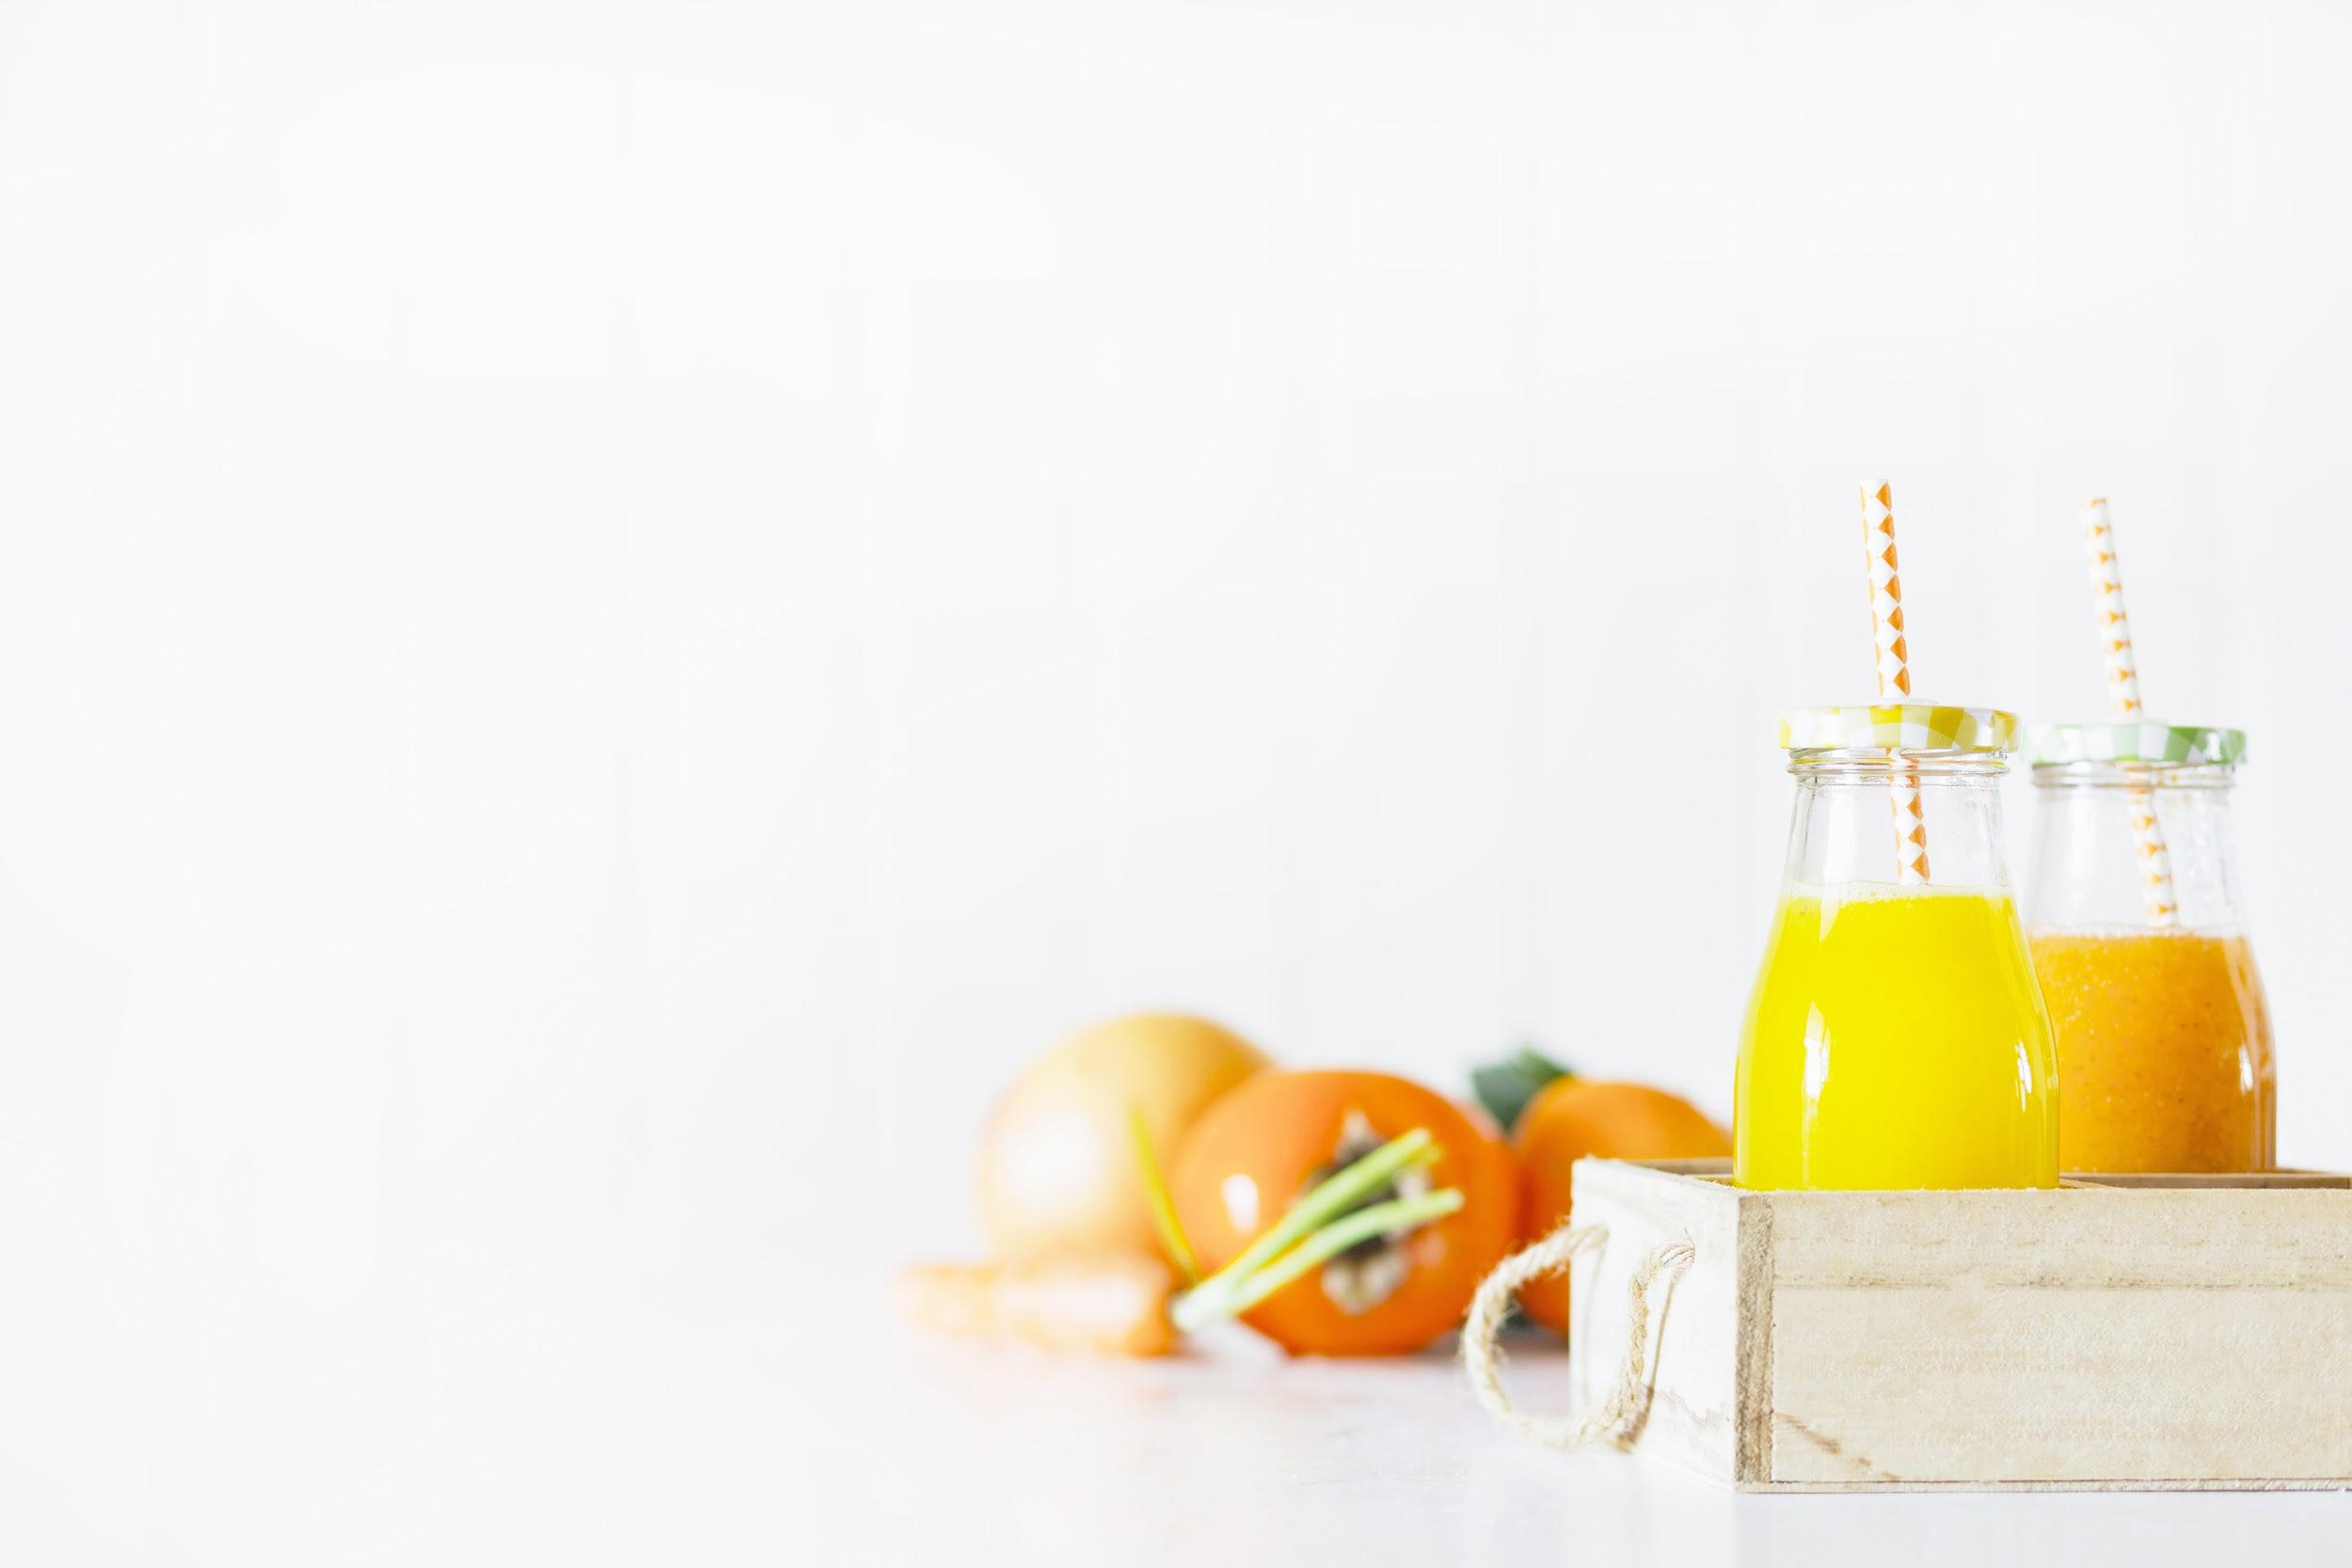

Unit 4: Food and drinks
Lesson 1 – Task 4, 5, 6

Slide 3


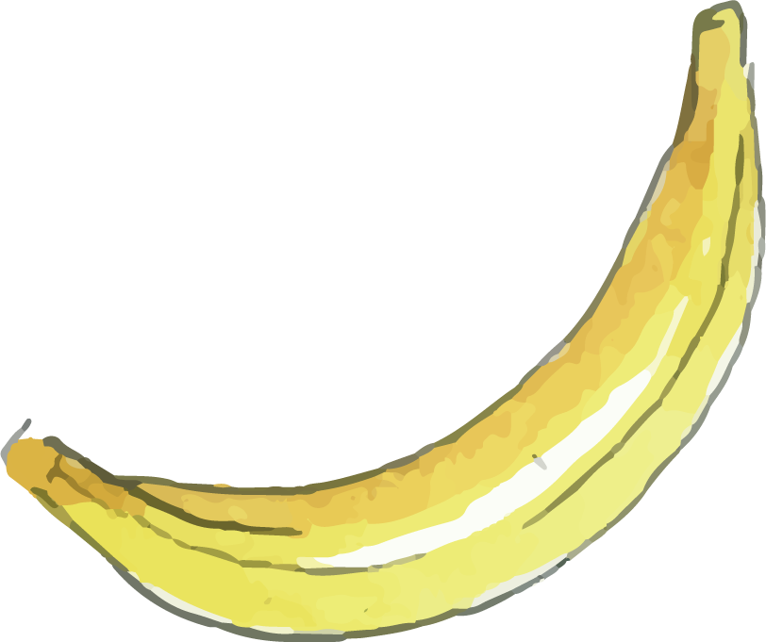
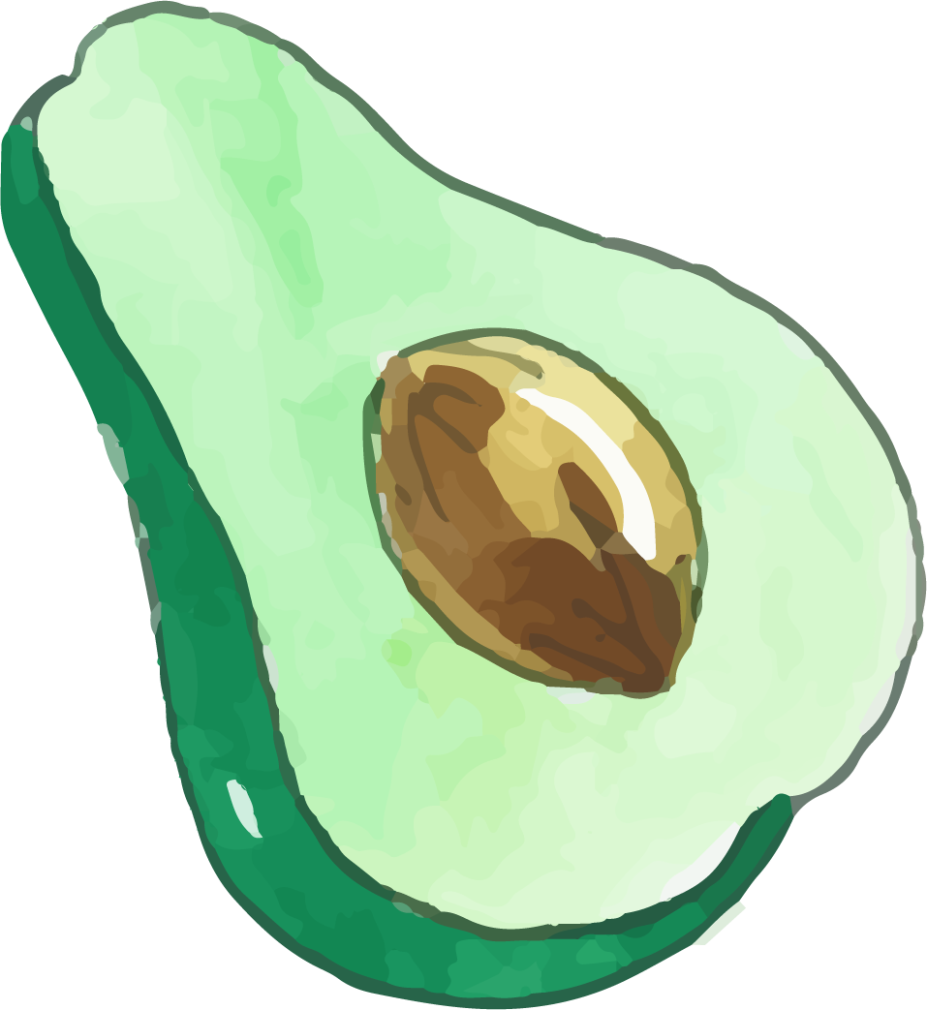
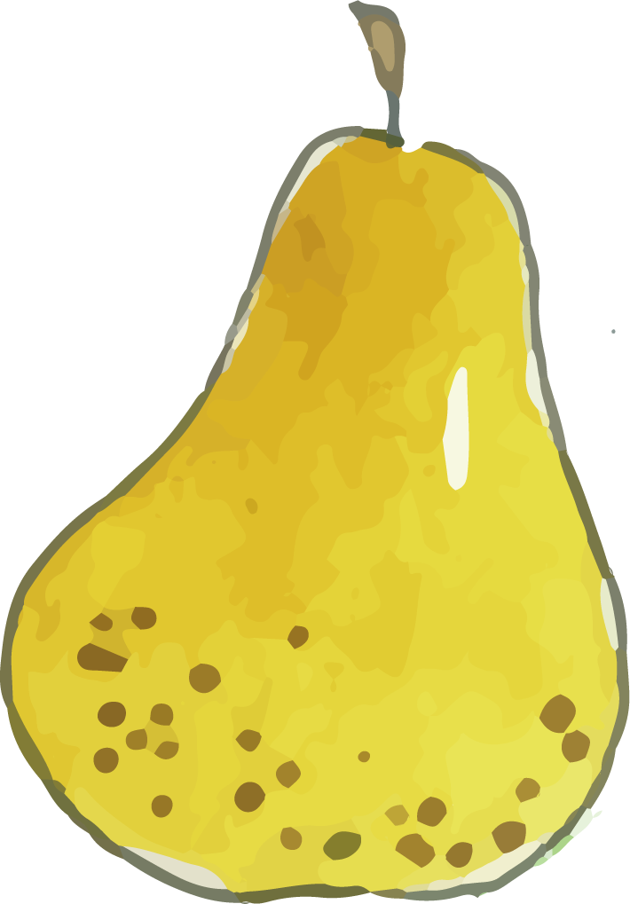


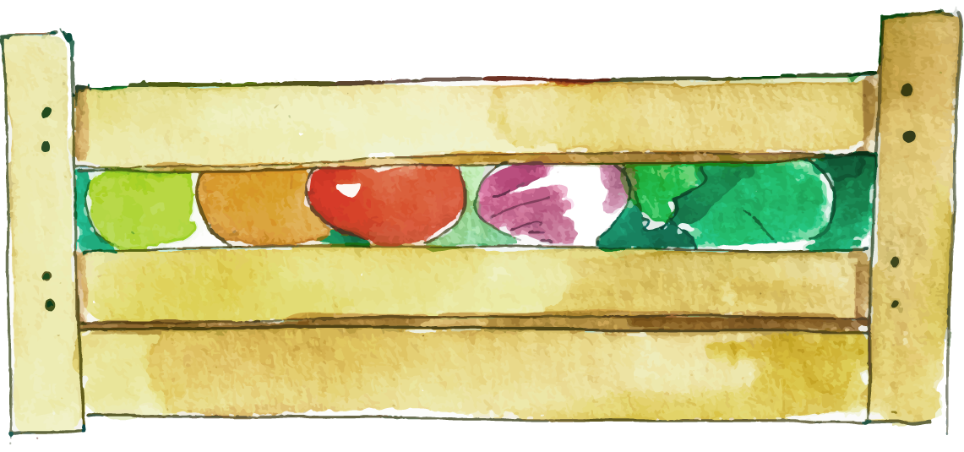

2 PRESENTATION
Task 4 Listen and repeat.

Slide 4
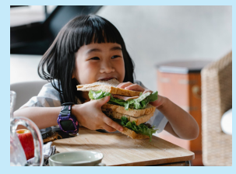
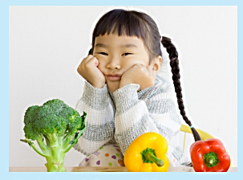
Listen and repeat.
1 Would you like a sandwich?
- Yes, please.
2 Would you like some vegetables?
-No, thanks.
Notes:
Bấm vào loa để nghe cả bài
Bấm vào câu để nghe từng câu

Slide 5

3 PRACTICE
Task 5 Look and say.

Slide 6
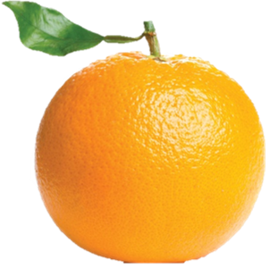
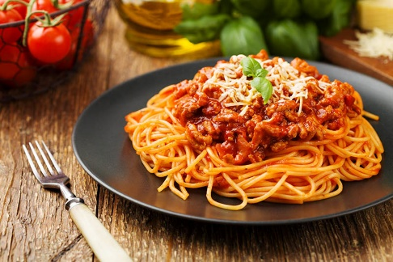
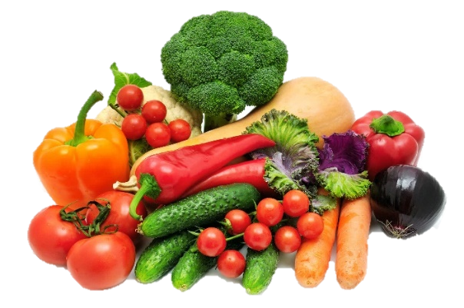
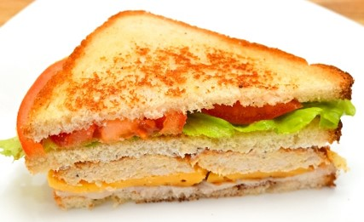
Look and say.
❎
✅
2 an orange
1 some spaghetti
✅
❎
3 a sandwich
4 some vegetables

Slide 7
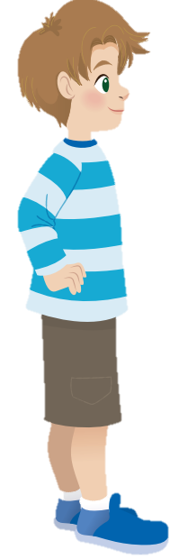
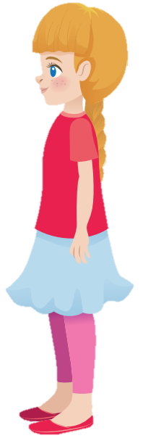
Look and say.
Would you like some spaghetti?
No, thanks.
❎

Slide 8
4 PRODUCTION
Task 6 Role play

Slide 9
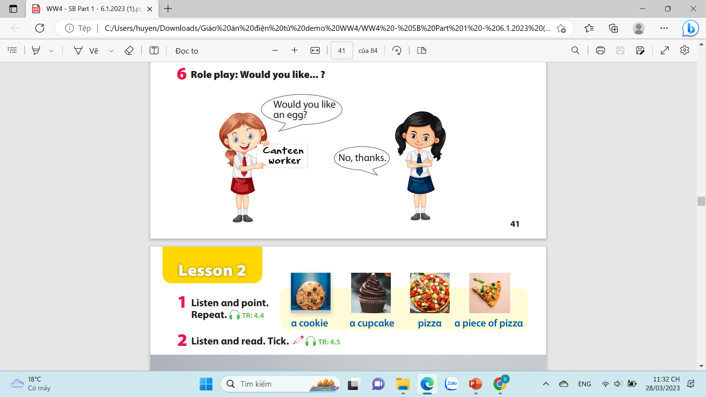
Role play: Would you like…?

Slide 10
5 ASSESSMENT
1. Would you like an orange? (✓)
→ Yes, please.
2. Would you like some juice? (✗)
→ No, thanks.
3. Would you like some biscuits? (✗)
→ No, thanks.
4. Would you like a sandwich? (✓)
→ Yes, please.

Slide 11


6.WRAP UP
1- Would you like ______?
-Yes, please.
2- Would you like some_______ ?
-No, thanks

