Slide 1
















Slide 2


Unit 4:
Lesson 1 – Task 1, 2, 3

Slide 3
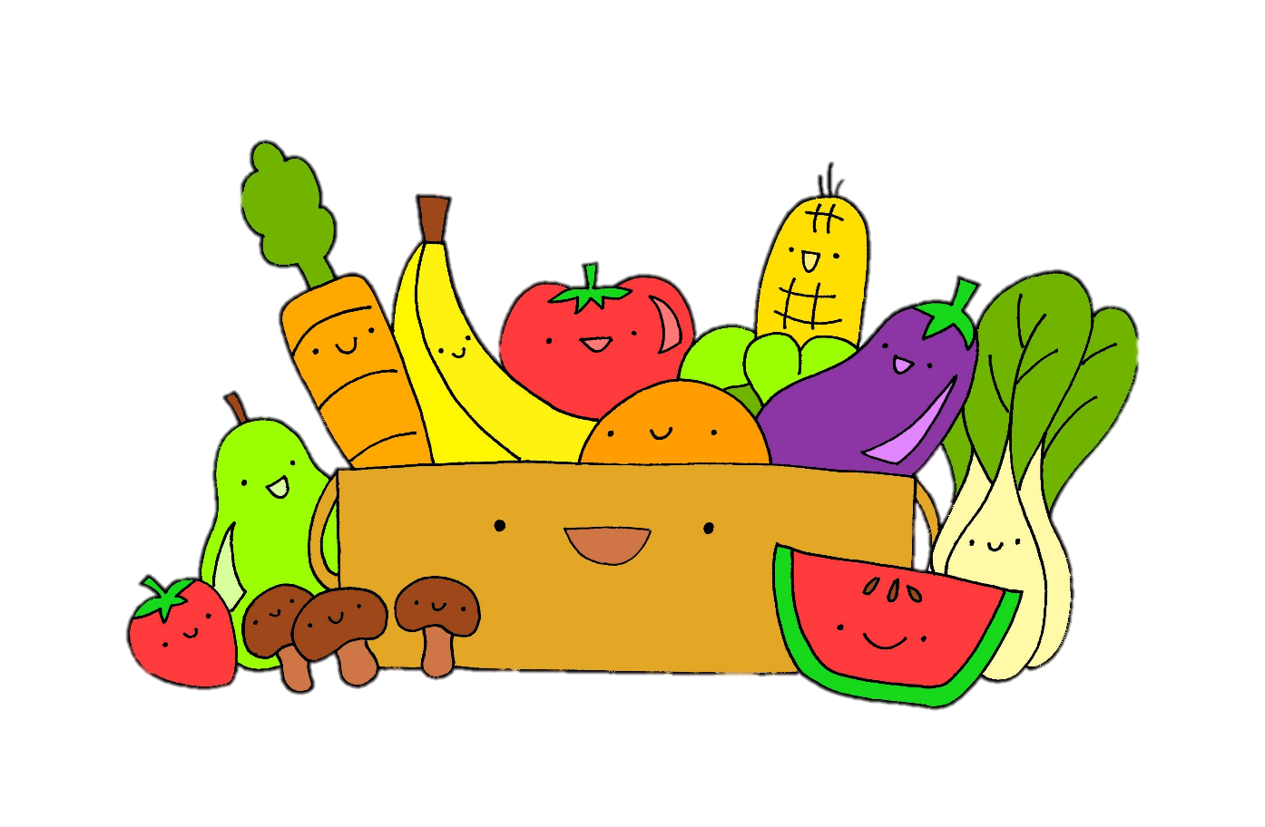
1 WARM UP
Listen and sing along.

Slide 4





2 PRESENTATION
Task 1 Listen and point. Repeat.

Slide 5

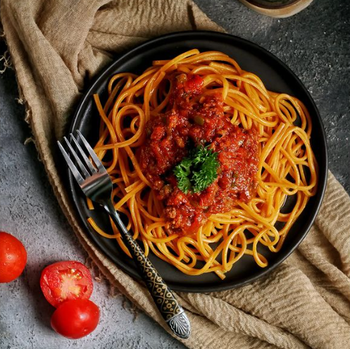
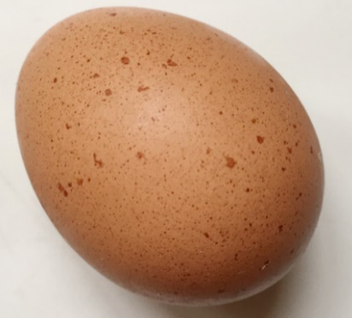
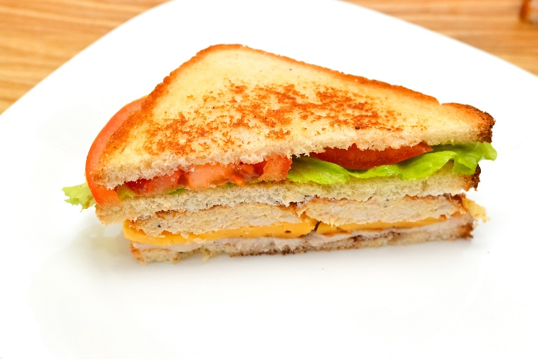


Listen and point. Repeat.
an egg
an orange
a sandwich
spaghetti
vegetables

Slide 6

3 PRACTICE
Task 2 Listen and read. Write.

Slide 7
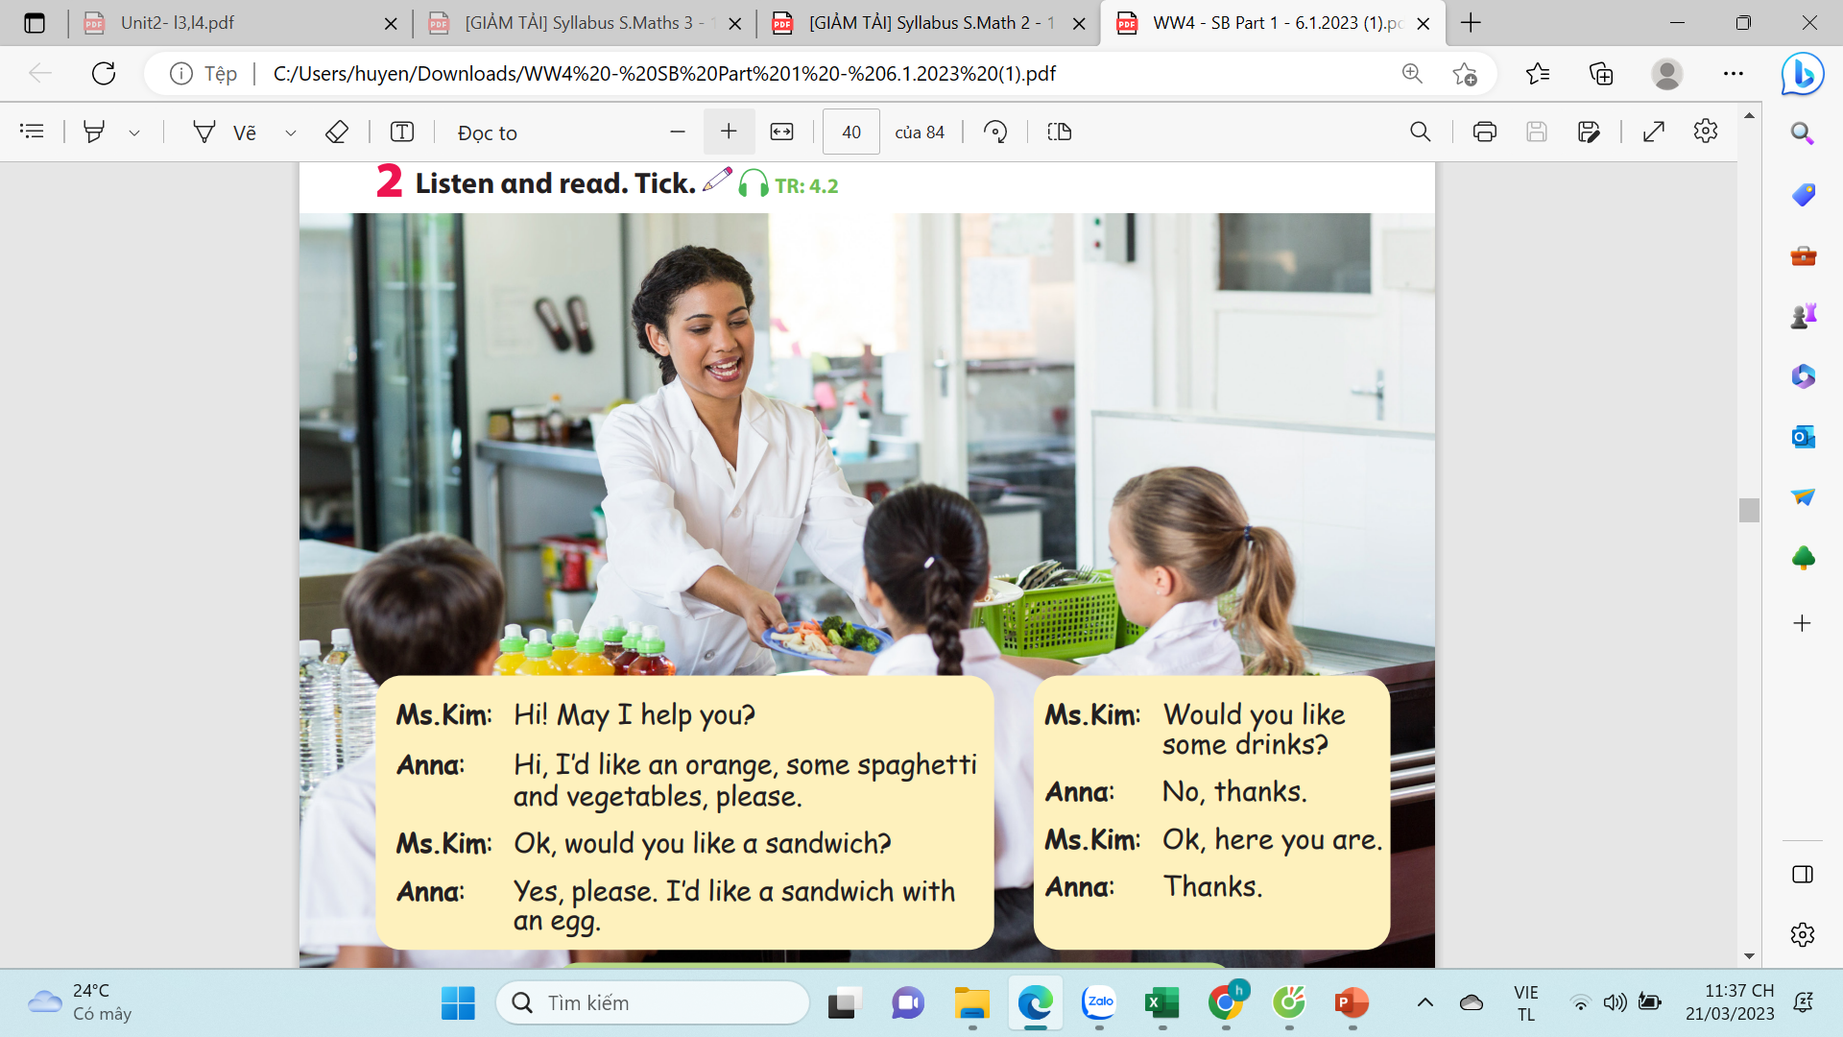
Listen and check.

Slide 8

4.PRODUCTION
Task 3 Look and say.
Notes:
- Introduce and set game rules
- Do a demo
- Play several rounds.

Slide 9
