Slide 1






















Slide 2

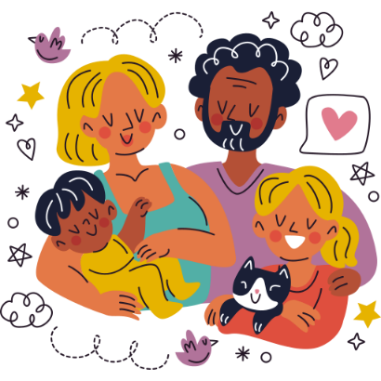
Unit 1:
FAMILY AND FRIENDS
Lesson 2 – Part 4, 5, 6

Slide 3


01 Warm up

Slide 4

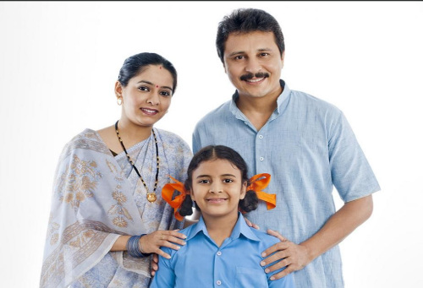
Order the word
srpetna
=> parents

Slide 5
02 Presentation

Slide 6


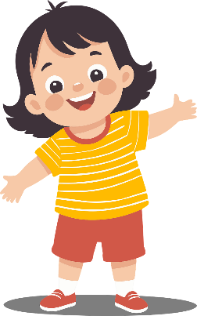
She is a happy girl.
noun
+
adjective
The adjective comes before the noun.

Slide 7

The cat dances happily.
verb
adverb
+
The adverb comes after the verb.

Slide 8


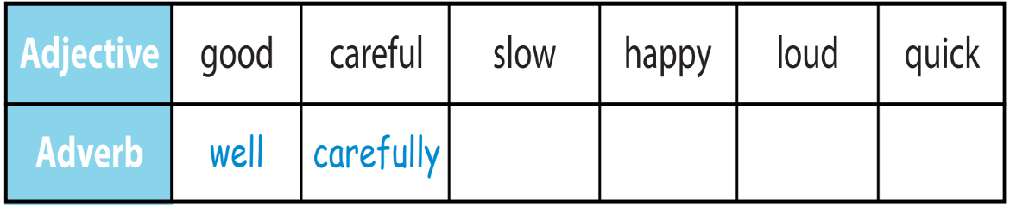


Complete the box below
slowly
loudly
quickly
happily

Slide 9
03 Practice

Slide 10

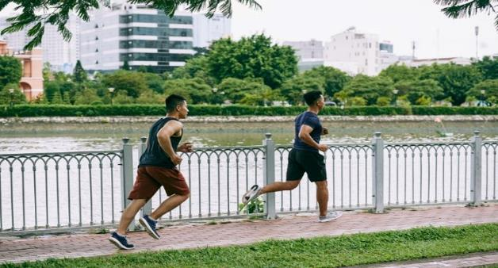

Who can run quickly?
Minh
Nam
Nam can run quickly.

Slide 11
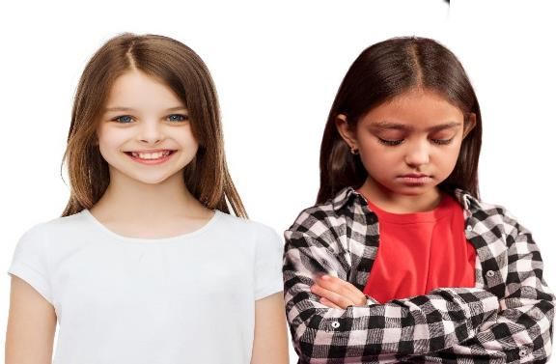

Who can smile happily?
Shally
Tina
Tina can smile happily.

Slide 12
04 Production

Slide 13


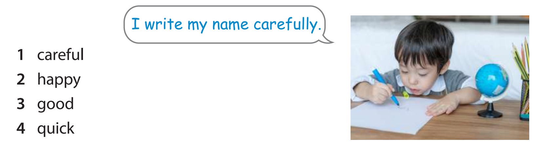

I laugh happily.
I cook well.
I can run quickly.

Slide 14
05 Wrap-up & Assessment

Slide 15


Listen and write
Listen and write
slowly
My dad walks ______.

Slide 16


Thank you
& goodbye!

