Slide 1



















Fun time
and project

Slide 2



1
Fun time

Slide 3



5
2
3
7
8
1
6
4
Next

Slide 4


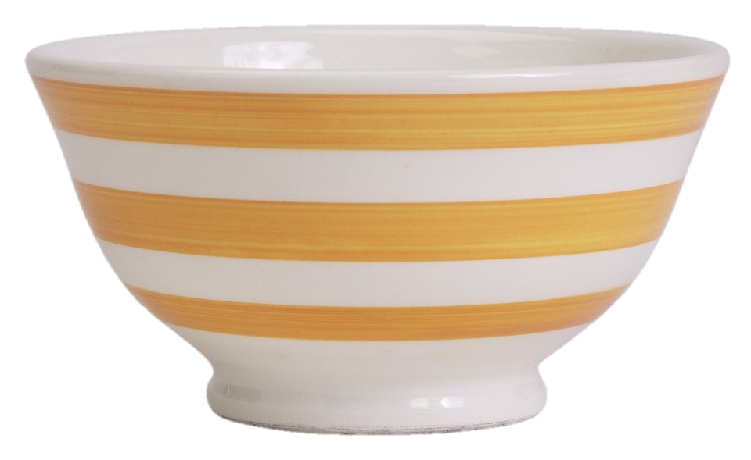




Plate
Spoon
Bowl
Bowl
Bowl
Back

Slide 5


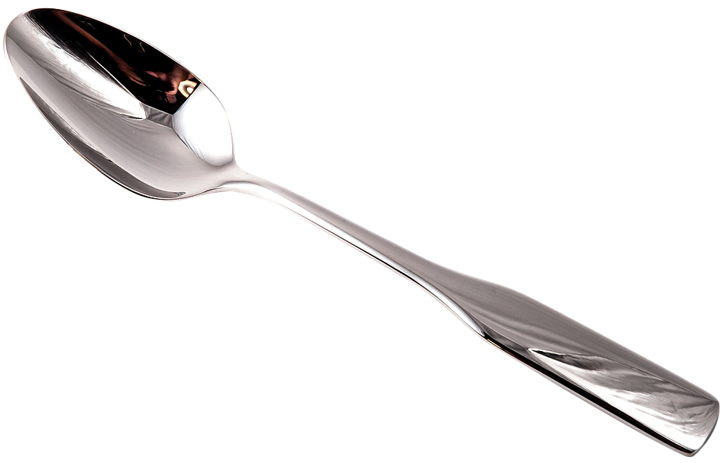
Spoon
Plate
Spoon
Dining room
Back

Slide 6


Floor
Floro
Floor
Olrof
Back

Slide 7

Fridge
Sofa
Bookshelf
Bookshelf
Bowl
Back

Slide 8
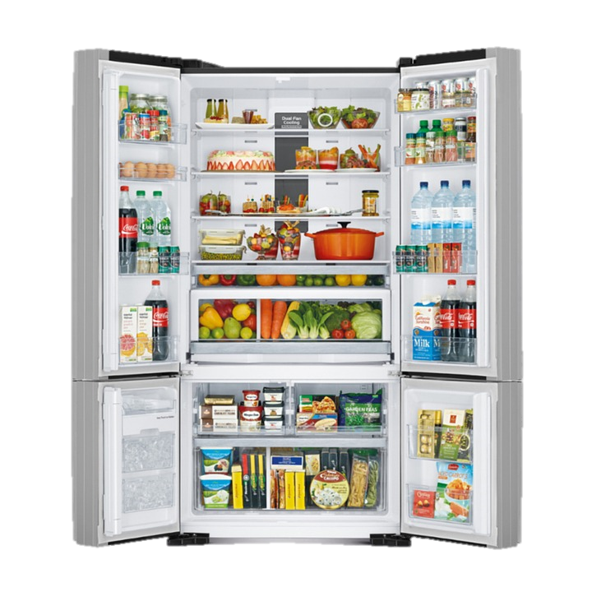
Fridge
Fidgre
Fridge
Drfige
Back

Slide 9
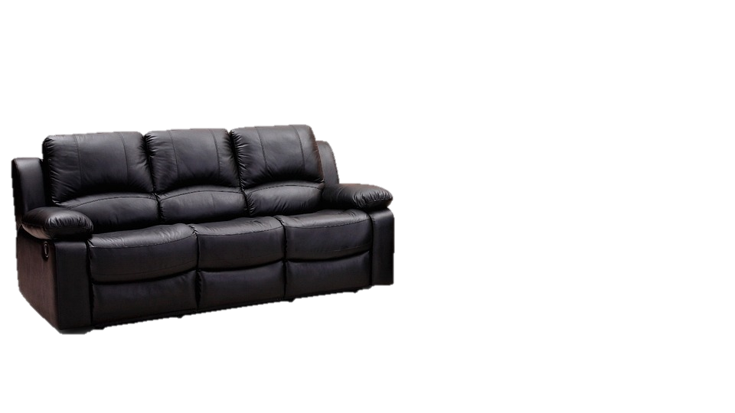
Fridge
Sofa
Sofa
Bookshelf
Bowl
Back

Slide 10
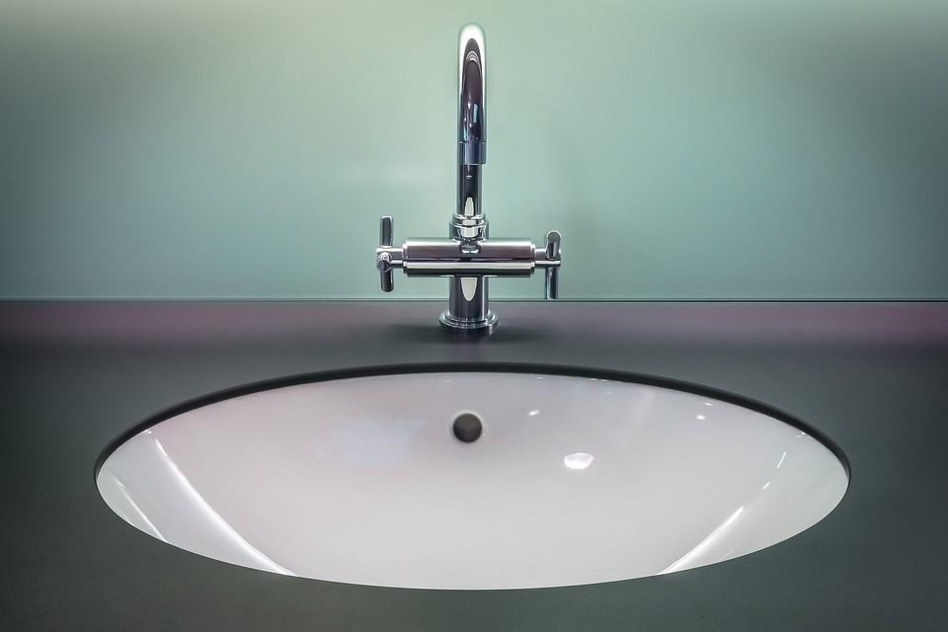
Sill
Sikn
Sink
Sink
Bowl
Back

Slide 11
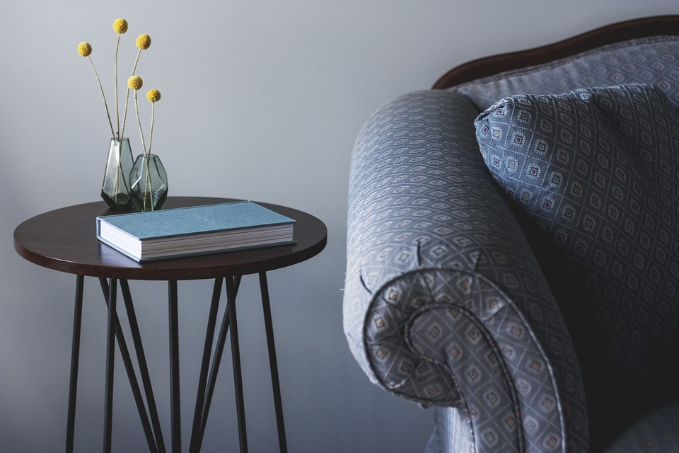
Table
Table
Fridge
Chair
Back

Slide 12
2
Project
House quiz

Slide 13




GAME TIME

Slide 14


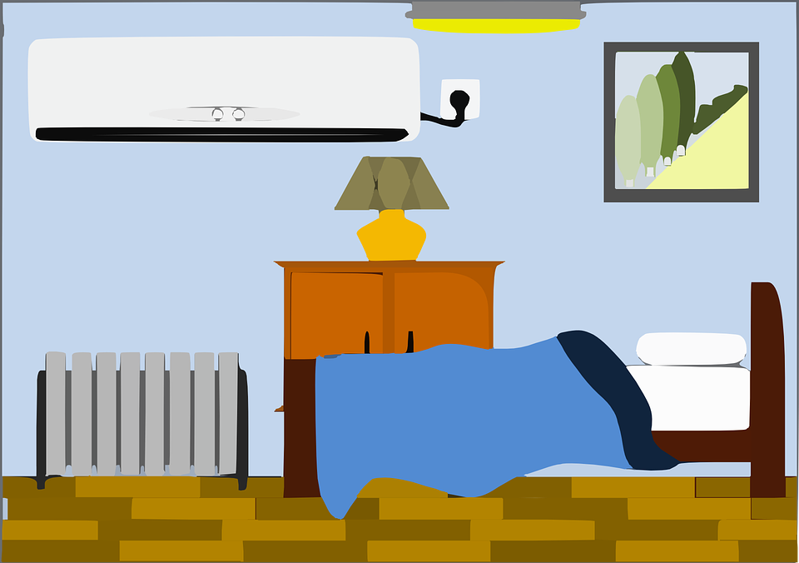
Look and tick
rug
spoon
bowl
✔
toy box
✔
car
teddy
bear
sink
sofa
✔
bookshelf
✔
bedroom
kitchen
dining room

Slide 15
2
Project
My Dream House

Slide 16

REMEMBER !
This is my….
There’s a ….

Slide 17
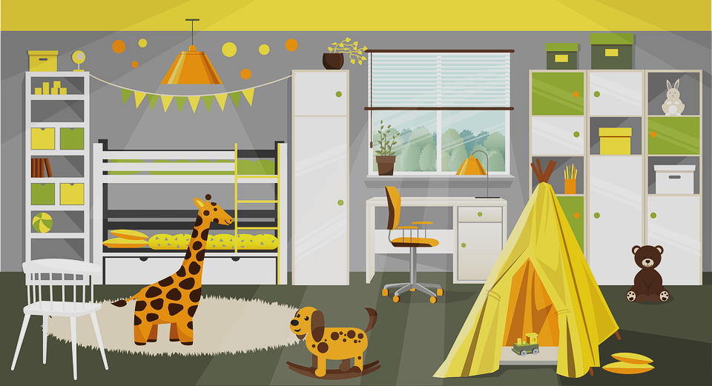
This is my dream room.

Slide 18


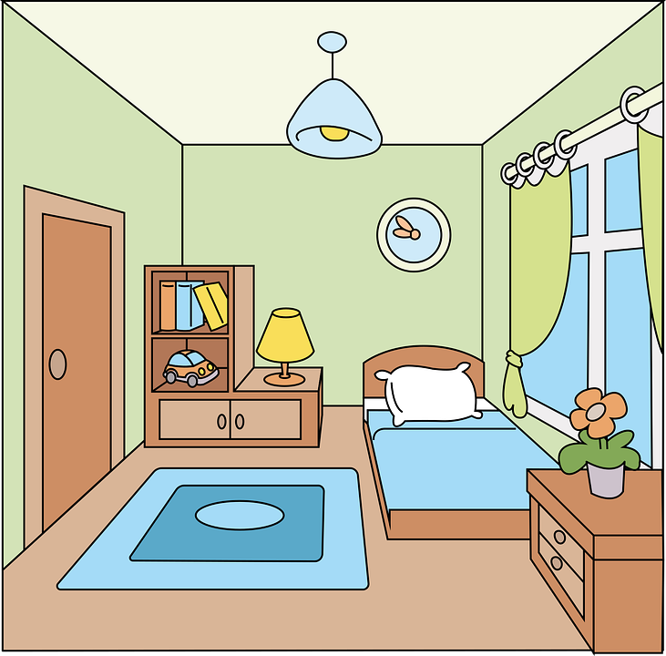

What’s this?
There is a big bookshelf
next to my bed.

Slide 19
Where are the toys?
There are some toys
on the floor.

Slide 20

Where is the chair?
The chair is in front of
the window.

Slide 21
Your Dream House

Slide 22
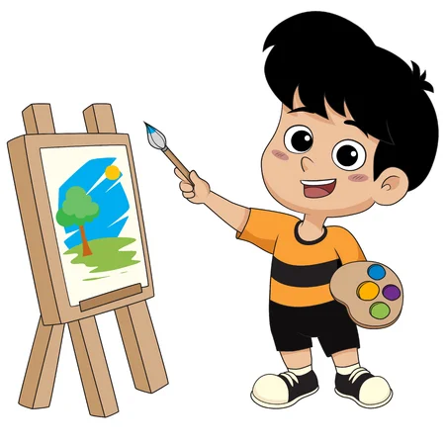

Drawing and Presenting

