Slide 1





















Notes:
Để nguyên trang bìa như này, chỉ thay đổi tên bài trong quá trình làm. Logo của sách Wonderful World

Slide 2


Unit 2 - My Home
Lesson 3 – Period 2

Slide 3







1 Presentation
Listen and repeat

Slide 4
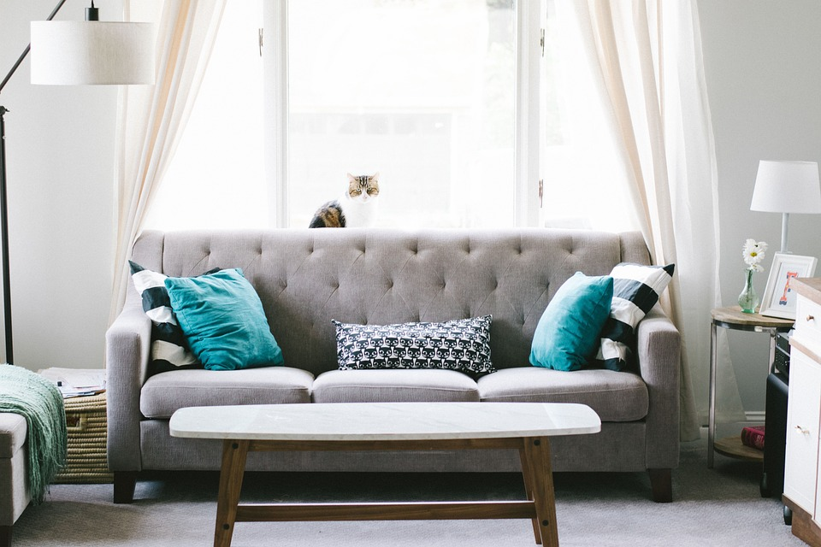
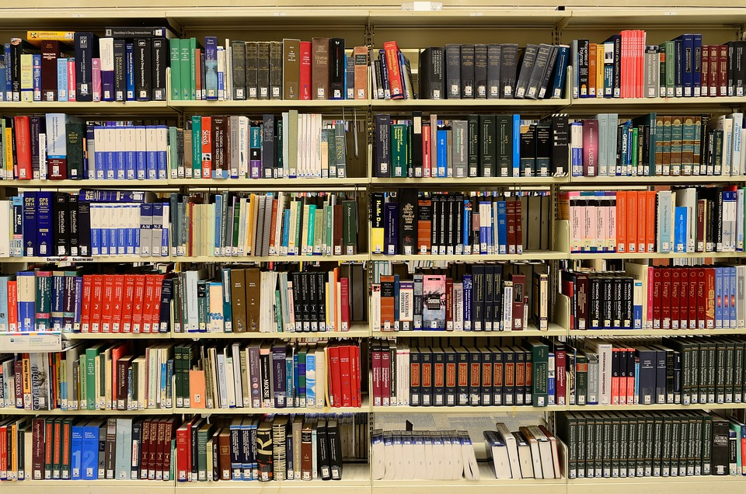
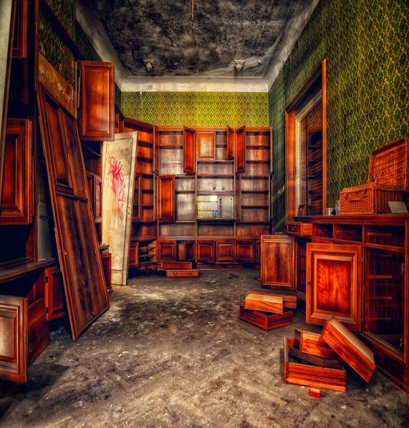

Circle and say.
dbookshelffvdroom
floorrsstidyrademessytf
1
2
3
4
room
bookshelf
messy
tidy

Slide 5


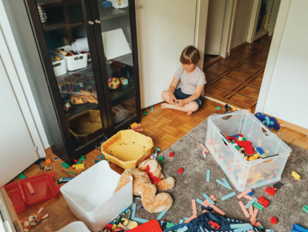
4
Listen and repeat.
1. How messy is his room?
- It’s very messy
Notes:
Không có hình loa để giáo viên click vào

Slide 6

2. How tidy is her bookshelf?
It’s very tidy.

Slide 7
2 Practice
Look and say

Slide 8

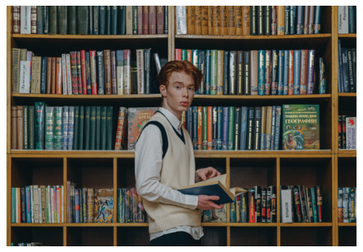


5
Look and say.
1. His/ bookshelf/ tidy
How tidy is his bookshelf?
It’s very tidy.

Slide 9

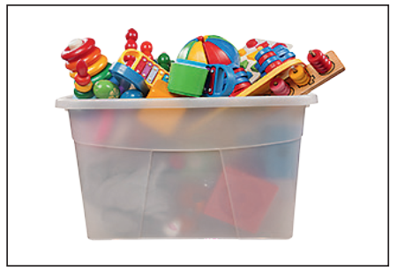
2. Our/ toy box/ big
How big is
our toy box?
Our toy box is very big.

Slide 10
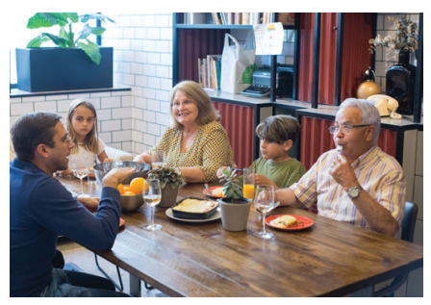


3 Our/ dining room/ new
How new is our dining room?
Our dining room is very new.

Slide 11

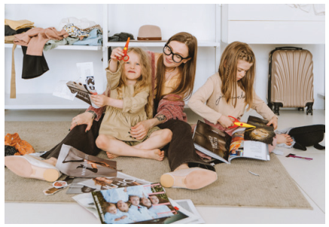
4 Their/ bedroom/ messy
Their bedroom is very messy.
How messy is their bedroom?

Slide 12
3 Production

Slide 13



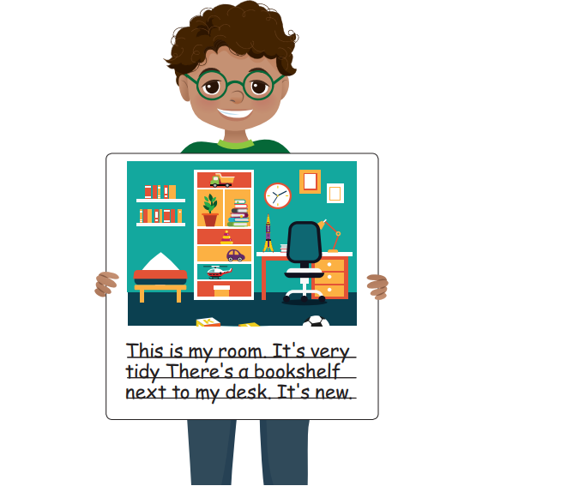
Draw and write. Say
This is my room…
This is my room. It’s very tidy. There’s a bookshelf next to my desk. It’s new.

Slide 14


4 Wrap-up

Slide 15

REMEMBER
Vocabulary:
-bookshelf, floor, toy box, messy, tidy
Structure:
How messy is his room?
It’s very messy.
How tidy is her bookshelf?
- Her bookshelf is very tidy.

