Slide 1
















Unit 2: My Home
Lesson 3 – Task 1,2,3

Slide 2

Presentation
Task 1 Listen and point.
Repeat.
Notes:
Dấu câu

Slide 3



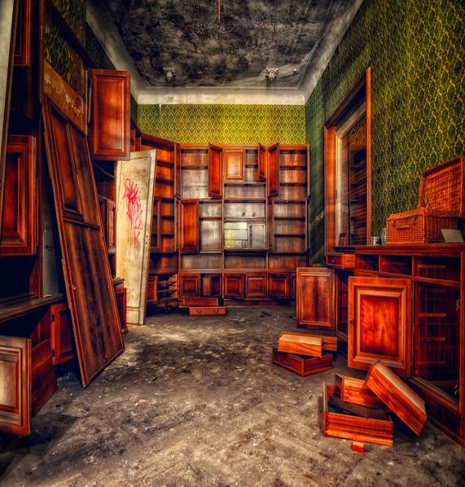
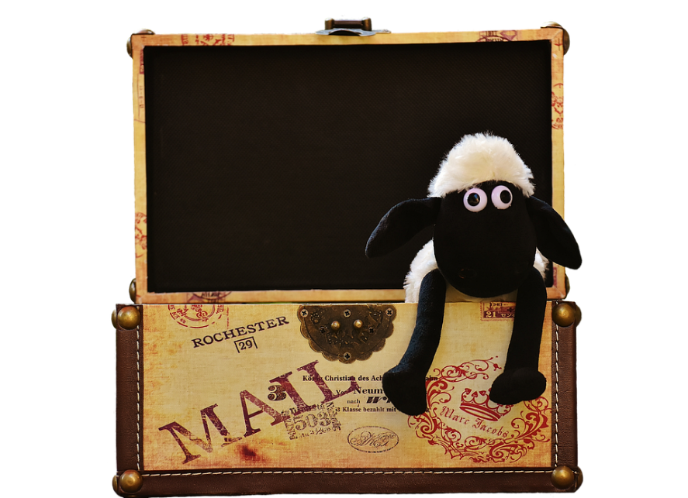



1 Listen and point.Repeat.
messy
floor
bookshelf
toy box
tidy

Slide 4
Practice
Task 2 Listen and tick.
Notes:
Dấu câu

Slide 5

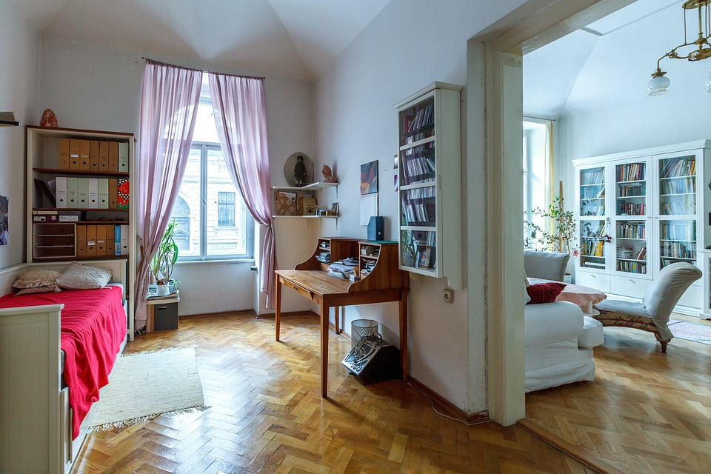
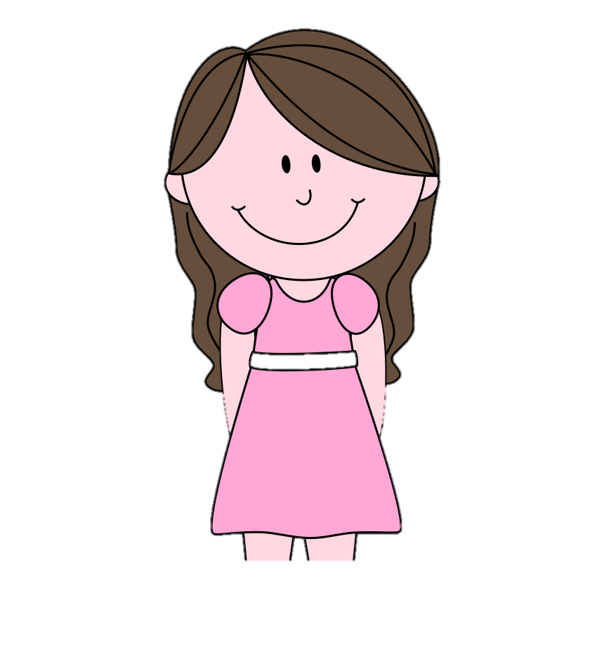

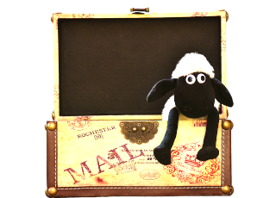
2
Listen and tick.
This is my son and this is his bedroom.
Wow! It’s tidy.
There aren’t any books or toys on the floor.
How is his bedroom?
Jane
Ms. Kim
Notes:
Không click chuột vào loa mà kích ra ngoài để chạy theo trình tự

Slide 6
2
Listen and tick.
His books are on the bookshelf.
Yes, his toys are in the toy box.
Jane
Ms. Kim

Slide 7
2
Listen and tick.
2. His toys are in the
✓
toy box.
bookshelf.
His room is
messy.
✓
tidy.
Jane
Ms. Kim

Slide 8
2
Listen and tick.
3. His books are on the
✓
bookshelf.
floor.
Jane
Ms. Kim

Slide 9
Practice
Task 3 Point and say.
Notes:
Dấu câu

Slide 10



3
Point and say.
bookshelf/ next to/ television
Where is
the bookshelf?
It’s next to
the television.

Slide 11

Wrap up
Notes:
Đây k phải là extra, đây là hđ 3 của bài

Slide 12
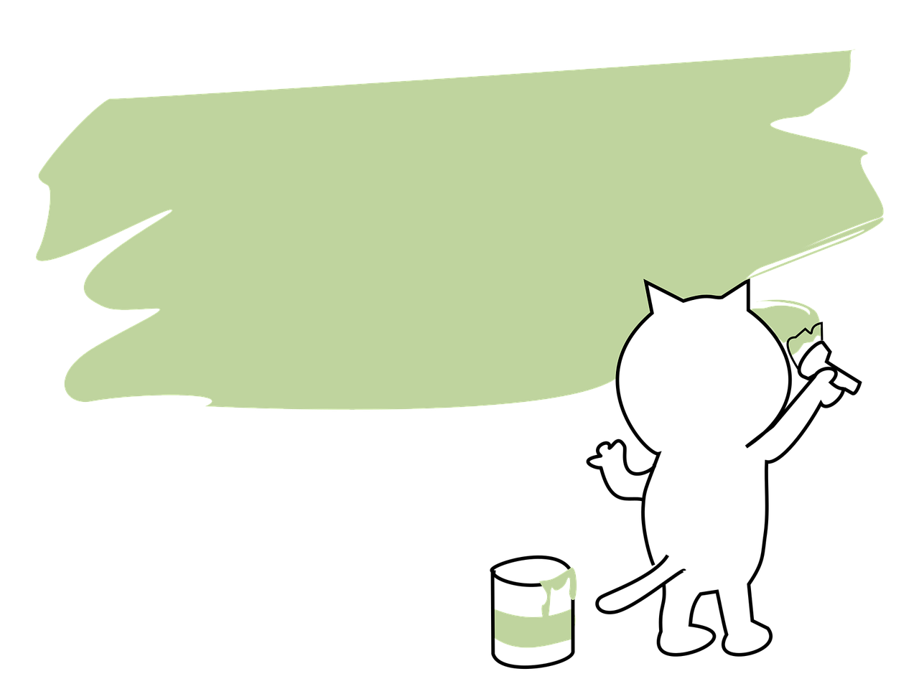
Vocabulary
Structure
Bookshelf
Floor
Toy box
Messy
Tidy
Where is/ are__?
It’s____.
They’re ___.

