Slide 1









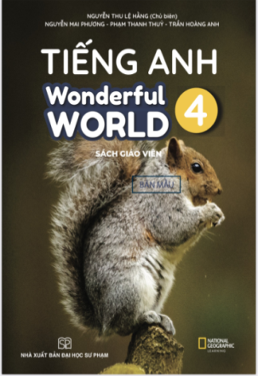










Fun time
and project

Slide 2




1
Fun time

Slide 3



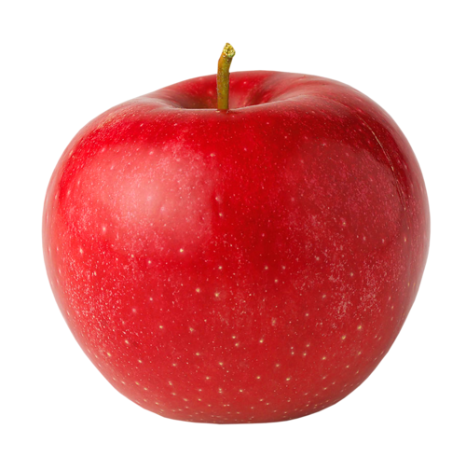



5
2
3
7
8
1
6
4
Next

Slide 4


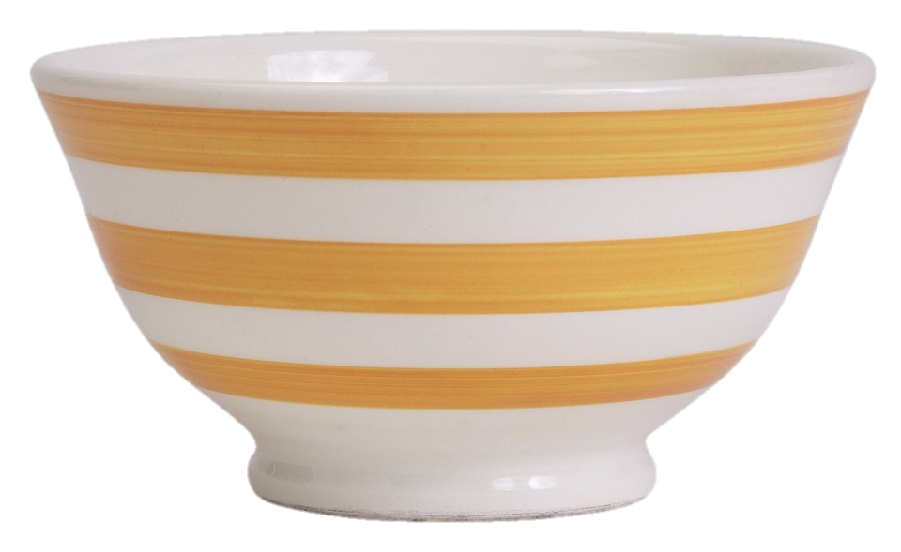

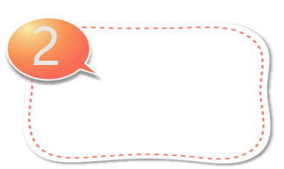


Plate
Spoon
Bowl
Bowl
Bowl
Back

Slide 5


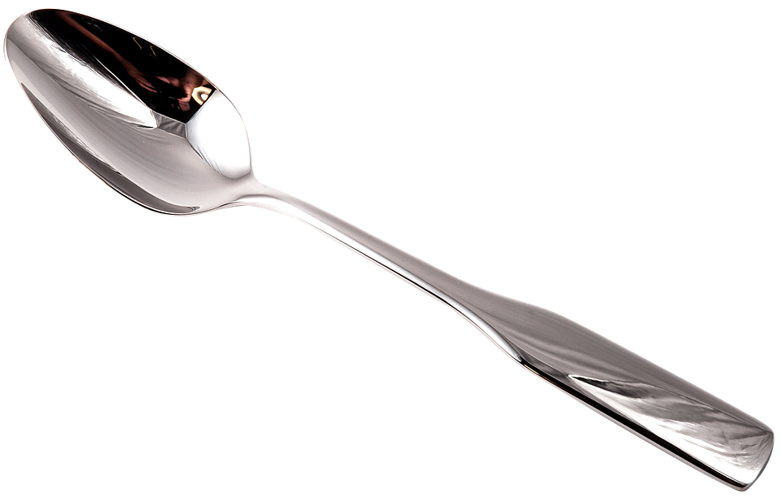
Spoon
Plate
Spoon
Dining room
Back

Slide 6

2
Project
House quiz

Slide 7



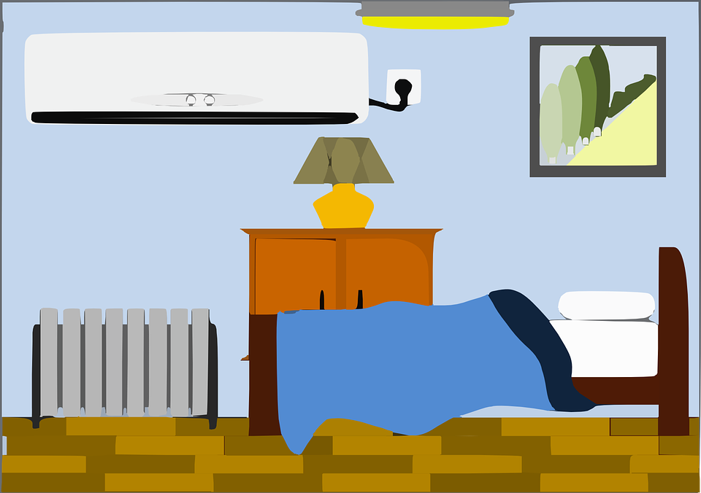
Look and tick
rug
spoon
bowl
✔
toy box
✔
car
teddy
bear
sink
sofa
✔
bookshelf
✔
bedroom
kitchen
dining room

Slide 8

REMEMBER !
This is my….
There’s a ….

Slide 9
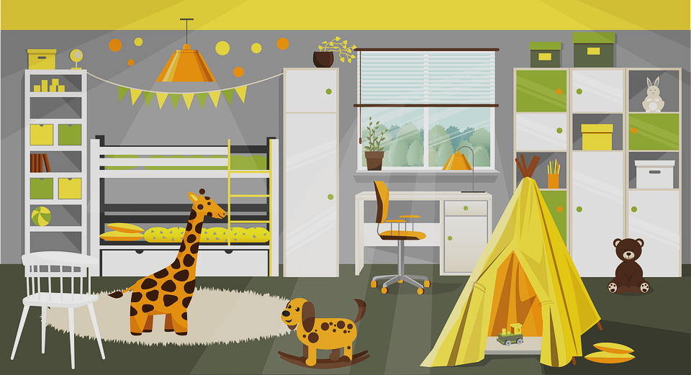
This is my dream room.

Slide 10
Your Dream House

Slide 11




Thank you & goodbye!

