Slide 1


















Slide 2



Unit 2 - My House
Lesson 1 – Period 2

Slide 3


1. Warm up

Slide 4

Do a crossword in red?
6
1
B
A
T
H
R
O
O
M
2
D
I
N
I
N
G
R
O
O
M
3
C
O
M
P
U
T
E
R
4
B
O
W
L
S
5
P
E
N
Next
Notes:
Chọn số 1-5, hiện slide hình để hs trả lời
Ân back sẽ tự động hiện từ ở slide 4
Câu 6 ấn sẽ hiện key.

Slide 5
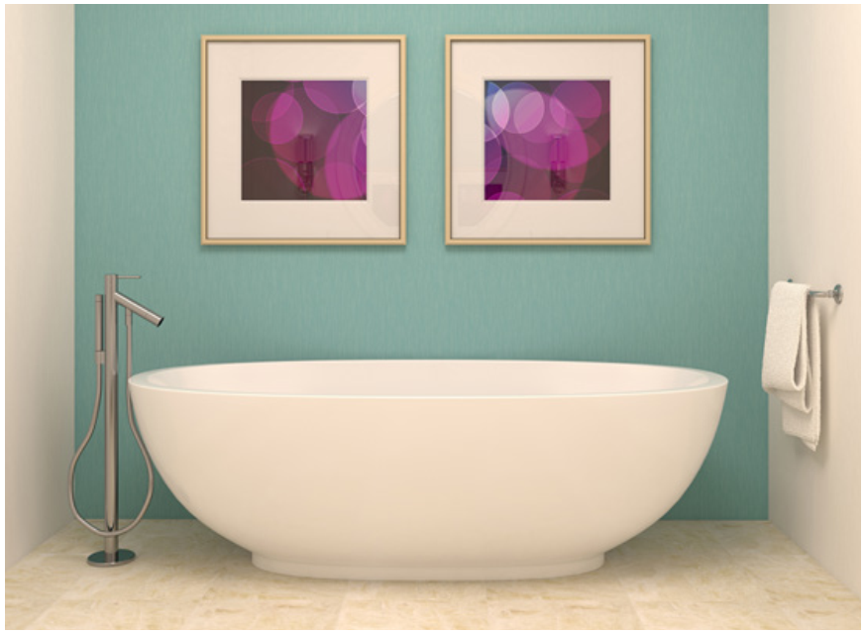
HOME

Slide 6
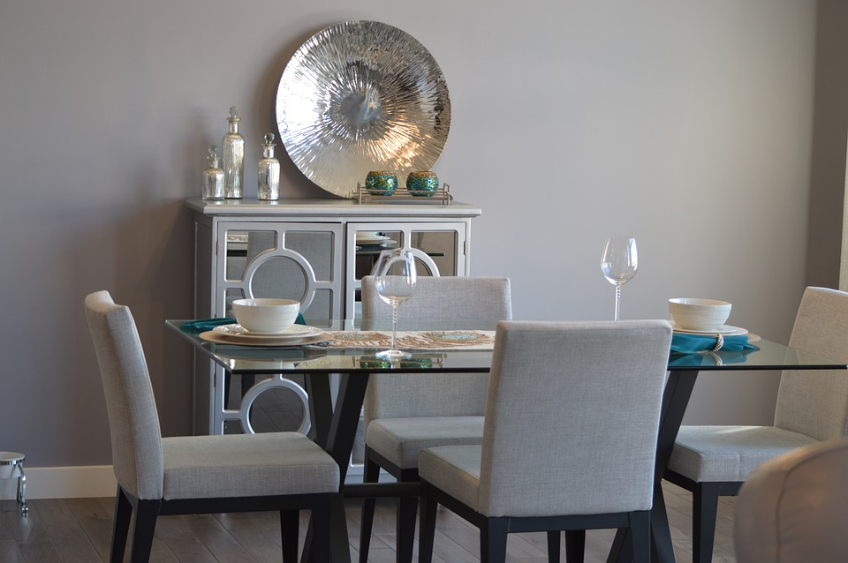
HOME

Slide 7

HOME

Slide 8
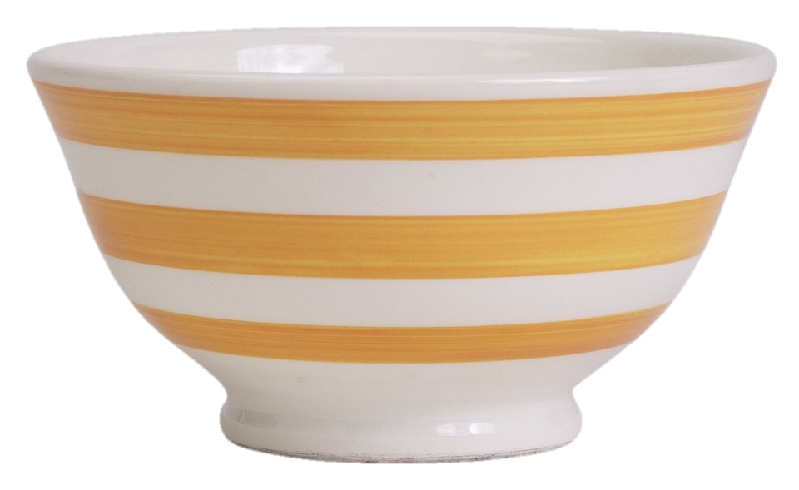
HOME

Slide 9

HOME

Slide 10

Presentation
4
Listen and repeat.

Slide 11




Possessive Adjective
He
- his
I
- my
We
- our
She
- her
They
- their

Slide 12

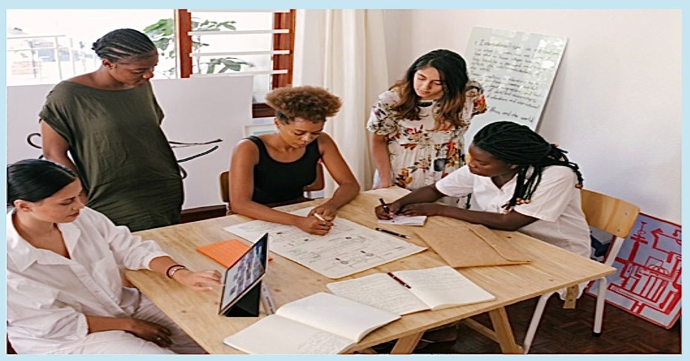
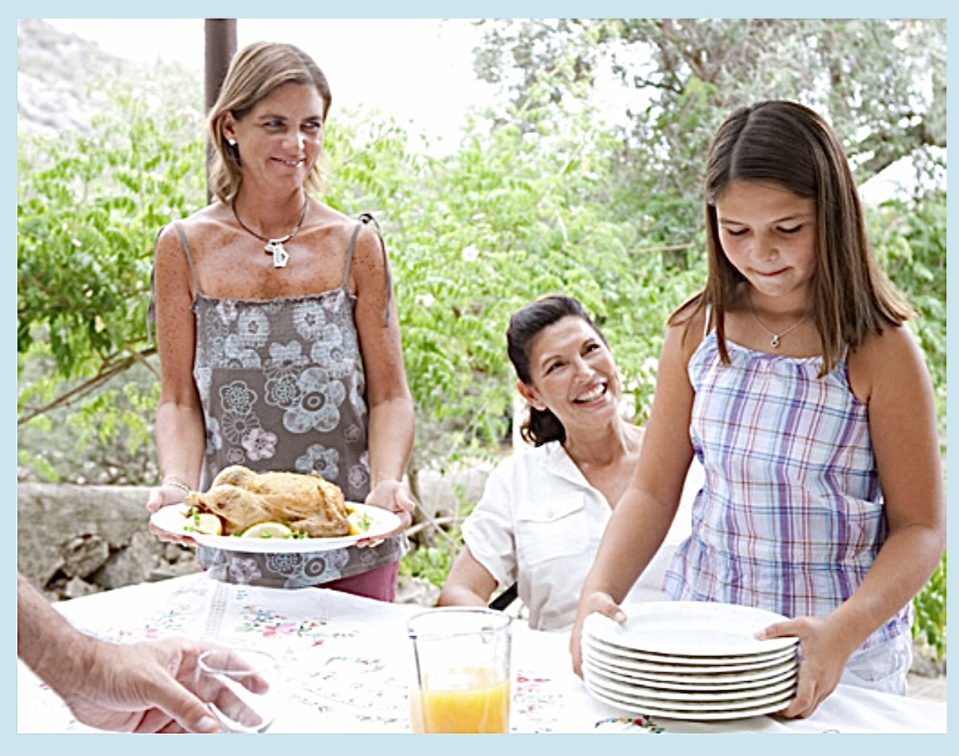
Choose the correct answer
1
Whose table is it?
2
Whose plates are they?
A. It’s their table.
A. They’re my plates.
B. It’s his table.
B. They’re his plates.
C. It’s her table.
C. They’re our plates.

Slide 13


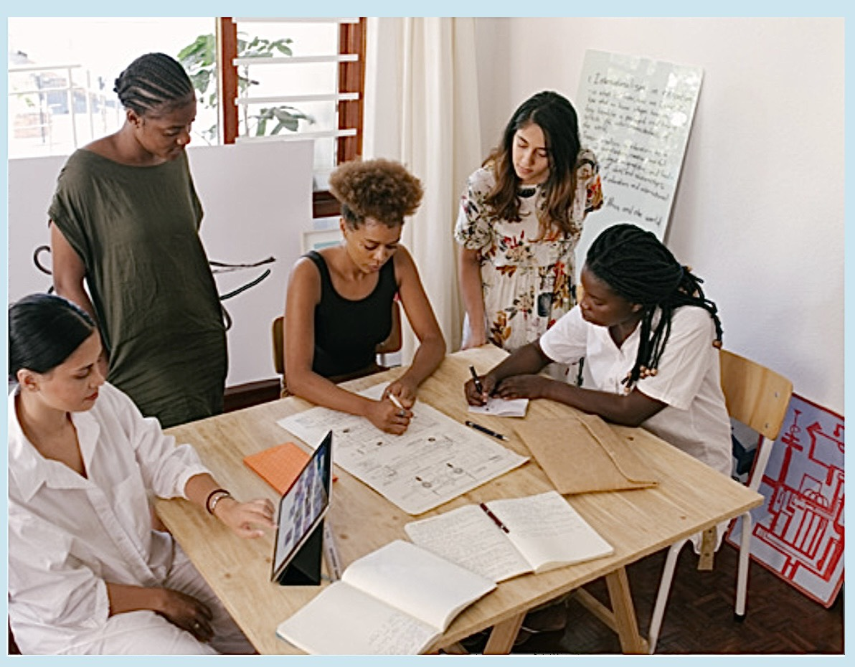
4
Listen and repeat.
1
Whose table is it?
2
Whose plates are they?
- It’s their table.
- They’re our plates.

Slide 14

Practice
5
Look and say.

Slide 15


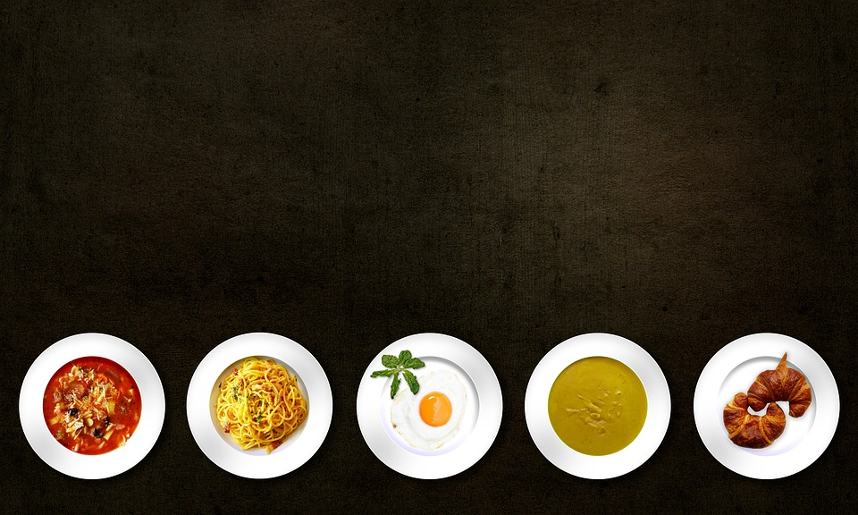
plates/our
Whose plates are they?
They’re our plates.

Slide 16


garden/their
Whose garden is it?
It’s their garden.

Slide 17
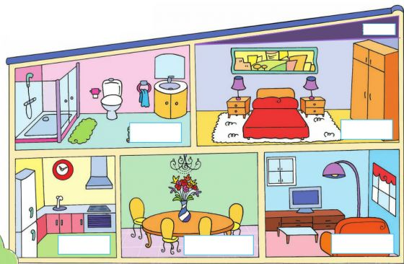
Further practice
It is…/ They are...
my …
his …
her …
our …
their…

Slide 18

Production
6
Let’s talk.

Slide 19
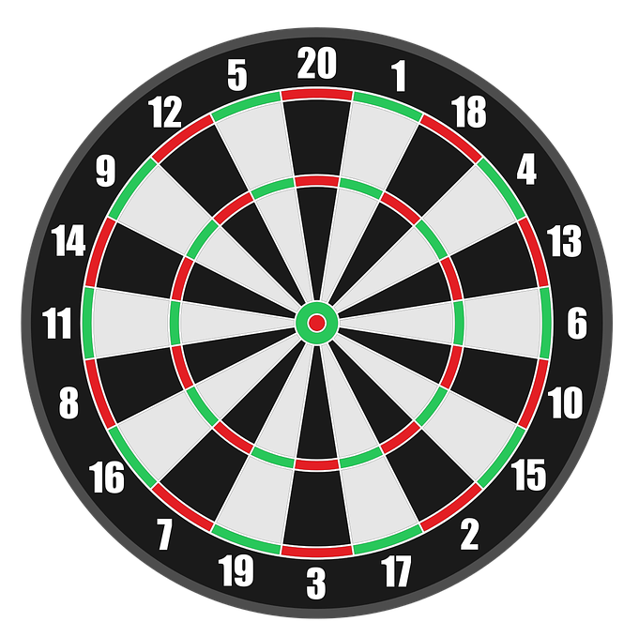


Game :Dart Board
Look and answer
1
3
5
2
4
Next

Slide 20



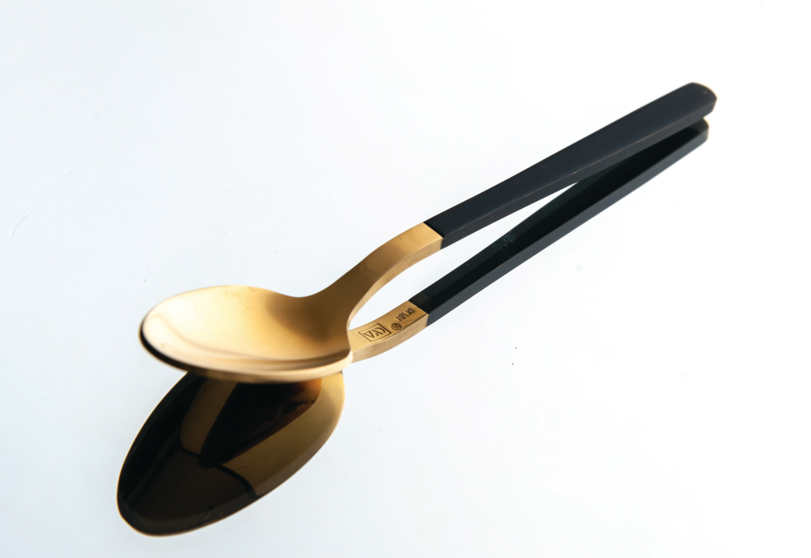


Whose spoon is it?
+ 3
It’s my spoon.
Next
They’re my spoons.
Abc.xyz789

Slide 21


They’re___ schoolbags.
+4
his
their
Next
Abc.xyz789
Notes:
Ms Huyền Phạm - 0936.082.789 – YOUTUBE: MsPham. Facebook: Dạy và học cùng công nghệ.

Slide 22

Assessment

Slide 23
Wrap up
Notes:
Đây k phải là extra, đây là hđ 3 của bài

Slide 24
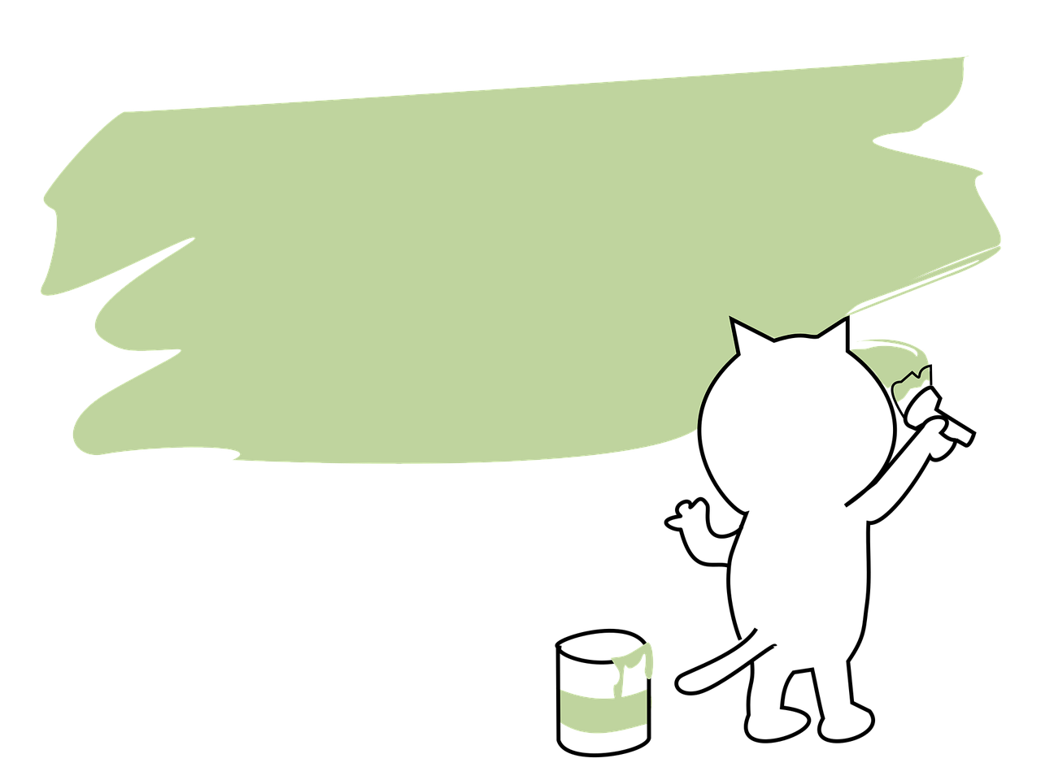
Structure
Whose ___ is it/ are they?
It’s____.
They’re ___.

Slide 25




Thank you & goodbye!

