Slide 1

Unit 1: Animals
Lesson 2.1
Page 9

Slide 2
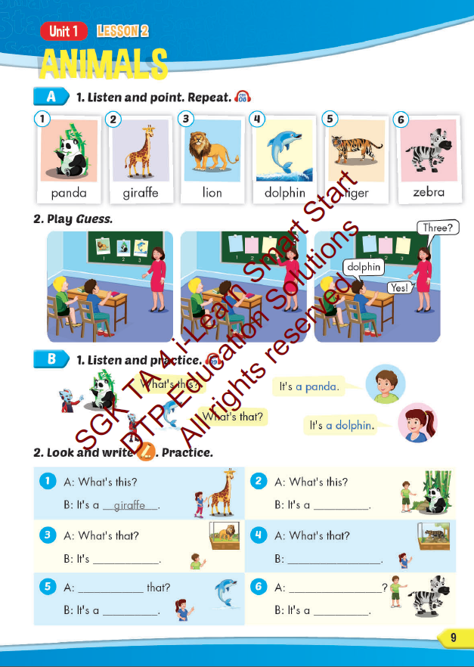
Lesson Outline
Warm-up
Vocabulary
Structure
Consolidation
Wrap-up

Slide 3
Objectives
By the end of this lesson, students will be able to…
Vocabulary: Pronounce and use the words related to the topic properly: panda, giraffe, lion, dolphin, tiger, zebra.
Structure: What's this? - It's a panda.
What's that? - It's a dolphin.

Slide 4

WARM UP

Slide 5
Look quickly and say aloud the word.
Who’s faster?

Slide 6
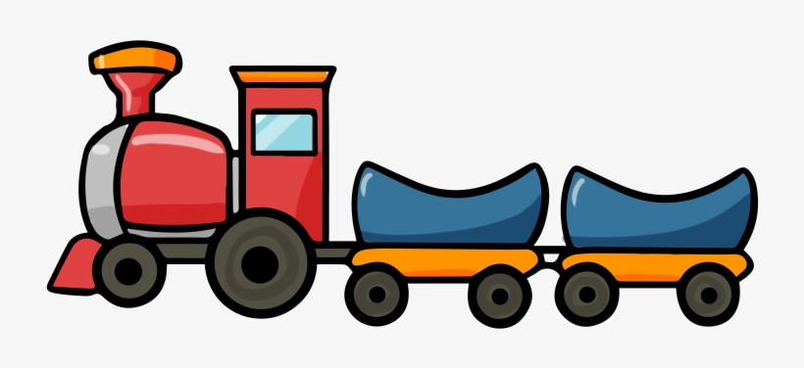
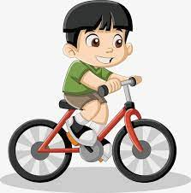
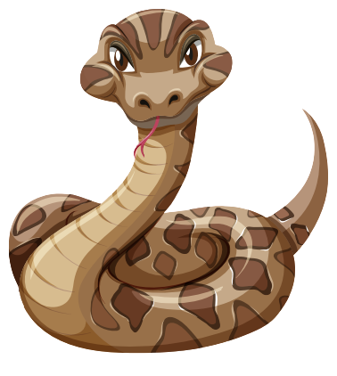

Slide 7

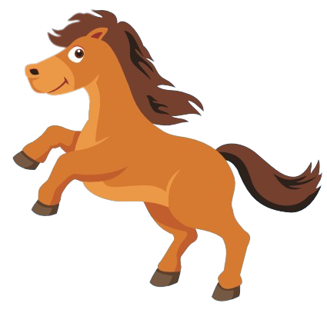

Slide 8

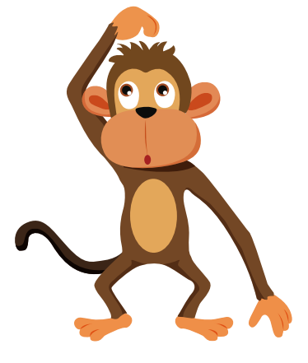

Slide 9
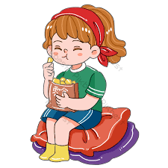
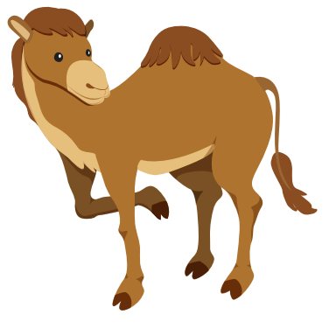

Slide 10
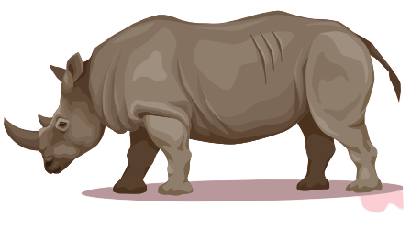

Slide 11


Slide 12

It’s time to learn …

Slide 13

New words
panda, giraffe, lion,
dolphin, tiger, zebra

Slide 14

Presentation

Slide 15


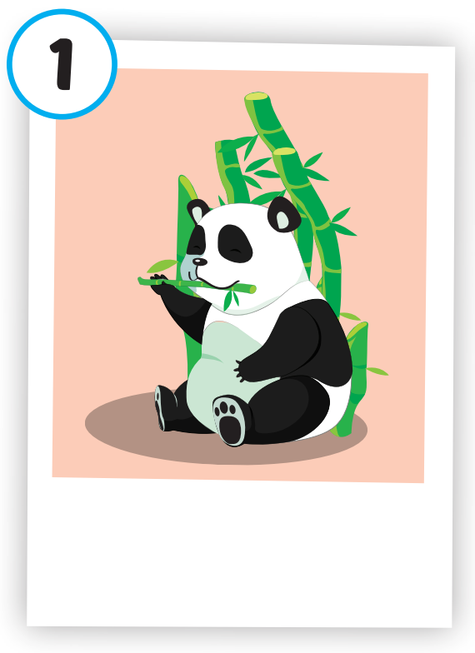
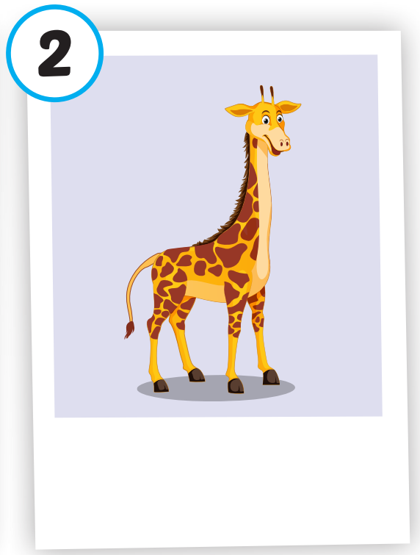
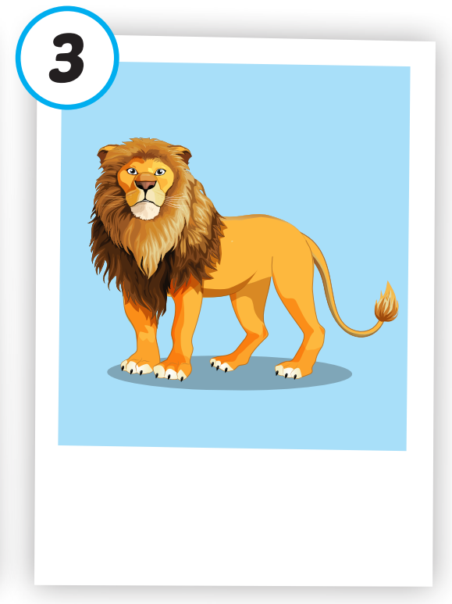
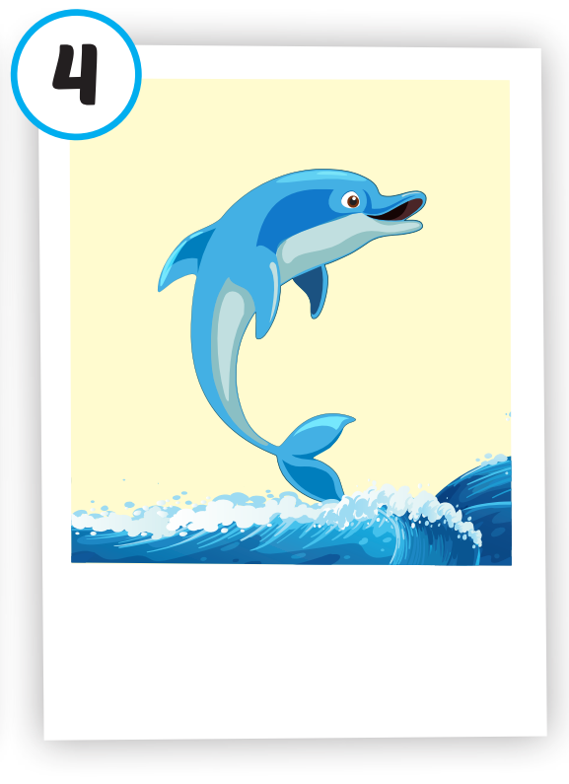
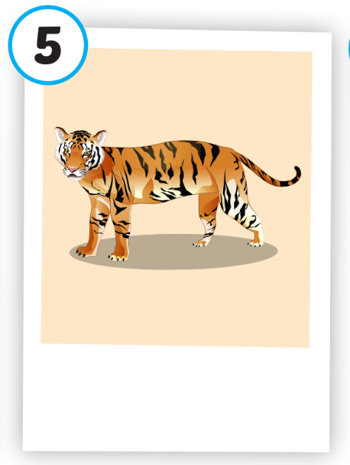
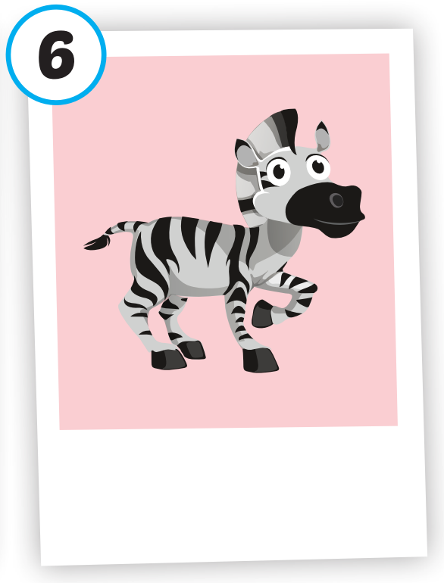






/ˈpændə/
con gấu trúc
/ˈlaɪən/
con sư tử
/ˈdɑːlfɪn/
cá heo
/ˈtaɪɡər/
con hổ
/ˈziːbrə/
con ngựa vằn
/dʒɪˈræf/
con hươu cao cổ

Slide 16
Practice

Slide 17
Check your memory

Slide 18


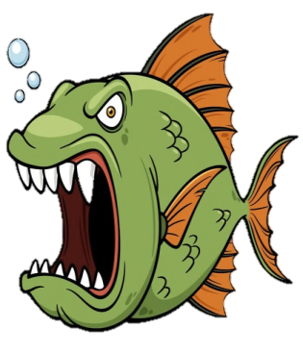

A. tiger
B. lion
C. panda

Slide 19
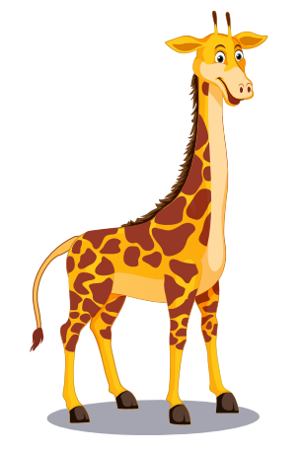
A. dolphin
B. giraffe
C. duck

Slide 20
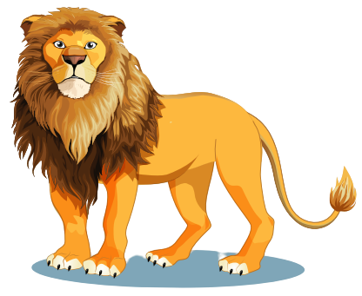
A. monkey
B. lion
C. tiger

Slide 21

A. dolphin
B. tiger
C. lion

Slide 22
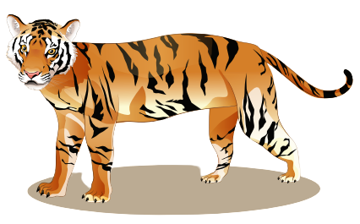
A. camel
B. tiger
C. giraffe

Slide 23
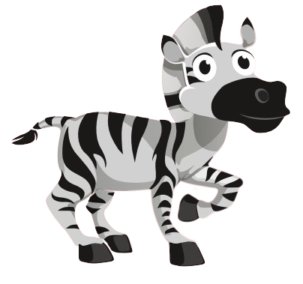
A. lion
B. tiger
C. zebra

Slide 24

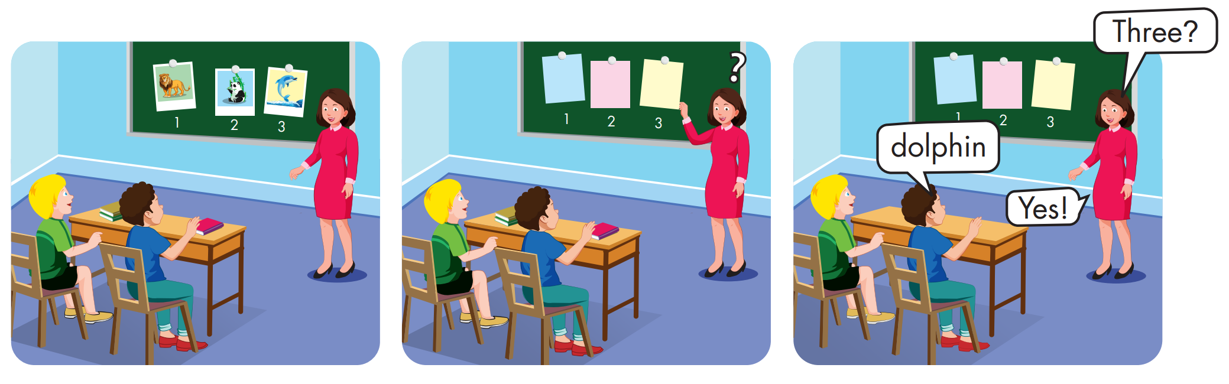

Slide 25
Structure
What's this? - It's a panda.
What's that? - It's a dolphin.

Slide 26
Presentation

Slide 27
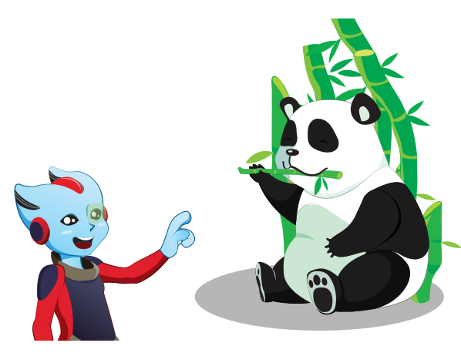



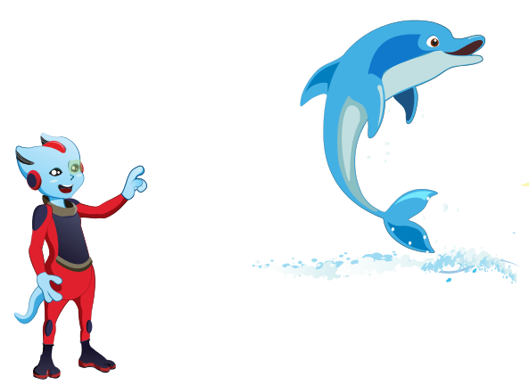



Structure

Slide 28

Practice

Slide 29


Slide 30

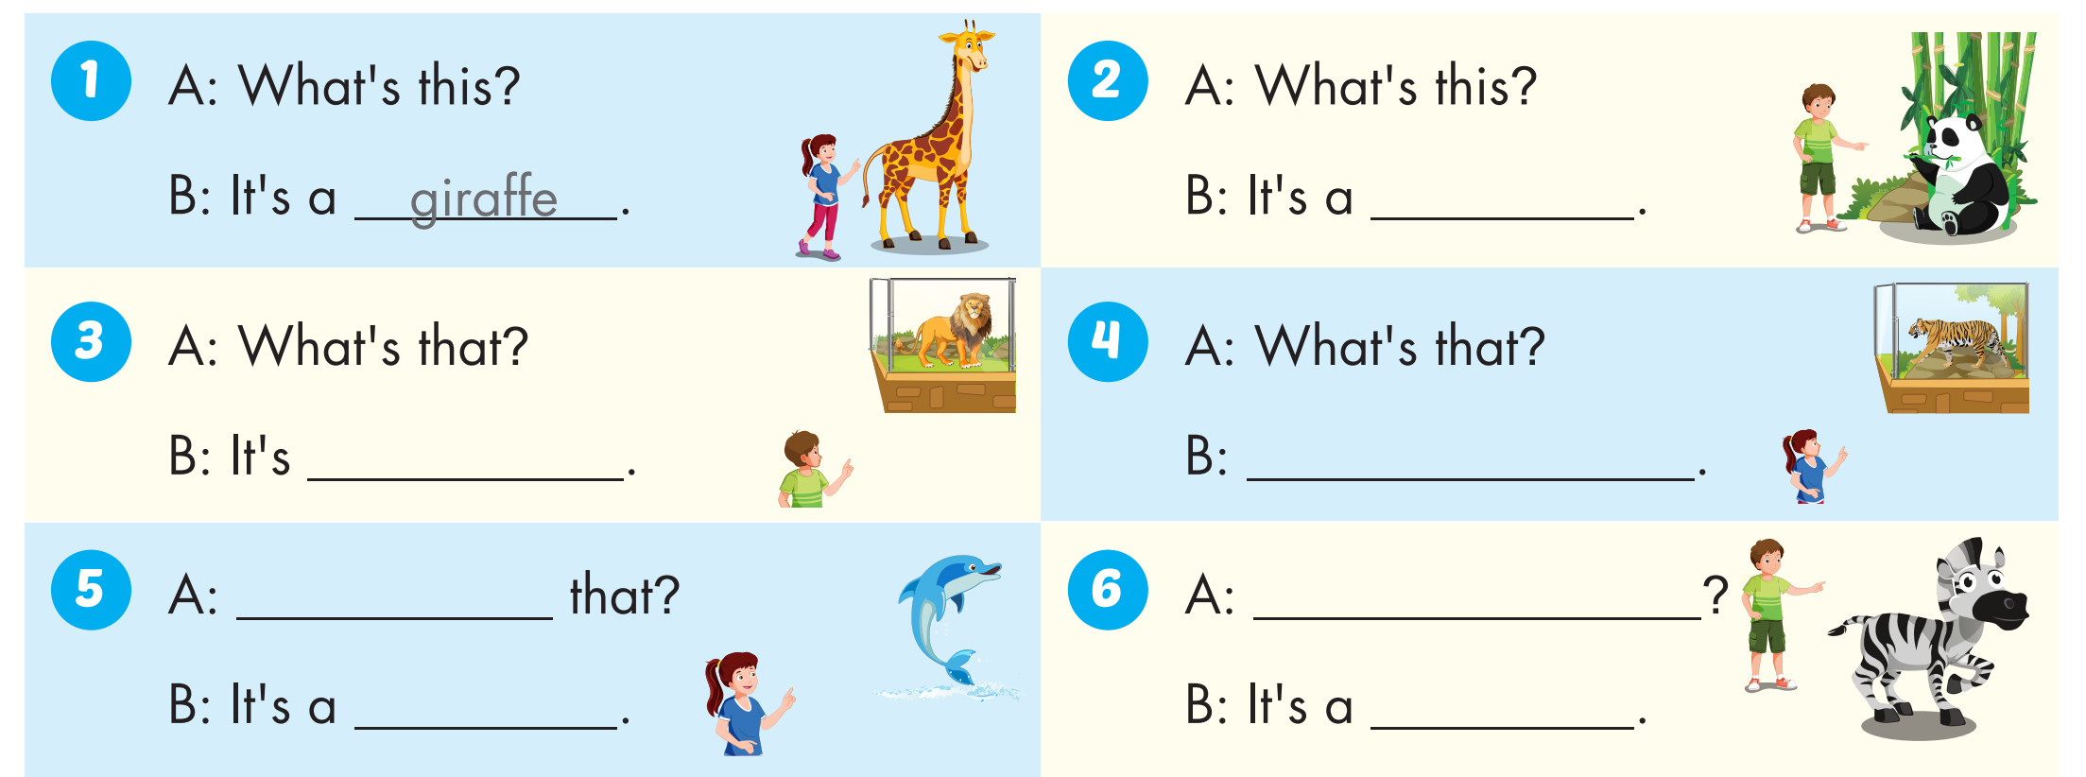
panda
a lion
It's a tiger
What's
What's this?
dolphin
zebra

Slide 31

WRAP-UP

Slide 32
Today’s lesson
Vocabulary
panda, giraffe, lion, dolphin, tiger, zebra.
Structures
What's this? - It's a panda. What's that? - It's a dolphin.

Slide 33
Homework
Practice the vocabularies and structure; and make sentences using them.
Prepare the next lesson (page 10 SB)

Slide 34

Lesson 3
Stay positive and have a nice day!

