Slide 1
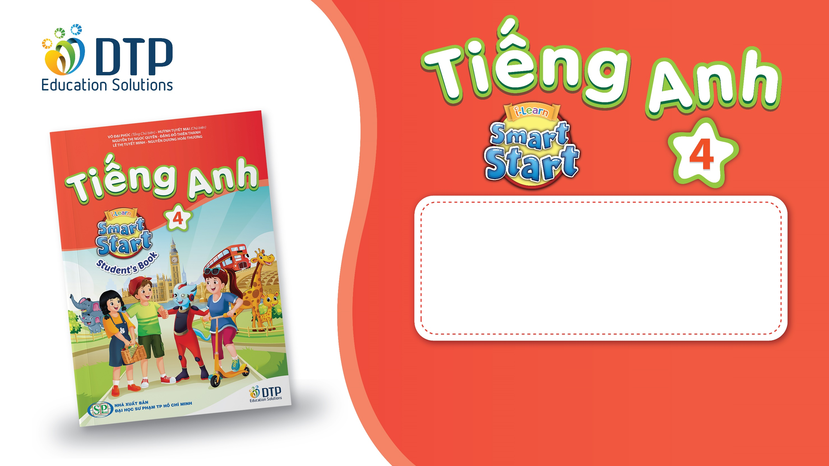
Unit 1: Animals
Lesson 2.3
Page 11

Slide 2
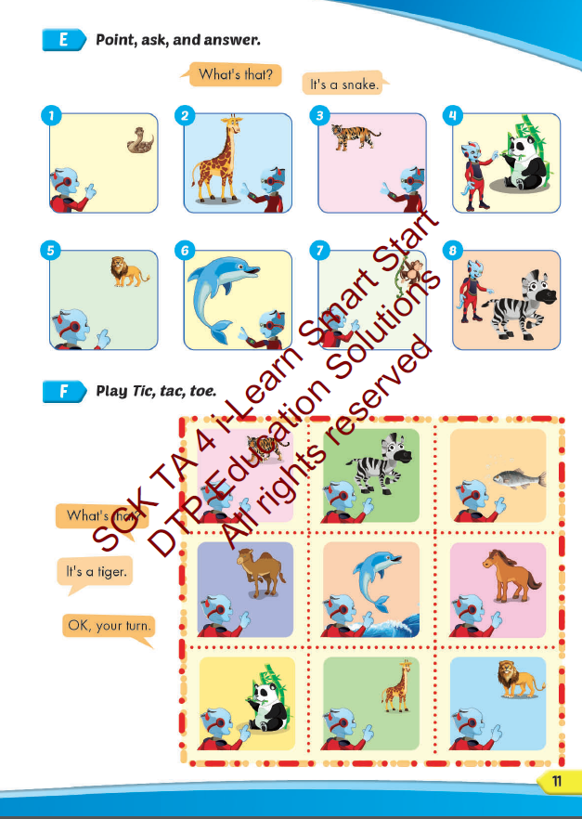
Lesson Outline
Warm-up
Practice
Speaking
Consolidation
Wrap-up

Slide 3
Objectives
By the end of this lesson, students will be able to…
Vocabulary: Pronounce and use the words related to the topic properly: panda, giraffe, lion, dolphin, tiger, zebra.
Structure: What's this? - It's a panda.
What's that? - It's a dolphin.
Phonics: Draw attention to the initial/f inal/medial /f/ sound. and practice the conversations.

Slide 4

WARM UP

Slide 5
Check your memory

Slide 6

It’s time to learn …

Slide 7

Speaking

Slide 8

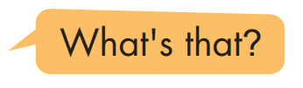

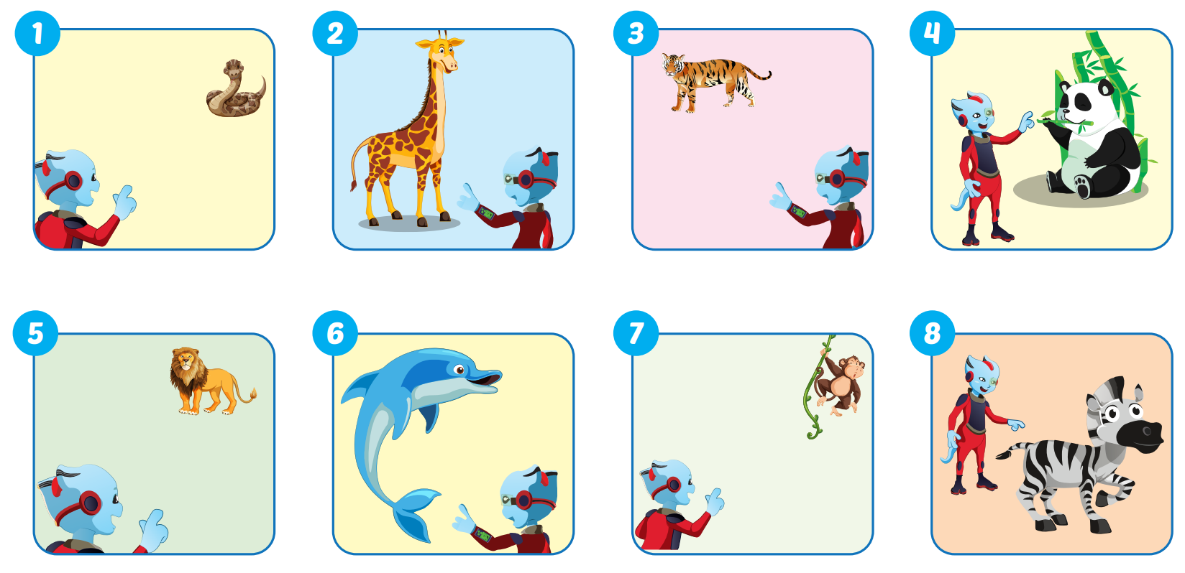

Slide 9

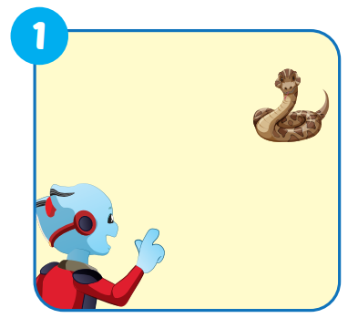


What's that?
It's a snake.

Slide 10
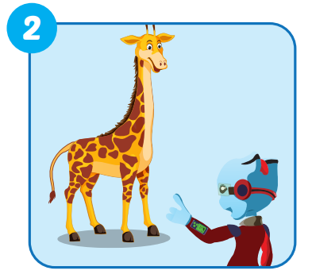
What's this?
It's a giraffe.

Slide 11
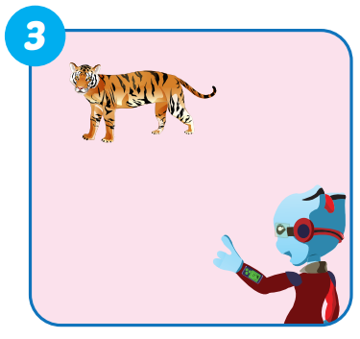
What's that?
It's a tiger.

Slide 12
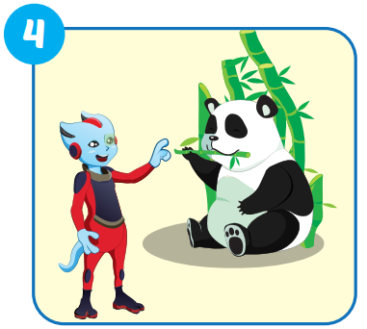
What's this?
It's a panda.

Slide 13
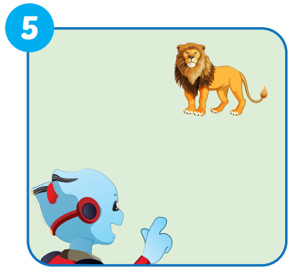
What's that?
It's a lion.

Slide 14
What's that?
It's a lion.

Slide 15
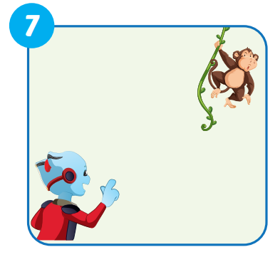
What's that?
It's a monkey.

Slide 16
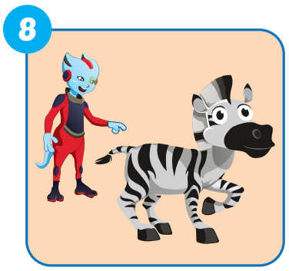
What's this?
It's a zebra.

Slide 17

Production

Slide 18

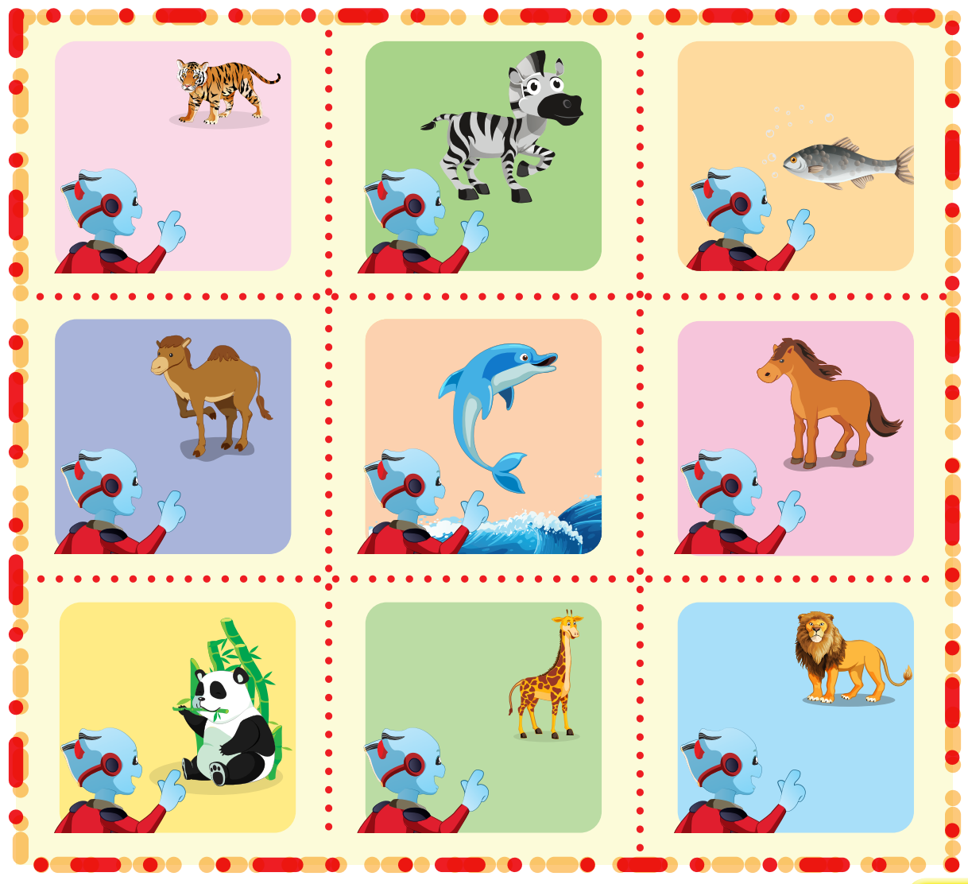
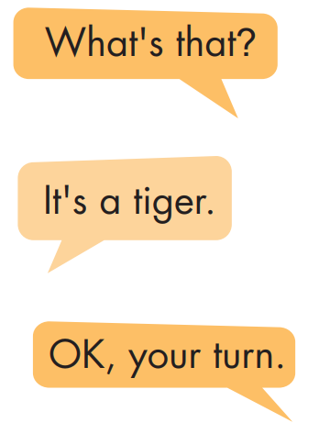

Slide 19
FINDING THE ANIMALS
GAME

Slide 20

Choose the correct answer.

Slide 21




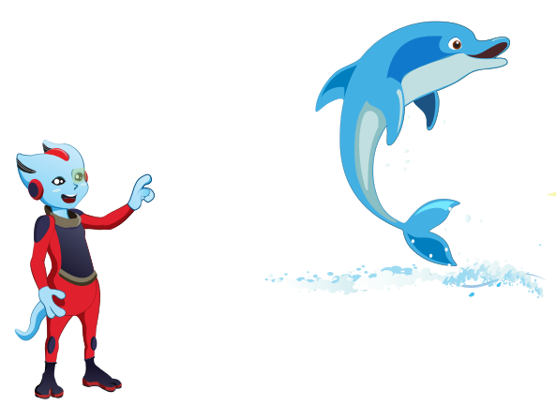
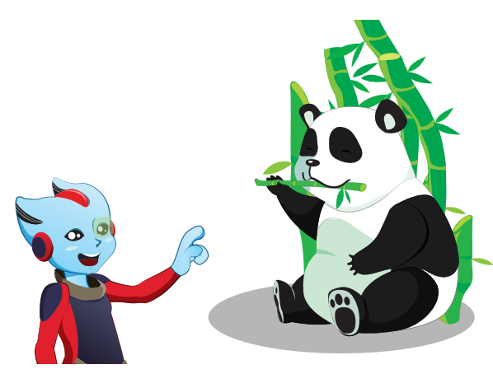
What's this?

Slide 22
What's that?

Slide 23
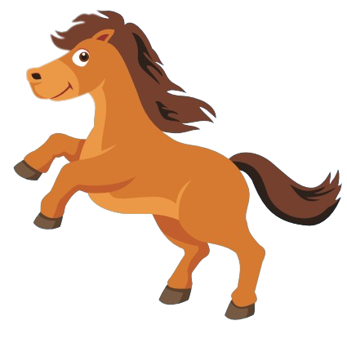

It's a horse.

Slide 24
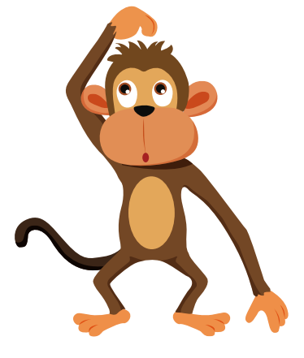
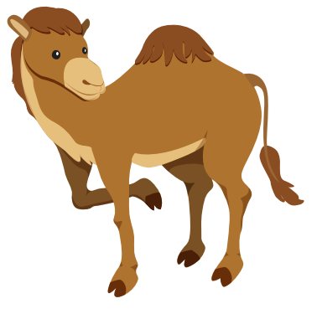
It's a monkey.

Slide 25
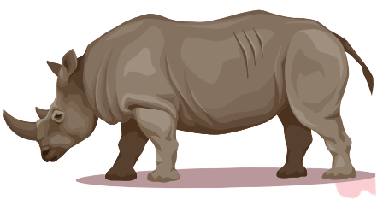
It's a hippo.

Slide 26
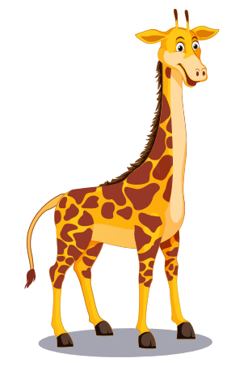

It's a giraffe.

Slide 27

It's a dolphin.

Slide 28

CONSOLIDATION

Slide 29

WRAP-UP

Slide 30
Today’s lesson
Vocabulary
panda, giraffe, lion, dolphin, tiger, zebra.
Structures
What's this? - It's a panda.
What's that? - It's a dolphin.
Phonics
Draw attention to the initial/f inal/medial /f/ sound. and practice the conversations.

Slide 31
Homework
Practice the vocabulary and structure; and make sentences using them.
Prepare the next lesson (page 12 SB)

Slide 32

Enjoy your day!

