Slide 1

Unit 4: Travel
Review and Practice 1
Page 60

Slide 2
Objectives
By the end of this lesson, students will be able to…
Vocabulary: Review: mountain, lake, river, beach, ocean, forest, Canada, France, South Korea, Brazil, Germany, Spain, ferry, minibus, plane, helicopter, van, speedboat, Laos, Cambodia, China, Thailand, Singapore, Indonesia.
Structure: I didn't go to the river. I went to the beach; I went to South Korea last month. - Did you sing karaoke? - Yes, I did. /No, I didn't; How did you get there? - We went by helicopter; I went to Laos last month. - What did you do there? - I watched a soccer game.

Slide 3

WARM-UP

Slide 4

JERRY’S
DOOR
START

Slide 5


Where did you go?
CHECK
I went to Canada.

Slide 6

Where did you go?
CHECK
I went to France.

Slide 7

Where did you go?
CHECK
I went to South Korea.

Slide 8

Where did you go?
CHECK
I went to Brazil.

Slide 9

Where did you go?
CHECK
I went to Germany.

Slide 10

Where did you go?
CHECK
I went to Spain.

Slide 11

Where did you go?
CHECK
I went to Laos.

Slide 12

Where did you go?
CHECK
I went to Cambodia.

Slide 13

Where did you go?
CHECK
I went to China.

Slide 14

Where did you go?
CHECK
I went to Thailand.

Slide 15

Where did you go?
CHECK
I went to Singapore.

Slide 16

Where did you go?
CHECK
I went to Indonesia.

Slide 17

It’s time to learn …

Slide 18

Listening

Slide 19


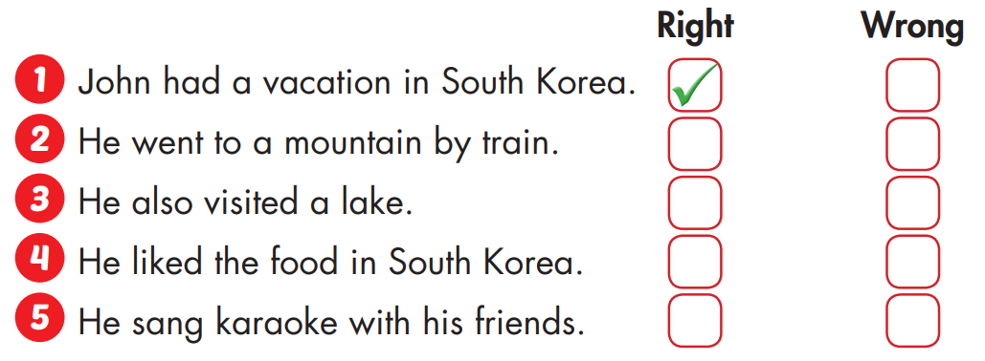


Slide 20

Reading

Slide 21
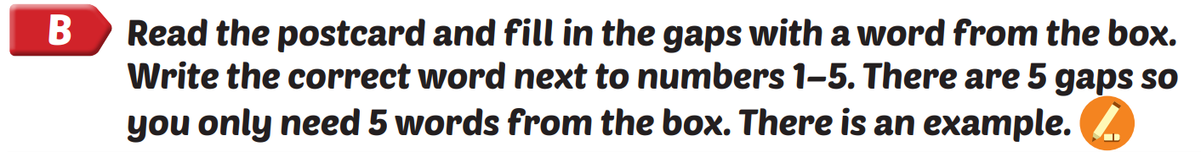
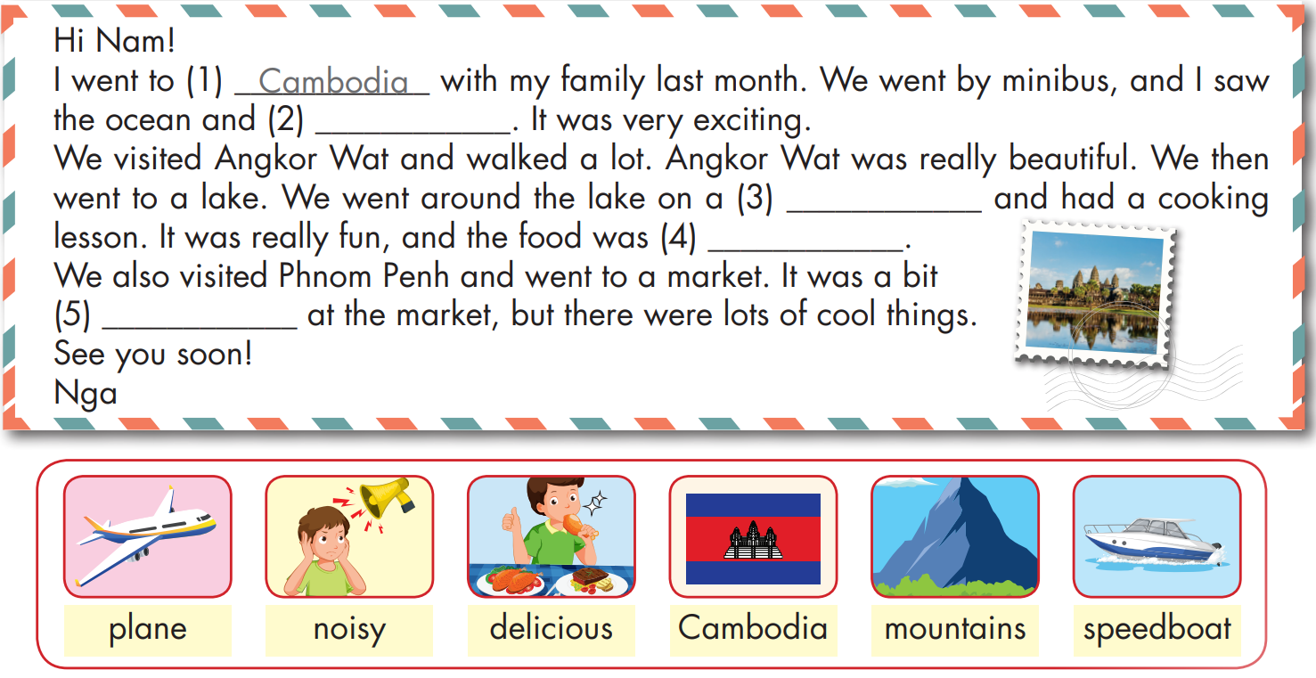
mountains
speedboat
delicous
noisy

Slide 22

Production

Slide 23
1. What's your friend's name?
2. Where did you go?
3. Who did you go with?
4. How did you get there?
5. What did you do there?
Sample writing:
Hi Ly!
My family went to Thailand. We went by plane. We went to the beach and swam in the ocean. It was beautiful. We also ate lots of delicious food. I'm having a great time.
See you soon.
My

Slide 24
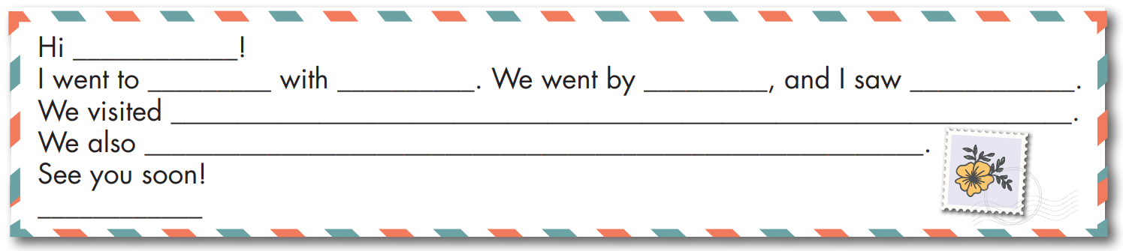

Slide 25

CONSOLIDATION

Slide 26

WRAP-UP

Slide 27
Structures/ Sentence patterns
I didn't go to the river. I went to the beach;
I went to South Korea last month.
- Did you sing karaoke?
- Yes, I did. /No, I didn't.
How did you get there?
- We went by helicopter;
I went to Laos last month.
- What did you do there?
- I watched a soccer game.
Today’s lesson
Vocabulary
mountain, lake, river, beach, ocean, forest, Canada, France, South Korea, Brazil, Germany, Spain, ferry, minibus, plane, helicopter, van, speedboat, Laos, Cambodia, China, Thailand, Singapore, Indonesia.

Slide 28
Homework
Practice the vocabulary and structure; and make sentences using them.
Do the exercises in Tiếng Anh 5 i-Learn Smart Start WB (page 40)
Do the exercises in Tiếng Anh 5 i-Learn Smart Start Notebook (page 26)
Prepare the next lesson (page 61 SB)

Slide 29

Enjoy your day!

Slide 30

Lesson 3
Stay positive and have a nice day!

