Slide 1

Unit 4: ACTIVITIES
Review and Practice
Page 60

Slide 2
Objectives
By the end of this lesson, students will be able to review the target language in the unit.
Vocabulary:
Activities: listen to music, watch television, play table tennis, do martial arts, skate, play chess, play a board game, do a puzzle, read a comic book, eat snacks, take photos, play video games.
Places: library, stadium, park, water park, market, swimming pool. studio, soccer field, arcade, skate park, coffee shop.
Structure:
What are you doing? What are they doing?
I’m swimming at the pool. They’re swimming at the pool.
What is he/she doing?
He/she swimming at the pool.

Slide 3

WARM UP

Slide 4

LET’S PLAY!
What’s missing?
Notes:
Put three or four FLASHCARDS (clothes) on the board and tell your child to look at them. Ask them to close their eyes and take one card away. When your child opens their eyes, ask them to guess what is missing.

Slide 5

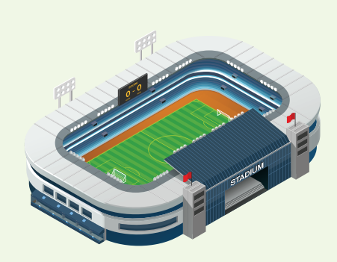



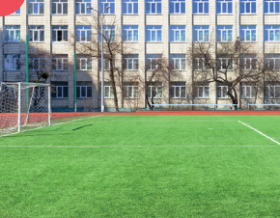


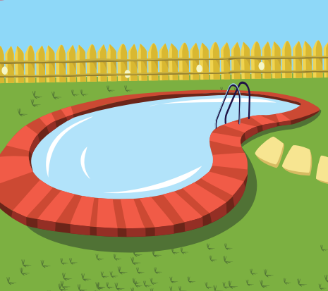


Slide 13
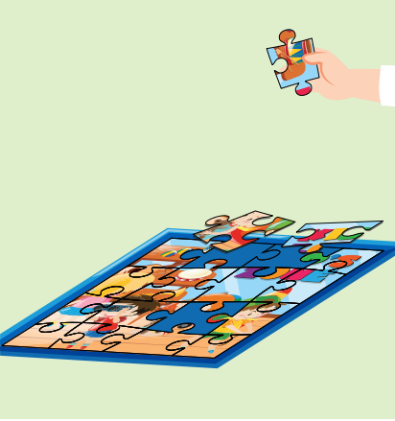

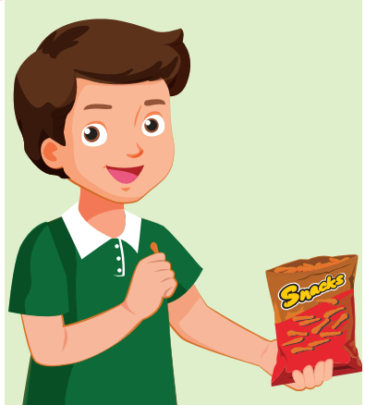

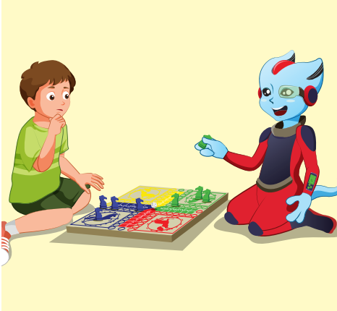
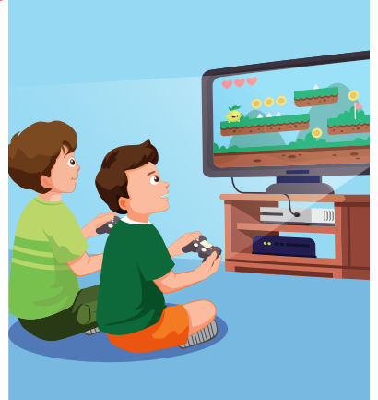
REVIEW 2
do puzzle
read a comic book
eat snack
take photo
play board game
play video game

Slide 14


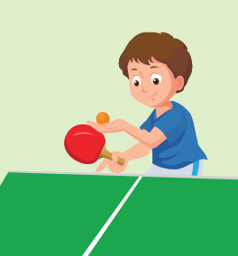
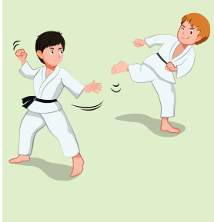
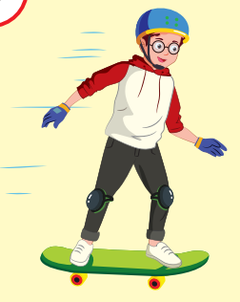
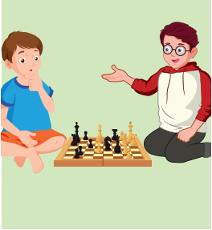
REVIEW 2
listen to music
watch TV
play table tennis
do martial arts
skate
play chess

Slide 15

It’s time to learn …

Slide 16

Listening

Slide 17


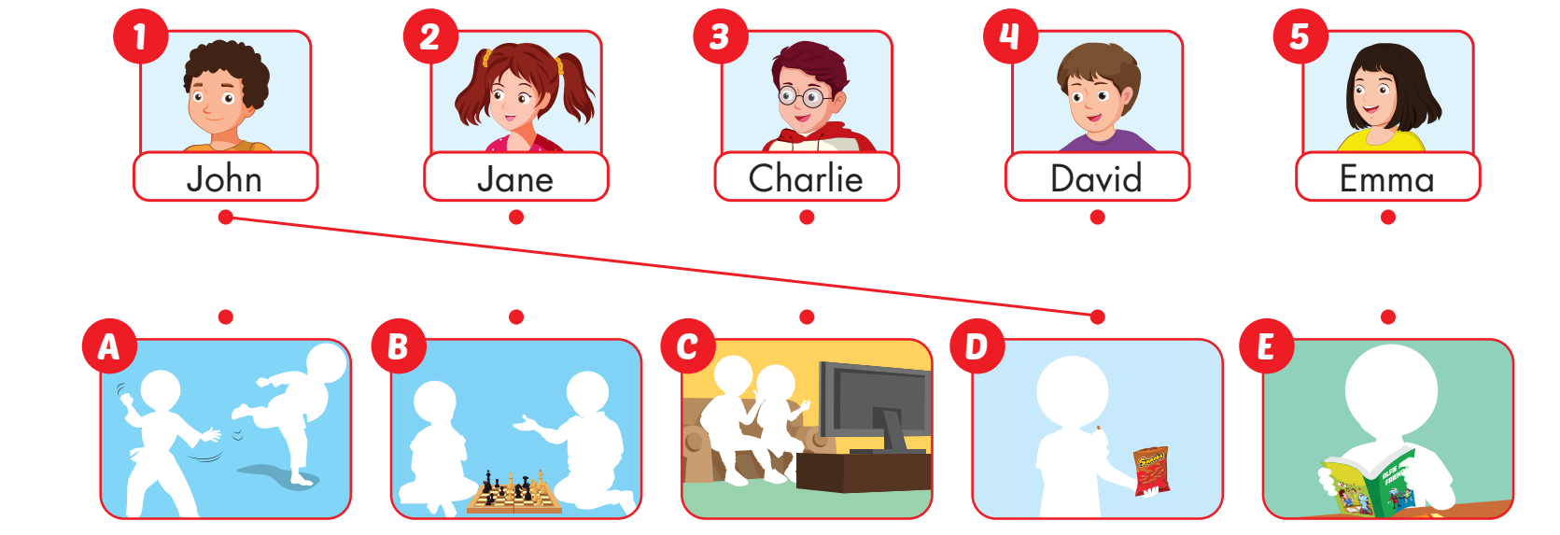

Slide 18

Reading

Slide 19







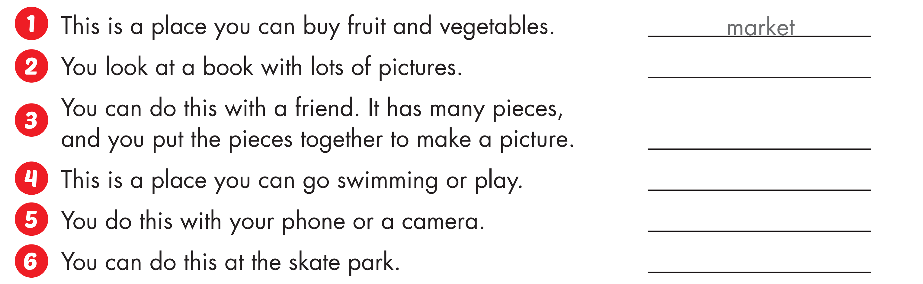
read a comic book
do a puzzle
water park
take photos
skate

Slide 20
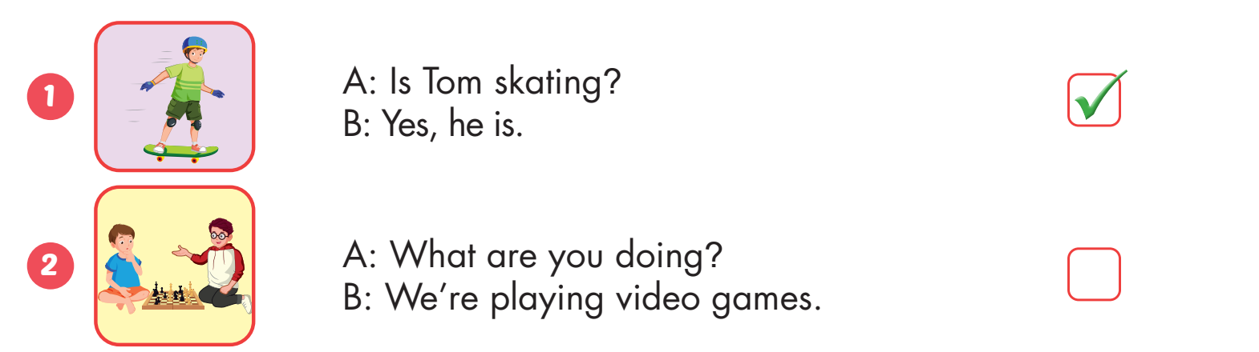


Slide 21
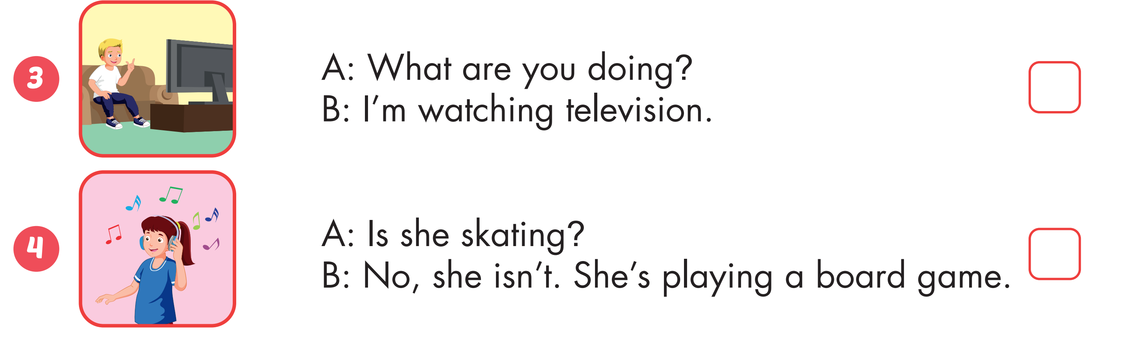



Slide 22
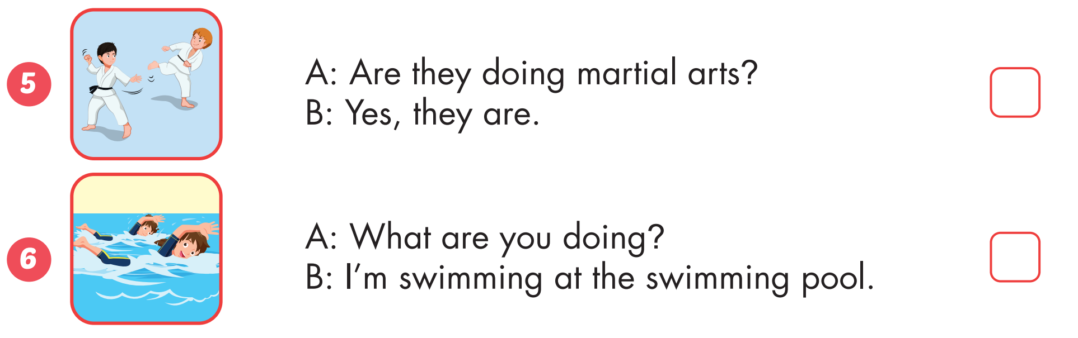

Slide 23
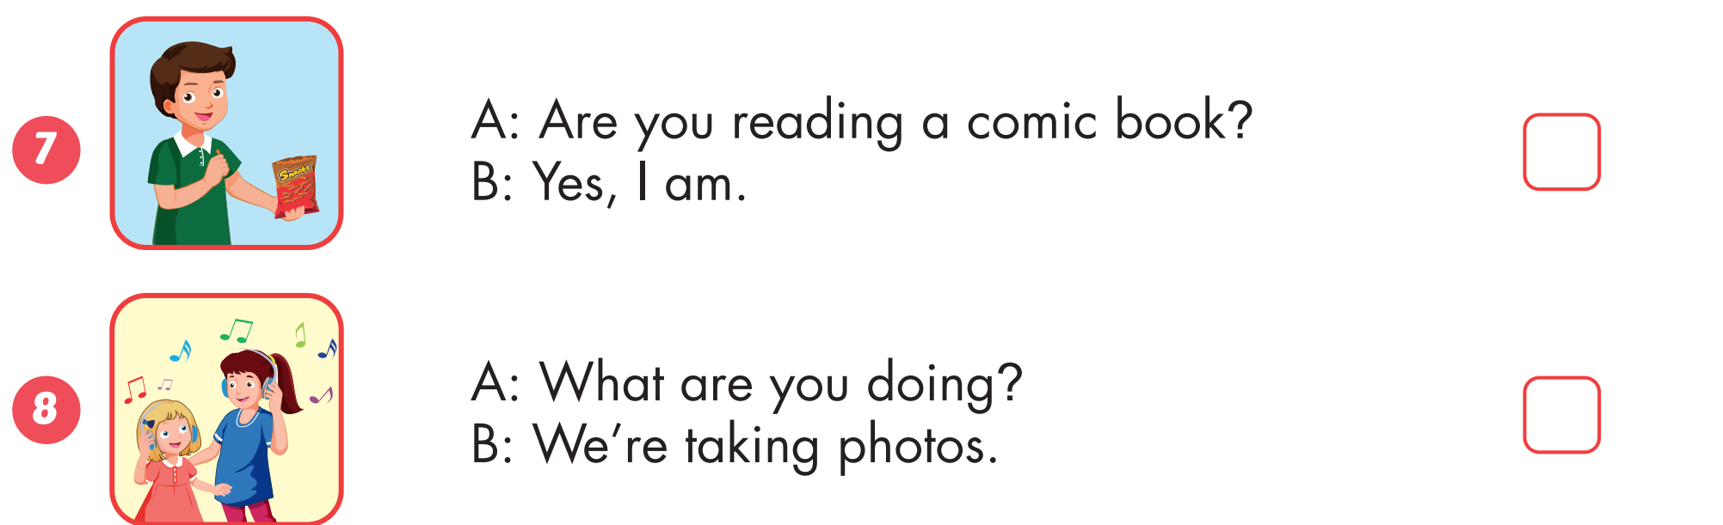

Slide 24
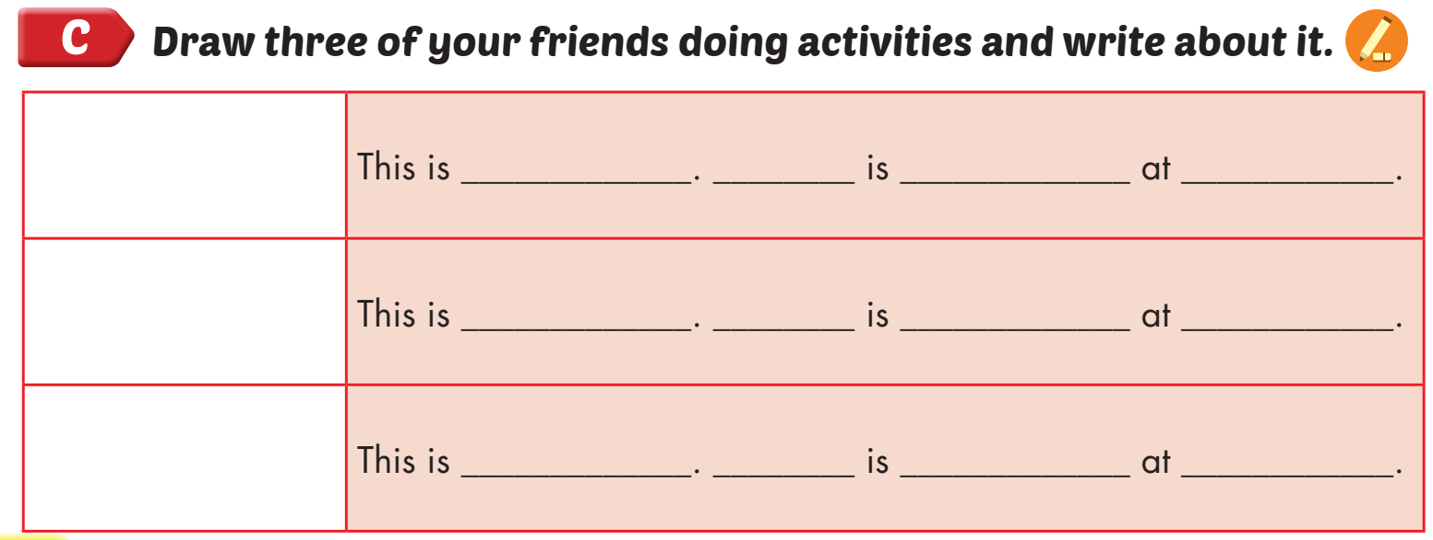

Nick
He
reading a comic book
home

Slide 25

Speaking

Slide 26



Slide 27
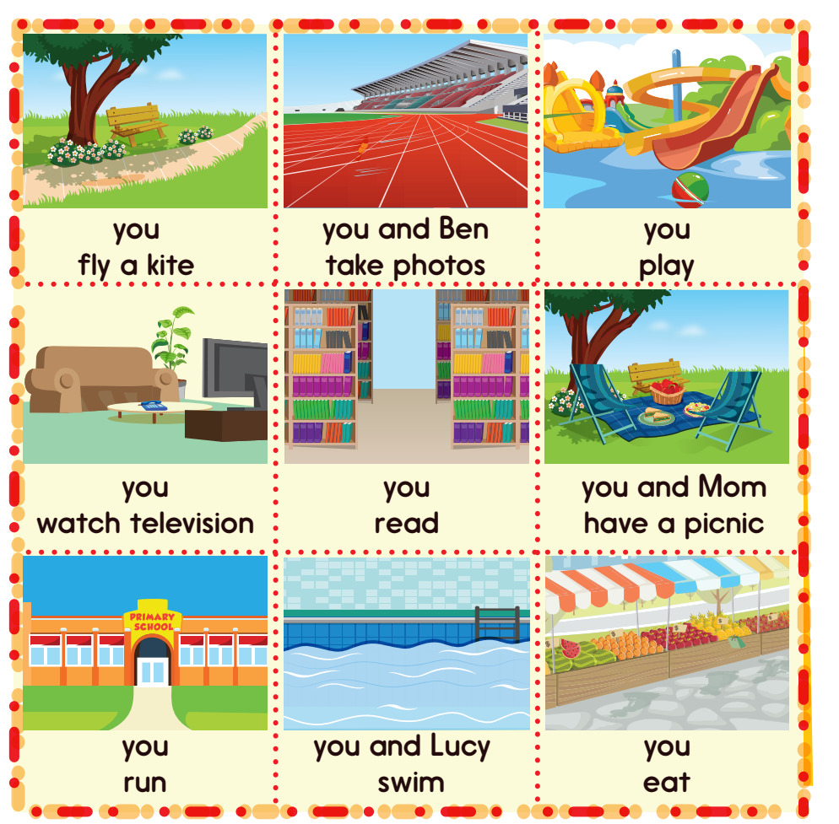
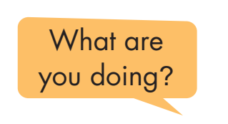
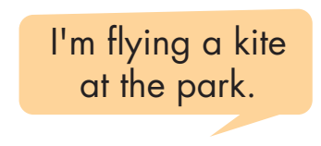
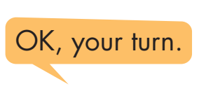

Slide 28

CONSOLIDATION

Slide 29

WRAP-UP

Slide 30
Today’s lesson
Vocabulary
Activities: listen to music, watch television, play table tennis, do martial arts, skate, play chess, play a board game, do a puzzle, read a comic book, eat snacks, take photos, play video games.
Places: library, stadium, park, water park, market, swimming pool. studio, soccer field, arcade, skate park, coffee shop.
Structures/ Sentence patterns
What are you doing?
I’m swimming at the pool.
What are they doing?
They’re swimming at the pool.
What is he/she doing?
He/she swimming at the pool.

Slide 31
Homework
Practice the vocabulary and structure; and make sentences using them.
Do the exercises in Tiếng Anh 4 i-Learn Smart Start WB (page 40)
Do the exercises in Tiếng Anh 4 i-Learn Smart Start Notebook (page 26).
Prepare the next lesson (page 61 SB)

Slide 32

Enjoy your day!

