Slide 1

Unit 4: HOME
Lesson 3.3
Page 60

Slide 2
Objectives
By the end of this lesson, students will be able to ask where people are.
Vocabulary: Revision (bedroom, bathroom, living room, kitchen, yard).
Structure: Where’s Tom? He’s in the living room.
Where’s Grandma? She’s in the bathroom.

Slide 3

WARM UP

Slide 4
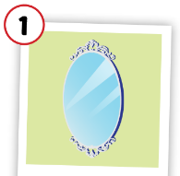
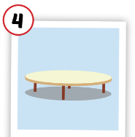
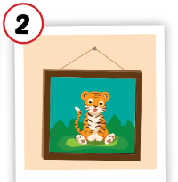
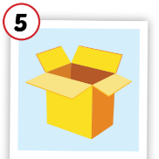
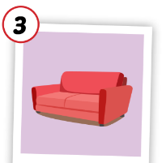
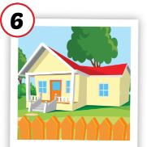
Matching the picture with its meaning.
table
picture
house
mirror
sofa
box

Slide 5

It’s time to learn …

Slide 6

Practice

Slide 7

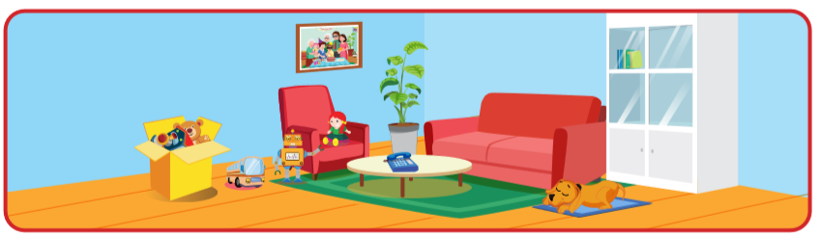
Is the table in the living room?
Yes, it is.

Slide 8
Is the mirror in the living room?
No, it isn’t.

Slide 9
Is the box in the living room?
Yes, it is.

Slide 10
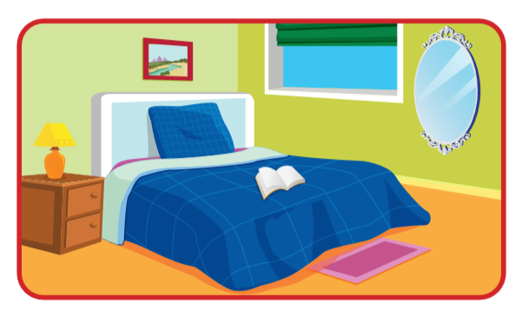
Is the mirror in the living room?
Yes, it is.

Slide 11
Is the picture in the bedroom?
Yes, it is.

Slide 12
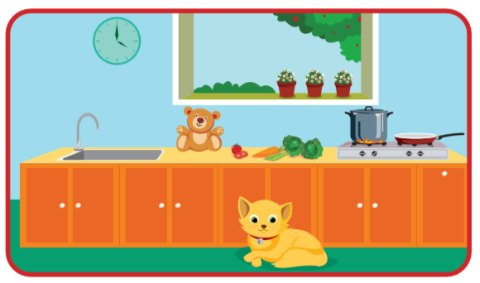
Is the cat in the kitchen?
Yes, it is.

Slide 13

Speaking

Slide 14
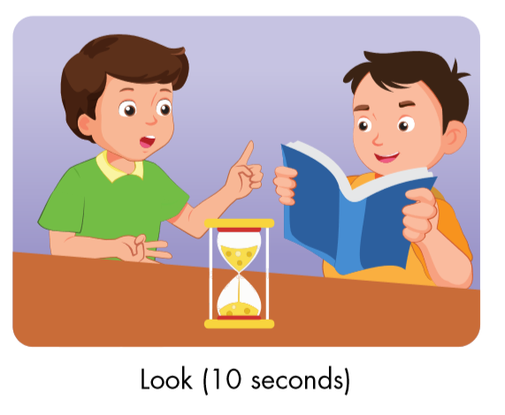
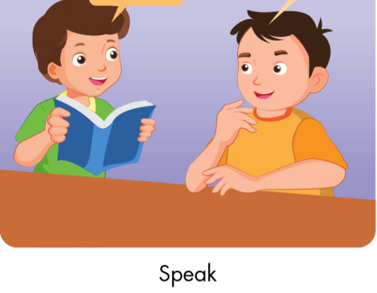
Is the cat in the bedroom?
No, it isn’t.
Correct.

Slide 15
Is the table in the living room?
Yes, it is.
Correct.

Slide 16
Is the picture in the living room?
Yes, it is.
Correct.

Slide 17
Is the box in the kitchen?
No, it isn’t.
Correct.

Slide 18

CONSOLIDATION

Slide 19
Lesson 3
Today’s lesson
Vocabularies
Revision (bedroom, bathroom, living room, kitchen, yard).
Structures/ Sentence patterns
Is the picture in the bedroom?
Yes, it is.
Is the mirror in the living room?
No, it isn’t.

Slide 20
Homework
Review the vocabularies and sentence patterns. Make sentences using them.
Do the exercise D on page 43 (WB)
Prepare the next lesson (page 61 SB)

Slide 21
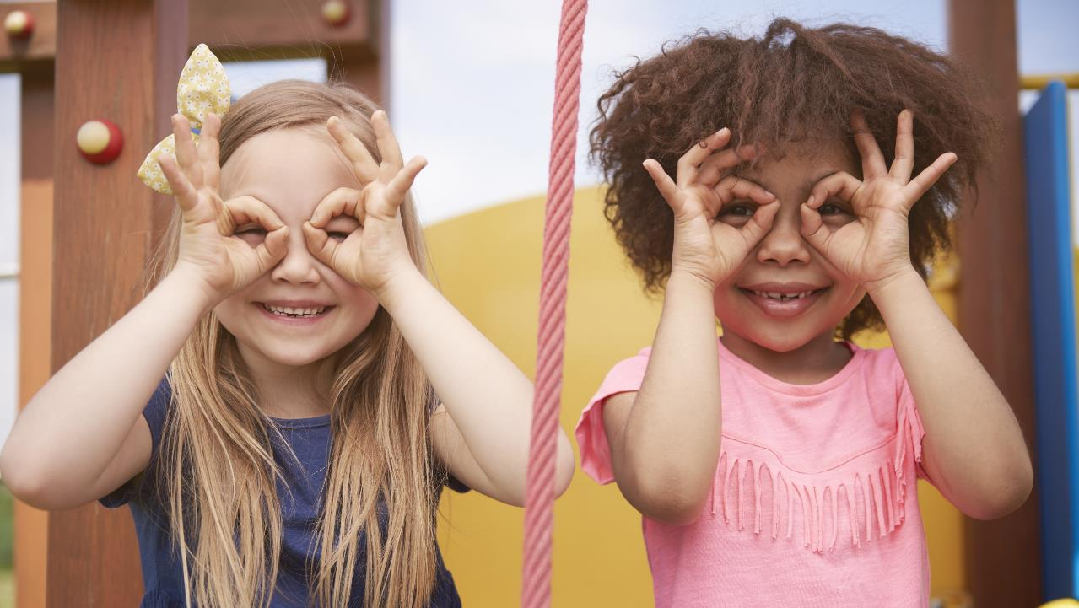
Enjoy your day!

Slide 22
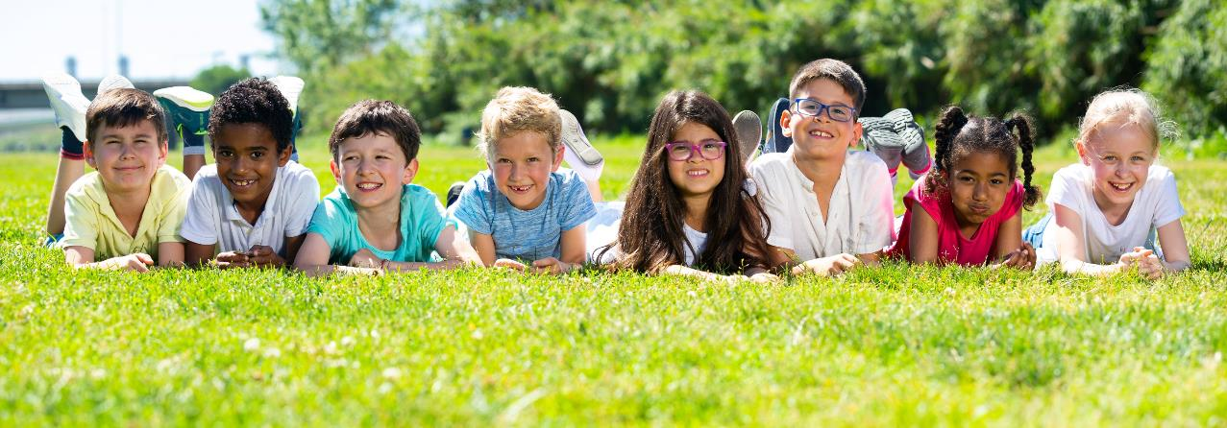
Have a nice day!

