Slide 1

Unit 3: WEATHER
Lesson 4.1
Page 43

Slide 2
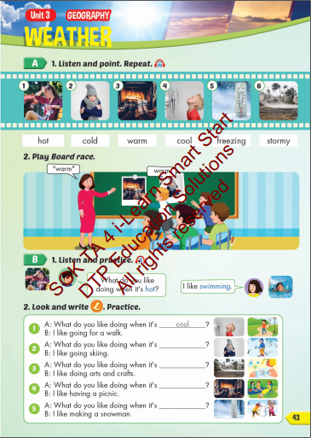
Lesson Outline
Warm-up
Vocabulary
Structure
Consolidation
Wrap-up

Slide 3
Objectives
By the end of this lesson, students will be able to the weather like today.
Vocabulary: Cold, Hot, Warm, Freezing, Cool, Stormy
Structure: What do you like doing when it's hot?
I like swimming.

Slide 4

WARM UP

Slide 5

Vocabulary

Slide 6

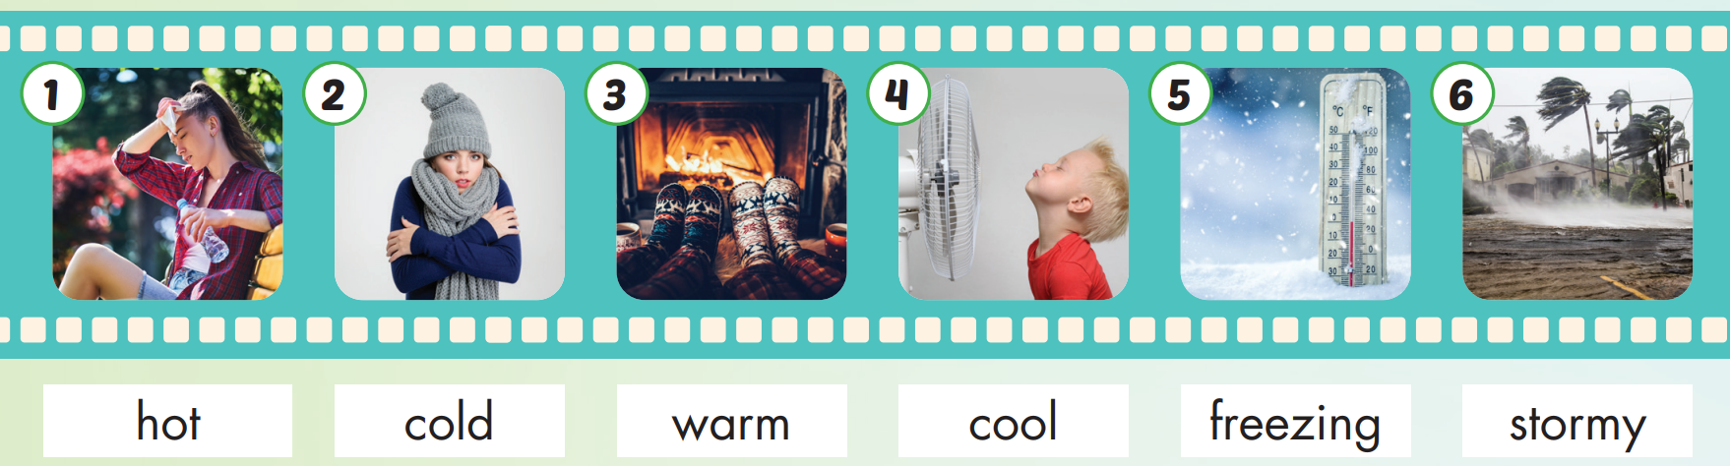

Slide 7

Practice

Slide 8

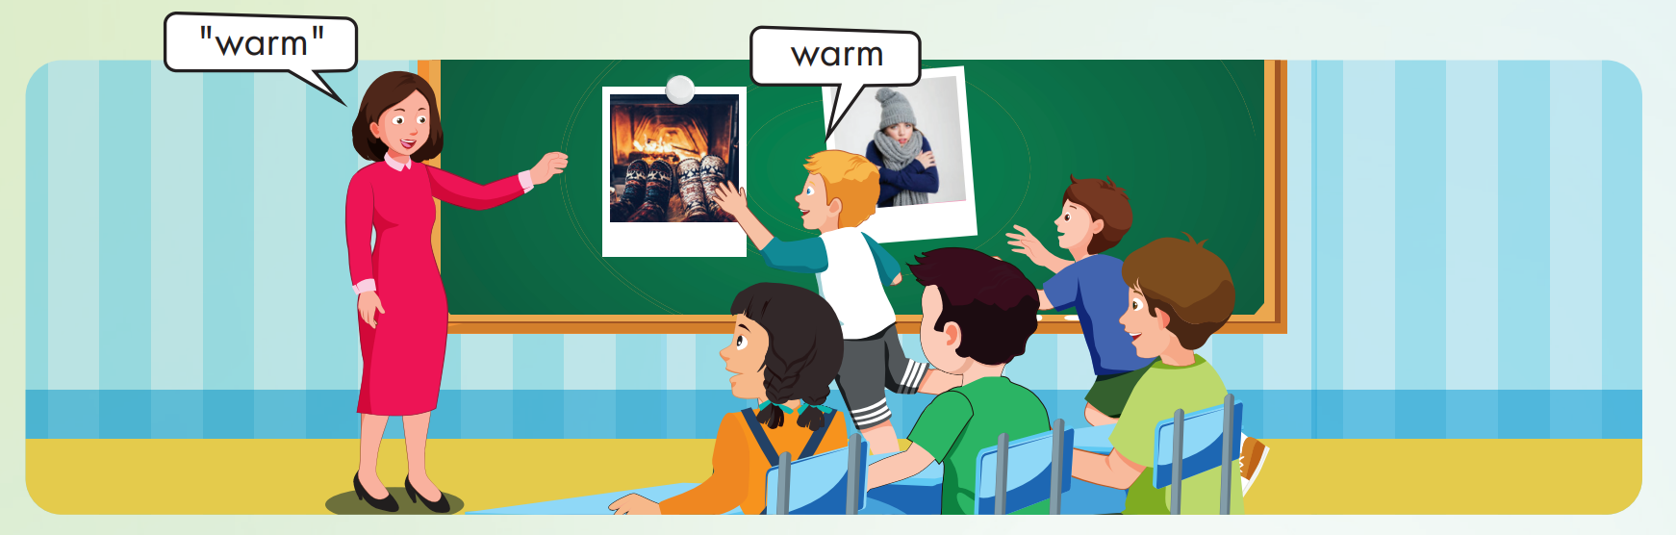

Slide 9
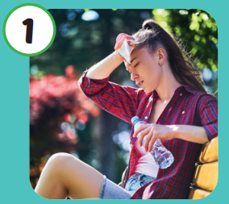

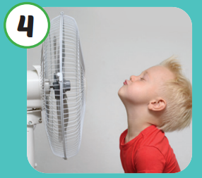
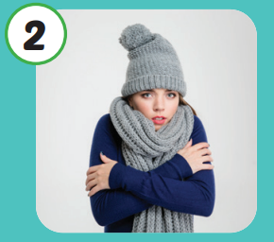
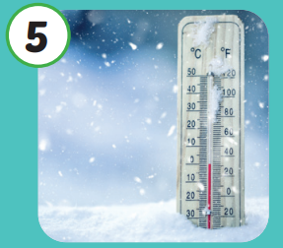
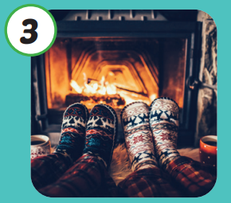
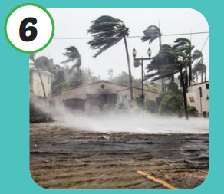
Hot
Cool
Cold
Freezing
Warm
Stormy

Slide 10

Structure

Slide 11

Structures
What do you like
doing when it's hot?
I like swimming.

Slide 12

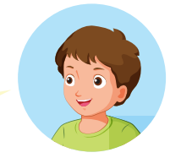

What do you like doing when it's hot?
I like swimming.

Slide 13

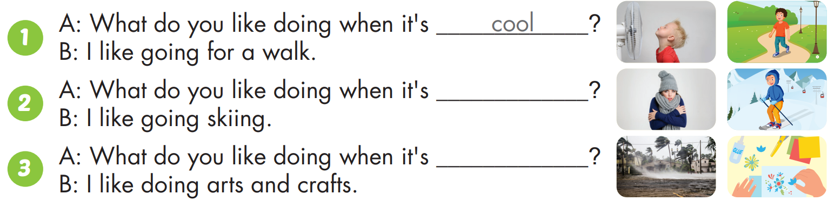
cold
stormy

Slide 14
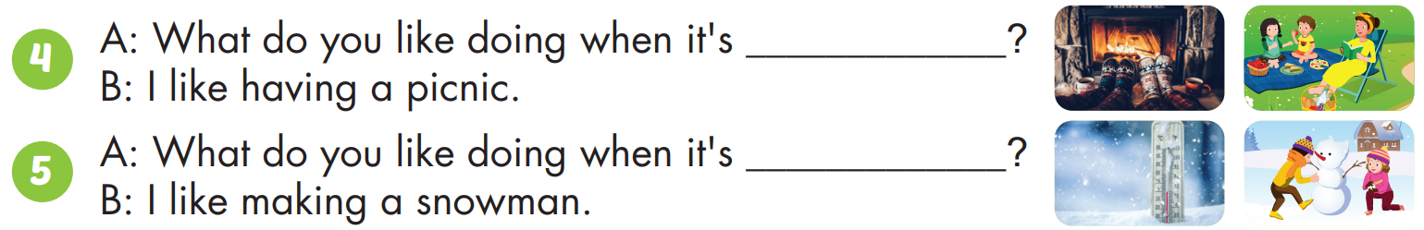
warm
freezing

Slide 15

CONSOLIDATION

Slide 16
Lesson 3
Today’s lesson
Vocabulary
Hot
Cold
Warm
Cool
Freezing
Stormy
Structures/ Sentence patterns
What do you like doing when it's hot?
I like swimming.

Slide 17
Homework
Practice the vocabularies and structure; and make sentences using them.
Prepare the next lesson (page 44 SB).

Slide 18
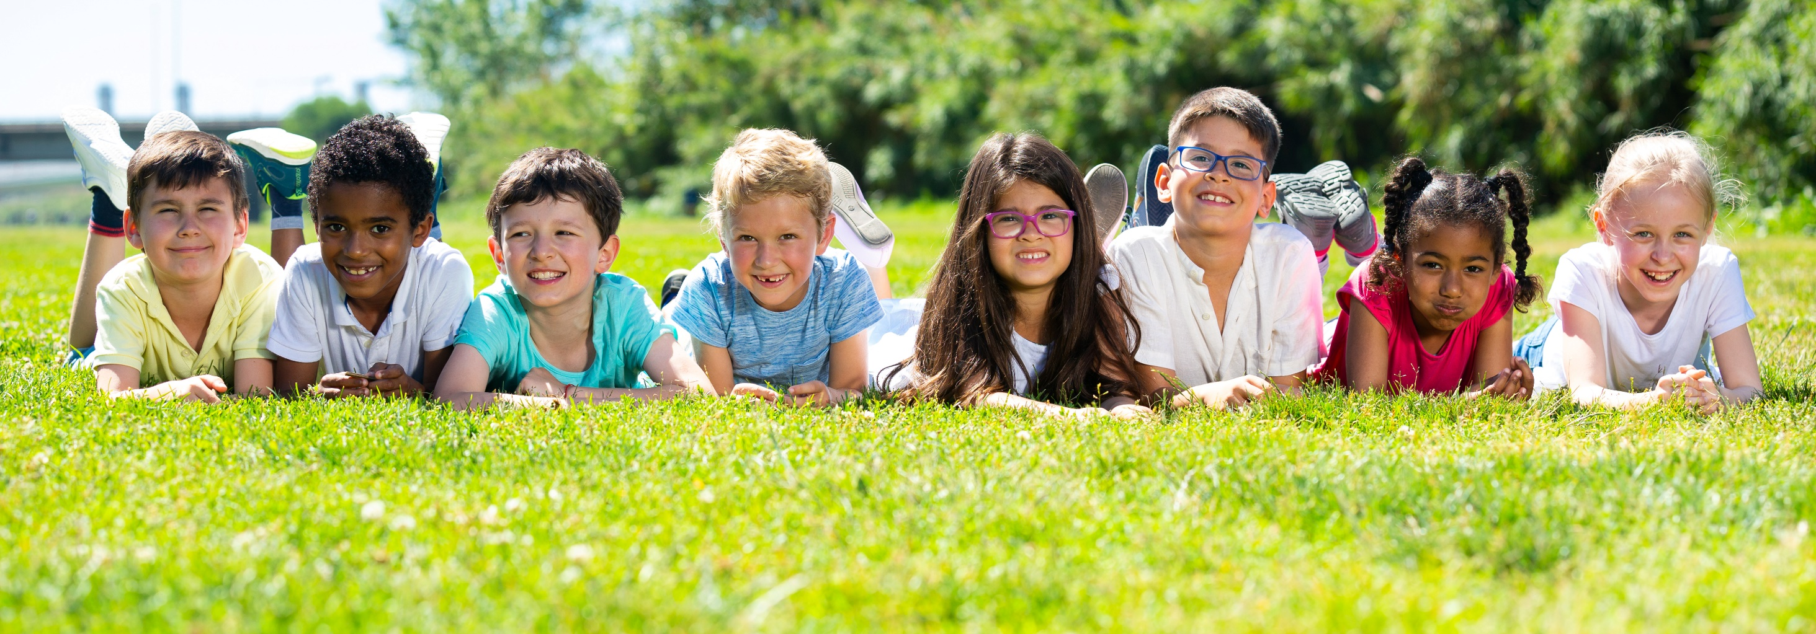
Have a nice day!

