Slide 1

Unit 2
WHAT I CAN DO
LESSON 3.3 - PAGE 28

Slide 2
Objectives
By the end of this lesson, students will be able to ask and answer about what their friends and family can do.
Vocabulary: play the guitar, play the piano, drive a car, ride a bike, do gymnastics, play the drums.
Structure:
What can you do? - I can play the piano.
What can your mom do? - She can drive a car.
What can your friends do? - They can ride bikes

Slide 3

WARM UP

Slide 4



Slide 5

It’s time to learn …

Slide 6

WORD
Click on the right word

Slide 7

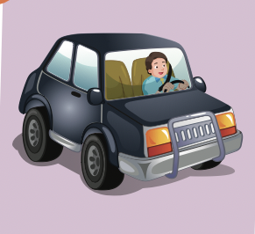


Click on the right word
do gymnastics
drive a car
ride a bike

Slide 8
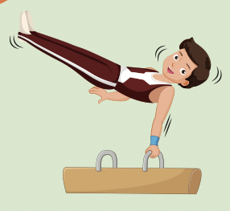
Click on the right word
do gymnastics
play the drums
ride a bike

Slide 9
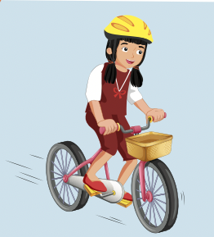
Click on the right word
draw
play the drums
ride a bike

Slide 10

Practice

Slide 11


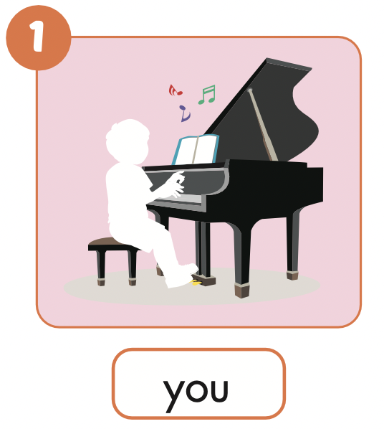

Slide 12
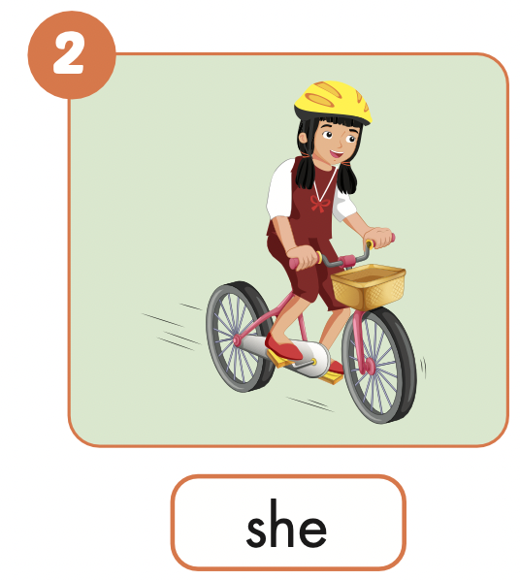
What can she do?
She can ride a bike.

Slide 13
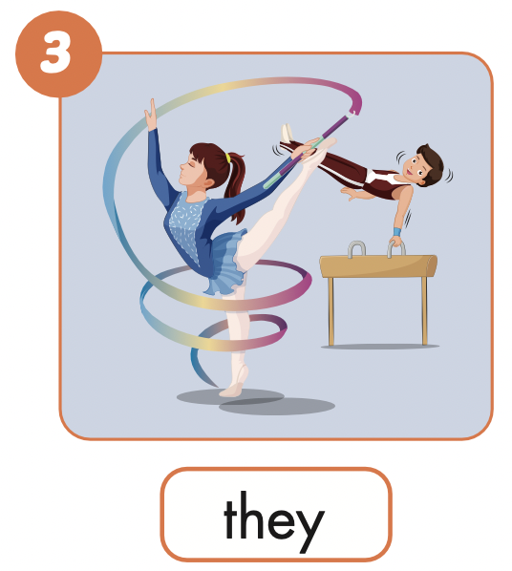
What can they do?
They can do gymnastics.

Slide 14
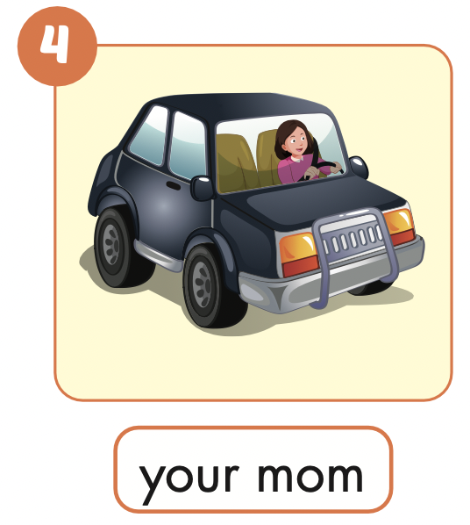
What can your mom do?
She can drive a car.

Slide 15
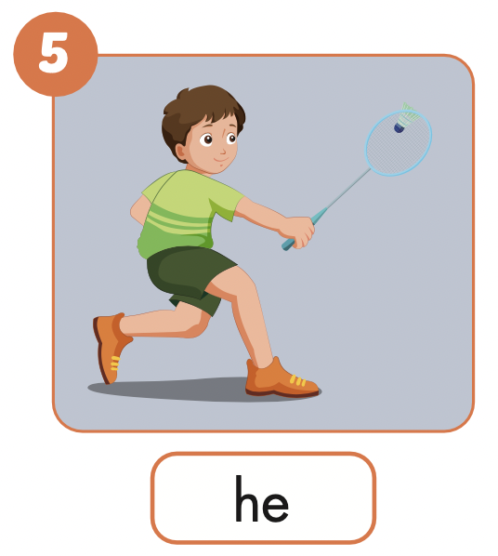
What can he do?
He can play badminton.

Slide 16
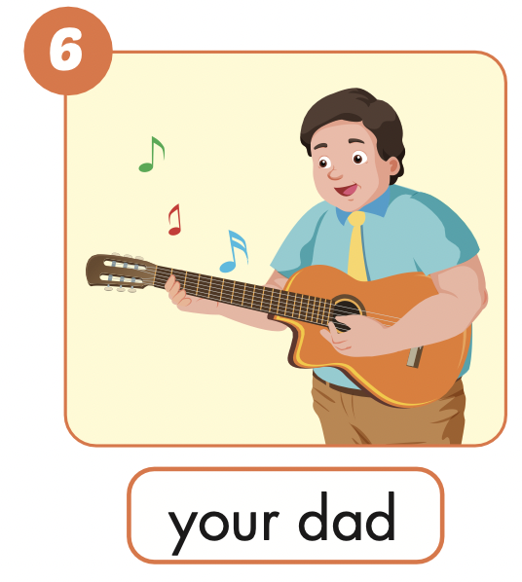
What can your dad do?
He can play the guitar.

Slide 17
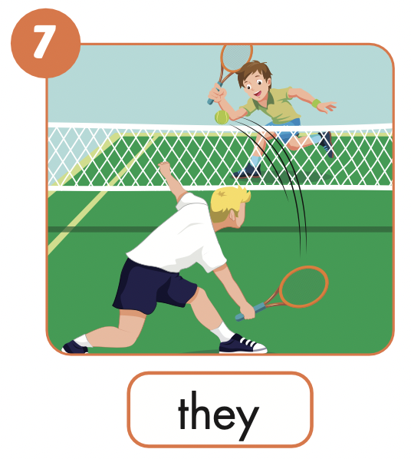
What can they do?
They can play tennis.

Slide 18
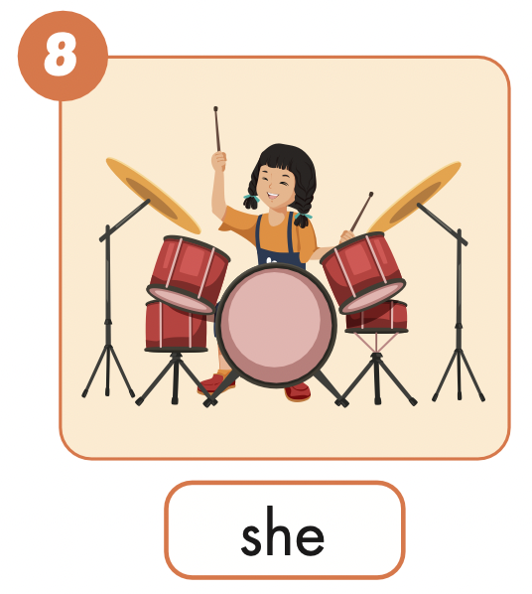
What can she do?
She can play the drums.

Slide 19

Production

Slide 20
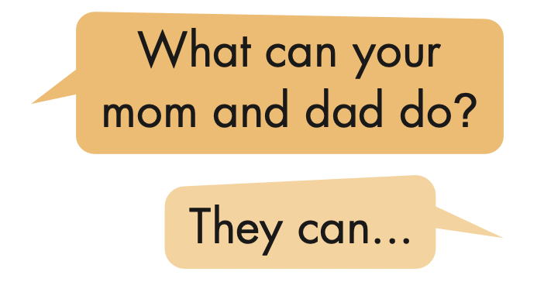
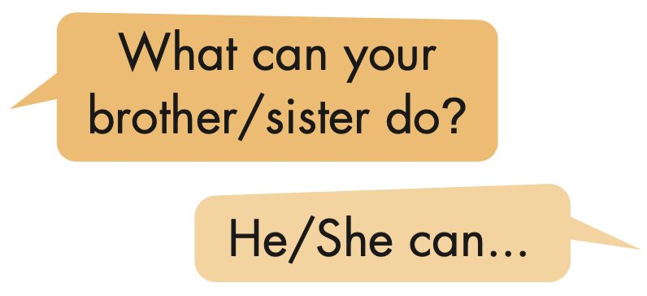

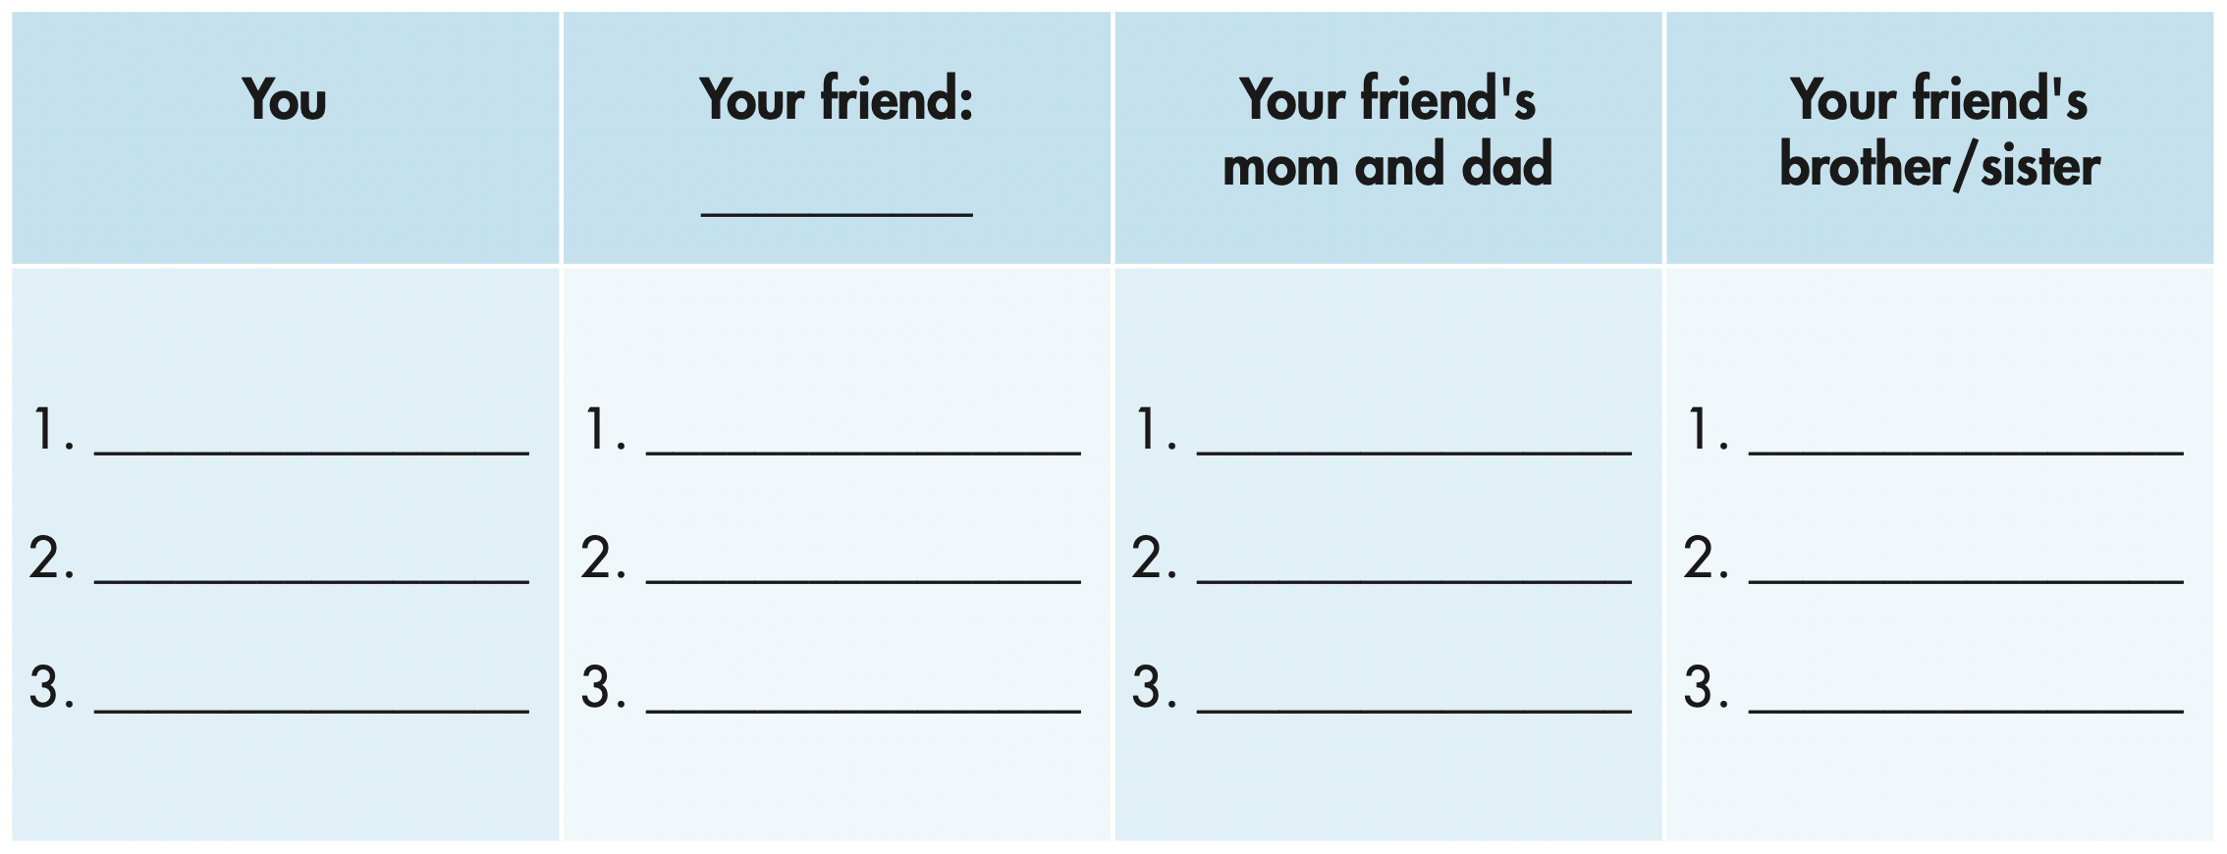

Slide 21
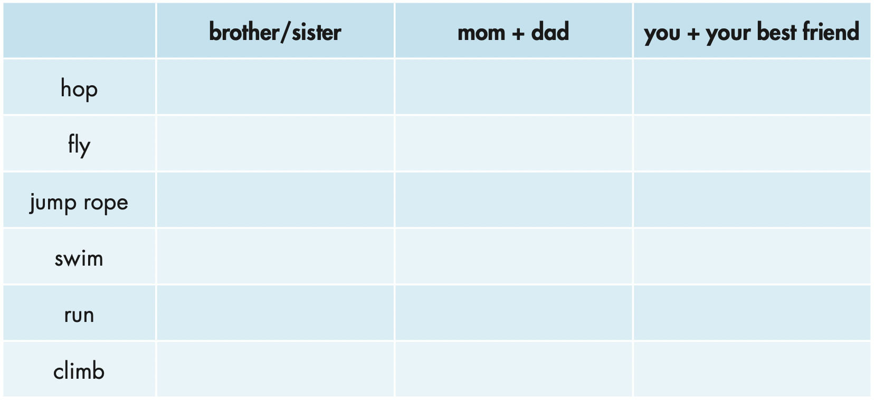


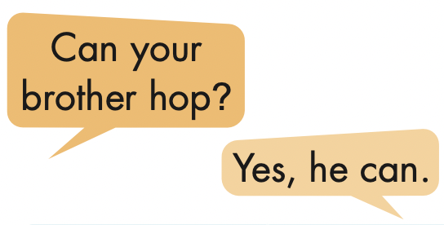
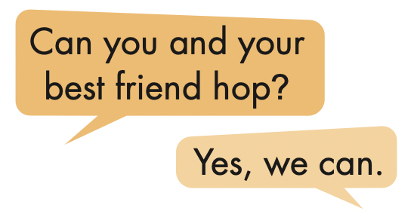
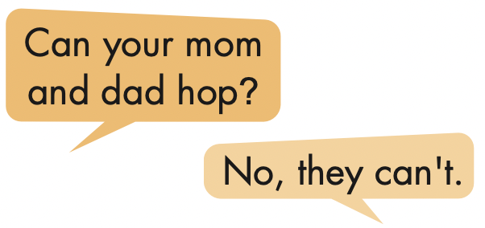

Slide 22

CONSOLIDATION

Slide 23

WRAP-UP

Slide 24
Today’s lesson
Structures/ Sentence patterns
What can you do?
I can play the piano.
What can your mom do?
She can drive a car.
What can your friends do? They can ride bikes.
Vocabulary
play the guitar,
play the piano,
drive a car,
ride a bike,
do gymnastics,
play the drums.

Slide 25
Homework
Practice the vocabularies and structure; and make sentences using them.
Do the exercises in Tiếng Anh 4 i-Learn Smart Start WB (page 17)
Do the exercises in Tiếng Anh 4 i-Learn Smart Start Notebook (page 12)

Slide 26

Enjoy your day!

