Slide 1
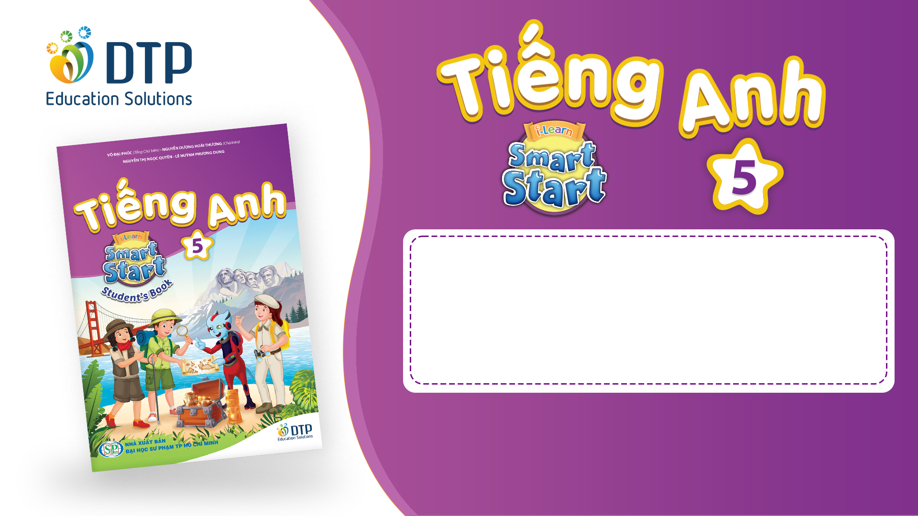
Unit 2: Holidays
Lesson 3.1
Page 26

Slide 2
Objectives
By the end of this lesson, students will be able to…
Vocabulary: Pronounce and use the words related to the topic properly: put up colored paper, buy candy, invite friends, blow up the balloons, make a cake, wrap the presents.
Structure: Could you blow up the balloons? - Yes, sure.

Slide 3

WARM-UP

Slide 4

It’s time to learn …

Slide 5

New words
put up colored paper,
buy candy, invite friends,
blow up the balloons,
make a cake,
wrap the presents.

Slide 6

Presentation

Slide 7
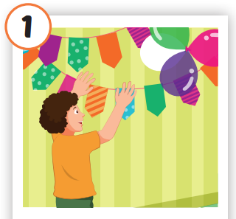
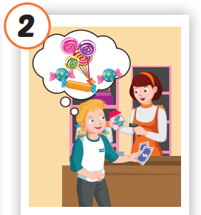
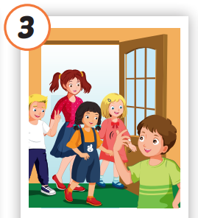
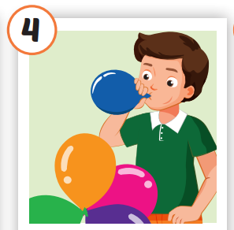
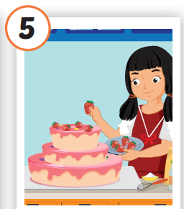
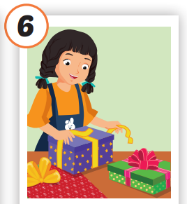






/pʊt ʌp
ˈkʌlərd ˈpeɪpər/
treo giấy màu
/baɪ ˈkændi/
mua kẹo
/ɪnˈvaɪt
frendz/
mời bạn bè
/bloʊ ʌp ðə bəˈluːnz/
thổi bóng bay
/meɪk ə keɪk/
làm bánh
/ræp ðə ˈprezənts/
gói quà
Notes:
Click vào hình A. 1. Listen and point. Repeat để cho cả audio full chạy

Slide 8
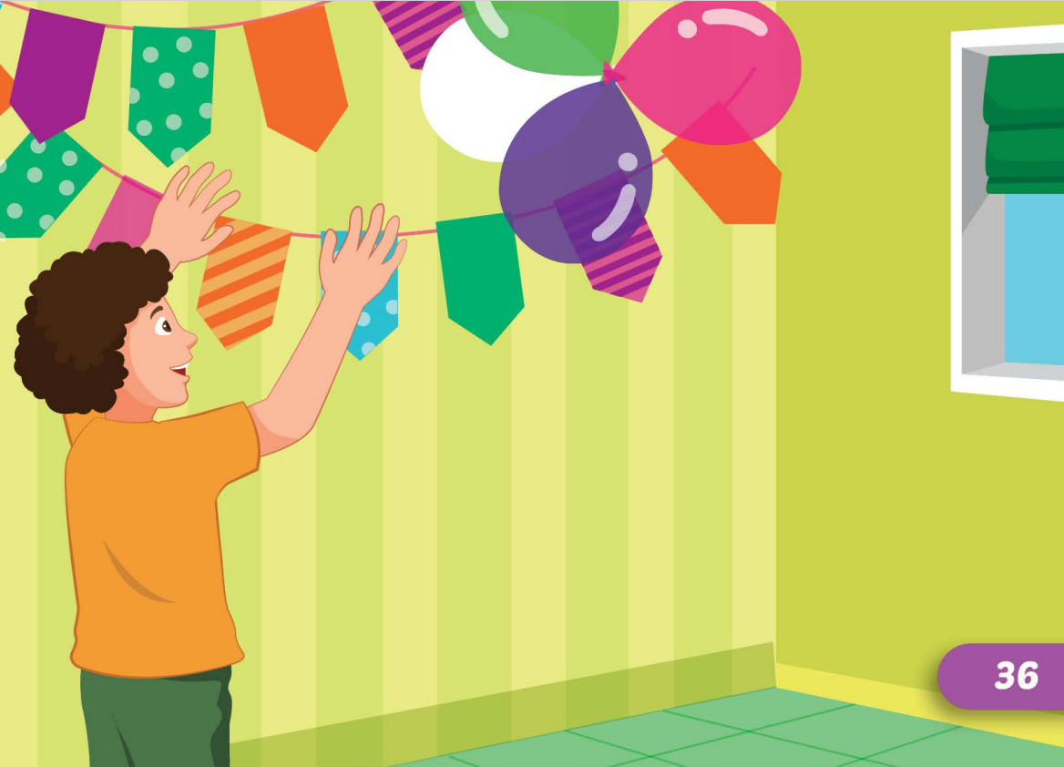
/pʊt ʌp
ˈkʌlərd ˈpeɪpər/
treo giấy màu

Slide 9
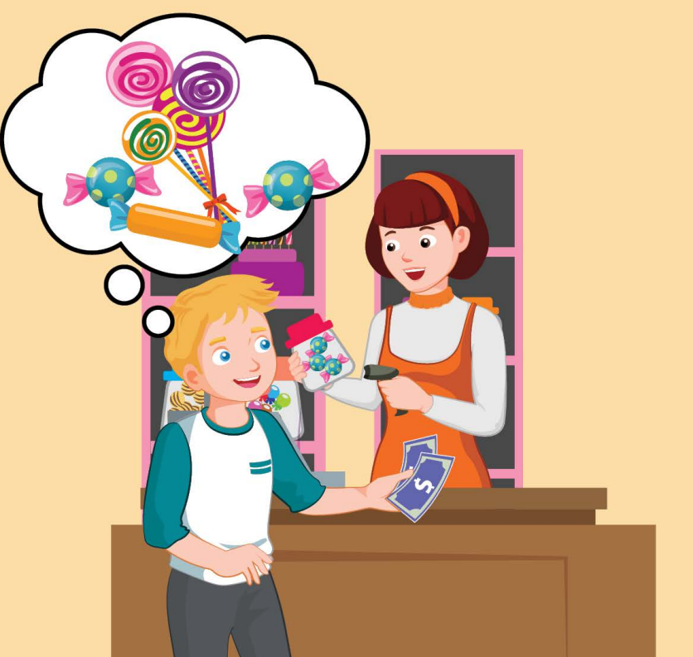

/baɪ ˈkændi/
mua kẹo

Slide 10
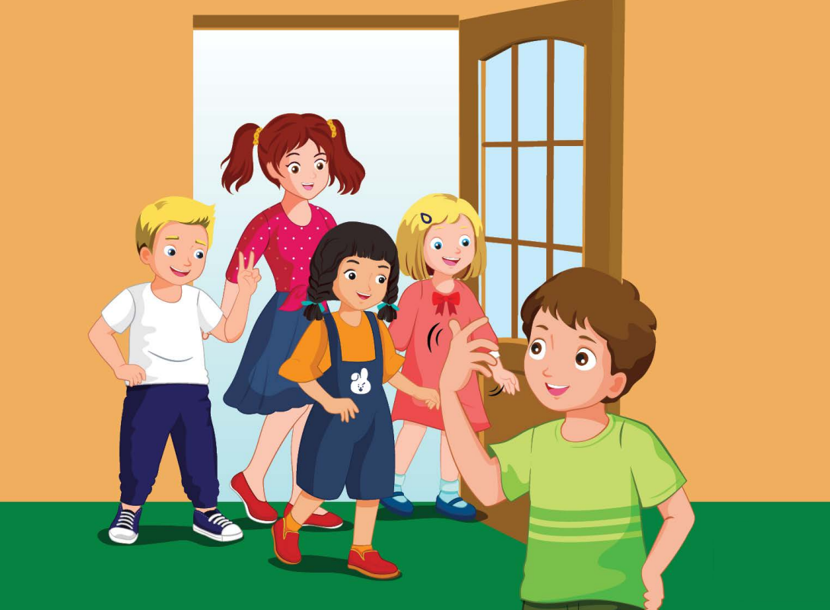
/ɪnˈvaɪt
frendz/
mời bạn bè

Slide 11
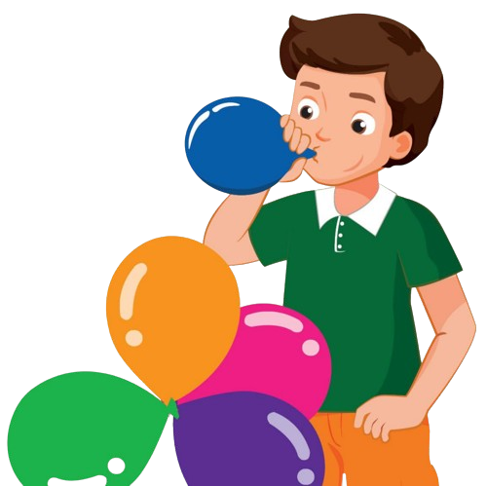
/bloʊ ʌp ðə bəˈluːnz/
thổi bóng bay

Slide 12
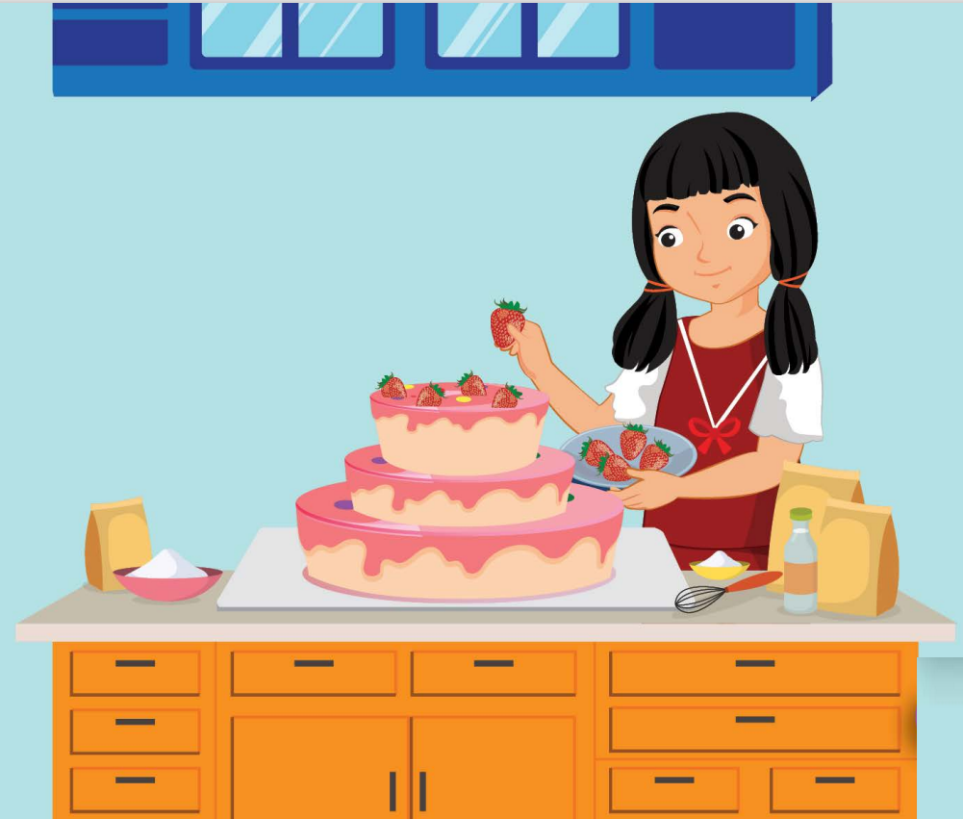

/meɪk ə keɪk/
làm bánh

Slide 13
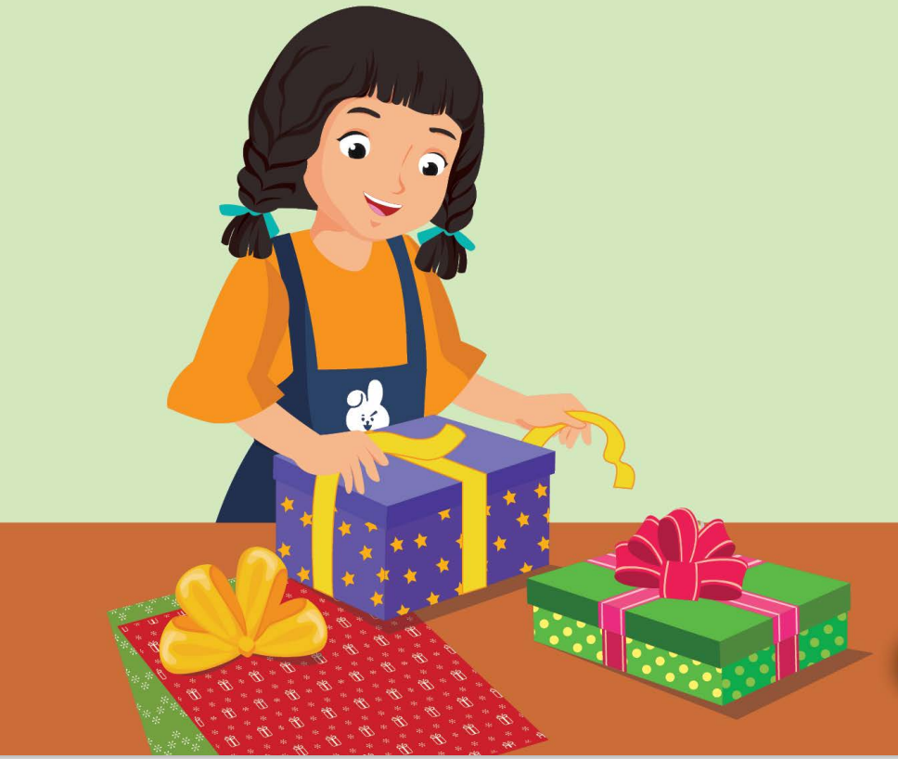
/ræp ðə ˈprezənts/
gói quà

Slide 14
Practice

Slide 15
CHECK YOUR MEMORY

Slide 16
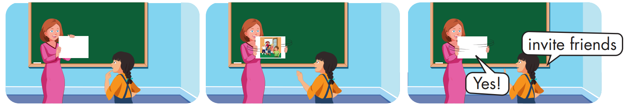

Slide 17
Structure
Could you blow up the balloons?
- Yes, sure.

Slide 18
Presentation

Slide 19
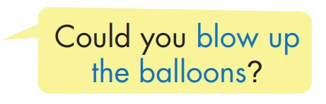


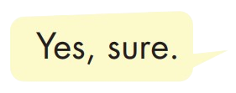
Structure

Slide 20

Practice

Slide 21
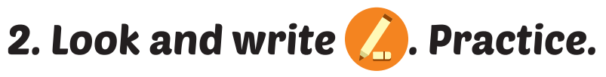
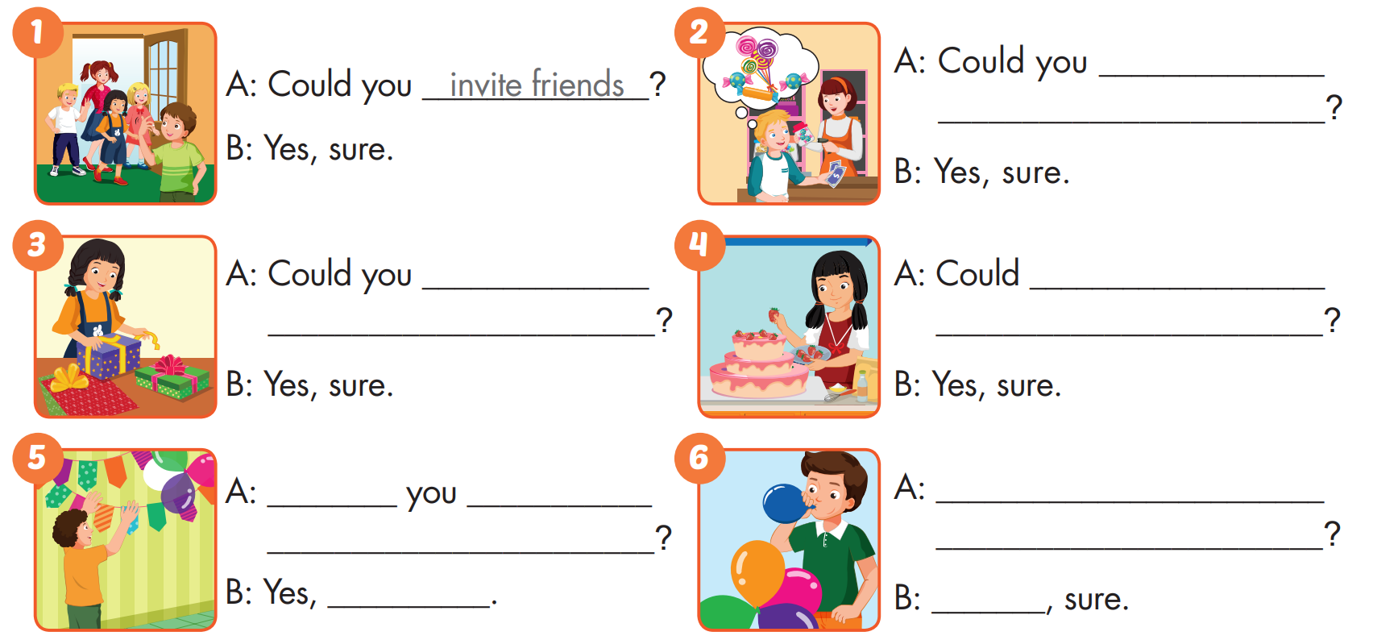
buy
candy
wrap
the presents
you make
a cake
Could
put up
Could you blow up
colored paper
the balloons
sure
Yes

Slide 22

CONSOLIDATION

Slide 23
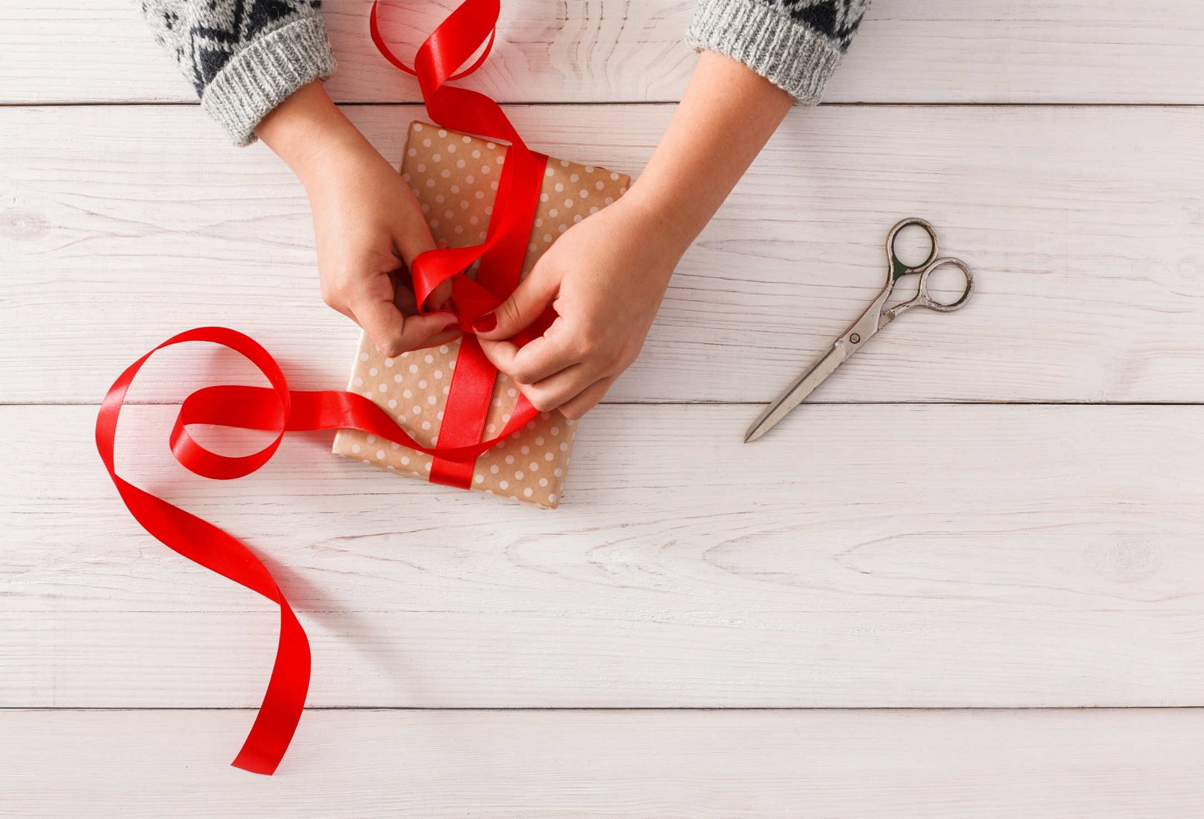
WRAP-UP

Slide 24
Today’s lesson
Vocabulary
put up colored paper, buy candy, invite friends, blow up the balloons, make a cake, wrap the presents.
Structures/ Sentence patterns
Could you blow up the balloons? - Yes, sure.

Slide 25
Homework
Practice the vocabularies and structure, and make sentences using them.
Do the exercises in Tiếng Anh 5 i-Learn Smart Start WB (page 16)
Do the exercises in Tiếng Anh 5 i-Learn Smart Start Notebook (page12)

Slide 26

Enjoy your day!

Slide 27
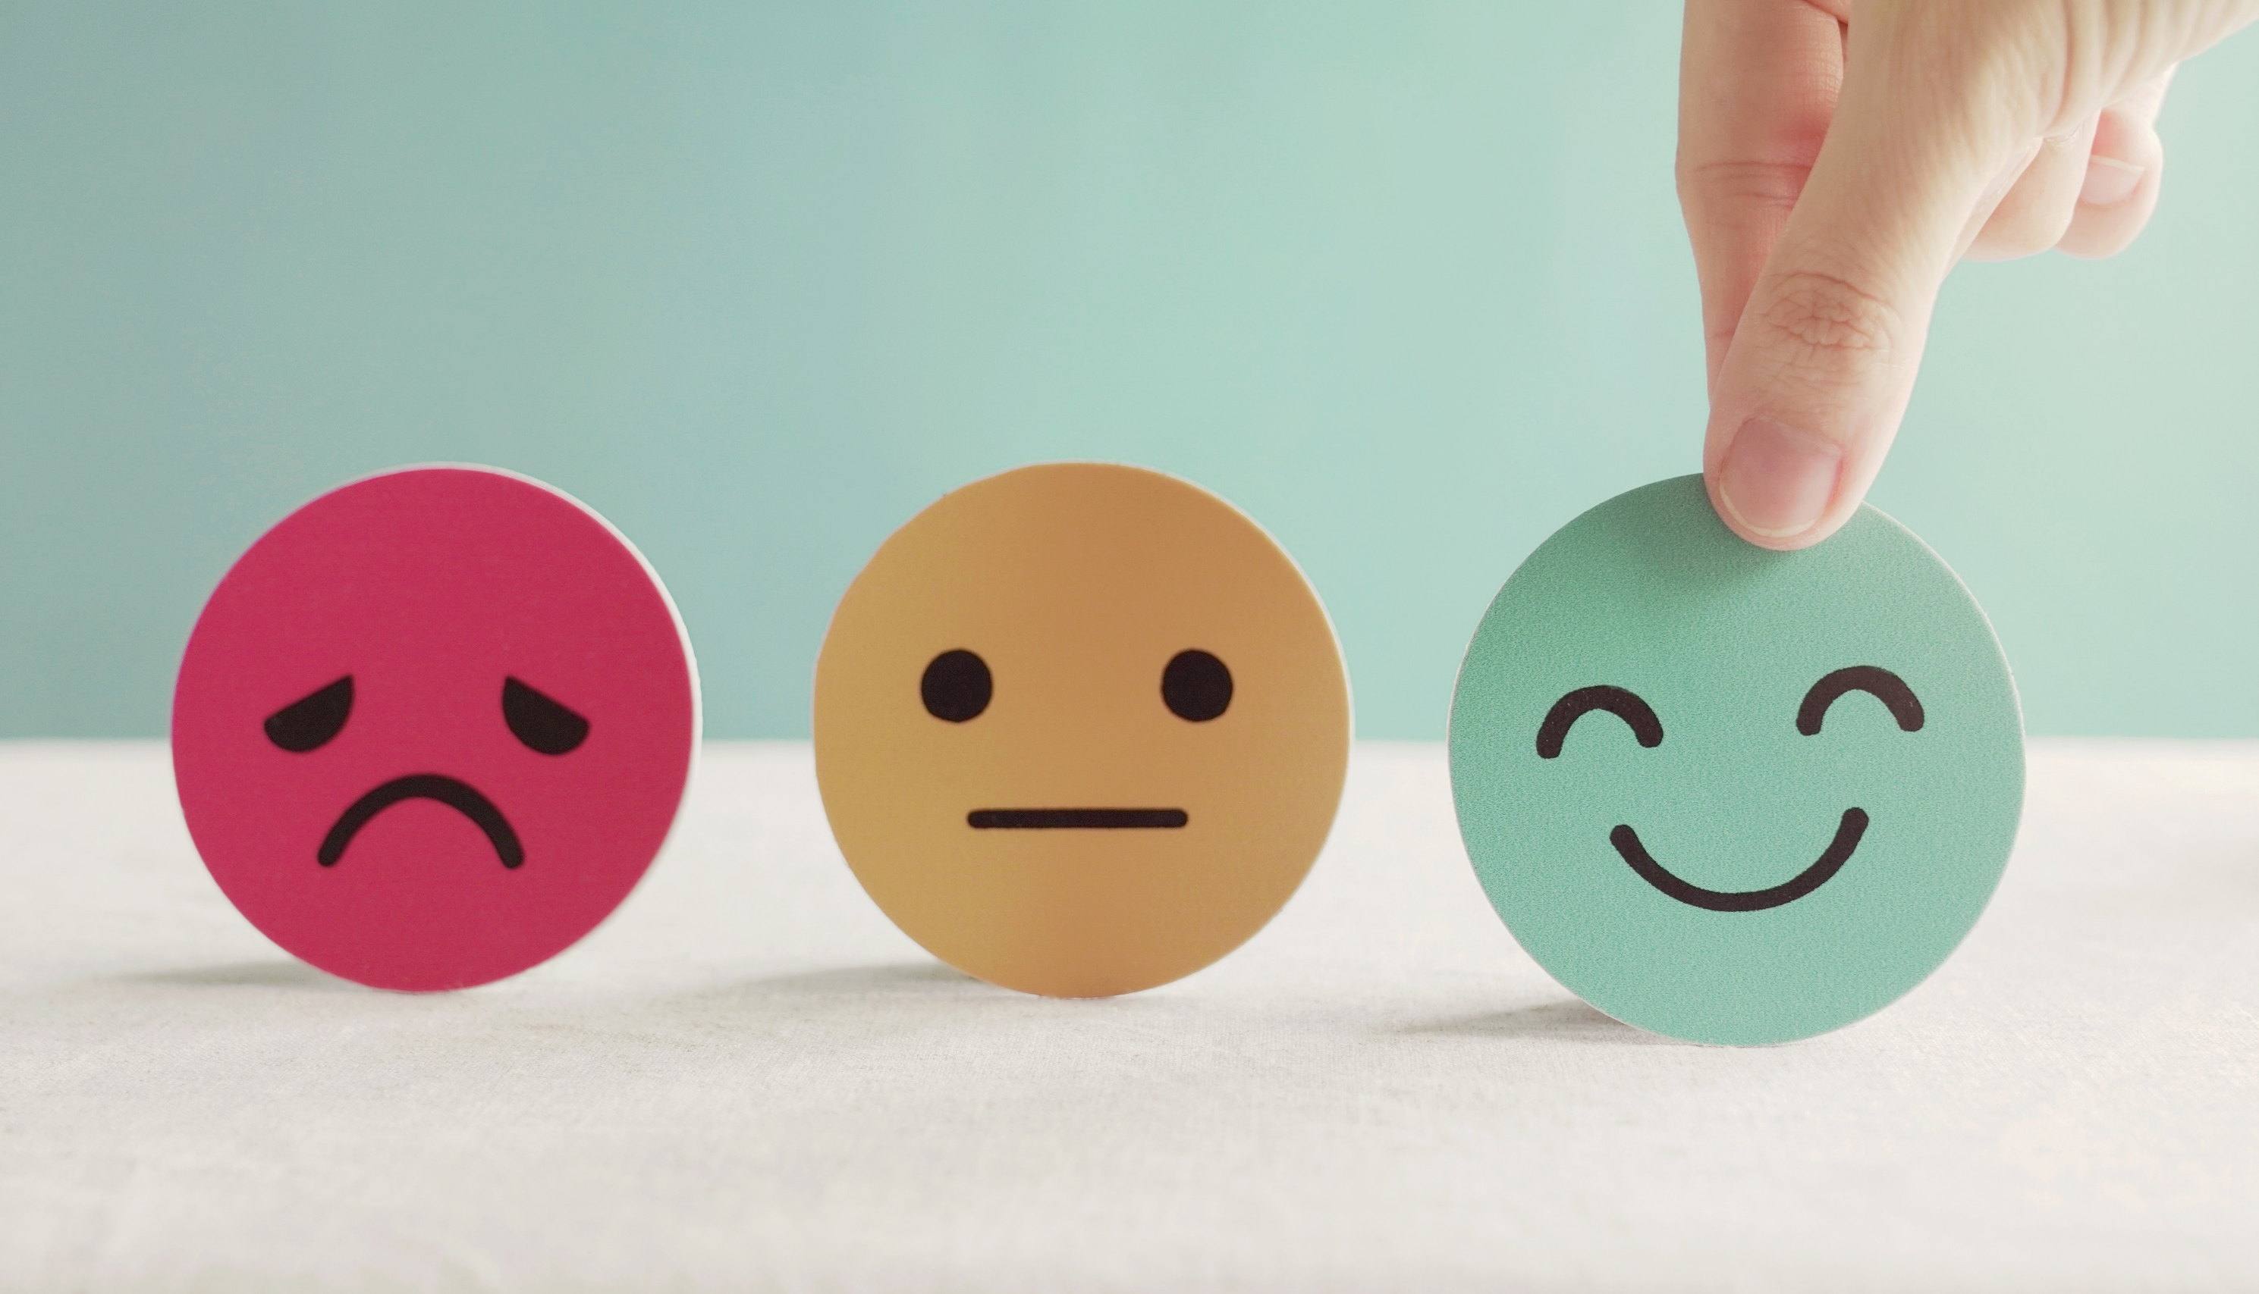
Lesson 3
Stay positive and have a nice day!

