Slide 1
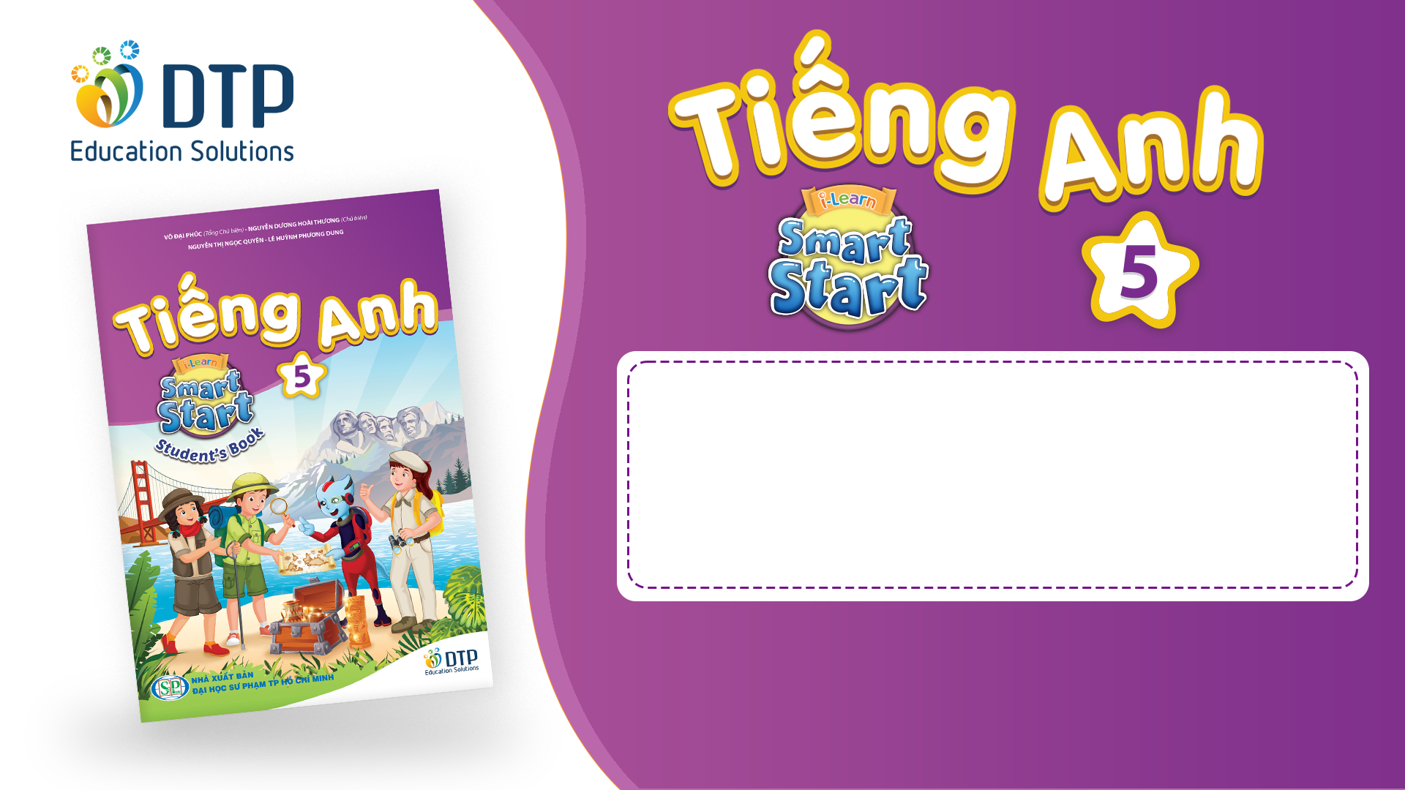
Unit 2: Holidays
Lesson 2.2
Page 24

Slide 2
Objectives
By the end of this lesson, students will be able to…
Word stress: Practice word stress - 'twenty-fifth, 'thirty-first
Structure: Practice asking and answering about dates
When's Christmas Day?
- It's on December twenty-fifth.

Slide 3

WARM-UP

Slide 4
CHECK-UP

Slide 5

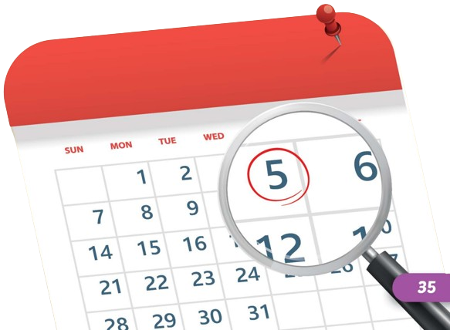


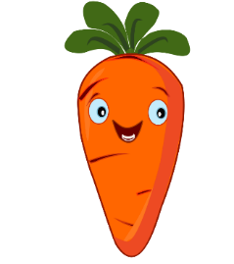


Listen and choose
B
A

Slide 6

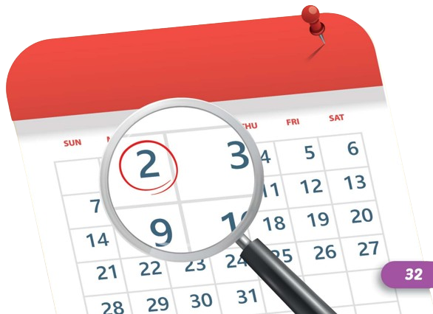
Listen and choose
A
B

Slide 7

It’s time to learn …

Slide 8

Stress
'twenty-fifth, 'thirty-first

Slide 9

Listening

Slide 10
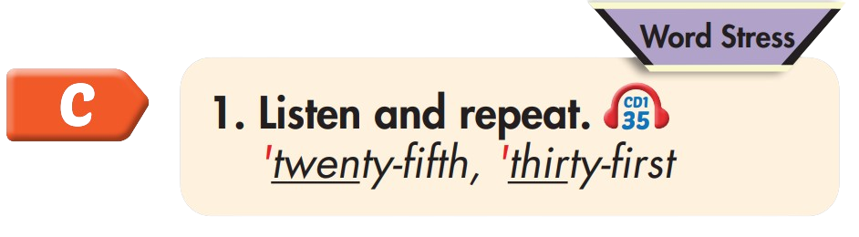
'twenty-fifth
'thirty-first

Slide 11
Practice

Slide 12

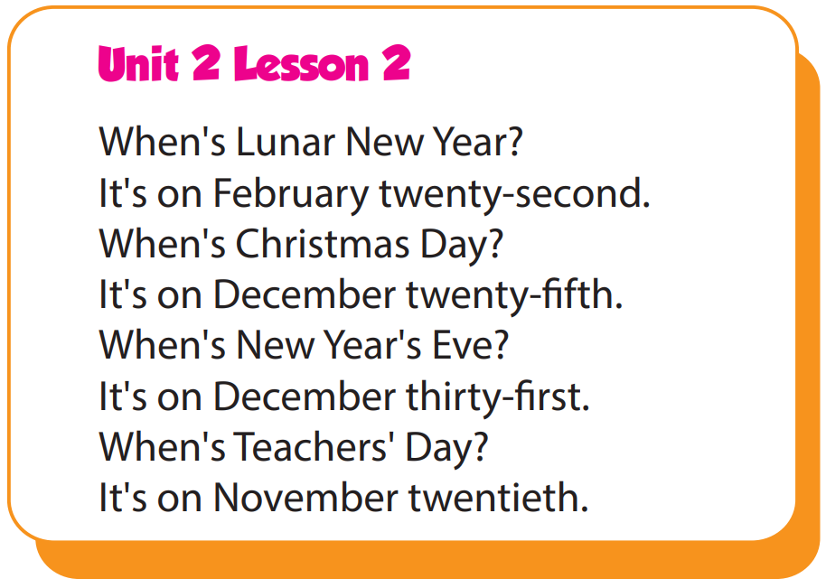

Slide 13
Structure
When's Christmas Day?
- It's on December twenty-fifth.

Slide 14

Speaking

Slide 15
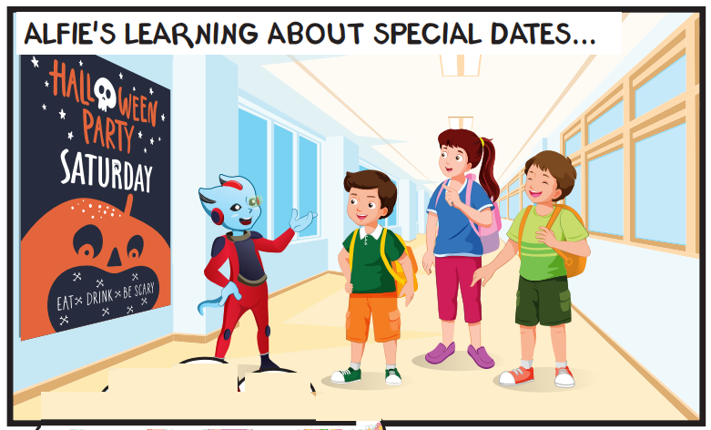
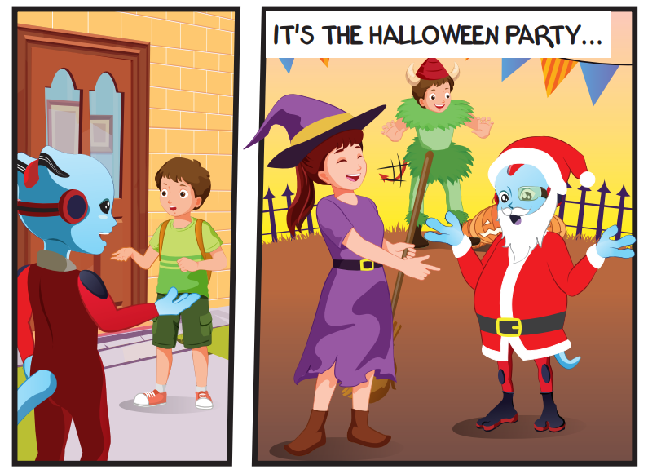
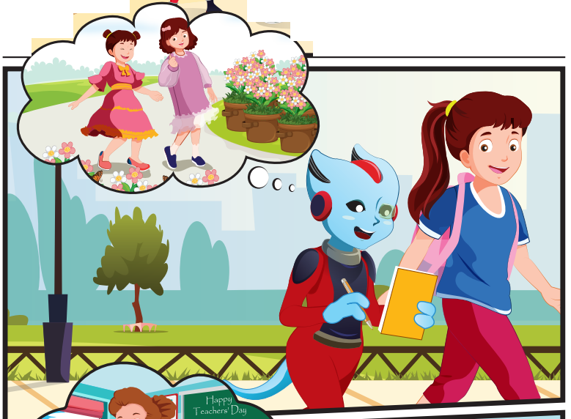
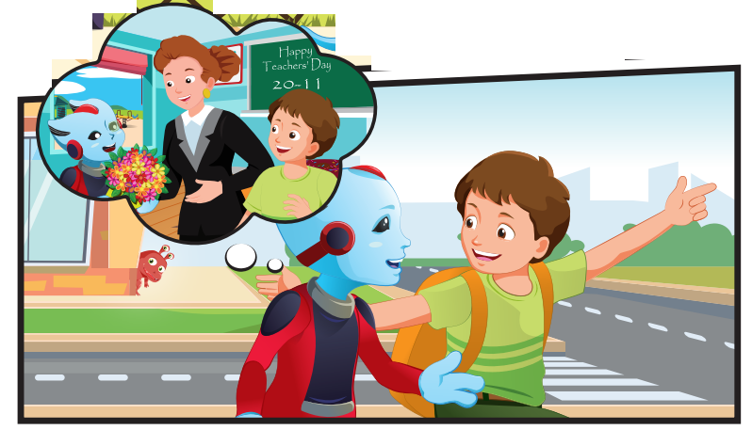
Who can you see?
Alfie, Tom, Lucy, Ben

Slide 16
Where are they?
They're outside.

Slide 17
What are they talking about?
They're talking about holidays.

Slide 18

Listening

Slide 19


Slide 20

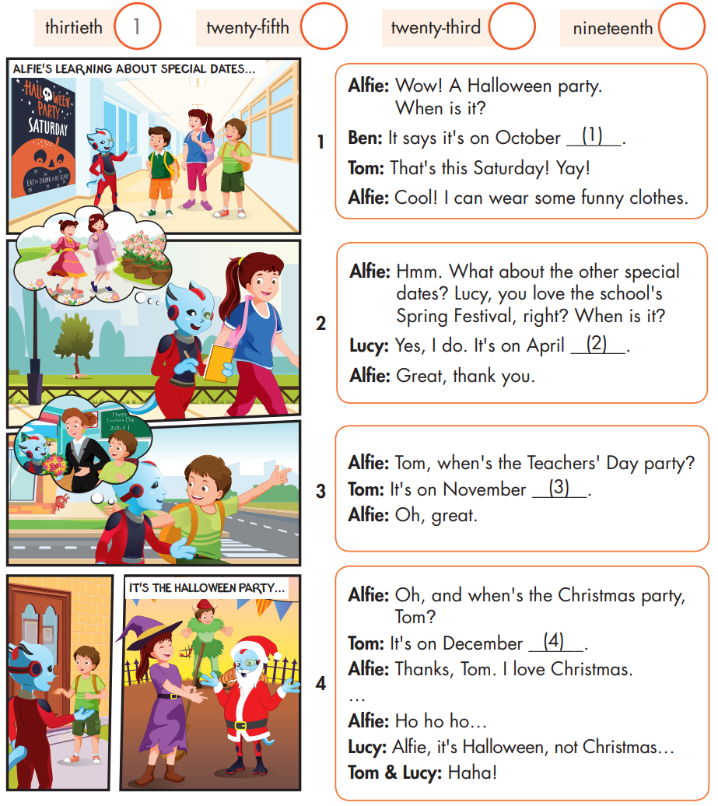

Slide 21
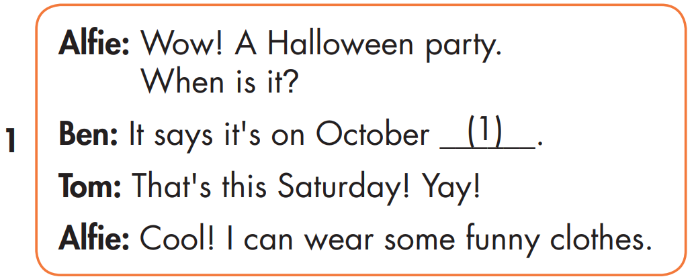

Slide 22
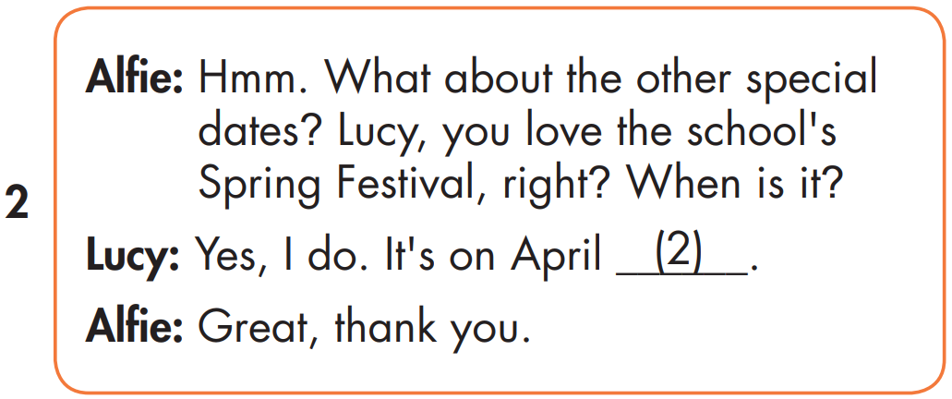
2
twenty-fifth

Slide 23
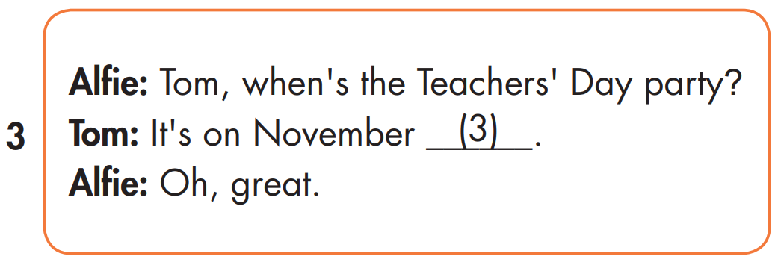
2
3
nineteenth

Slide 24
2
4
3
twenty-third

Slide 25

Speaking

Slide 26
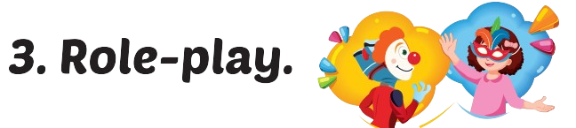
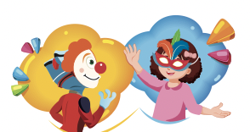

Slide 27

Writing

Slide 28
MAKE YOUR OWN STORY
twenty-fifth
nineteenth
twenty-third

Slide 29

Production

Slide 30

CONSOLIDATION

Slide 31

WRAP-UP

Slide 32
Today’s lesson
Stress
Word stress: 'twenty-fifth, 'thirty-first
Structures/ Sentence patterns
When's Christmas Day?
- It's on December twenty-fifth.

Slide 33
Homework
Practice the vocabularies and structure, and make sentences using them.
Do the exercises in Tiếng Anh 5 i-Learn Smart Start WB (page 15)
Do the exercises in Tiếng Anh 5 i-Learn Smart Start Notebook (page 11)

Slide 34

Enjoy your day!

Slide 35

Lesson 3
Stay positive and have a nice day!

