Slide 1

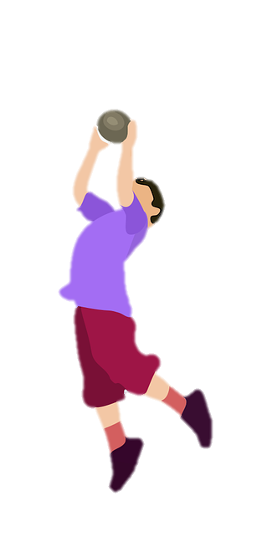
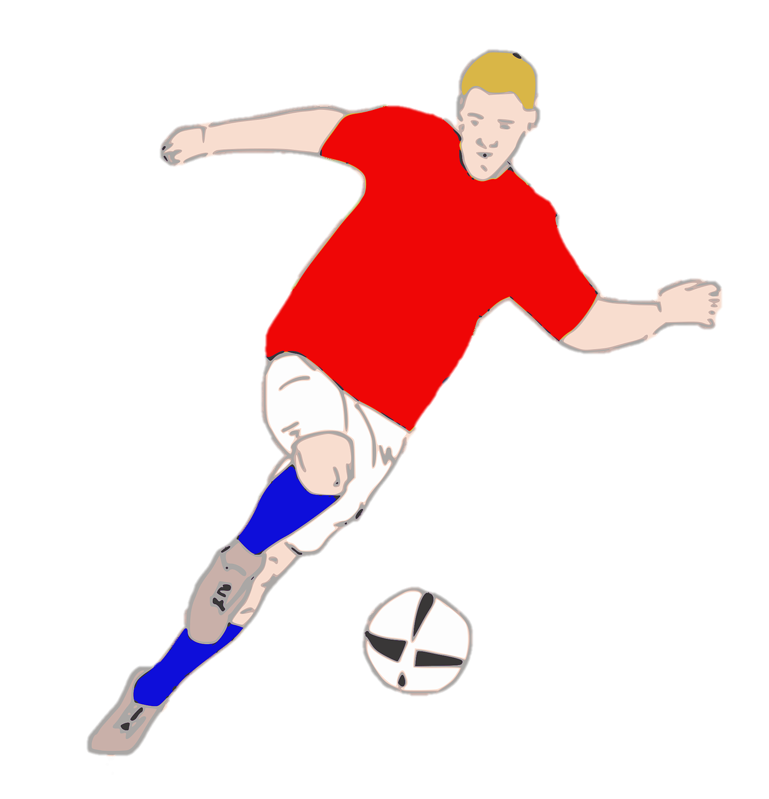
Unit 7:
SPORTS
Lesson 1 – Part 4, 5, 6

Slide 2

1 Warm-up
Reorder the letters to make meaningful words.

Slide 3
2
Presentation

Slide 4

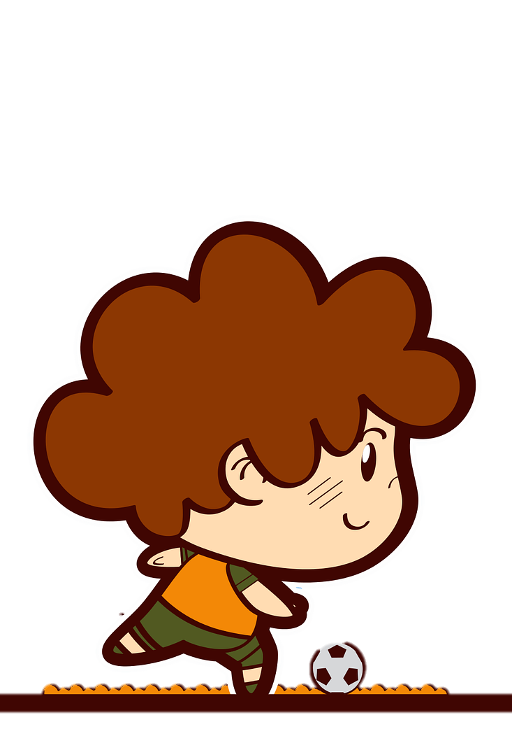

Present continuous
What is he doing now?
- He is playing football.
Describe things happen now, at present
or at the moment, etc.

Slide 5


Present continuous
What + to be + S + V-ing?
am
I
What
You
We
They
+ are
+
+ V-ing ?
He
She
It
is

Slide 6

Present continuous
S + to be + V-ing.
I
+ am
You
We
They
+ are
+ V-ing
He
She
It
+ is
S + to be + not + V-ing.

Slide 7

Spelling rules
She is ______ now (write) .
write
+
=
ing
writing
writing

Slide 8
Spelling rules
have
+
=
ing
having
ride
+
=
ing
riding
prepare
+
=
ing
preparing

Slide 9

Spelling rules
I am ________ at the moment. (swim)
m
ing
swimming
swim
+
+
=
swimming

Slide 10
Spelling rules
run
n
ing
running
+
+
=
jog
g
ing
jogging
+
+
=
cut
t
ing
=
cutting
+
+

Slide 11
3
Practice

Slide 12


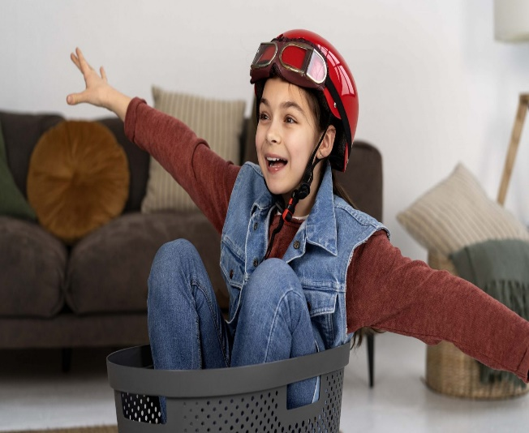
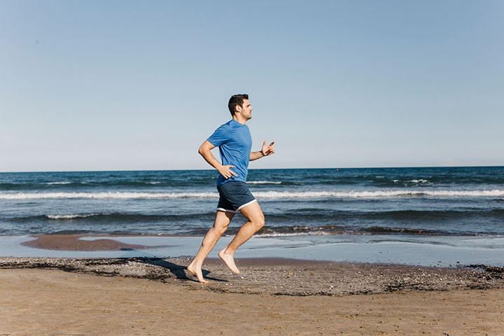
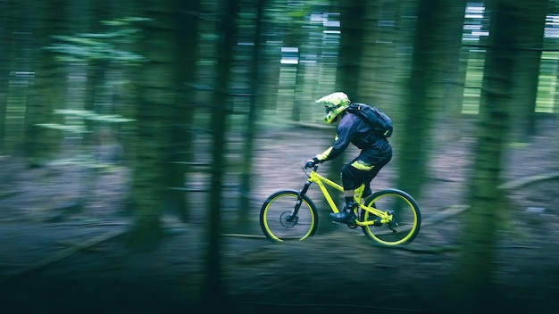
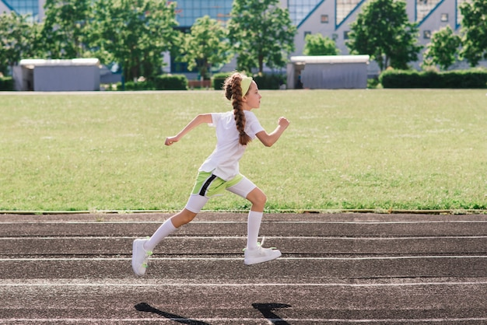
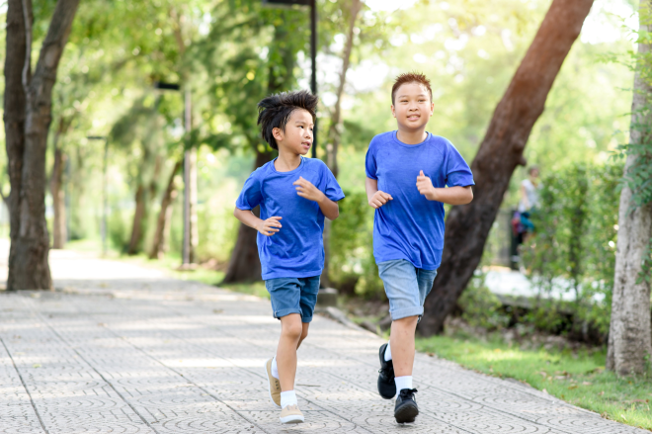
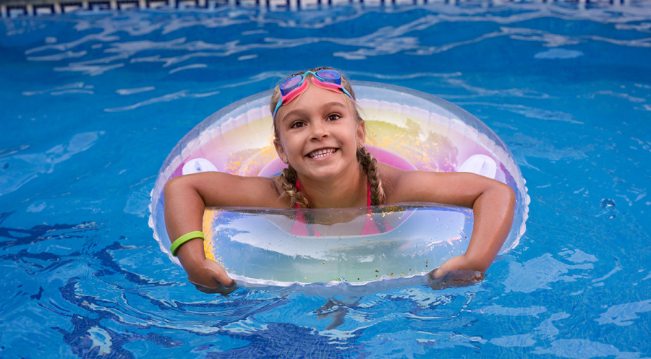
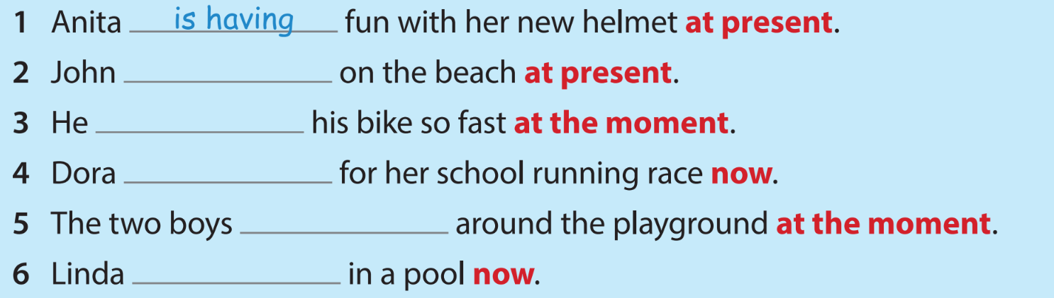
4 Listen and write.
1
2
3
4
5
6
is running
is riding
is preparing
are jogging
is swimming

Slide 13
4
Production

Slide 14
5
Wrap-up & Assessment

