Slide 1







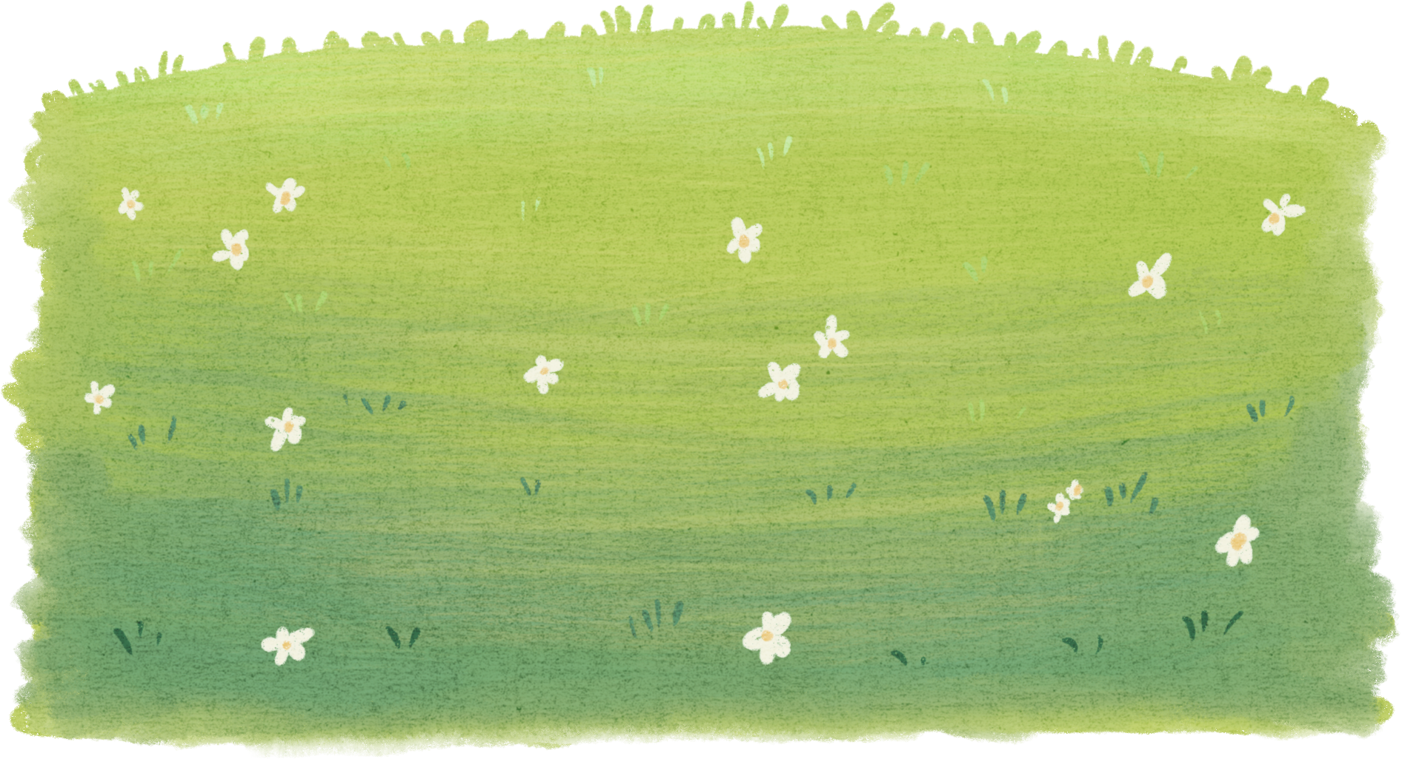
REVIEW 5: PART 2

Slide 2



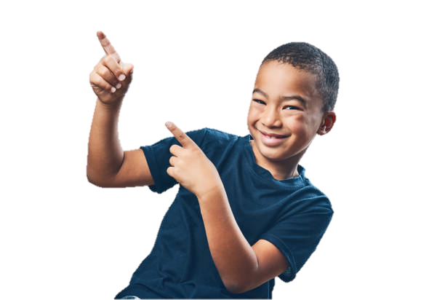

HELLO EVERYONE!
LET'S PLAY
A GAME
Put a finger down

Slide 3




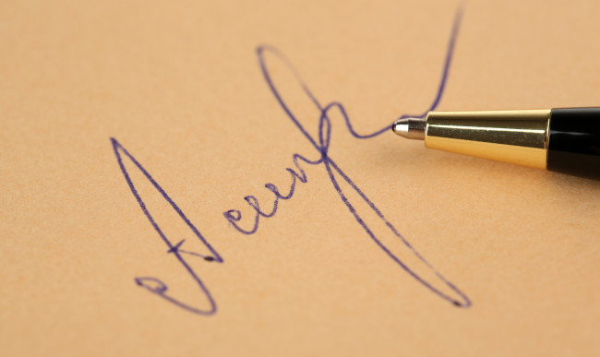
advert
autograph

Slide 4
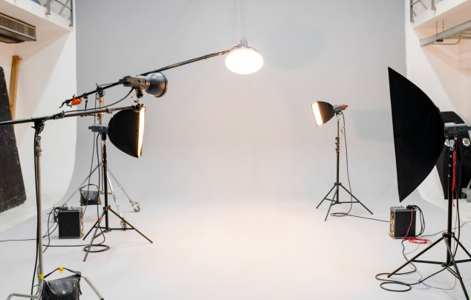
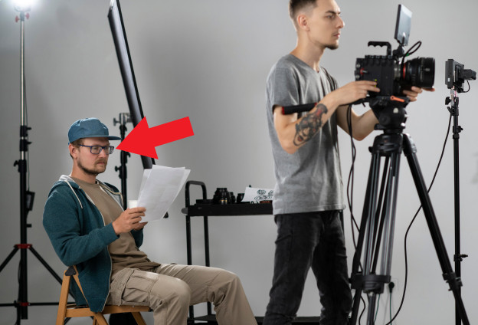
film studio
director

Slide 5
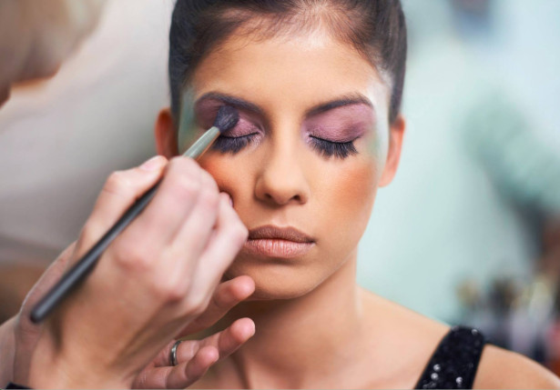
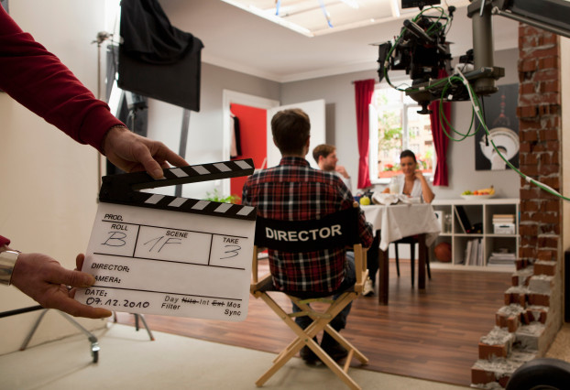
make-up
set

Slide 6
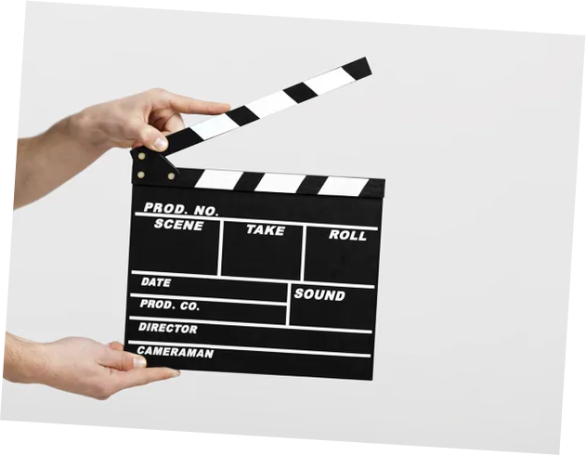
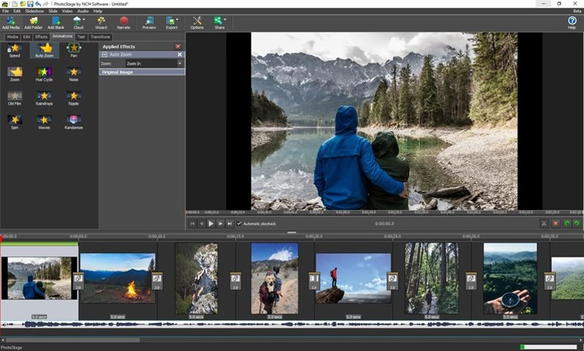
action
animated

Slide 7
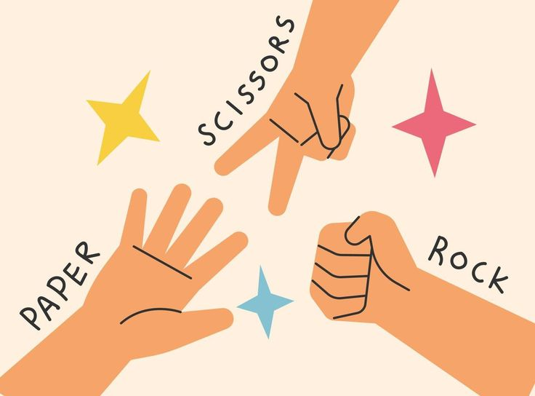
3. Let’s play.
What did you do last weekend?
go play see visit watch
ride meet help stay
I went to Hanoi last weekend.
last weekend
last year
last month
How was your trip?
three days ago
one week ago
two years ago
It was fun!
yesterday
in 2020
yesterday morning

