Slide 1







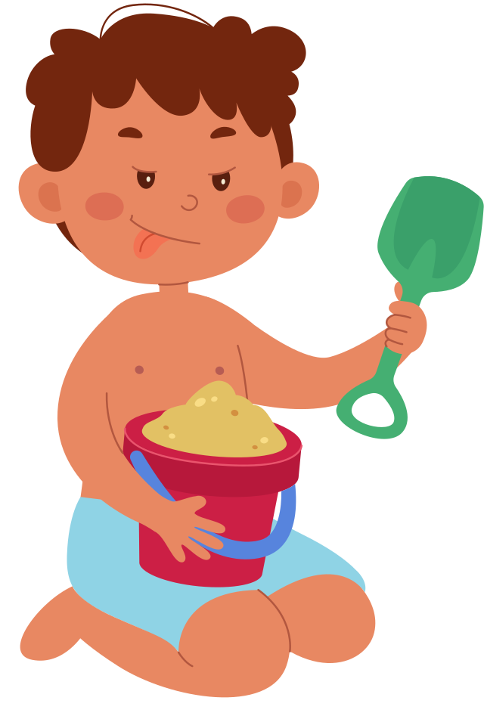




REVIEW 5: PART 1

Slide 2

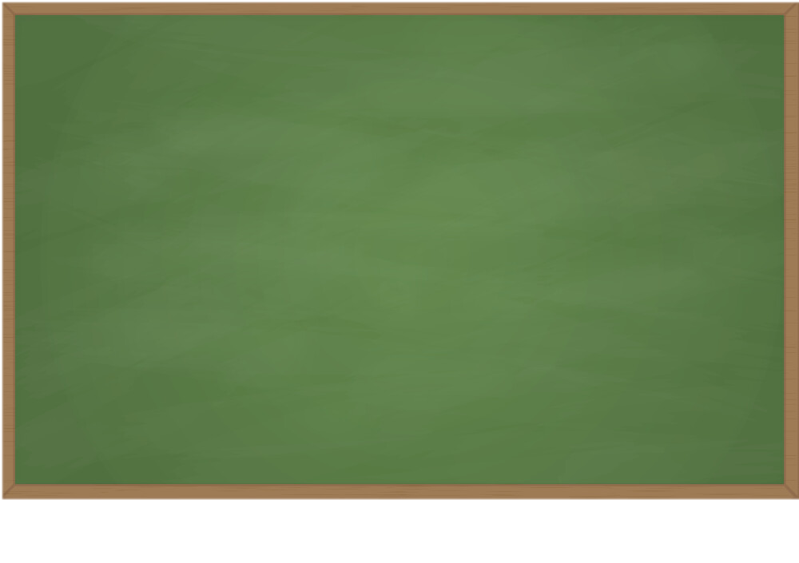


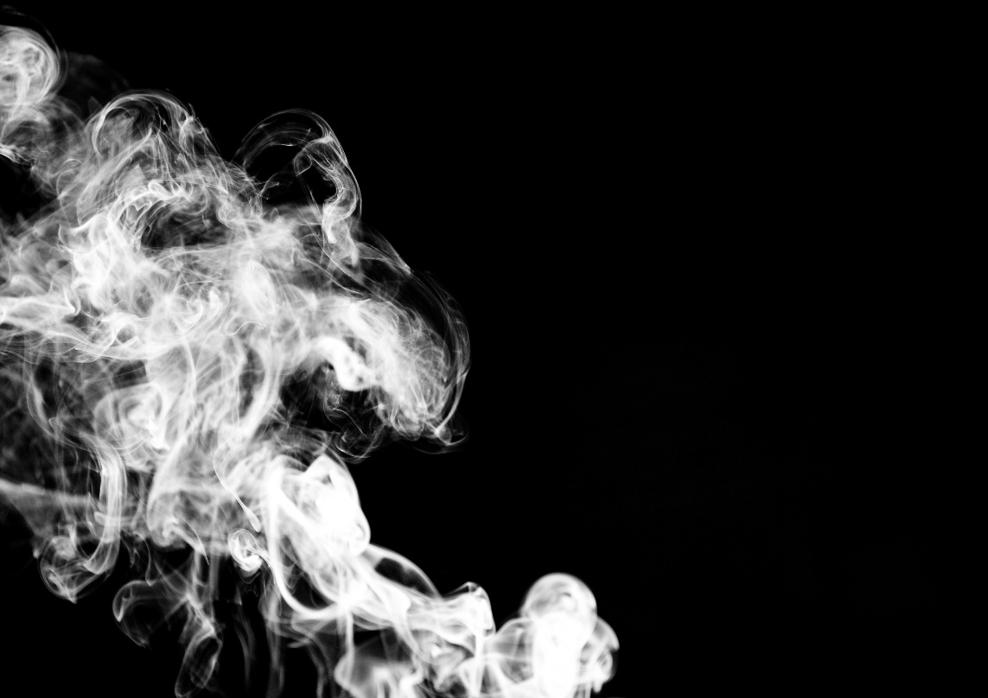

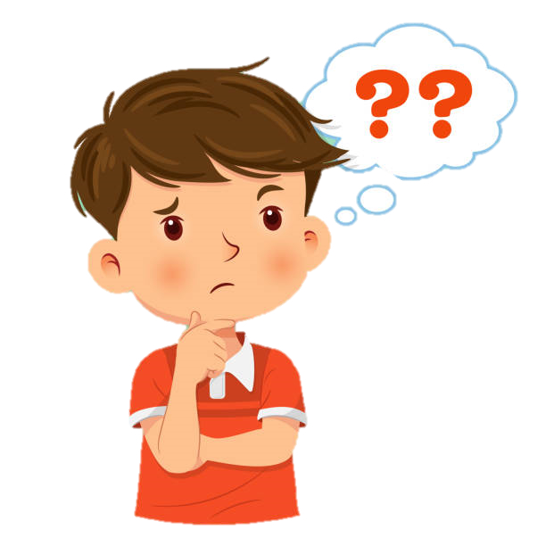
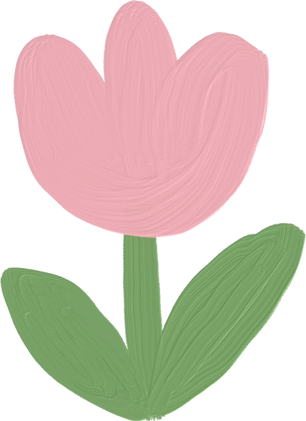

Play game: Back to the board
smoke

Slide 3
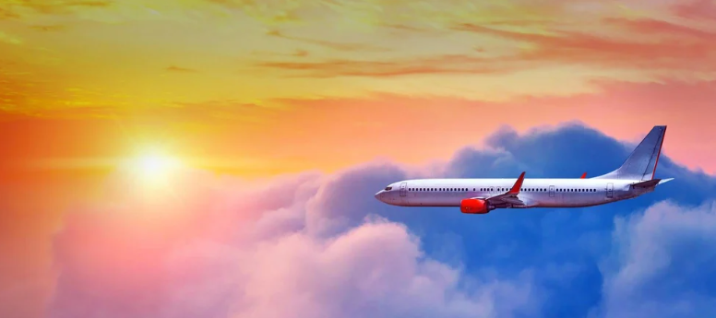
Play game: Back to the board
flight

Slide 4
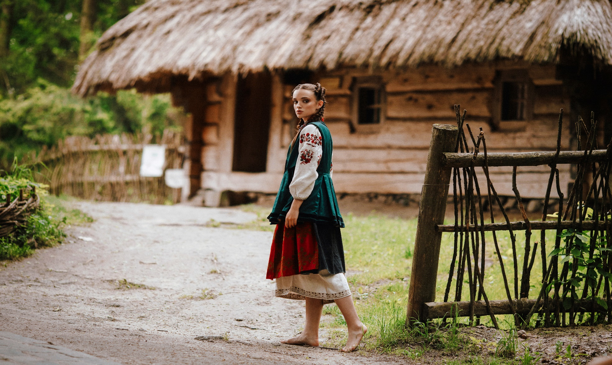
Play game: Back to the board
villager

Slide 5



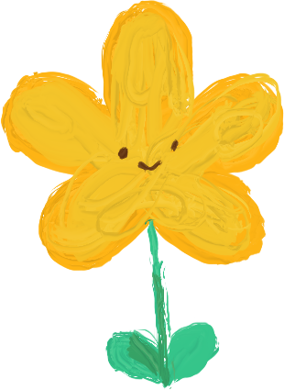

Past simple tense: Summary
buy
bought
Irregular verbs
have
had
cut
cut

Slide 6
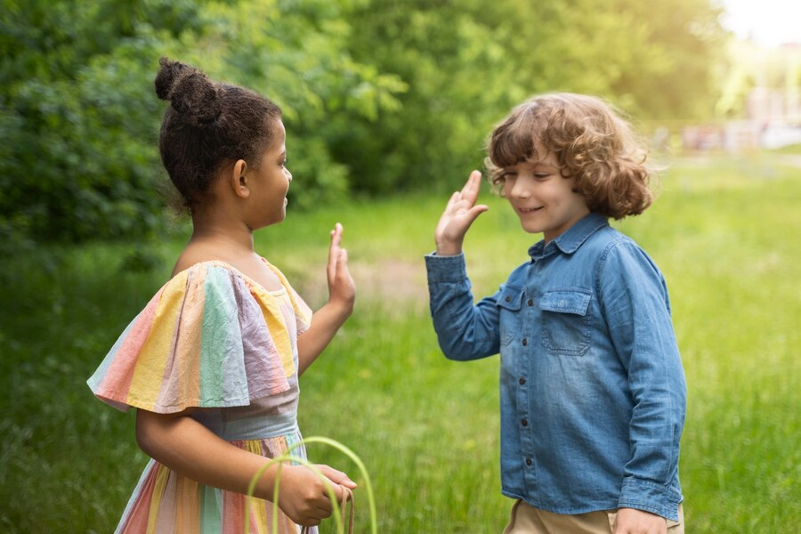


1 Read and choose the best answer.
1 Mia: Hi, Peter! Did you enjoy
your trip last summer?
Peter:
a It was great.
b What a lovely day!
c It’s Saturday!

Slide 7
1 Read and choose the best answer.
2 Mia: How did you travel?
Peter:
a There were five of us.
b We went by bus.
c The car was so fast.

Slide 8
1 Read and choose the best answer.
3 Mia: Was the weather good?
Peter:
a Well done!
b Yes, it was warm there.
c It is so good.

Slide 9




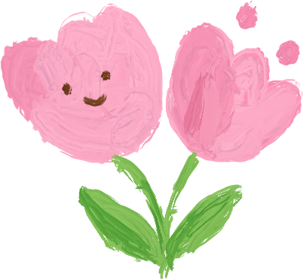
3 Write a postcard to a friend from a city you know. Use the plan below. Remember to use adjectives to describe nouns.
Dear...,
I’m having a great time in...! The city is a very...
The city has got... . There are (a lot of)...
Yesterday, I / we...
Last night, / This morning, I / we...
See you soon!
(your name)

