Slide 1

Unit 6: Clothes
Lesson 1.1
Page 82

Slide 2
Lesson Outline
Warm-up
Vocabulary
Structure
Consolidation
Wrap-up

Slide 3
Objectives
By the end of this lesson, students will be able to talk about what clothes they want.
Vocabulary: dress, shirt, shorts, socks, pants
Structure: What do you want? I want a dress./I want some socks.

Slide 4

WARM-UP

Slide 5






WORDSNAKE
Look and find 5 words about sports.
socvolleyballten
soccerbal
dfbasketball
badmintonvoll
hgtennisfr
◆
❖
⬥


Click on the animal to show the answers.
Click on the arrow after finishing the game.
Click on the number to check the answers.

Slide 6



Click on the picture to hear the sound.
basketball
Click here to return to the game.

Slide 7
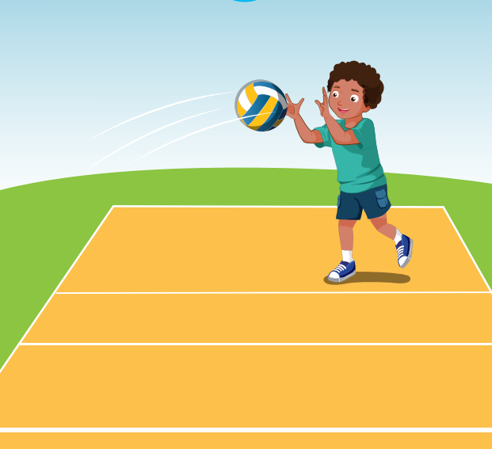
Click on the picture to hear the sound.
volleyball
Click here to return to the game.

Slide 8
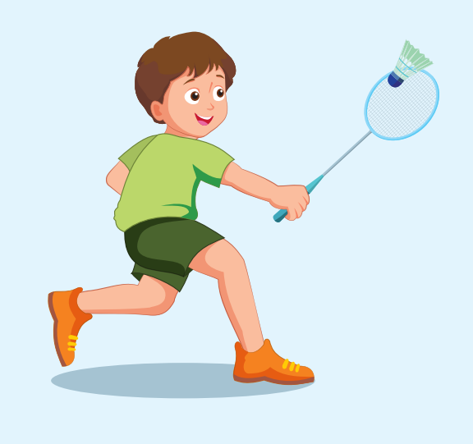
Click on the picture to hear the sound.
badminton
Click here to return to the game.

Slide 9
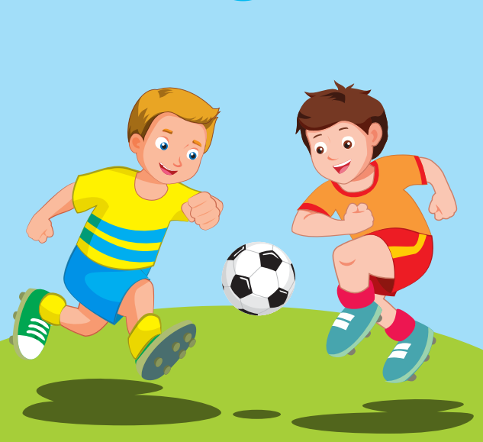
Click on the picture to hear the sound.
soccer
Click here to return to the game.

Slide 10
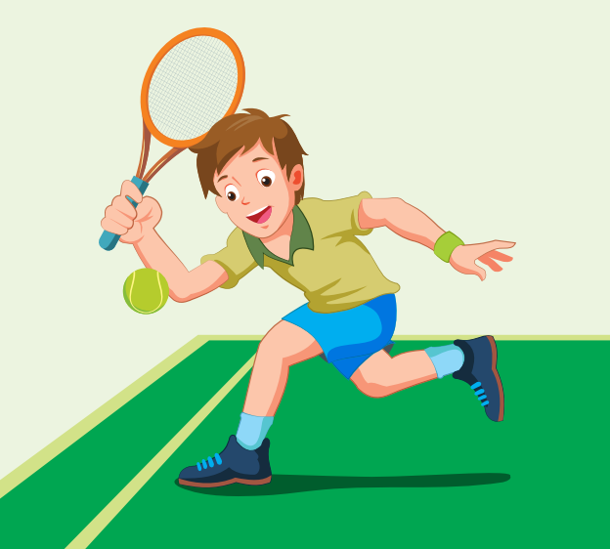
Click on the picture to hear the sound.
tennis
Click here to return to the game.

Slide 11

It’s time to learn …

Slide 12

New words
dress
shirt
shorts
socks
pants

Slide 13

Presentation

Slide 14

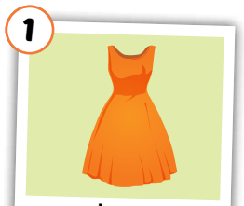
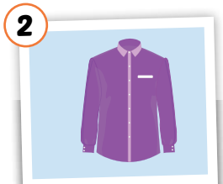
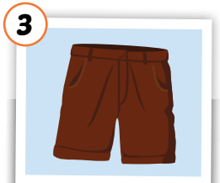
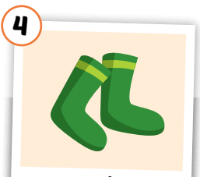
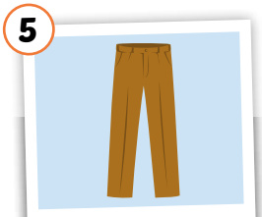
Click each word to hear the sound.
dress
shirt
shorts
socks
pants
/dres/
đầm, áo đầm
/ʃɜːrt/
áo sơ mi
/ʃɔːrts/
quần soóc,
quần cộc
/sɑːks/
đôi tất
/pænts/
quần tây, quần dài

Slide 15
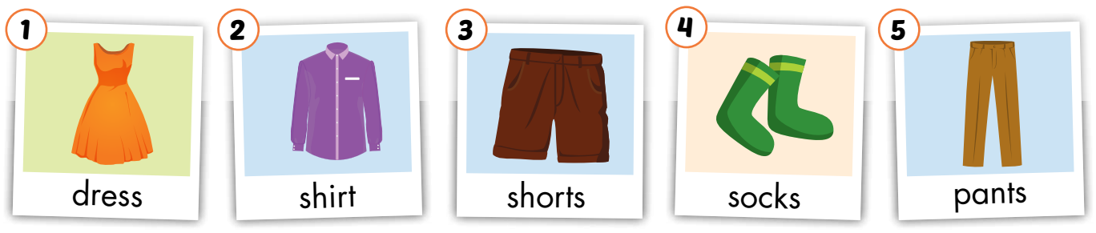
Look and read. Then listen and point to the right picture.
a
b
c
d
e
f
g
h
i
j
Click on the letters to play audios.

Slide 16
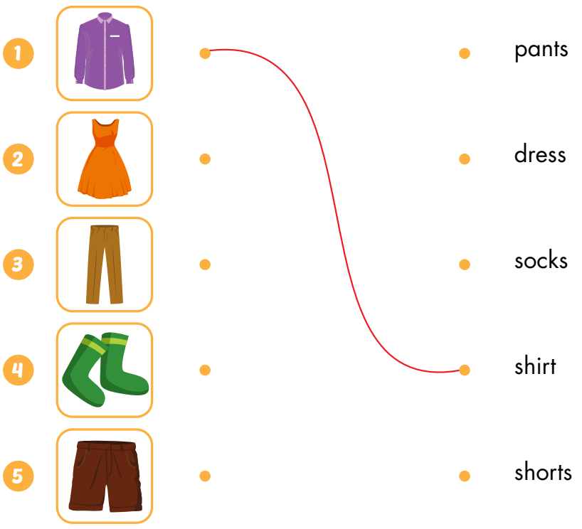
Draw lines

Slide 17


Look at the word and say the right number.
shirt

Slide 18
Look at the word and say the right number.
socks

Slide 19
Look at the word and say the right number.
dress

Slide 20
Look at the word and say the right number.
pants

Slide 21
Look at the word and say the right number.
shorts

Slide 22
Put the pictures in the right group.
◆
❖
a
some

Slide 23
Structures
What do you want?
I want a dress.
What do you want?
I want some socks.

Slide 24

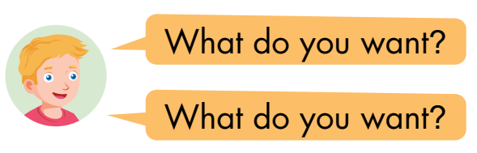
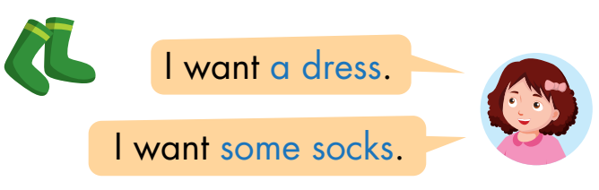

Click on the number to hear the sound.
◆
❖
⬥


Slide 25

Practice

Slide 26


__________
some shorts.
________________

Slide 27
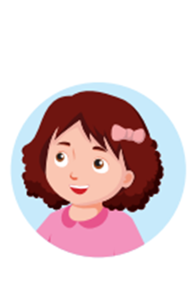
some socks.
________________

Slide 28
__________
some pants.
________________

Slide 29
a dress.
__________

Slide 30
a shirt.
__________

Slide 31

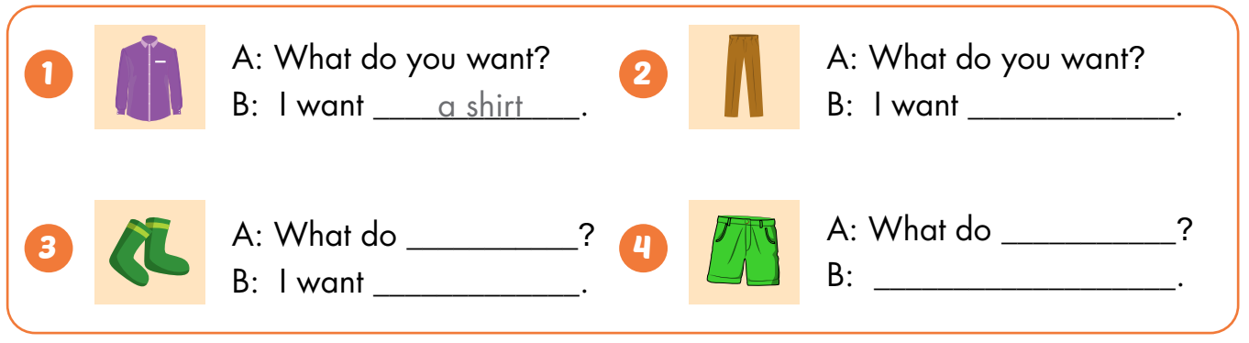
some pants
you want
you want
some socks
I want some shorts

Slide 32

CONSOLIDATION

Slide 33



Draw the clothes you want. Ask and answer with 3 friends.

Slide 34

WRAP-UP

Slide 35
Today’s lesson
Vocabularies
dress
shirt
shorts
socks
pants
Structures/ Sentence patterns
What do you want?
I want a dress.
What do you want?
I want some shorts.

Slide 36

Enjoy your day!

Slide 37
Homework
Practice the vocabularies and structure, and make sentences using them.
Do the exercises in Tiếng Anh 3 i-Learn Smart Start Workbook (page 58).
Prepare the next lesson (page 83 SB).
Play the consolidation games in Tiếng Anh 3 i-Learn Smart Start DHA App on www.eduhome.com.vn
Do the exercise in Tiếng Anh 3 i-Learn Smart Start Notebook (page 40).

