Slide 1

Unit 5: Sports and hobbies
Lesson 1.1
Page 68

Slide 2
Lesson Outline
Warm-up
Vocabulary
Structure
Consolidation
Wrap-up

Slide 3
Objectives
By the end of this lesson, students will be able to…
Vocabulary: Pronounce and use the words related to the names of sports: badminton, tennis, volleyball, basketball, soccer
Structure: Ask and answer about ability:
Can you play soccer?
- Yes, I can./No, I can't.

Slide 4

WARM-UP

Slide 5
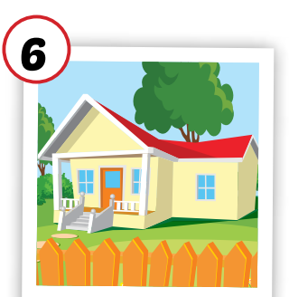
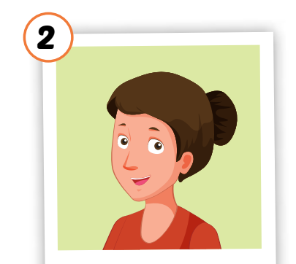


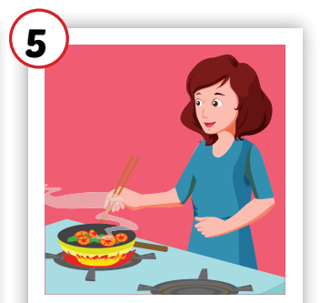
Crossword Puzzle
1
H | O | U | S | E
Click the boxes to show the answer.
2
W | A | K | E | U | P
3
C | O | O | K | I | N | G
4
M | O | T | H | E | R
5
N | O | T | E | B | O | O | K
Double click on the number to open the hint.
Click again on the number to close the hint.
KEYWORD

Slide 6

It’s time to learn …

Slide 7

New words
badminton
tennis
volleyball
basketball
soccer

Slide 8

Presentation

Slide 9


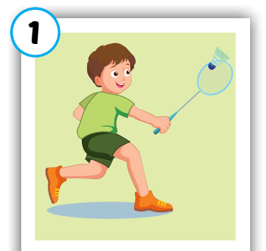
Click on each word to hear the sound.
badminton
/ˈbædmɪntən/
cầu lông

Slide 10
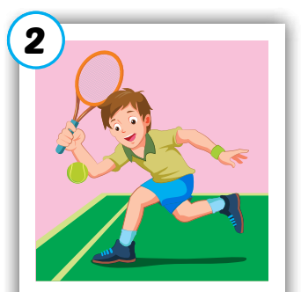
Click on each word to hear the sound.
tennis
/ˈtenɪs/
quần vợt

Slide 11
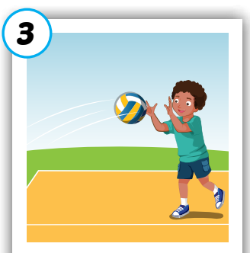
Click on each word to hear the sound.
volleyball
/ˈvɑːlibɑːl/
bóng chuyền

Slide 12
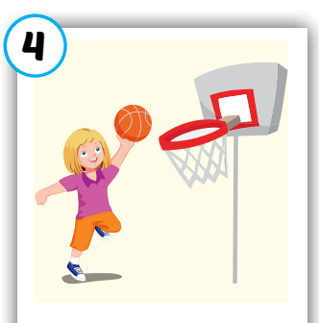
Click on each word to hear the sound.
basketball
/ˈbæskətbɑːl/
bóng rổ

Slide 13
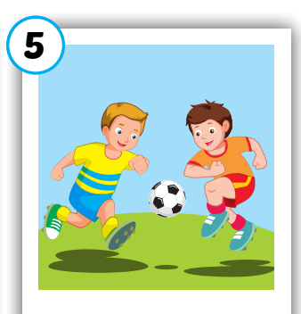
Click on each word to hear the sound.
soccer
/ˈsɑːkər/
bóng đá

Slide 14
Click on each word to hear the sound.
badminton
tennis
volleyball
basketball
soccer
/ˈbædmɪntən/
cầu lông
/ˈtenɪs/
quần vợt
/ˈvɑːlibɑːl/
bóng chuyền
/ˈbæskətbɑːl/
bóng rổ
/ˈsɑːkər/
bóng đá

Slide 15

Practice

Slide 16

1
2
3
4
Click on the square to see the picture
6
7
8
Click on the button to close the picture
5
9
10
11
12
Notes:
Memory game. GV nhấn vào ô để mở, nếu HS chọn 2 hình không giống nhau, GV nhấn vào hình tròn để đóng hình lại, HS phải nhớ những hình đã mở.

Slide 17


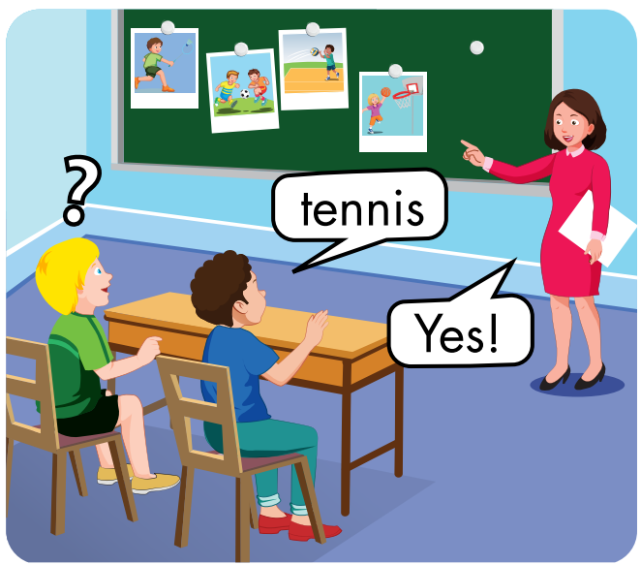

Slide 19
badminton
/ˈbædmɪntən/
cầu lông

Slide 21

volleyball
/ˈvɑːlibɑːl/
bóng chuyền

Slide 23

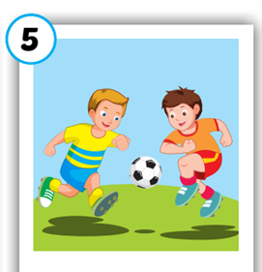





Slide 24

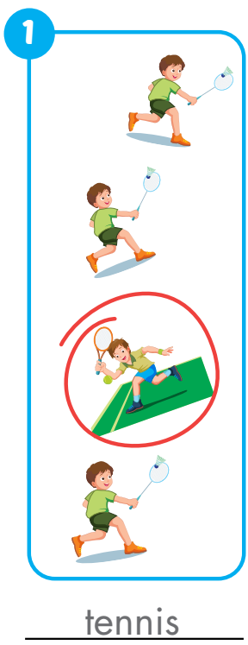
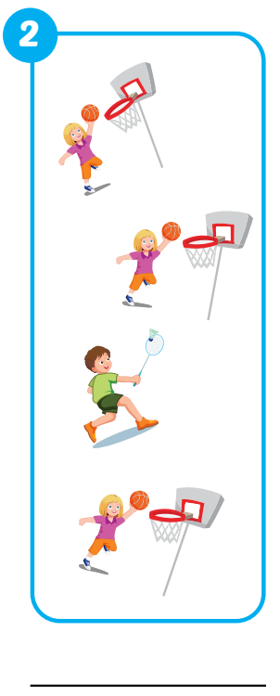
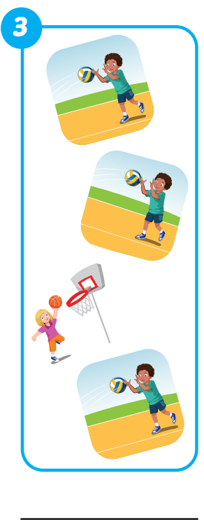
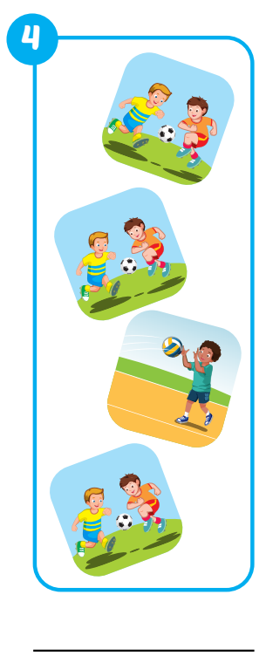
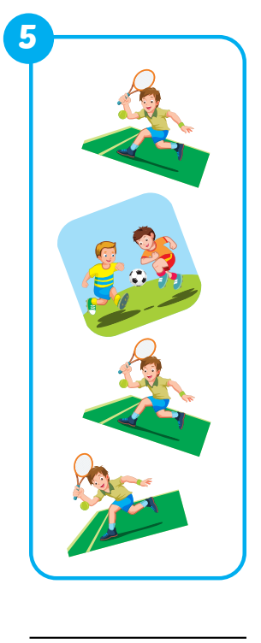
Extra Practice
WB, page 48.
badminton
basketball
volleyball
soccer

Slide 25

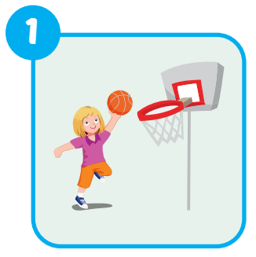
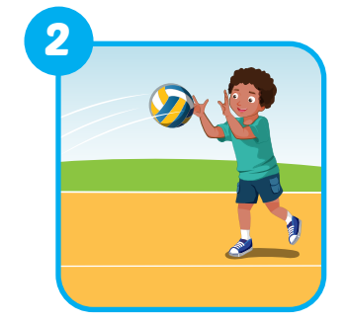
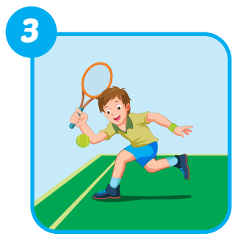
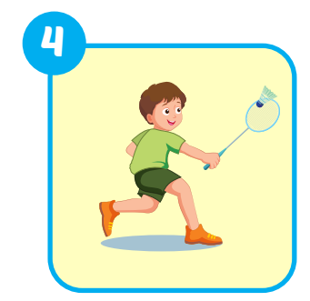
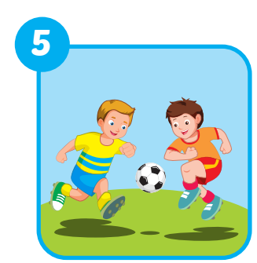

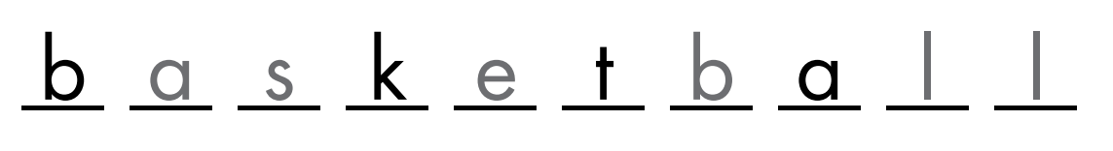



Extra Practice
WB, page 48.
3
e n i s
1
2
o l e b a l
5
S c c r
4
b a m i n o

Slide 26
Structures
Can you play soccer?
-Yes, I can./No, I can't.

Slide 27

Presentation

Slide 28


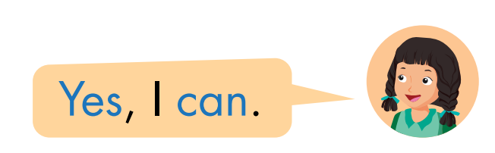
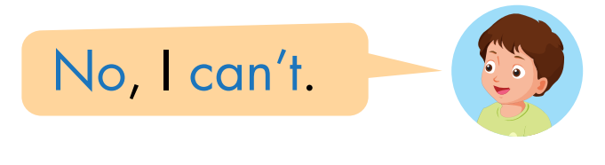

Slide 29

Practice

Slide 30

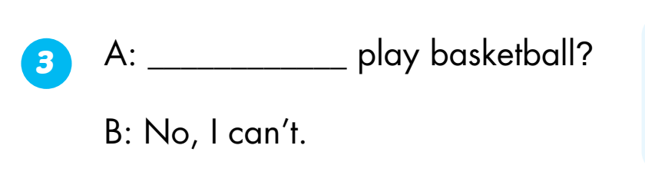
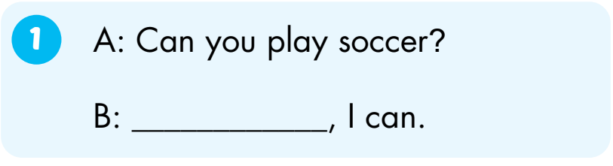
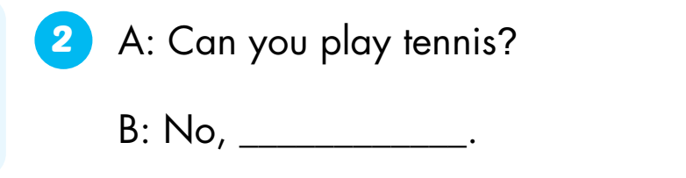
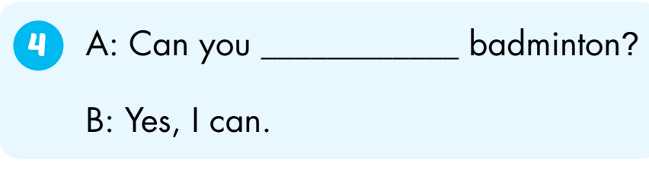
Can you
Yes
play
I can’t

Slide 31

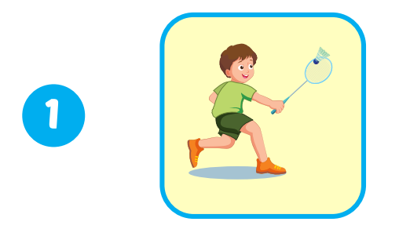
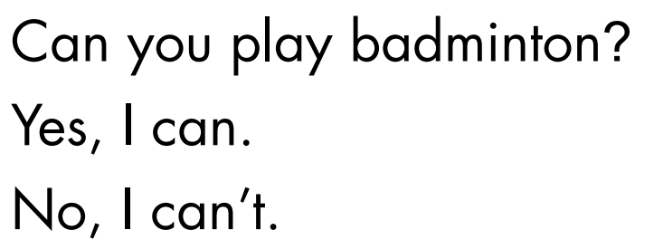
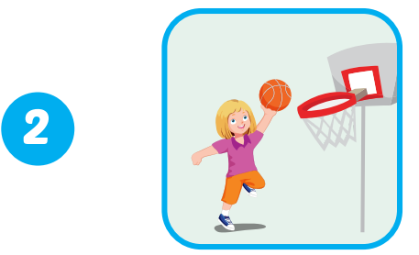

Extra Practice
WB, page 49.
1
✓
✓
2
Click on the number to hear the sound.

Slide 32
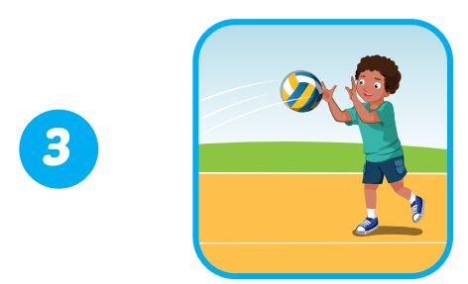

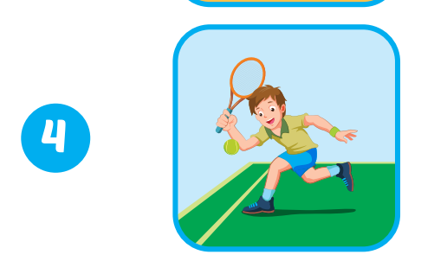
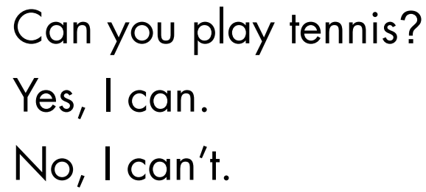
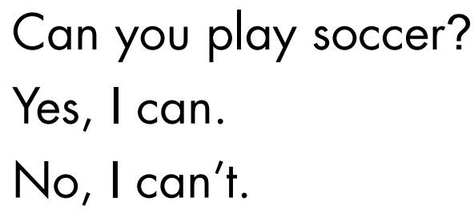
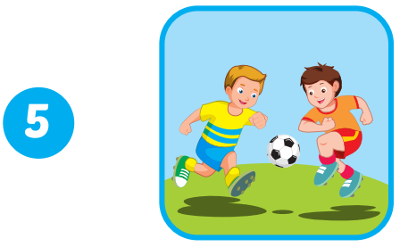
3
✓
✓
4
5
✓
Click on the number to hear the sound.

Slide 33

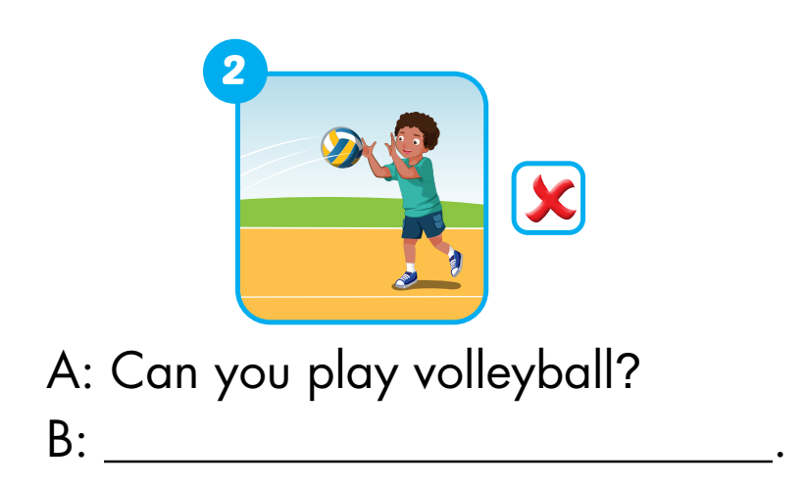
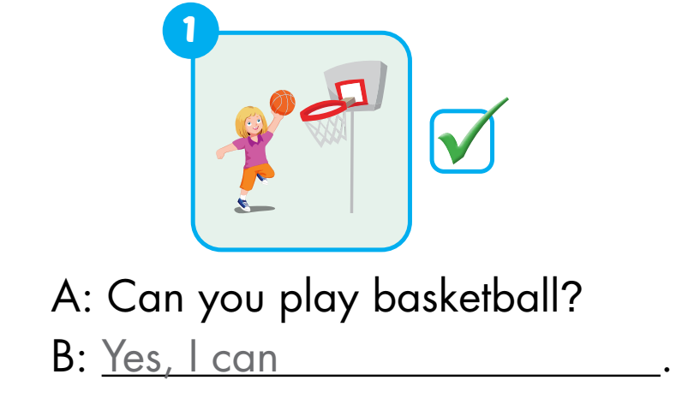
Extra Practice
WB, page 49.
No, I can’t

Slide 34
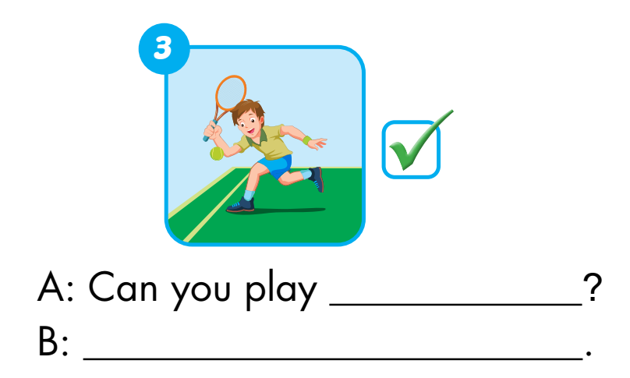
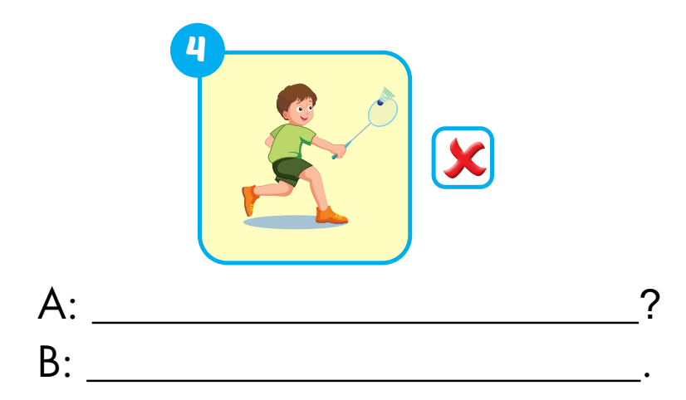
tennis
Can you play badminton
Yes, I can
No, I can’t

Slide 35
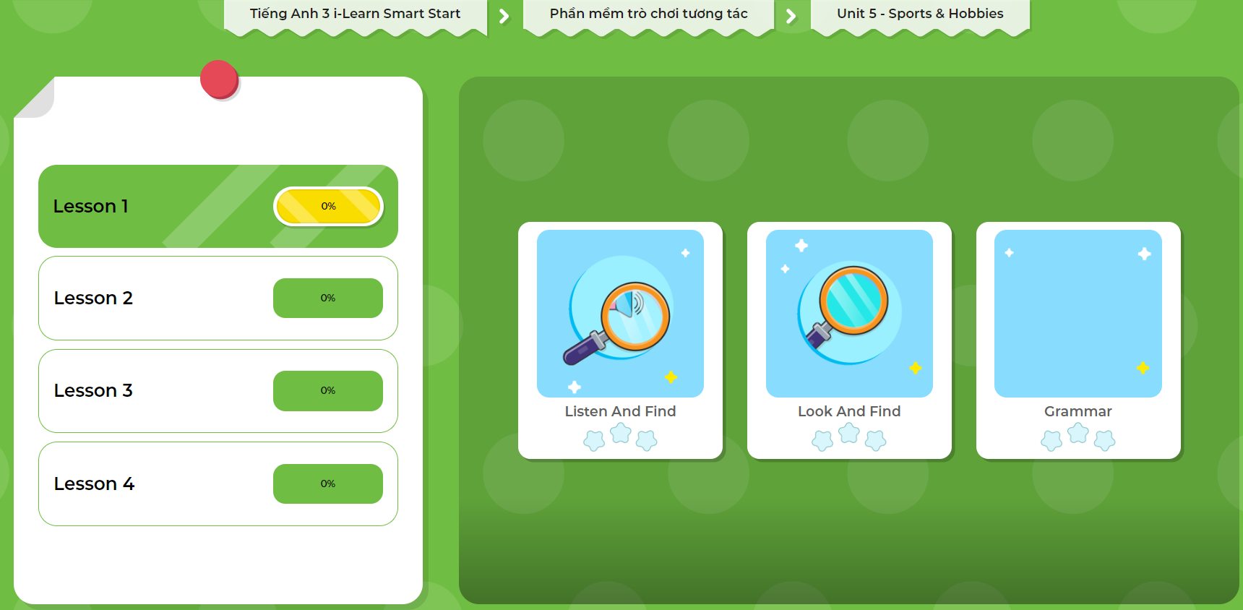
LET’S PLAY!
Click here to play the game.

Slide 36

CONSOLIDATION

Slide 37

Early Production

Slide 38
Can you play ….?
Lost turn
☹
1
SPIN
5
2
4
3
Yes, I can.
No, I can’t.

Slide 39

WRAP-UP

Slide 40
Today’s lesson
Vocabularies
badminton
tennis
volleyball
basketball
soccer
Structures/ Sentence patterns
Can you play soccer?
- Yes, I can./No, I can't.

Slide 41
Homework
Practice the vocabularies and structure. Make sentences using them.
Do the exercises in Tiếng Anh 3 i-Learn Smart Start Workbook (page 48).
Do the exercises in Tiếng Anh 3 i-Learn Smart Start Notebook (page 34).
Play the consolidation games in Tiếng Anh 3 i-Learn Smart Start DHA App on www.eduhome.com.vn
Prepare the next lesson (page 69).

Slide 42

Have a nice day!

