Slide 1

Unit 7: MY FAMILY
REVIEW AND PRACTICE 2
Page 105

Slide 2
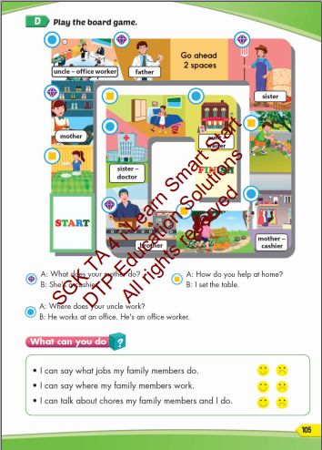
Lesson Outline
Warm-up
Speaking
Consolidation
Wrap-up

Slide 3
Objectives
By the end of this lesson, students will be able to do all the exercises.
Vocabulary: review all vocabularies learnt in Unit 7.
Speaking: Practice asking and answering questions, playing a board game.

Slide 4

WARM UP

Slide 5
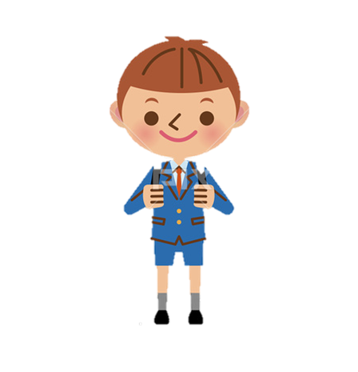
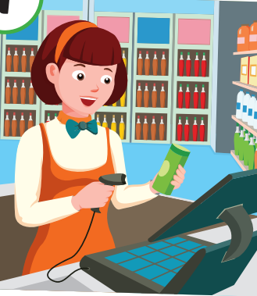
A CASHIER
What is in the picture?
T
I
M
E
I
S
U
P
CHECK
NEXT
Click on the coloued boxes to turn them around

Slide 6
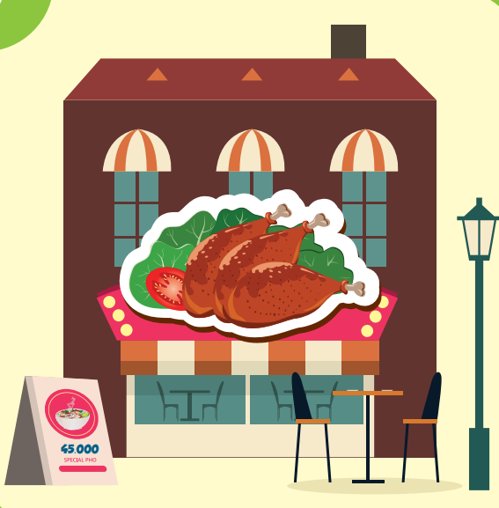
A RESTAURANT
What is in the picture?
T
I
M
E
I
S
U
P
CHECK
NEXT
Click on the colored boxes to turn them around

Slide 7
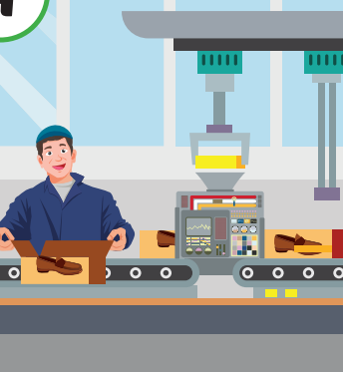
A FACTORY WORKER
What is in the picture?
T
I
M
E
I
S
U
P
CHECK
NEXT
Click on the colored boxes to turn them around

Slide 8

A FARM
What is in the picture?
T
I
M
E
I
S
U
P
CHECK
NEXT
Click on the colored boxes to turn them around

Slide 9
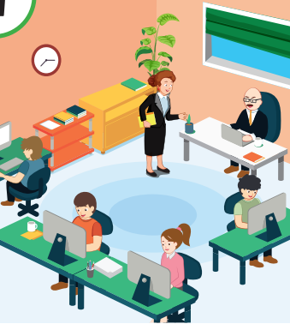
AN OFFICE
What is in the picture?
T
I
M
E
I
S
U
P
CHECK
NEXT
Click on the colored boxes to turn them around

Slide 10
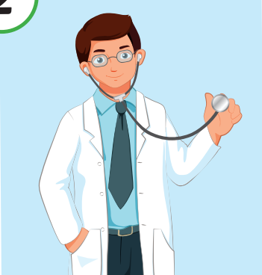
A DOCTOR
What is in the picture?
T
I
M
E
I
S
U
P
CHECK
NEXT
Click on the colored boxes to turn them around

Slide 11
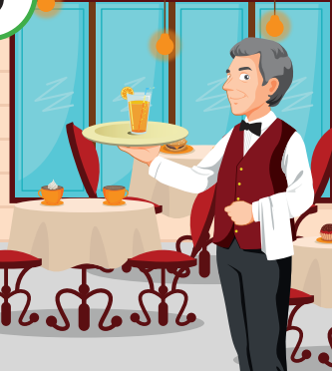
A WAITER
What is in the picture?
T
I
M
E
I
S
U
P
CHECK
NEXT
Click on the colored boxes to turn them around

Slide 12

Speaking

Slide 13
PRE-SPEAKING
Rearrange these words to make a sentence.
father / a / My / is / doctor.
My father is a doctor.

Slide 14
PRE-SPEAKING
Rearrange these words to make a sentence.
table. / I / My / brother / and / set / the
My brother and I set the table.

Slide 15
PRE-SPEAKING
Rearrange these words to make a sentence.
mom / at / My / office. / an / works
My mom works at an office.

Slide 16
PRE-SPEAKING
Rearrange these words to make a sentence.
do / the / I / laundry.
I do the laundry.

Slide 17
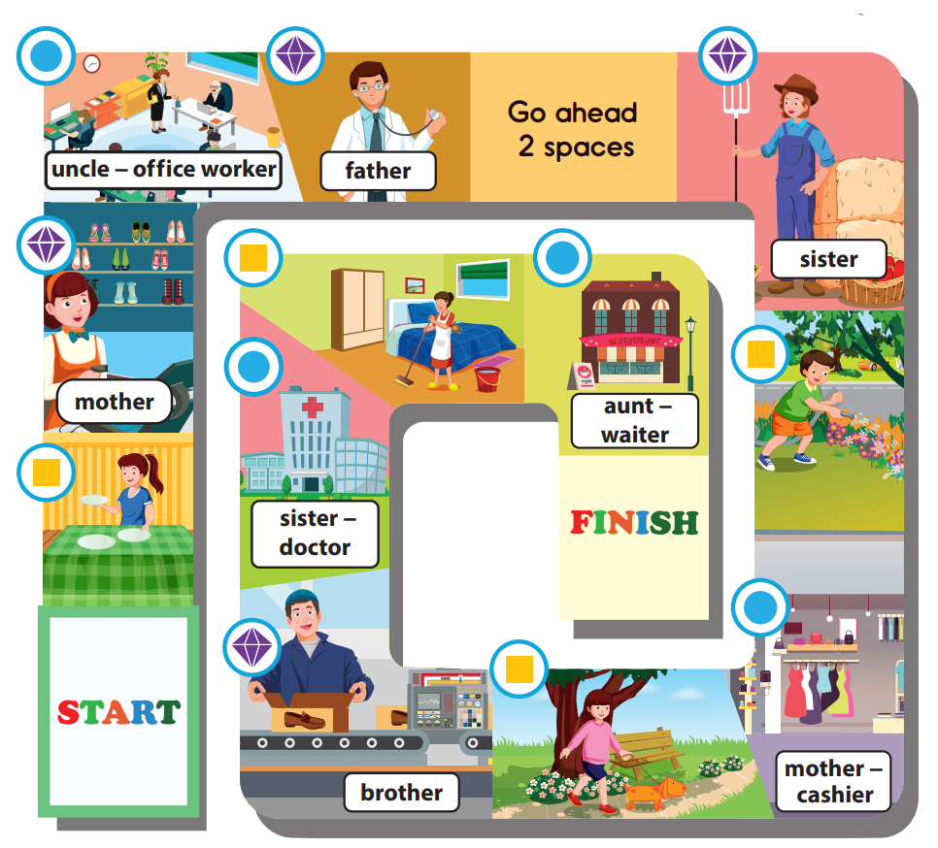

WHILE-SPEAKING

Slide 18
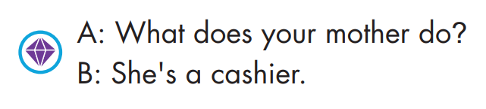
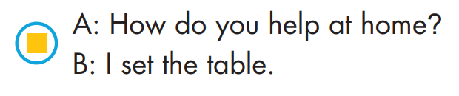
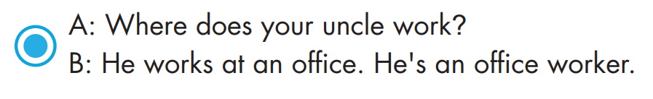

Slide 19



A: What does your father do?
B: He’s a doctor.
A: How do you help at home?
B: I water the plants.
A: Where does your mother work?
B: She works at a store. She’s a cashier.

Slide 20
A: What does your sister do?
B: She’s a farmer.
A: How do you help at home?
B: I walk the dog.
A: Where does your sister work?
B: She works at a hospital. She’s a doctor.

Slide 21
A: What does your brother do?
B: He’s a factory worker.
A: How do you help at home?
B: I mop the floor.
A: Where does your aunt work?
B: She works at a restaurant. She’s a waiter.

Slide 22
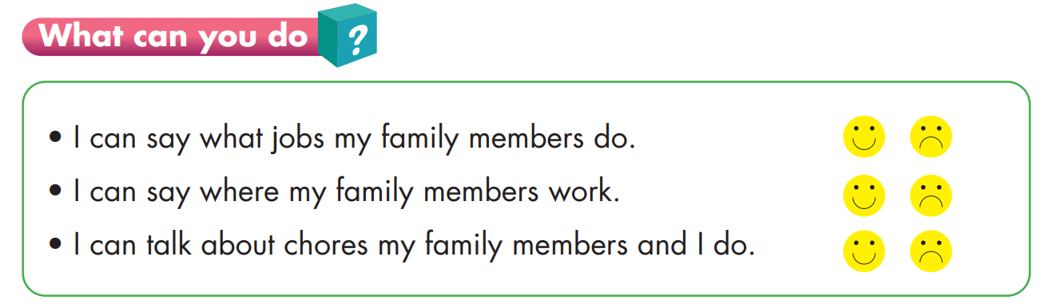

Slide 23

CONSOLIDATION

Slide 24

Workbook
p.71

Slide 25

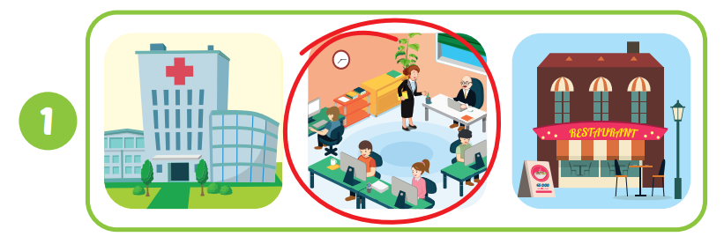

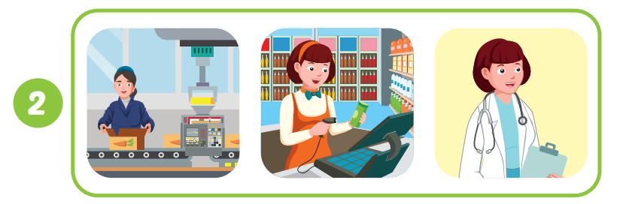

Slide 26
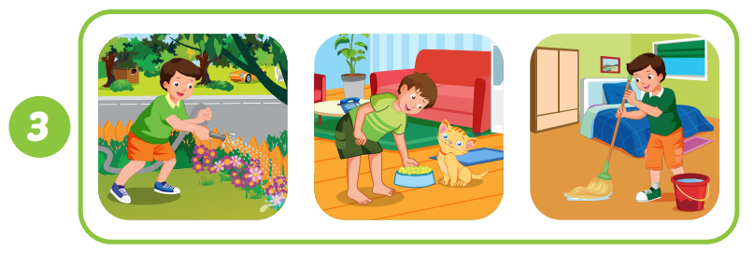
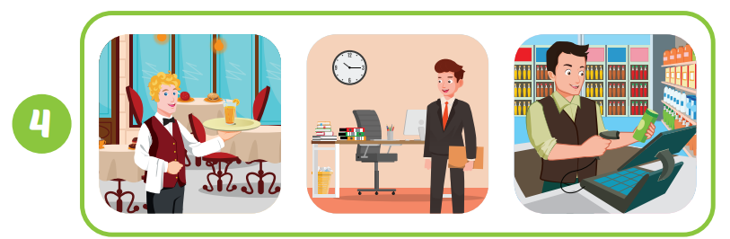

Slide 27

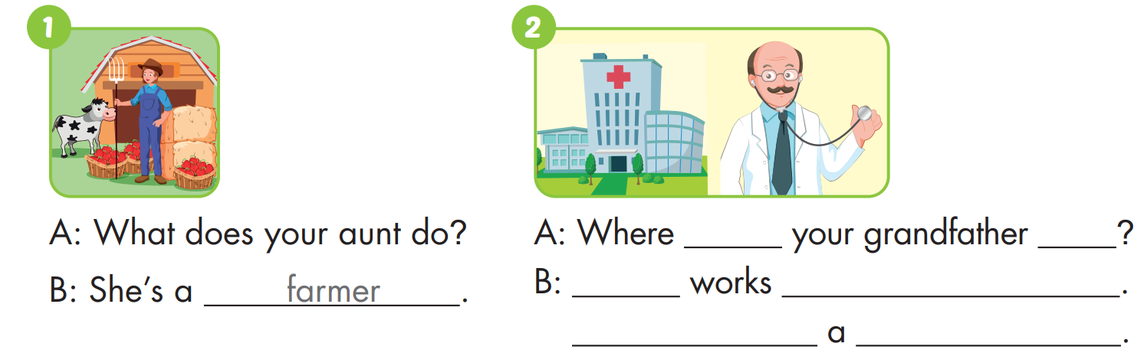
does
work
He
at a hospital
He’s
doctor

Slide 28
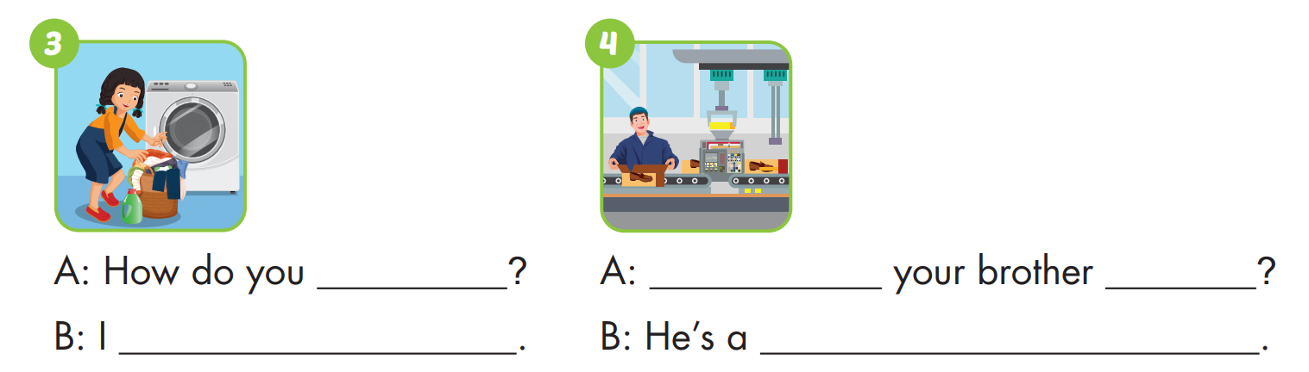
help at home
What does
do
do the laundry
factory worker

Slide 29
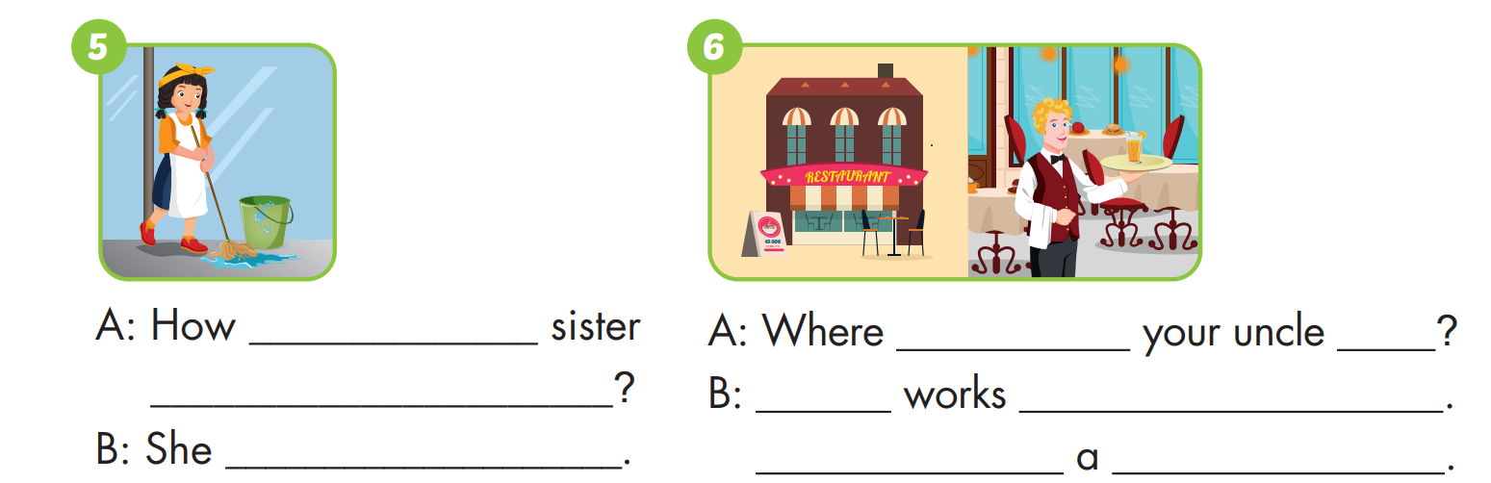
does your
does
work
help at home
He
at a restaurant
mops the floor
He’s
waiter

Slide 30

WRAP-UP

Slide 31
Today’s Lesson
Vocabulary: review all vocabularies learnt in Unit 7.
Speaking: Practice asking and answering questions, playing a board game.

Slide 32
Lesson 3
Homework
Practice the vocabularies and structure; and make sentences using them.
Do the exercises in Tiếng Anh 4 i-Learn Smart Start WB (page 71)
Do the exercises in Tiếng Anh 4 i-Learn Smart Start Notebook (page 45)
Prepare the next lesson (page 106 SB)
Play the consolidation games in Tiếng Anh 4 i-Learn Smart Start DHA App on www.eduhome.com.vn

Slide 33

Have a nice day!

