Slide 1

Unit 7: MY FAMILY
REVIEW AND PRACTICE 1
Page 104

Slide 2
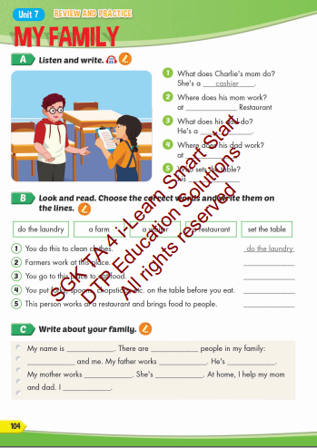
Lesson Outline
Warm-up
Practice
Consolidation
Wrap-up

Slide 3
Objectives
By the end of this lesson, students will be able to review the target language learn in the unit and ask and answer about what and where their family members do and work.
_{E.g.}
What does your mom do?
She’s a cashier.
Where does your mom work?
She works at a restaurant.

Slide 4

WARM UP

Slide 5


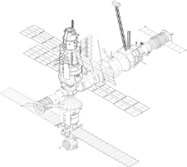










SPACE RACE
GO!
3
2
1
ROCKET SHIP WINS!
ALIEN SHIP
WINS!

Slide 6




SPACE RACE
1
2
3
4
5
6
7
8
9
10
11
12
13
14
15

Slide 7


Who is this?
This is a waiter.

Slide 8

Who is this?
This is a factory worker.

Slide 9

Who is this?
This is a cashier.

Slide 10

What does she do?
She sets the table.

Slide 11

Is this an office worker?
Yes.

Slide 12

Where is this?
This is a hospital.

Slide 13

Is this a store?
No.

Slide 14

Is this an office?
No.

Slide 15

Where is this?
This is a store.

Slide 16

Is this a bank?
Yes.

Slide 17
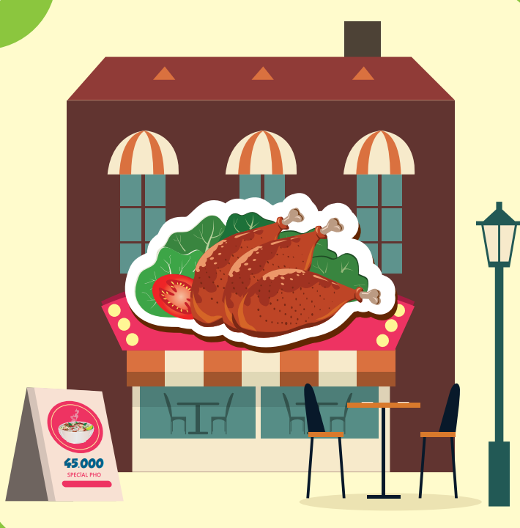
Where is this?
This is a restaurant.

Slide 18
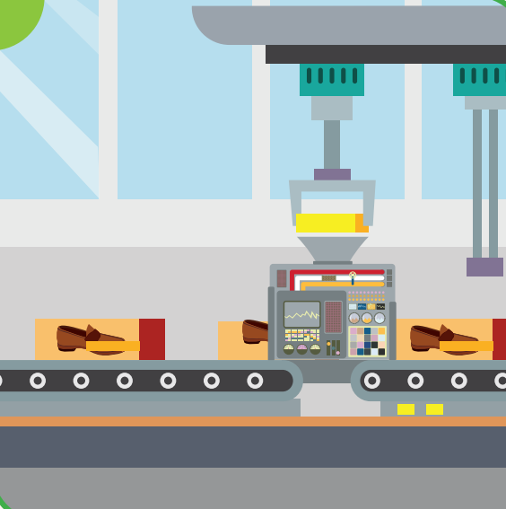
Where is this?
This is a factory.

Slide 19

What does he do?
He waters the plants.

Slide 20

What does he do?
He feeds the cat.

Slide 21

Practice

Slide 22



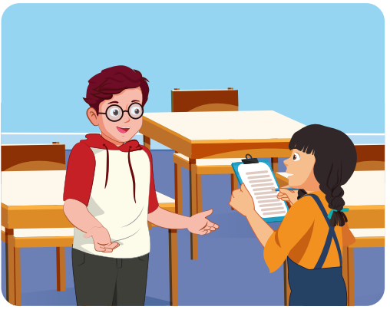
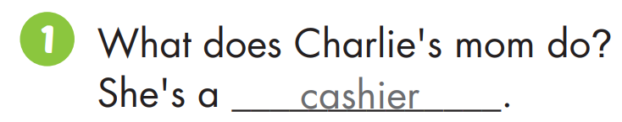

Slide 23
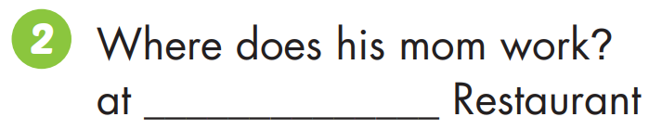
Sun

Slide 24
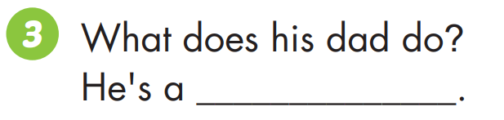
doctor

Slide 25
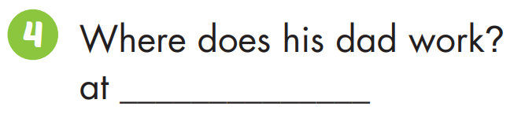
Green Hospital

Slide 26
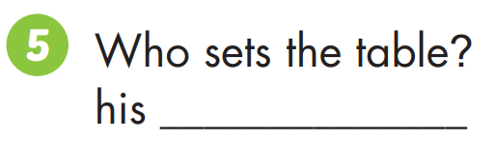
sister

Slide 27
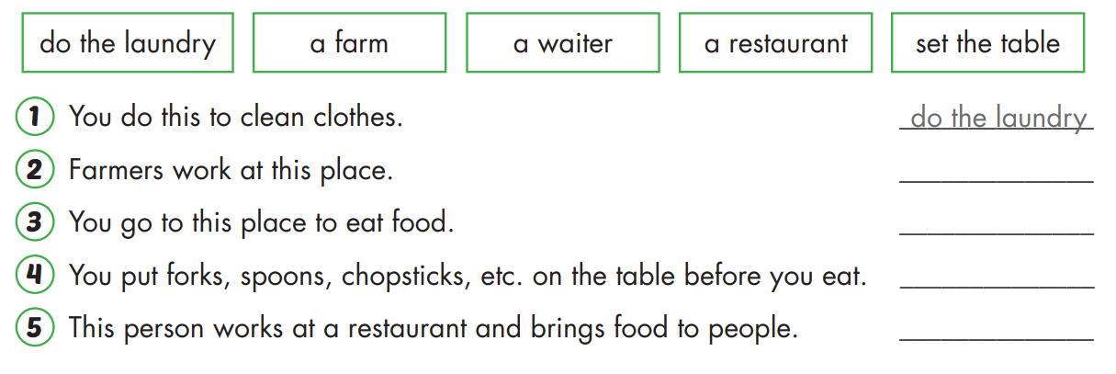

Slide 28
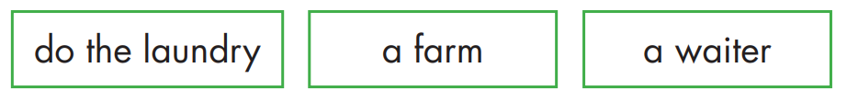
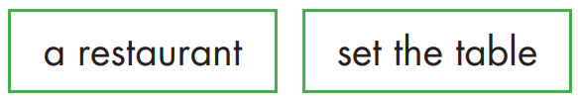



Slide 29


a farm

Slide 30

a restaurant

Slide 31
set the table

Slide 32
a waiter

Slide 33

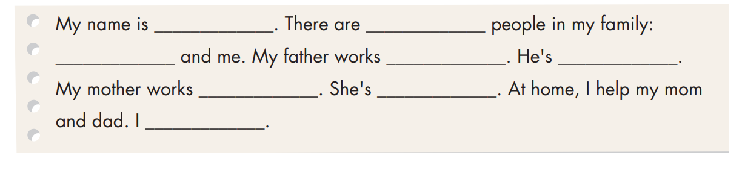
Practice

Slide 34

CONSOLIDATION

Slide 35

Workbook
p.70

Slide 36
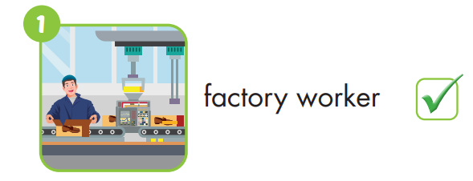
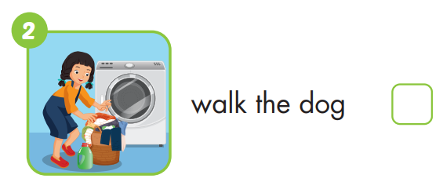


Slide 37
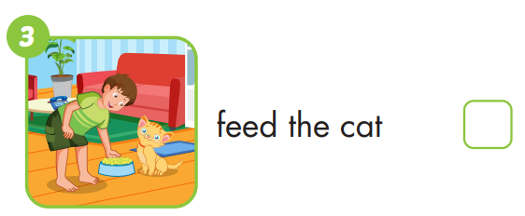
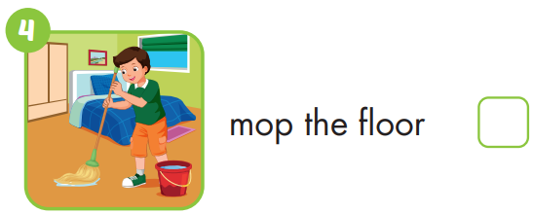

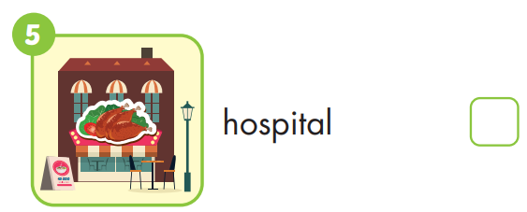
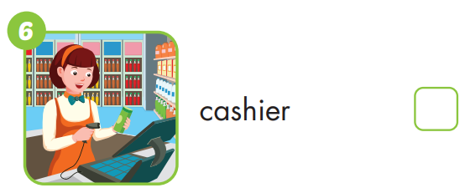

Slide 38

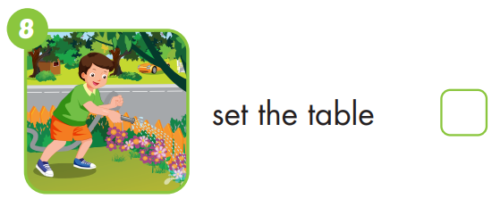



Slide 39

WRAP-UP

Slide 40
Today’s lesson
Review the target language in the unit.

Slide 41
Homework
Practice the vocabularies and structure; and make sentences using them.
Do the exercises in Tiếng Anh 4 i-Learn Smart Start WB (page 70)
Do the exercises in Tiếng Anh 4 i-Learn Smart Start Notebook (page 44)
Prepare the next lesson (page 105 SB)
Play the consolidation games in Tiếng Anh 4 i-Learn Smart Start DHA App on www.eduhome.com.vn

Slide 42

Have a nice day!

