Slide 1

Unit 7: MY FAMILY
Ethics Lesson 4.2
Page 102

Slide 2
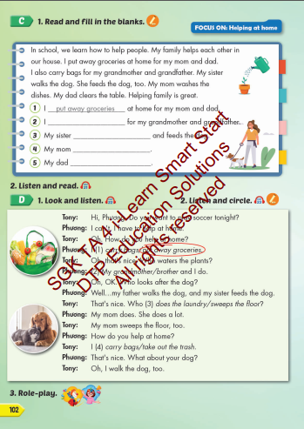
Lesson Outline
Warm-up
Listening
Consolidation
Wrap-up

Slide 3
By the end of this lesson, students will be able to…
- read a passage about ways family members help at home.
- listen to a talk about ways their family members help at home.
Vocabulary: put away groceries, carry bags,
clear the table, sweep the floor,
take out the trash, wash the dishes.

Slide 4

WARM UP

Slide 5
How to Play:
Students will go to the board and listen.
Students must write the words they hear.

Slide 6
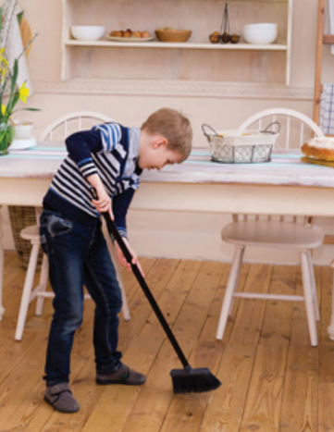


Click on the icon to hear the sound
s | w | e | e | p |  | t | h | e |  | f | l | o | o | r

Slide 7
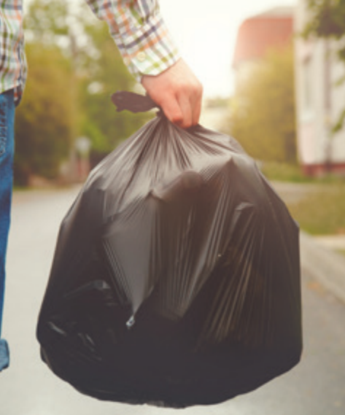
Click on the icon to hear the sound
t | a | k | e |  | o | u | t |  | t | h | e |  | t | r
a | s | h

Slide 8
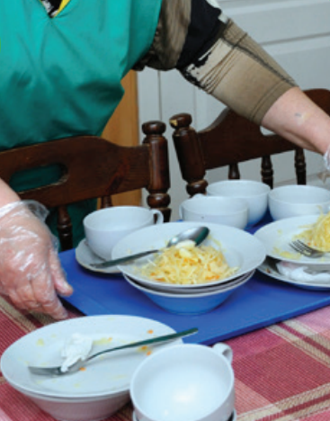
Click on the icon to hear the sound
c | l | e | a | r |  | t | h | e |  | t | a | b | l | e

Slide 9
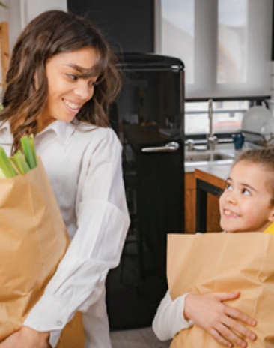
Click on the icon to hear the sound
c | a | r | r | y |  | b | a | g | s

Slide 10
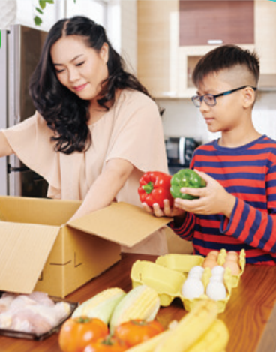
Click on the icon to hear the sound
p | u | t |  | a | w | a | y |  | g | r | o | c | e | r
i | e | s

Slide 11
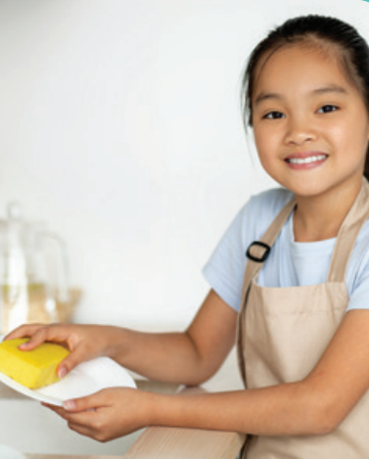
Click on the icon to hear the sound
w | a | s | h |  | t | h | e |  | d | i | s | h | e | s

Slide 12

It’s time to learn …

Slide 13

Reading

Slide 14


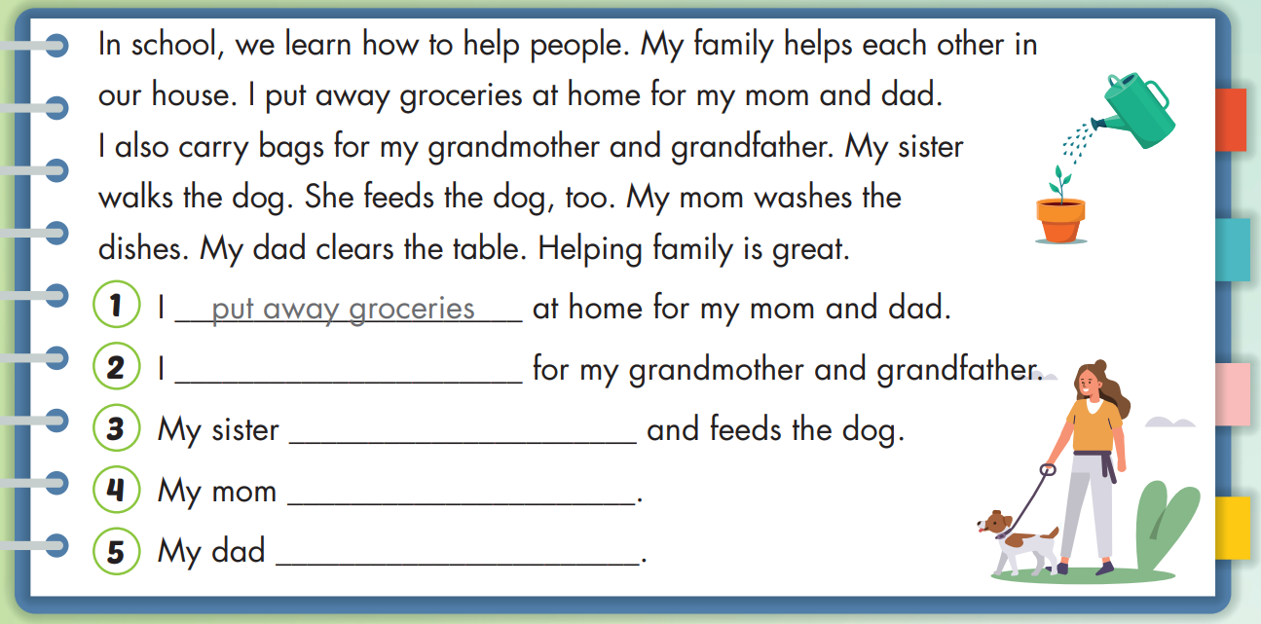
carry bags
walks
washes the dishes
clears the table

Slide 15


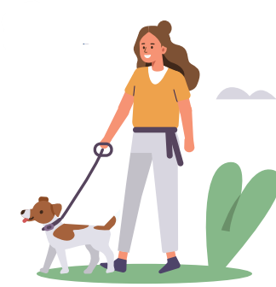
In school, we learn how to help people. My family helps each other in our house. I put away groceries at home for my mom and dad. I also carry bags for my grandmother and grandfather. My sister walks the dog. She feeds the dog, too. My mom washes the dishes. My dad clears the table. Helping family is great.

Slide 16

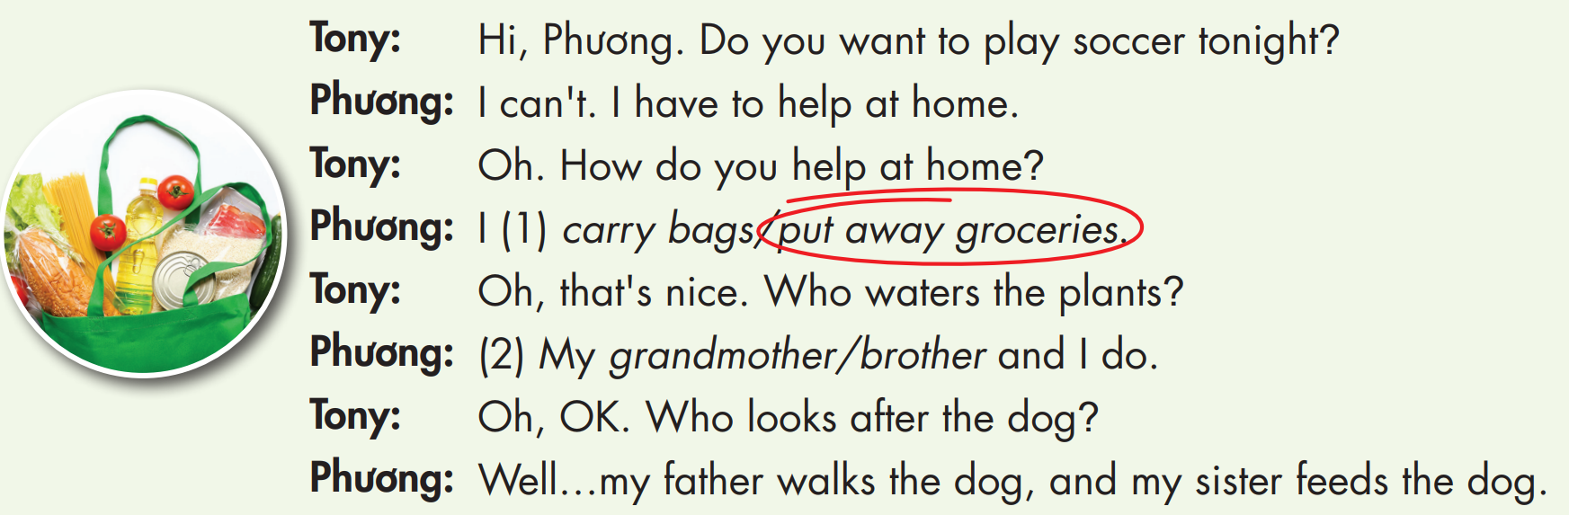

Slide 17
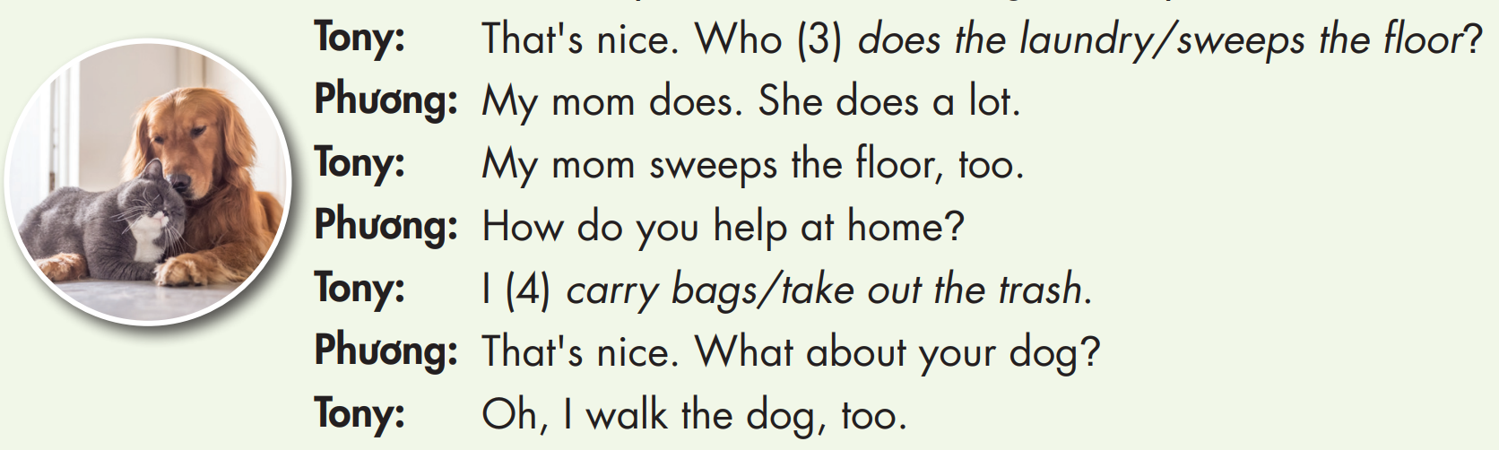

Slide 18


Slide 20

Practice

Slide 21



How do you help at home?
I put away groceries.
Oh, that’s nice.
Who washes the dishes?
My brother does.

Slide 22
How do you help at home?
I clear the tables.
Oh, that’s nice.
Who feeds the dog?
My dad does.

Slide 23
How do you help at home?
I sweep the floor.
Oh, that’s nice.
Who takes out the trash?
I do.

Slide 24
How do you help at home?
I carry bags.
Oh, that’s nice.
Who sweeps the floor?
My mom does.

Slide 25

CONSOLIDATION

Slide 26
Rearrange these words to make a complete sentence.
you do How at home? help
How do you help at home?

Slide 27
Rearrange these words to make a complete sentence.
dishes. My the brother washes
My brother washes the dishes.

Slide 28
Rearrange these words to make a complete sentence.
away mother My I put and groceries.
My mother and I put away groceries.

Slide 29
Rearrange these words to make a complete sentence.
sister floor. My sweeps the
My sister sweeps the floor.

Slide 30

Further Practice

Slide 31

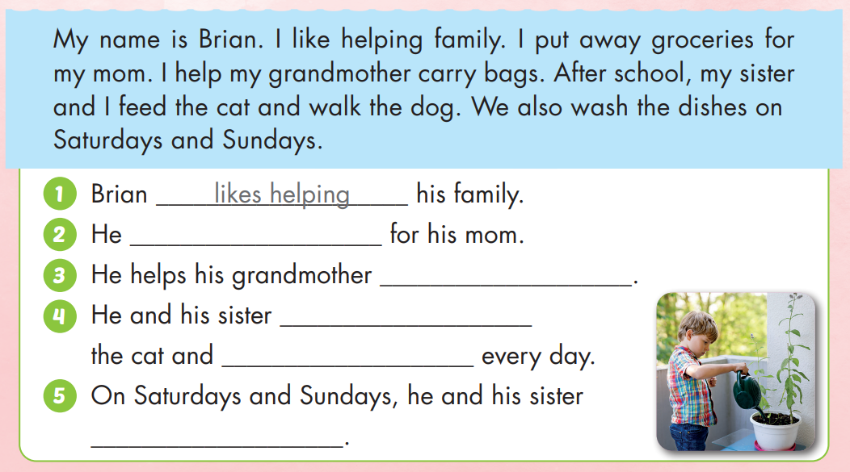
puts away groceries
carries bags
feed
walk the dog
wash the dishes

Slide 32

WRAP-UP

Slide 33
Students can use the following vocab and structure to talk about ways family members help at home.
Vocabulary: put away groceries, carry bags, clear the table, sweep the floor, take out the trash, wash the dishes.
Structures: I put away groceries.
My sister sweeps the floor.

Slide 34
Homework
Practice the vocabularies and structure; and make sentences using them.
Do the exercises in Tiếng Anh 4 i-Learn Smart Start WB (page 69)
Do the exercises in Tiếng Anh 4 i-Learn Smart Start Notebook (page 43)
Prepare the next lesson (page 103 SB)
Play the consolidation games in Tiếng Anh 4 i-Learn Smart Start DHA App on www.eduhome.com.vn

Slide 35

Have a nice day!

