Slide 1

Unit 7: MY FAMILY
Ethics Lesson 4.1
Page 101

Slide 2
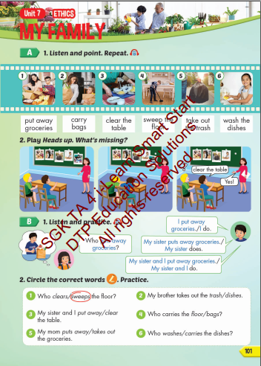
Lesson Outline
Warm-up
Vocabulary
Structure
Consolidation
Wrap-up

Slide 3
Lesson objectives
By the end of this lesson, students will be able to learn and practice ….
Vocabulary: put away groceries, carry bags, clear the table, sweep the floor, take out the trash, wash the dishes.
Structure:
Who puts away groceries?
I put away groceries./I do.

Slide 4

WARM UP

Slide 5
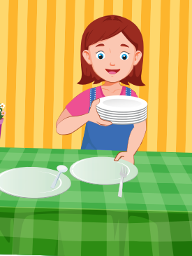

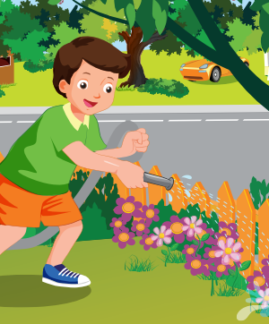
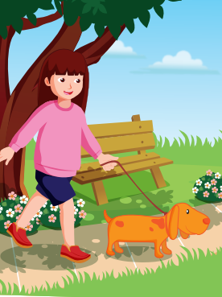
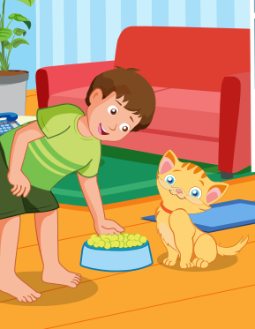
1
4
4
1
SPIN
5
2
2
4
3
3
5

Slide 6

Vocabulary

Slide 7


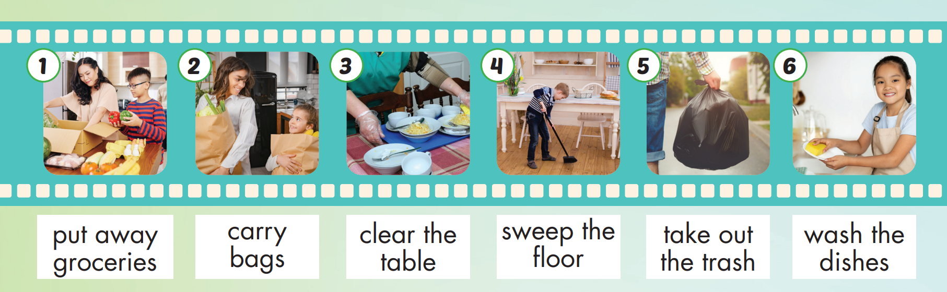
/pʊt
əˈweɪ
ˈɡrəʊsəriz/
/ˈkæri bæɡz/
/klɪr ðəˈteɪbl/
/swiːp ðə flɔːr/
/teɪk aʊt ðə træʃ/
/wɑːʃ ðəˈdɪʃɪz/

Slide 8
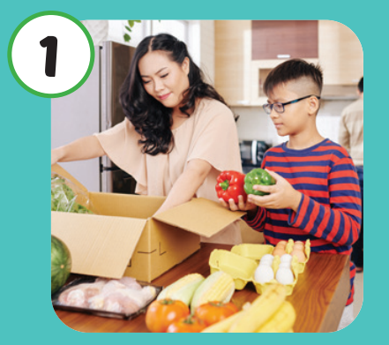
Listen and repeat.
Click each picture to hear the sound.
put away
groceries
Cất đồ hàng tạp hóa và thực phẩm

Slide 9
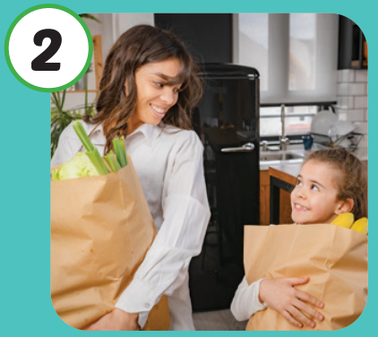
Listen and repeat.
Click each picture to hear the sound.
carry bags
Mang túi

Slide 10
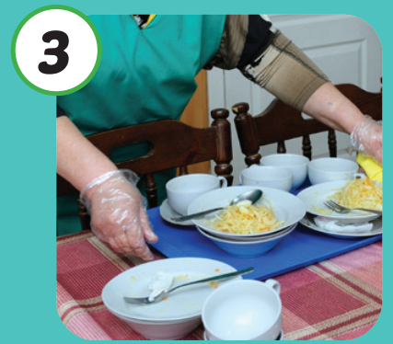
Listen and repeat.
Click each picture to hear the sound.
clear the table
Dọn bàn

Slide 11
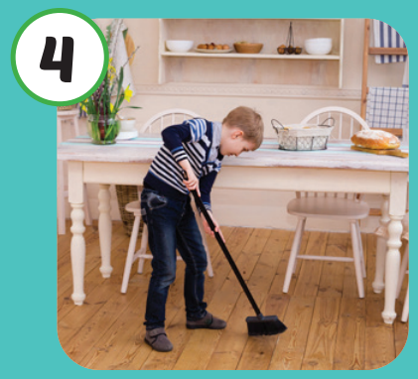
Listen and repeat.
Click each picture to hear the sound.
sweep the floor
Quét sàn nhà

Slide 12
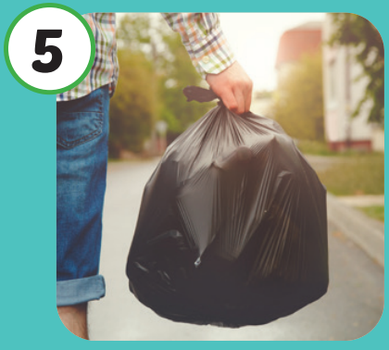
Listen and repeat.
Click each picture to hear the sound.
take out
the trash
Đổ rác

Slide 13

Listen and repeat.
Click each picture to hear the sound.
wash the dishes
Rửa bát đĩa

Slide 14
Practice

Slide 15
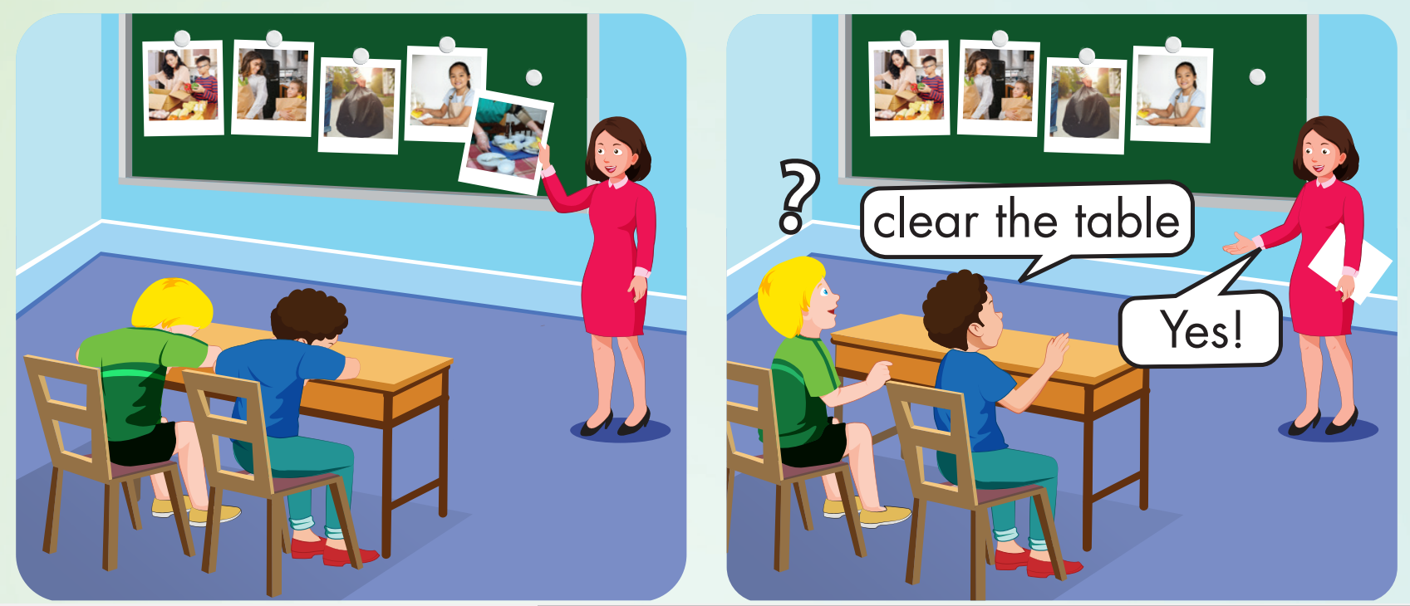

Slide 16
What’s missing?
carry bags

Slide 17
What’s missing?
sweep the floor

Slide 18
What’s missing?
clear the table

Slide 19

Structures
Who puts away groceries?
I put away groceries./ I do.

Slide 20
Presentation

Slide 21





Slide 22


Slide 23


Slide 24

Practice

Slide 25

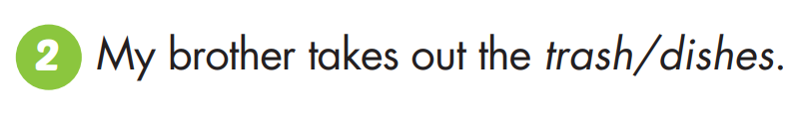

Slide 26
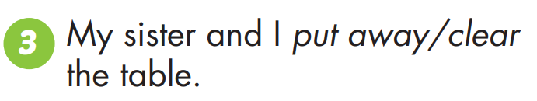
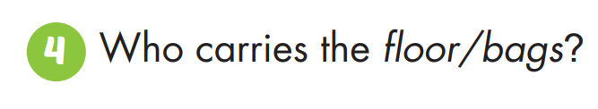

Slide 27
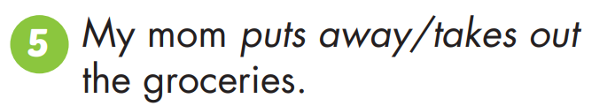
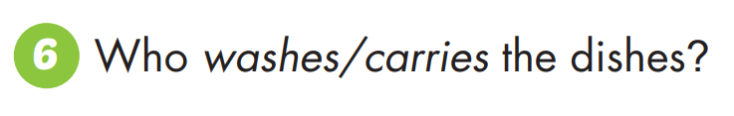

Slide 28

CONSOLIDATION

Slide 29

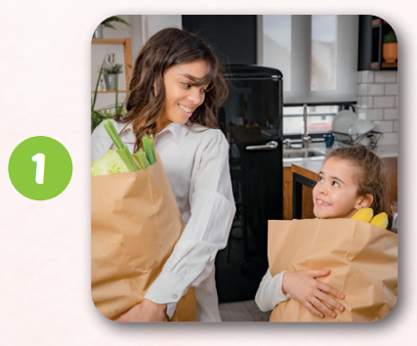
c | a | r | r | y
b | a | g | s

Slide 30
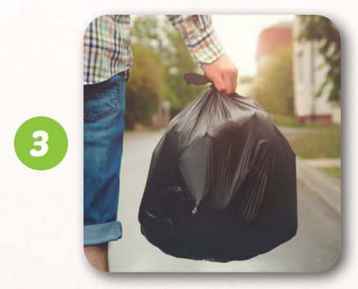
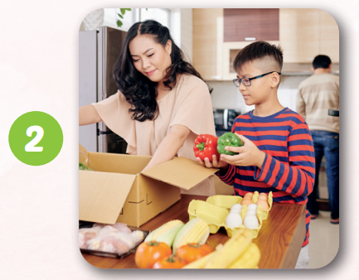
p | u | t |  | a | w | a | y
g | l | o | c | e | r | i | e | s

Slide 31
t | a | k | e |  | o | u | t
t | h | e |  | t | r | a | s | h

Slide 32
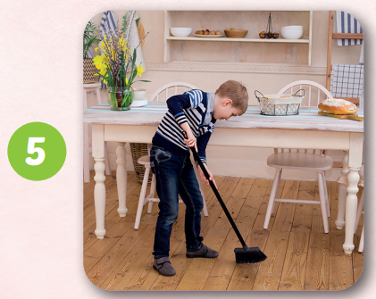
s | w | e | e | p |  | t | h
f | l | o | o | r
e

Slide 33
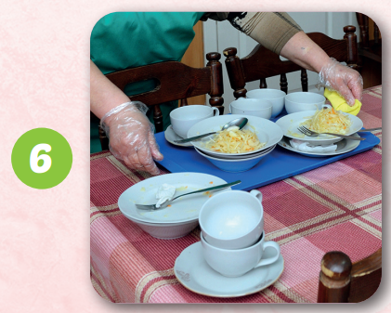
c | l | e | a | r
t | h | e |  | t | a | b | l
e

Slide 34

WRAP-UP

Slide 35
Today’s lesson
Vocabulary: put away groceries, carry bags, clear the table, sweep the floor, take out the trash, wash the dishes.
Structure:
Who puts away groceries?
I put away groceries./I do.

Slide 36
Homework
Practice the vocabularies and structure; and make sentences using them.
Do the exercises in Tiếng Anh 4 i-Learn Smart Start WB (page 68)
Do the exercises in Tiếng Anh 4 i-Learn Smart Start Notebook (page 43)
Prepare the next lesson (page 102 SB)
Play the consolidation games in Tiếng Anh 4 i-Learn Smart Start DHA App on www.eduhome.com.vn

Slide 37

Have a nice day!

