Slide 1

Unit 7: MY FAMILY
Lesson 3.3
Page 100

Slide 2
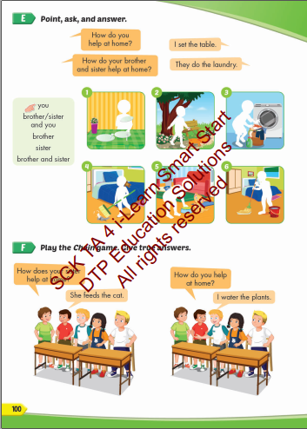
Lesson Outline
Warm-up
Practice
Speaking
Consolidation
Wrap-up

Slide 3
Lesson 3
Today’s lesson
Vocabularies
Set the table
Water the plants
Walk the dog
Feed the cat
Mop the floor
Do the laundry
Structures/ Sentence patterns
How do you help at home?
I set the table.
How does your brother help at home?
He mops the floor.

Slide 4

WARM UP

Slide 5

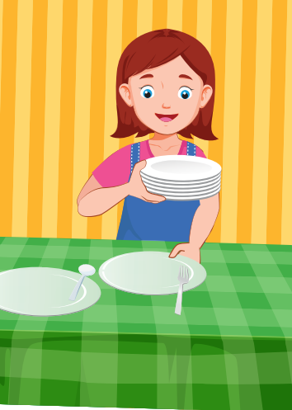

sit
cut
set
_ | _ | _ |  | t | h | e |  | t | a | b | l | e

Slide 6
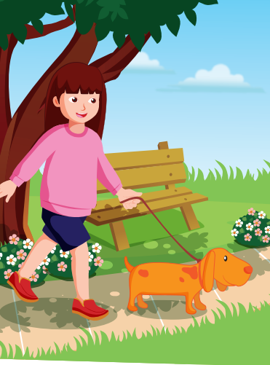
walk
feed
open
_ | _ | _ | _ |  | t | h | e |  | d | o | g

Slide 7
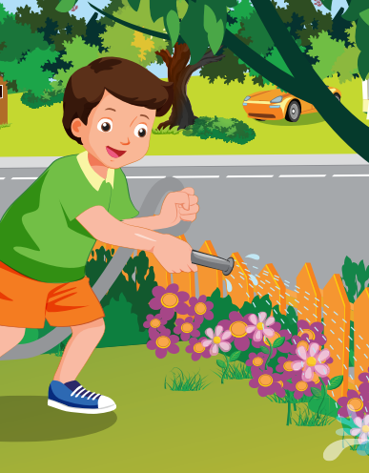
sweep
close
water
_ | _ | _ | _ | _ |  | t | h | e |  | p | l | a
n | t | s

Slide 8
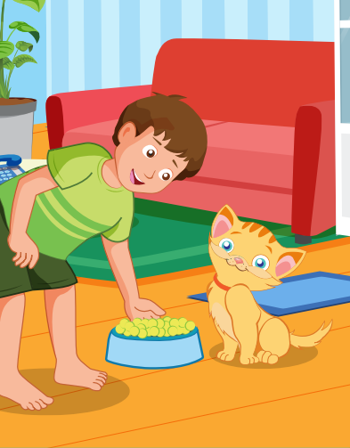
walk
feed
need
_ | _ | _ | _ |  | t | h | e |  | c | a | t

Slide 9
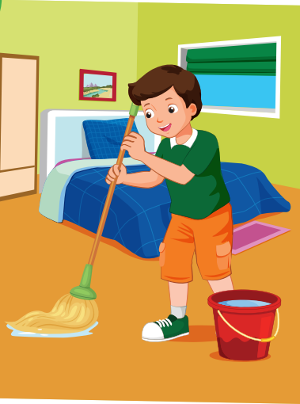
see
put
mop
_ | _ | _ |  | t | h | e |  | f | l | o | o | r

Slide 10
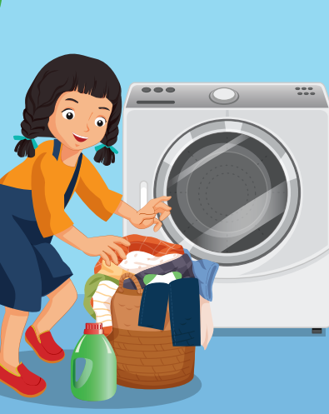
do
hi
go
_ | _ |  | t | h | e |  | l | a | u | n | d | r
y

Slide 11

Structures
How do you have at home?
I set the table.

Slide 12

Practice

Slide 13


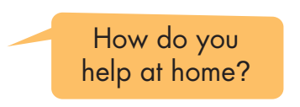


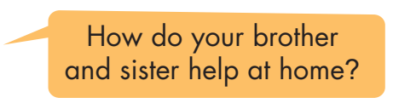
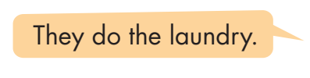

Slide 14
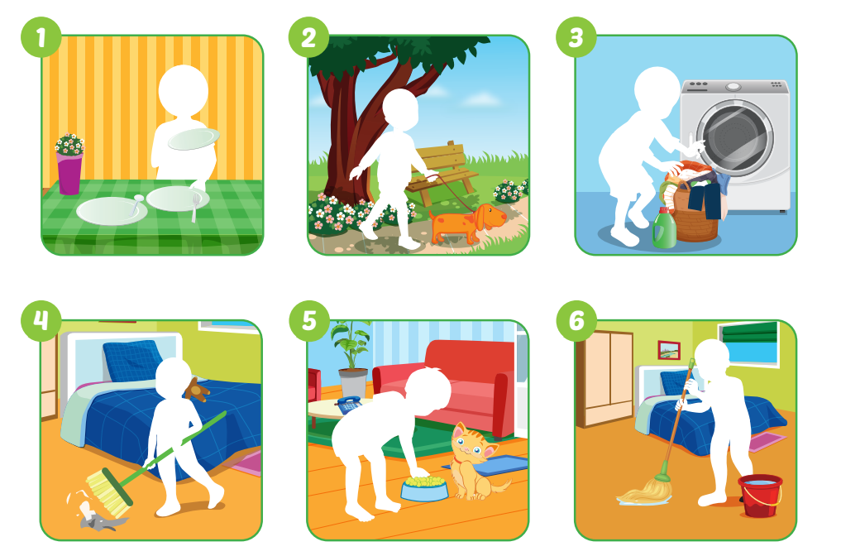
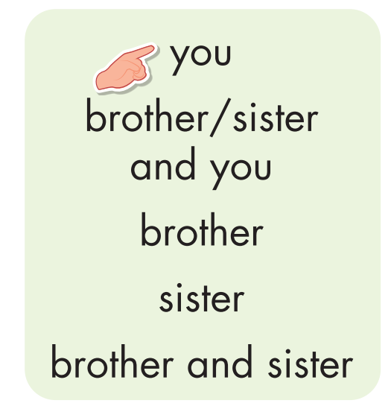

Slide 15
How does your brother help at home?
They do the laundry
Oh, that’s nice.

Slide 16
How do your brother and your sister help at home?
They set the table
I set up the table at home, too.

Slide 17
How do your sister and you help at home?
My sister feeds the cat and I walk the dog.
I walk the dog, too.

Slide 18
How does your sister help at home?
She mops the floor.
My sister mops the floor, too.

Slide 19

Speaking

Slide 20
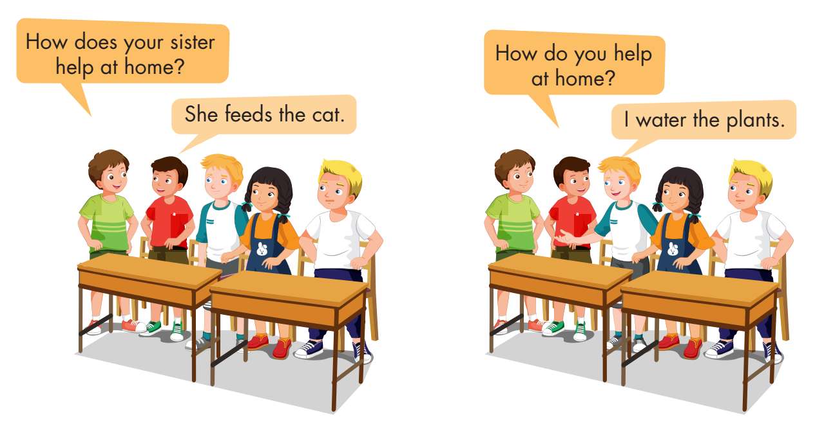

Slide 21
Work in pairs.
Ask each other using the form below.

Slide 22

CONSOLIDATION

Slide 23

Let’s play!
Let’s Dance Game

Slide 24
How To Play
Students must take turns reading the words in order.
Each time a student can choose to say the words in 1 square, 2 squares or a maximum of 3 squares.
The student who says the last word must dance!

Slide 25

set
walk
table
mop
water
floor
plant
laundry
feed
do
dog
cat
DANCE!!
store
hospital
office
farm
bank
mop
set
water
floor
laundry
plant
floor
walk
feed
store
farm
dog
table

Slide 26

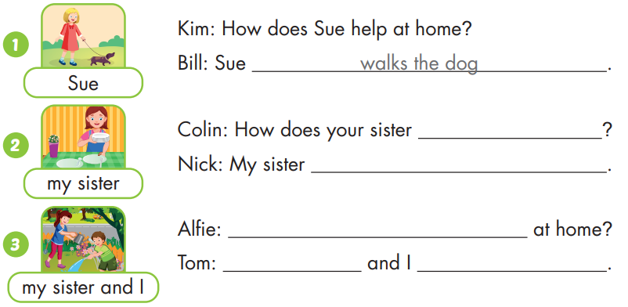
help at home
sets the table
How do your sister and you help
My sister
water the plants

Slide 27
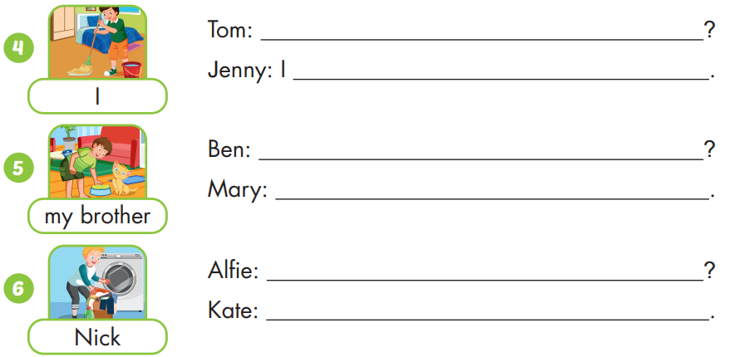
How do you help at home
mop the floor
How does your brother help at home
My brother feeds the cat
How does Nick help at home
Nick does the laundry

Slide 28

WRAP-UP

Slide 29
Today’s lesson
Vocabularies
Set the table
Water the plants
Walk the dog
Feed the cat
Mop the floor
Do the laundry
Structures/ Sentence patterns
How do you help at home?
I set the table.
How does your brother help at home?
He mops the floor.

Slide 30
Homework
Practice the vocabularies and structure; and make sentences using them.
Do the exercises in Tiếng Anh 4 i-Learn Smart Start WB (page 67)
Do the exercises in Tiếng Anh 4 i-Learn Smart Start Notebook (page 42)
Prepare the next lesson (page 101 SB)
Play the consolidation games in Tiếng Anh 4 i-Learn Smart Start DHA App on www.eduhome.com.vn

Slide 31

Have a nice day!

