Slide 1

Unit 7. MY FAMILY
Lesson 3.1
Page 98

Slide 2
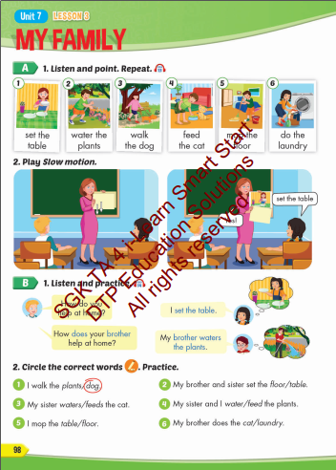
Lesson Outline
Warm-up
Vocabulary
Structure
Consolidation
Wrap-up

Slide 3
By the end of this lesson, students will be able to talk about chores they do.
Vocabularies
Set the table
Water the plants
Walk the dog
Feed the cat
Mop the floor
Do the laundry
Structures/ Sentence patterns
How do you help at home?
I set the table.
How does your brother help at home?
My brother waters the plants.

Slide 4

WARM UP

Slide 5
How to Play:
- Create 2 teams and answer the question quickly and correctly will get 1 point.
- The team with the most correct answers will win.

Slide 6

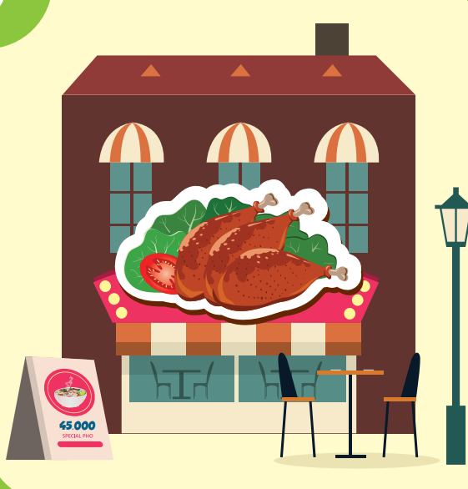

WHERE IS THIS?

Slide 7
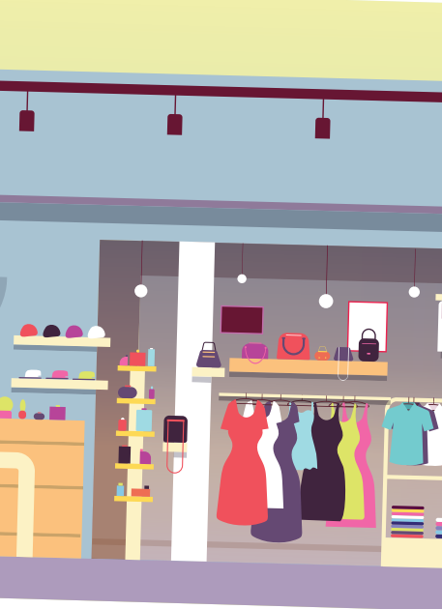
WHERE IS THIS?

Slide 8

WHERE IS THIS?

Slide 9

WHERE IS THIS?

Slide 10
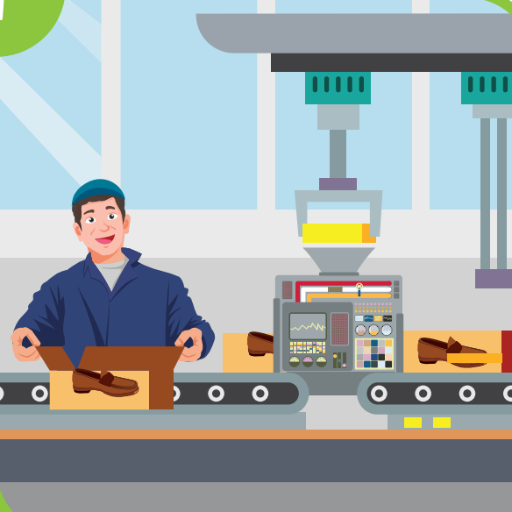
WHERE IS THIS?

Slide 11
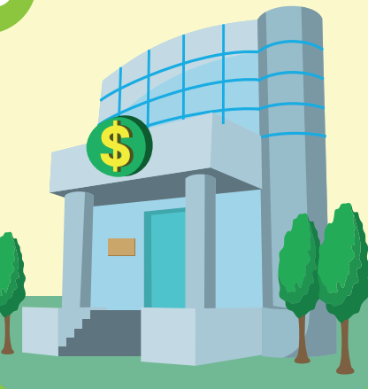
WHERE IS THIS?

Slide 12

It’s time to learn …

Slide 13

New words
Set the table,
water the plants,
walk the dog,
feed the cat,
mop the floor,
do the laundry

Slide 14

Presentation

Slide 15


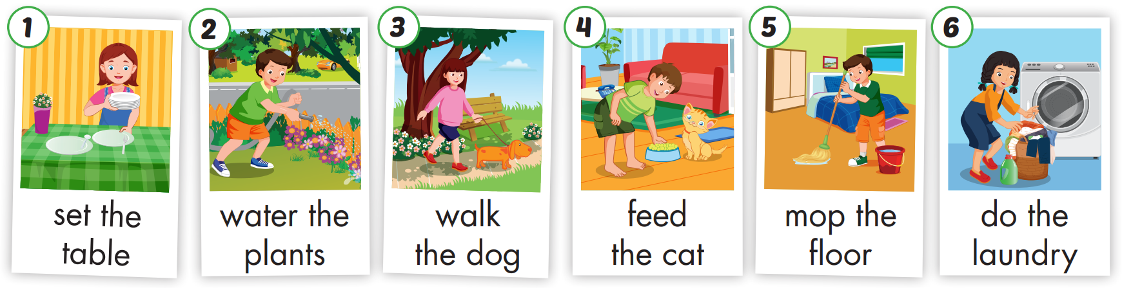

Slide 16
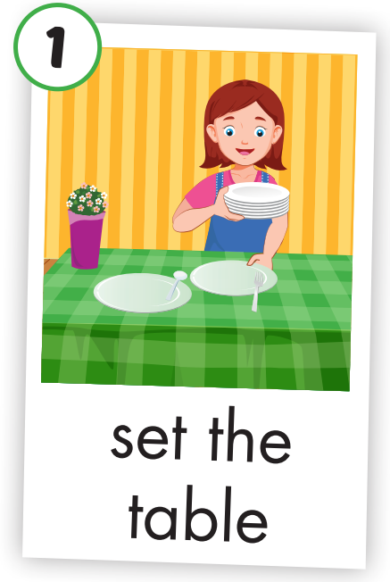
Click each word to hear the sound.
set the table
/set ðə ˈteɪbl/
Chuẩn bị bàn ăn

Slide 17
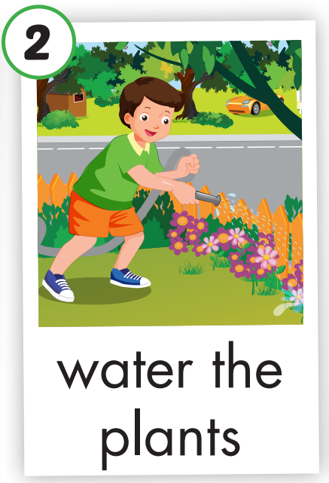
Click each word to hear the sound.
water the plants
/ˈwɔːtə ðə plɑːnts/
Tưới cây

Slide 18
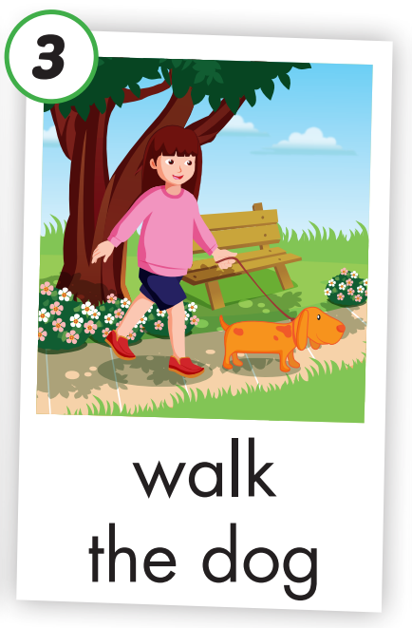
Click each word to hear the sound.
walk the dog
/wɑːk ðə dɑːɡ/
Dắt chó đi dạo

Slide 19
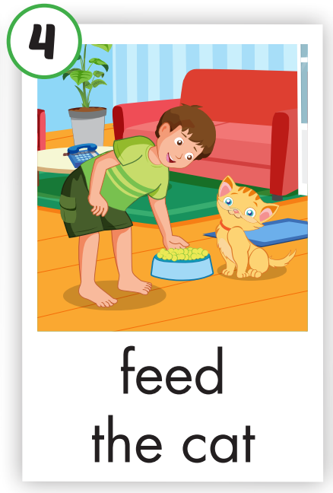
Click each word to hear the sound.
feed the cat
/fiːd ðə kæt/
Cho mèo ăn

Slide 20
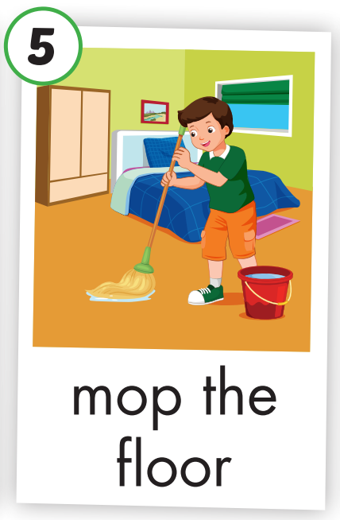
Click each word to hear the sound.
mop the floor
/mɒp ðə flɔː/
Lau nhà

Slide 21
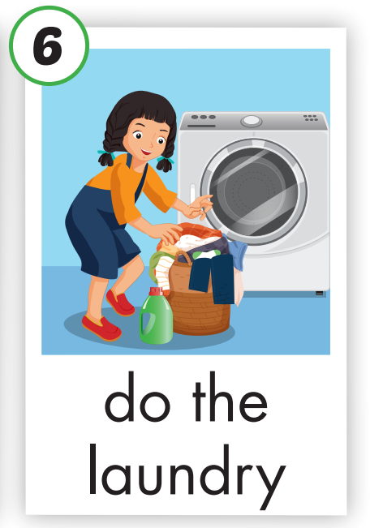
Click each word to hear the sound.
do the laundry
/duː ðə ˈlɑːndri/
Giặt đồ

Slide 22

Practice

Slide 23


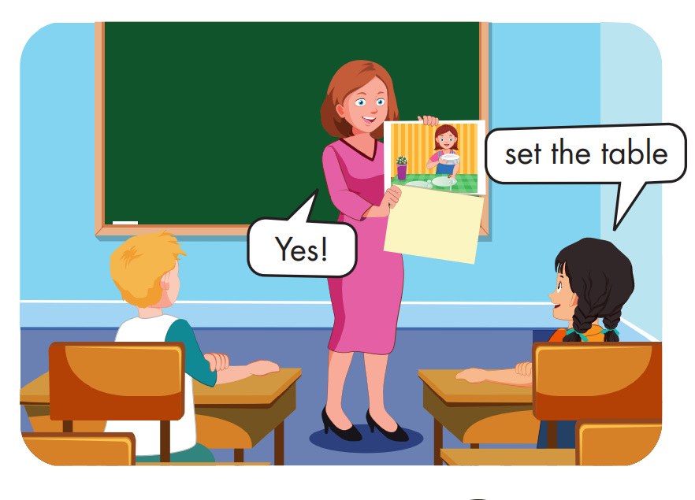

Slide 24
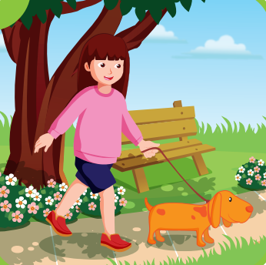
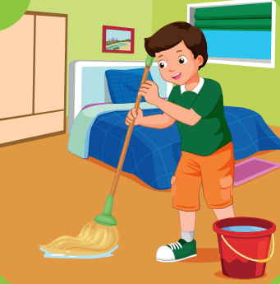
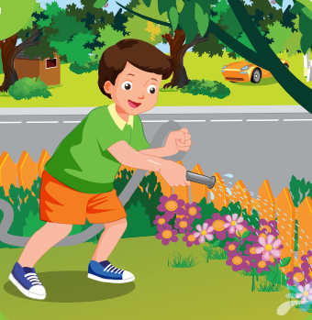

Slide 25
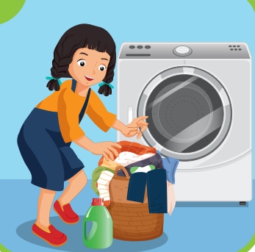
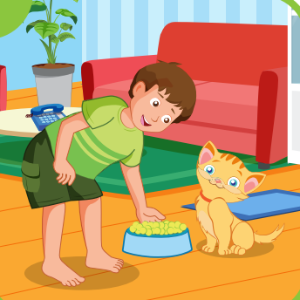

Slide 26
Structure

Slide 27
Presentation

Slide 28

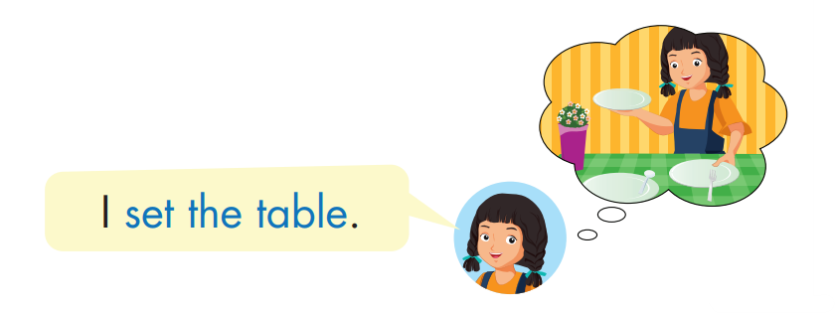
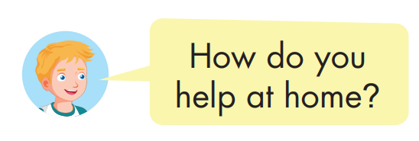
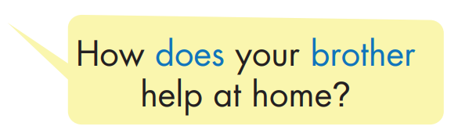
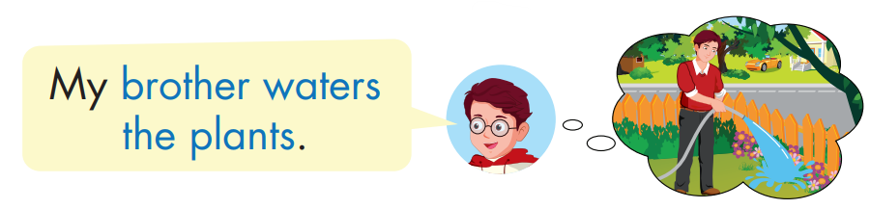

Slide 29
Practice

Slide 30
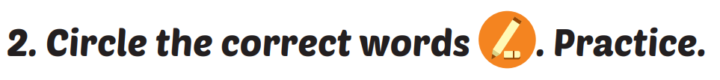



Slide 31


Slide 32



Slide 33
He walks the dog/ plants.
My mother feeds / mops the cat.

Slide 34
laundry/ my mother/ the/ does.
My mother does the laundry.
my / waters/ sister/ plants/ the.
My sister waters the plants.

Slide 35

CONSOLIDATION

Slide 36

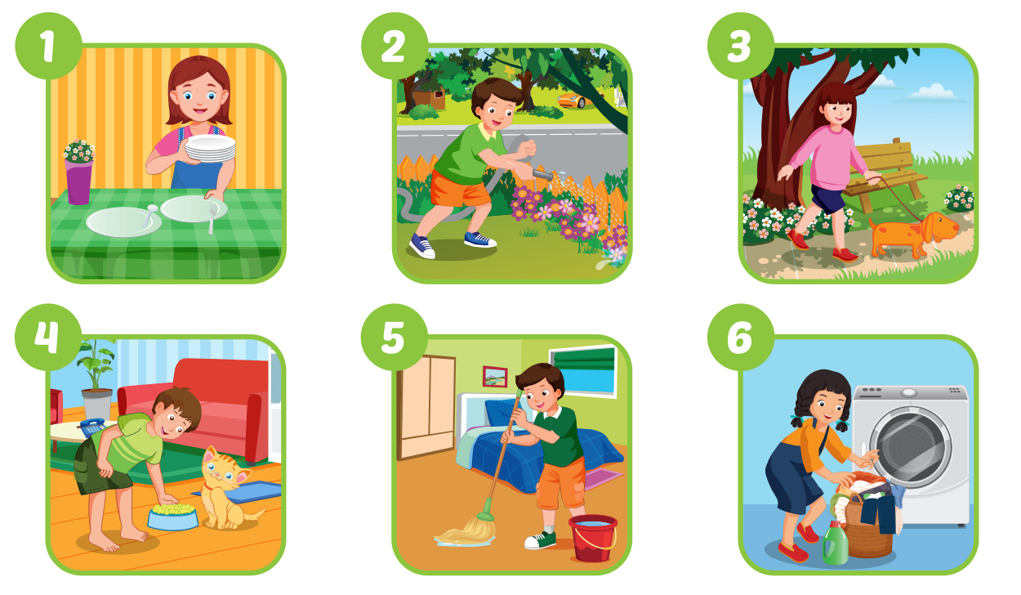
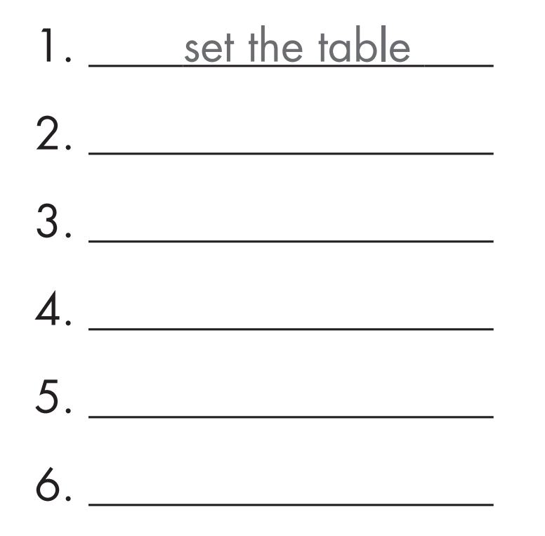
water the plants
walk the dog
feed the cat
mop the floor
do the laundry

Slide 37
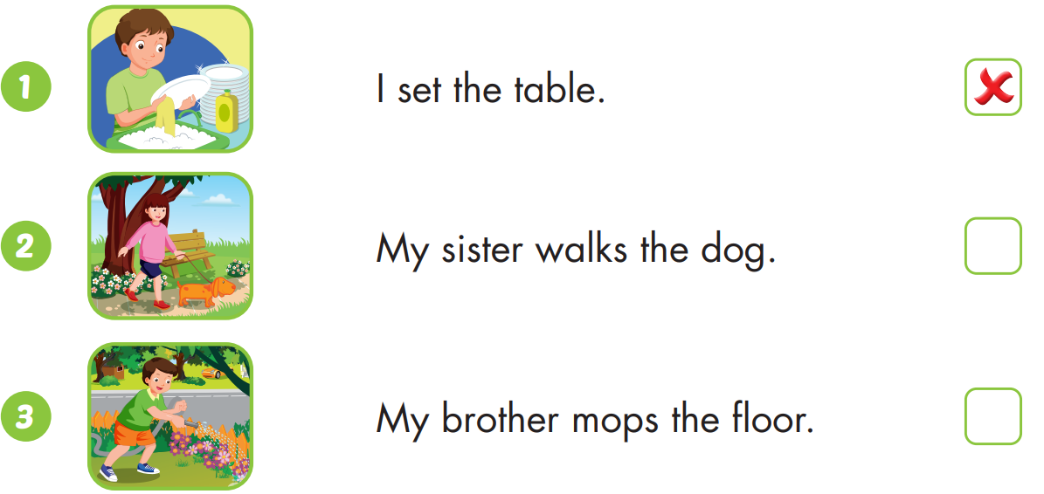



Slide 38
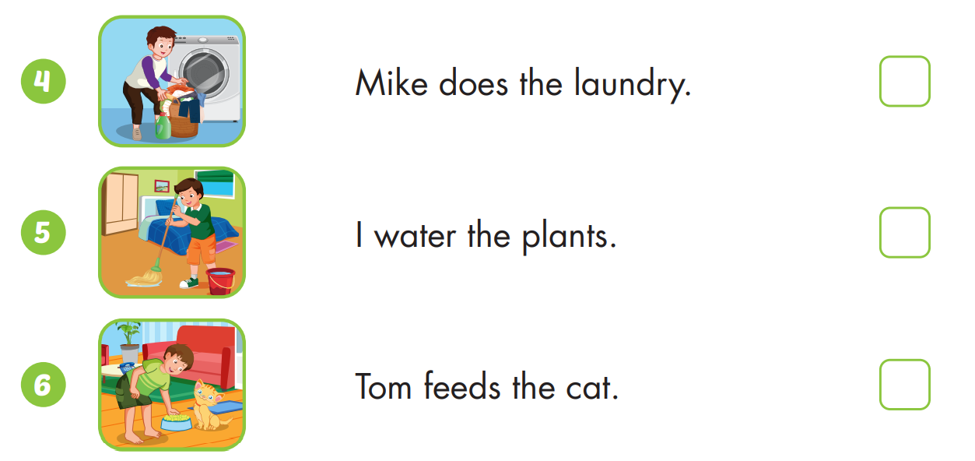

Slide 39

WRAP-UP

Slide 40
Today’s lesson
Vocabularies
Set the table
Water the plants
Walk the dog
Feed the cat
Mop the floor
Do the laundry
Structures/ Sentence patterns
How do you help at home?
I set the table.
How does your brother help at home?
My brother waters the plants.

Slide 41
Homework
Practice the vocabularies and structure; and make sentences using them.
Do the exercises in Tiếng Anh 4 i-Learn Smart Start WB (page 66)
Do the exercises in Tiếng Anh 4 i-Learn Smart Start Notebook (page 42)
Prepare the next lesson (page 99 SB)
Play the consolidation games in Tiếng Anh 4 i-Learn Smart Start DHA App on www.eduhome.com.vn

Slide 42
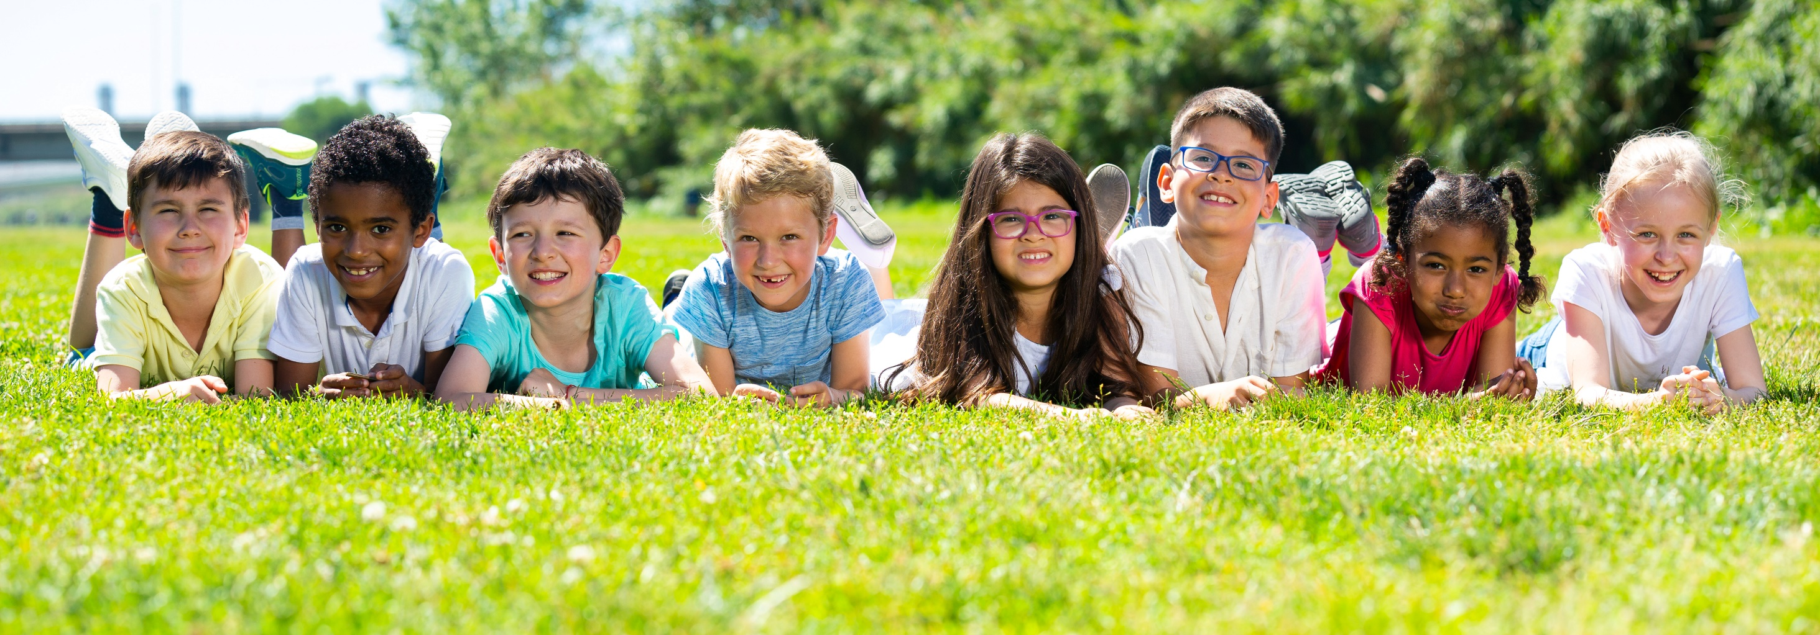
Have a nice day!

