Slide 1

Unit 7: MY FAMILY
Lesson 2.1
Page 95

Slide 2
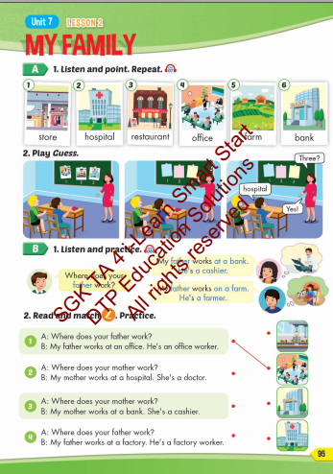
Lesson Outline
Warm-up
Vocabulary
Structure
Consolidation
Wrap-up

Slide 3
Objectives
By the end of this lesson, students will be able to talk about where their family members work.
Vocabulary: store, hospital, restaurant, office, farm, bank.
Structure: Where does your father work?
My father works at a bank. He's a cashier.

Slide 4

WARM UP

Slide 5
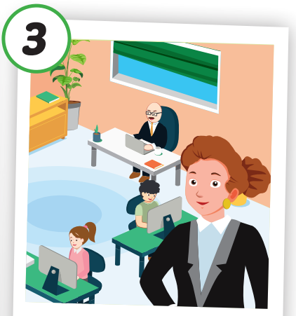
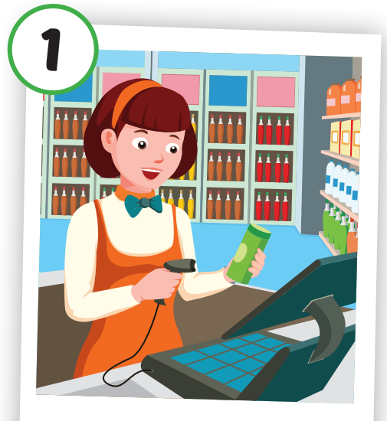
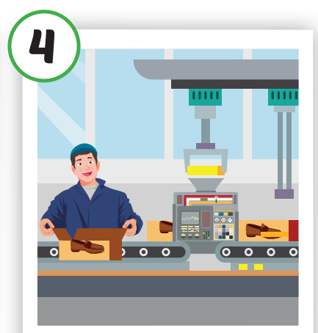
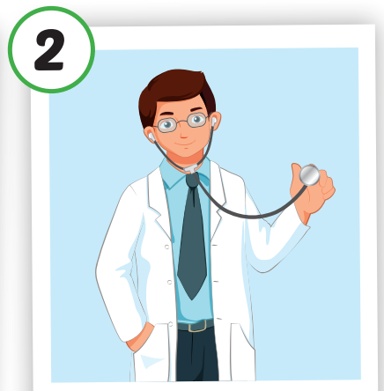
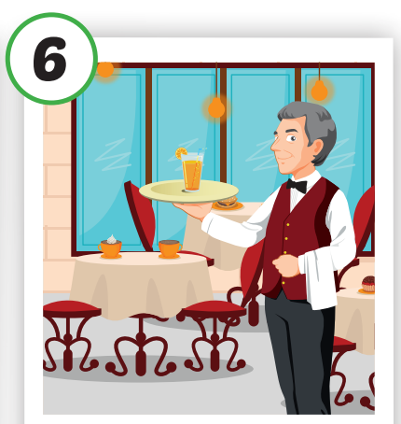

4
1
SPIN
3
2
2
5

Slide 6

It’s time to learn …

Slide 7

New words
store,
hospital,
restaurant,
office,
farm,
bank.

Slide 8

Presentation

Slide 9


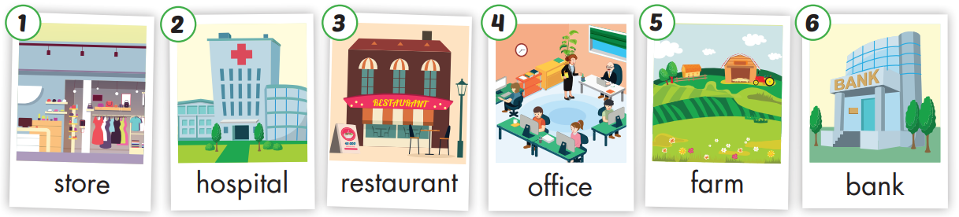

Slide 10

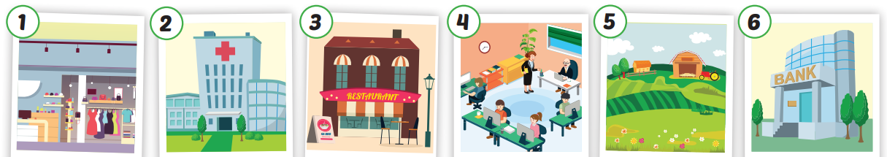
Click each English word to hear the sound.
store
hospital
restaurant
office
farm
bank
/stɔːr/
Cửa hàng
/ˈhɑːspɪtl
Bệnh viện
/ˈrestərɑːnt/
Nhà hàng
/ˈɑːfɪs/
Văn phòng
/fɑːrm/
Nông trại
/bæŋk/
Ngân hàng

Slide 11
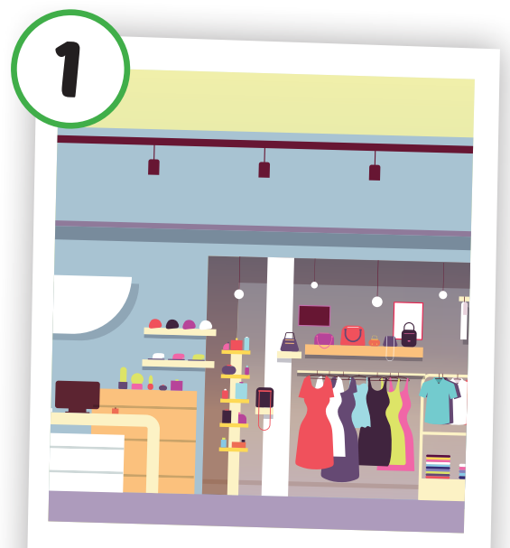
Click each English word to hear the sound.
store
/stɔːr/
Cửa hàng

Slide 12
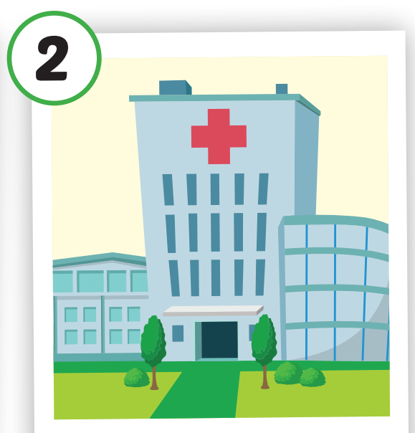
Click each English word to hear the sound.
hospital
/ˈhɑːspɪtl/
Bệnh viện

Slide 13
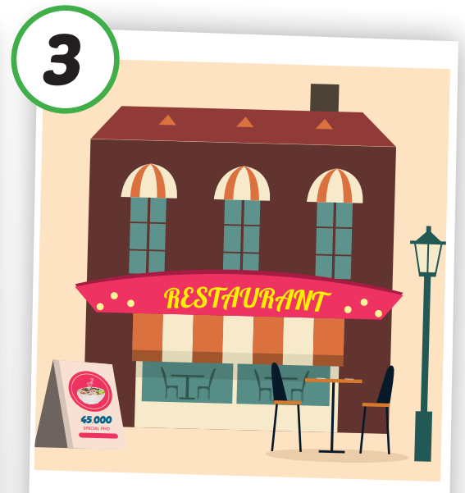
Click each English word to hear the sound.
restaurant
/ˈrestərɑːnt/
Nhà hàng

Slide 14
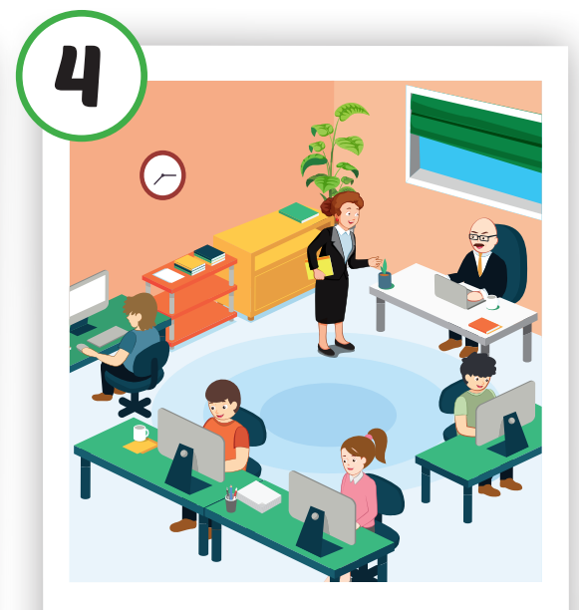
Click each English word to hear the sound.
office
/ˈɑːfɪs/
Văn phòng

Slide 15

Click each English word to hear the sound.
farm
/fɑːrm/
Nông trại

Slide 16
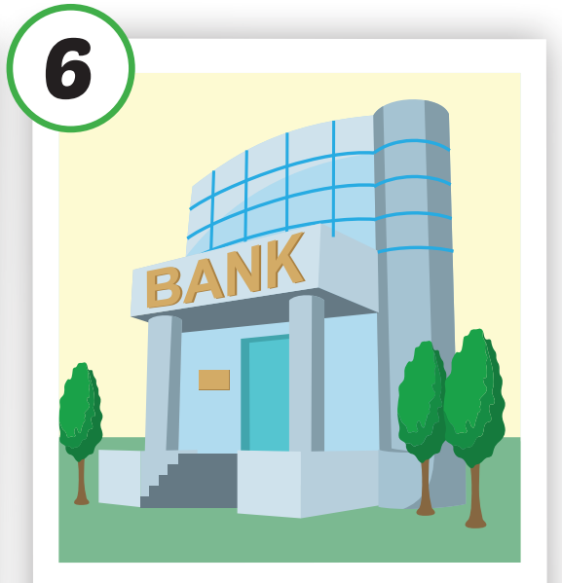
Click each English word to hear the sound.
bank
/bæŋk/
Ngân hàng

Slide 17

Practice

Slide 18

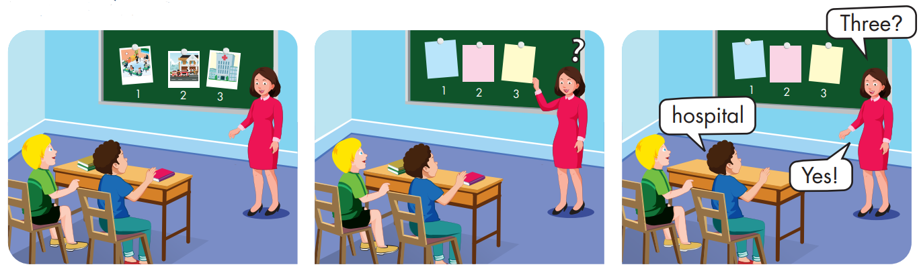

Slide 19
Structures:
Where does your father work?
My father works at a bank.
He's a cashier.

Slide 20
Presentation

Slide 21

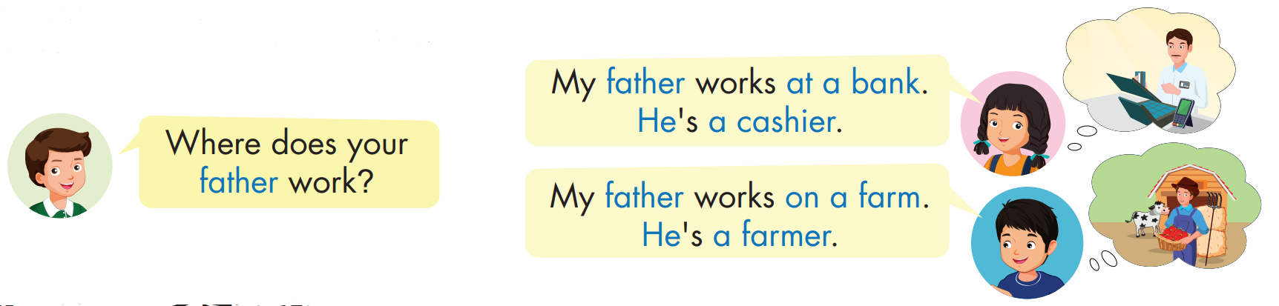

Click each English word to hear the sound.

Slide 22

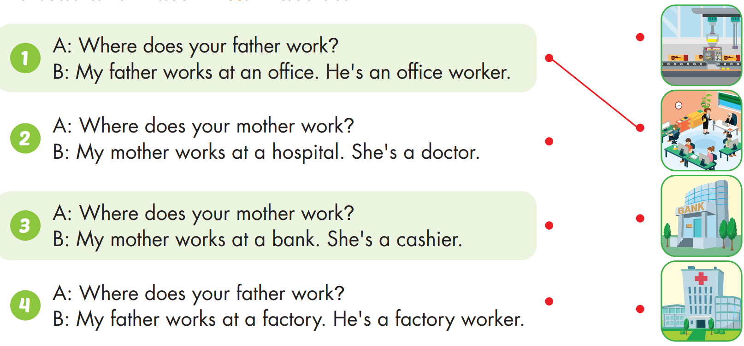

Slide 23
Practice

Slide 24

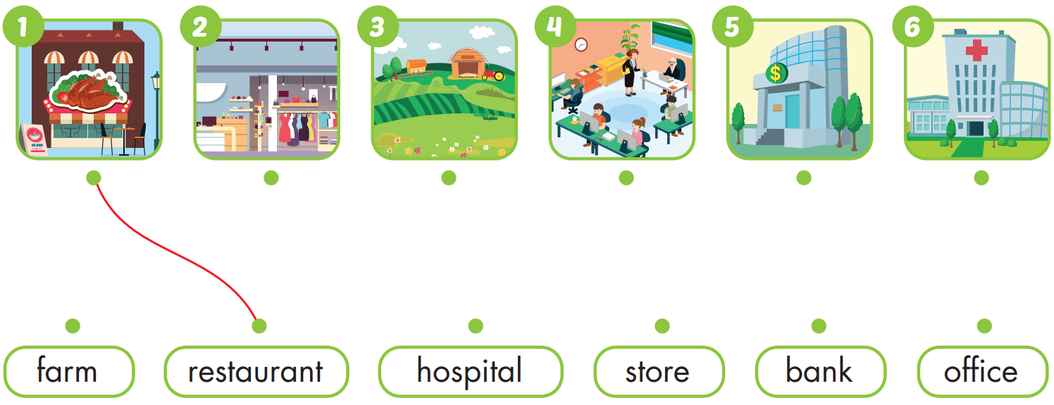
Practice

Slide 25

CONSOLIDATION

Slide 26

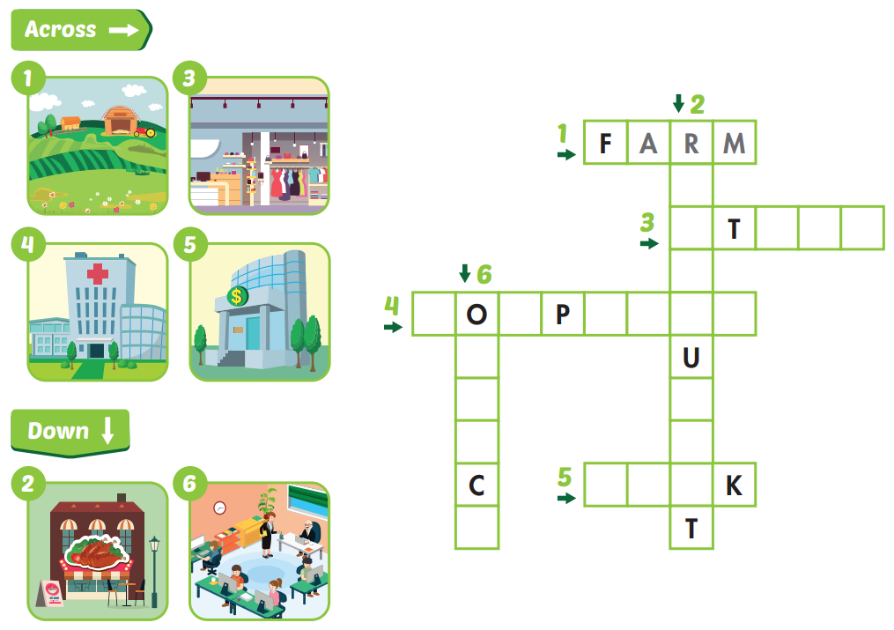

Slide 27
E
S
T
A
R
A
N

Slide 28
E
S
O
R
E
T
A
R
A
N

Slide 29
E
S
O
R
E
T
H
S
I
T
A
L
R
A
N

Slide 30
E
S
O
R
E
T
H
S
I
T
A
L
R
A
B
A
N

Slide 31
E
S
O
R
E
T
H
S
I
T
A
L
F
F
R
I
A
B
A
N
E

Slide 32

WRAP-UP

Slide 33
Lesson 3
Today’s lesson
Vocabularies
store, hospital, restaurant, office, farm, bank.
Structures/ Sentence patterns
Where does your father work?
My father works at a bank. He's a cashier.

Slide 34
Lesson 3
Homework
Practice the vocabularies and structure; and make sentences using them.
Do the exercises in Tiếng Anh 4 i-Learn Smart Start WB (page 64)
Do the exercises in Tiếng Anh 4 i-Learn Smart Start Notebook (page 41)
Prepare the next lesson (page 96 SB)
Play the consolidation games in Tiếng Anh 4 i-Learn Smart Start DHA App on www.eduhome.com.vn

Slide 35

Have a nice day!

