Slide 1

Unit 8: MY FRIENDS AND I
Lesson 1 - Page 107

Slide 2
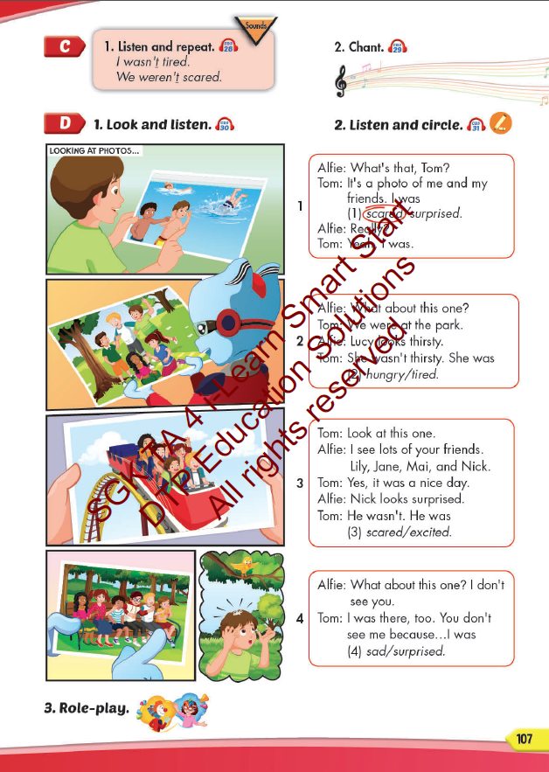
Lesson Outline
Warm-up
Listening
Consolidation
Wrap-up

Slide 3
Objectives
By the end of this lesson, students will be able to pronounce the sound /t/ and practice the conversations.
Vocabulary: hungry, thirsty, scared, surprised, tired, excited.
Structure:
- I was tired.
- Alfie wasn't thirsty. He was hungry.
- Lucy and Ben weren't scared. They were excited.
Phonics: /t/, wasn’t, weren’t.

Slide 4

WARM UP

Slide 5


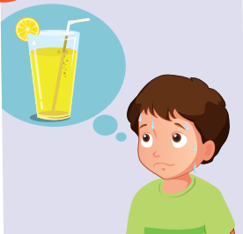

Look. Choose the correct answer.
A
hungry
B
thirsty
C
tired

Slide 6

Look. Choose the correct answer.
A
excited
B
scared
C
surprised

Slide 7


Listen. Choose the correct answer.
A
B
C

Slide 8
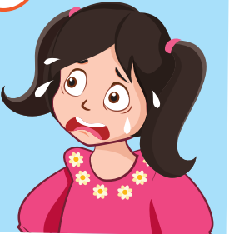
Listen. Choose the correct answer.
Click on A, B, C box to check the correct answer
A
B
C
Click on speaker icon to hear the sound

Slide 9
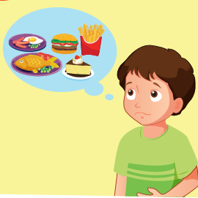
Listen. Choose the correct answer.
A
B
C

Slide 10

It’s time to learn …

Slide 11

Phonics
/t/

Slide 12
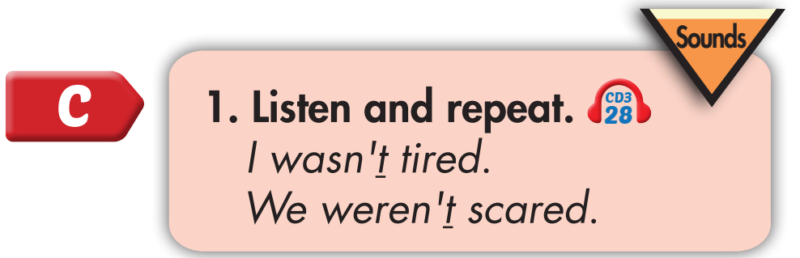
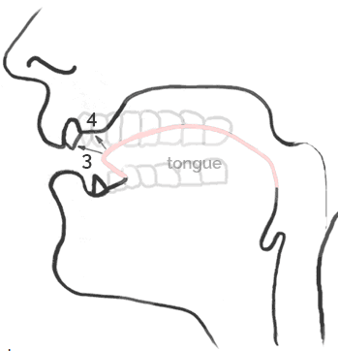


Click on the sentence to hear the sound

Slide 13
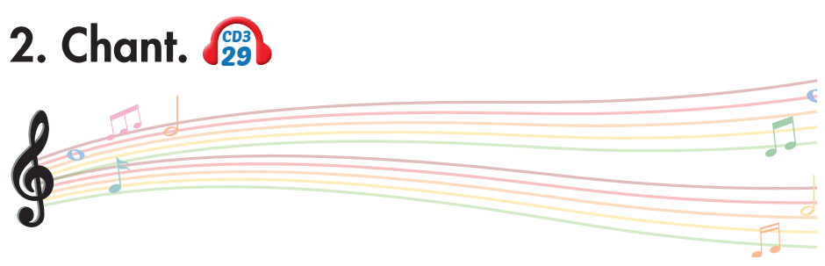
Tom wasn’t scared. He was tired.
Kim wasn’t surprised. She was excited.
And they weren’t hungry, but they were very thirsty.
Notes:
1. Listen.
2. Listen and chant.

Slide 14
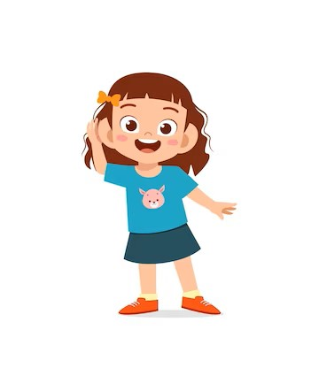
Listen. Hop and repeat when you hear /t/ sound.
Notes:
T says
Tea
Teacher
Chant
Pan
Can
Tired
Stop
What
Hat
Fat
Run

Slide 15

Listening

Slide 16
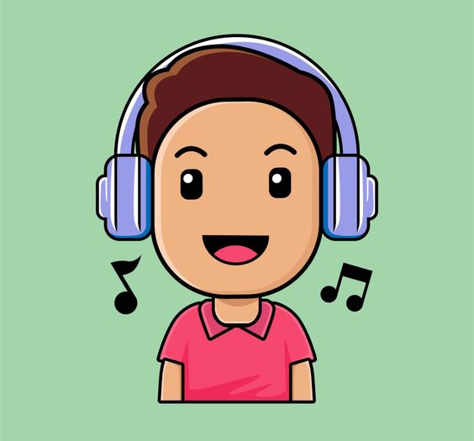
BEFORE YOU LISTEN

Slide 17
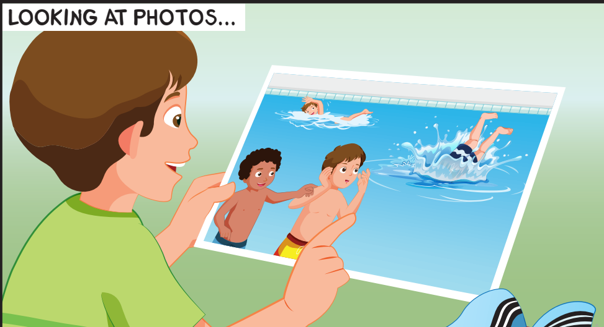
Where was Tom?
Was Tom hungry?

Slide 18
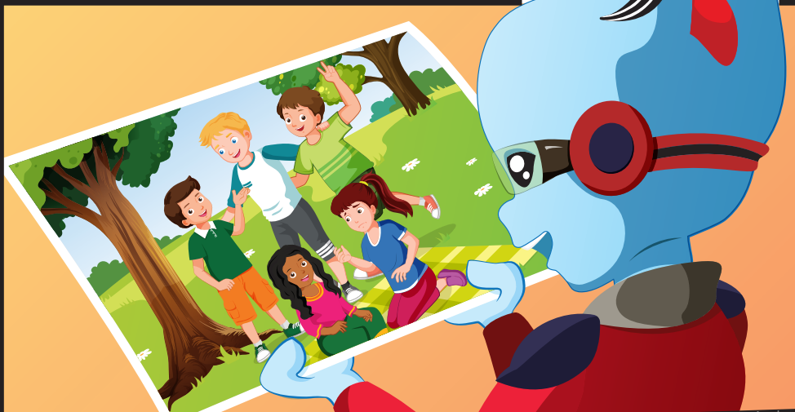
Was Lucy happy?

Slide 19
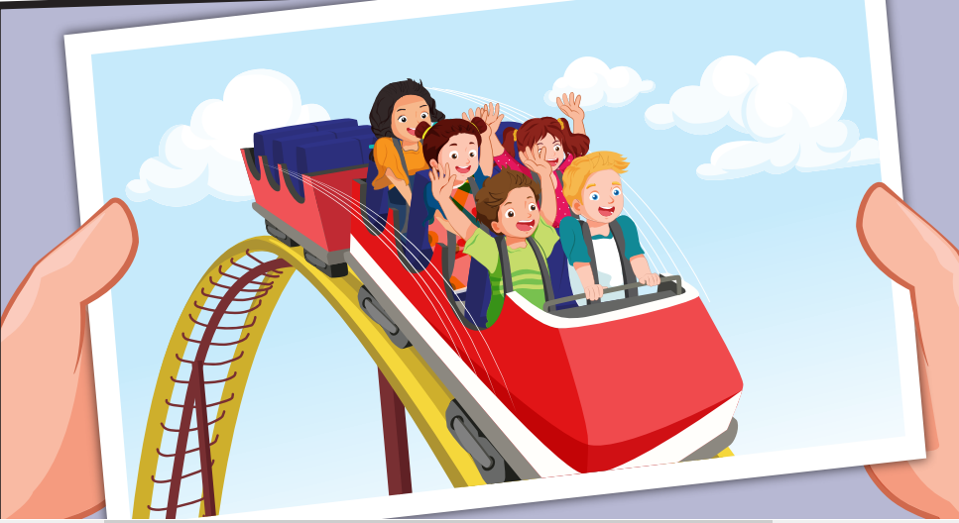
How did they feel?

Slide 20
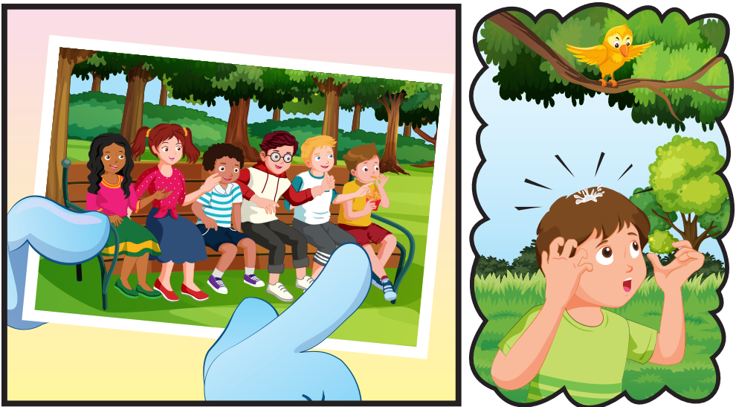
How did Tom and his friends feel?

Slide 21

Click on the picture to hear the sound

Slide 22
Click on the picture to hear the sound

Slide 23
Click on the picture to hear the sound

Slide 24
Click on the picture to hear the sound

Slide 25

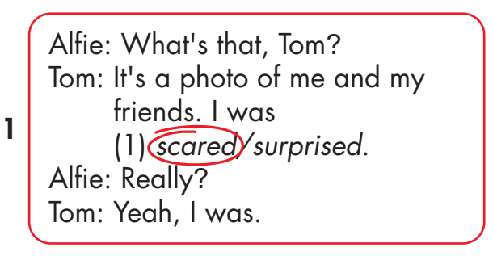
Click on the headphone icon to hear the sound.

Slide 26
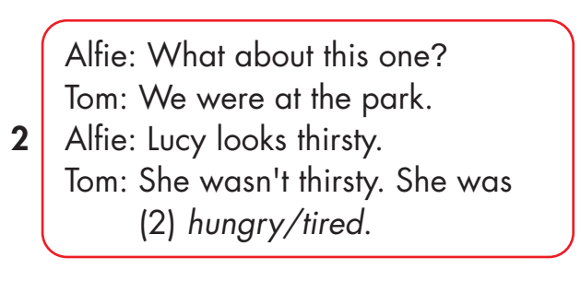
Click on the headphone icon to hear the sound.
Click on number 2
to show the answer.

Slide 27
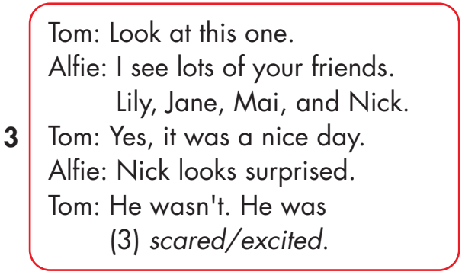
Click on the headphone icon to hear the sound.
Click on number 3
to show the answer.

Slide 28
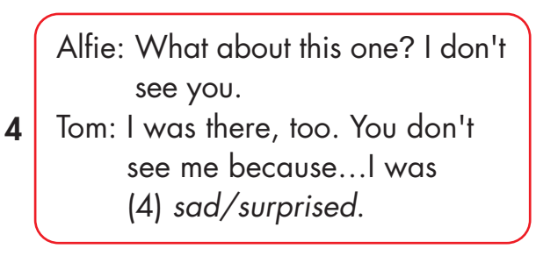
Click on the headphone icon to hear the sound.
Click on number 4
to show the answer.

Slide 29

Practice

Slide 30
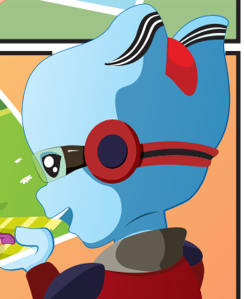
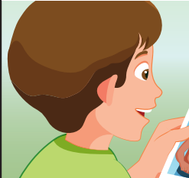
What’s that, Tom?
It’s a photo of me and my friends. I was scared.

Slide 31
What about this one?
We were at the park.
Lucy looks thirsty.
She wasn’t thirsty. She was hungry.

Slide 32
I see lots of your friends.
Yes, It was a nice day.
Nick looks suprised.
He wasn’t. He was excited.

Slide 33
What’s about this? I don’t see you.
I was there, too.
You don’t see me because… I was surprised.

Slide 34

Production

Slide 35
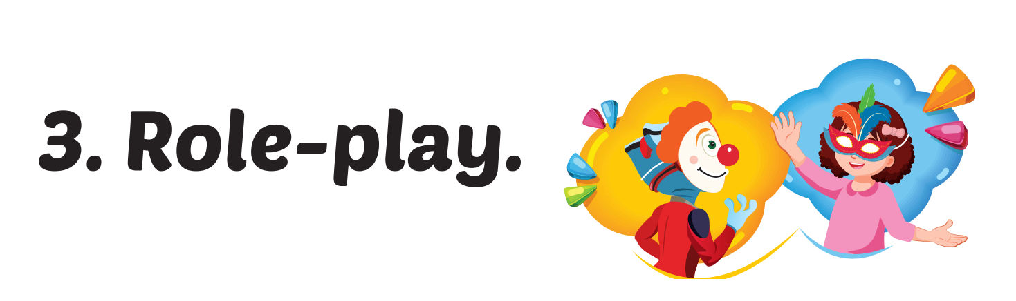

Slide 36

CONSOLIDATION

Slide 37


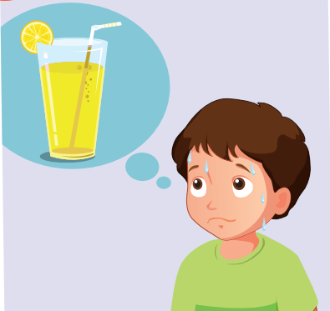
thirsty
_____________________________
Notes:
WB page 32

Slide 38
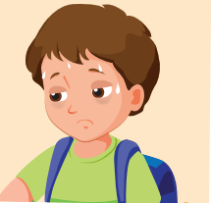
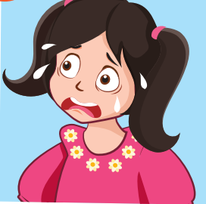
scared
_____________________________
Notes:
WB page 32

Slide 39

hungry
_____________________________
Notes:
WB page 32

Slide 40

surprised
_____________________________
Notes:
WB page 32

Slide 41
excited
_____________________________
Notes:
WB page 32

Slide 42

WRAP-UP

Slide 43
Lesson 3
Today’s lesson
Vocabularies
hungry, thirsty, scared, surprised, tired, excited
Structures/ Sentence patterns
- I was tired.
- Alfie wasn't thirsty. He was hungry.
- Lucy and Ben weren't scared. They were excited.

Slide 44
Lesson 3
Homework
Practice the vocabularies and structure, and make sentences using them.
Do the exercises in Tiếng Anh 4 i-Learn Smart Start WB (page 73)
Do the exercises in Tiếng Anh 4 i-Learn Smart Start Notebook (page 46)
Prepare the next lesson (page 108 SB)
Play the consolidation games in Tiếng Anh 4 i-Learn Smart Start DHA App on www.eduhome.com.vn

Slide 45

Lesson 3
Stay positive and have a nice day!

