Slide 1

Unit 6: FOOD AND DRINKS
Culture - Lesson 1
Page 87

Slide 2
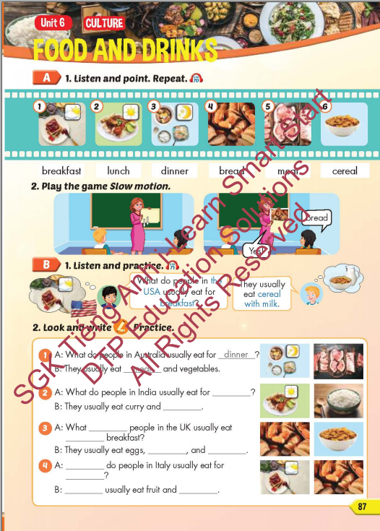
Lesson Outline
Warm-up
Vocabulary
Structure
Consolidation
Wrap-up

Slide 3
Objectives
By the end of this lesson, students will be able to identify meals and some food and practice talking about what food people eat in different countries.
Vocabulary: breakfast, lunch, dinner, bread, meat, cereal.
Structure:
What do people in the USA usually eat for breakfast?
They usually eat cereal with milk.

Slide 4

WARM-UP

Slide 5
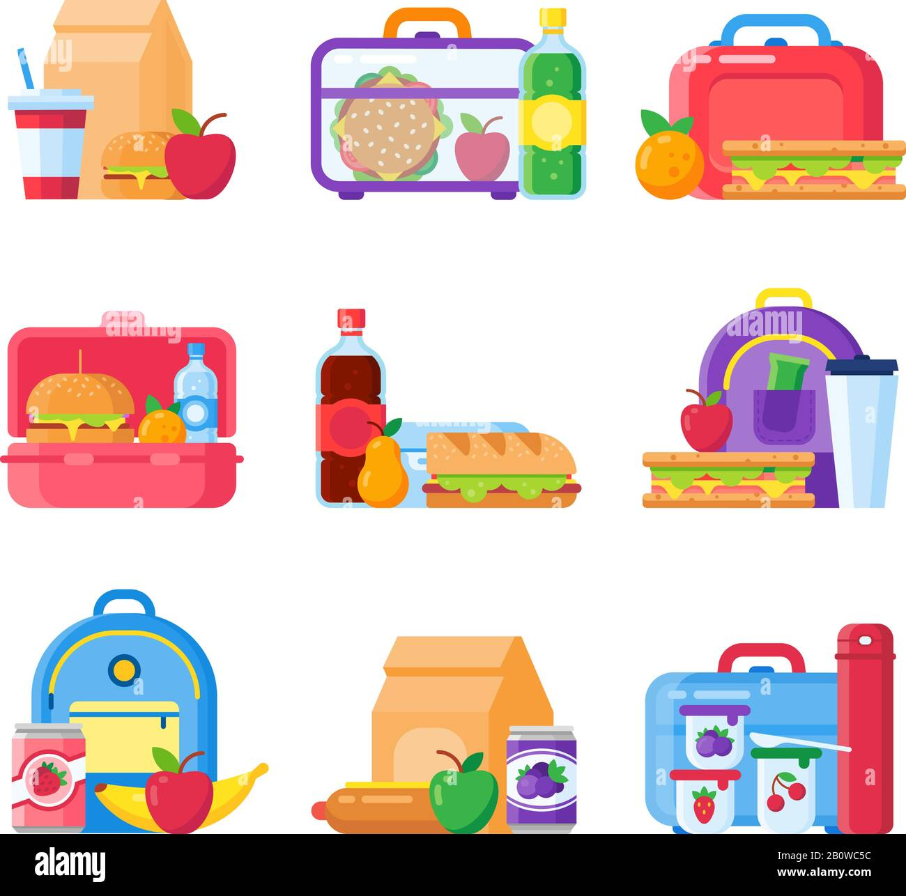

You are preparing food for your lunch. Now let’s make your lunch box.

Slide 6
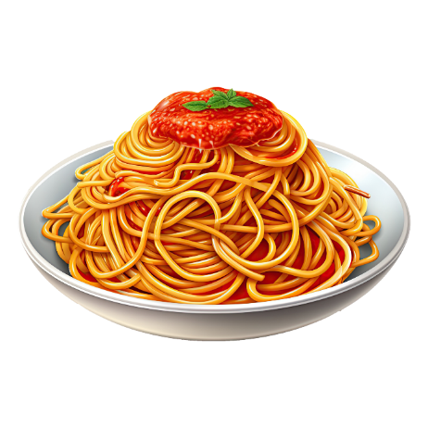





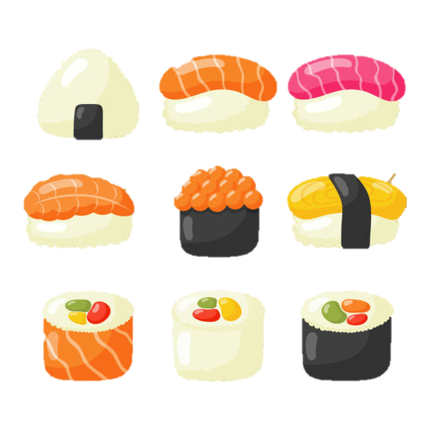





You are preparing food for your lunch. Now let’s make your lunch box.

Slide 7
I have sushi, eggs, sausages, cakes, and milk for my lunch.

Slide 8

It’s time to learn …

Slide 9

New words
breakfast, lunch, dinner, bread, meat, cereal

Slide 10

Presentation

Slide 11


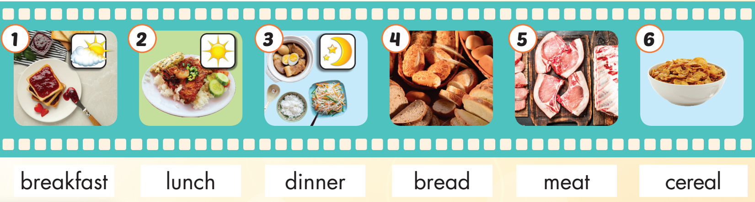
/ˈbrekfəst/
bữa sáng
/lʌntʃ/
bữa trưa
/ˈdɪnər/
bữa tối
/bred/
bánh mì
/miːt/
thịt
/ˈsɪriəl/
ngũ cốc
Notes:
Click vào hình A. 1. Listen and point. Repeat để cho cả audio full chạy

Slide 12

Click on the picture to hear the sound.
breakfast (n)
/ˈbrekfəst/
bữa sáng

Slide 13
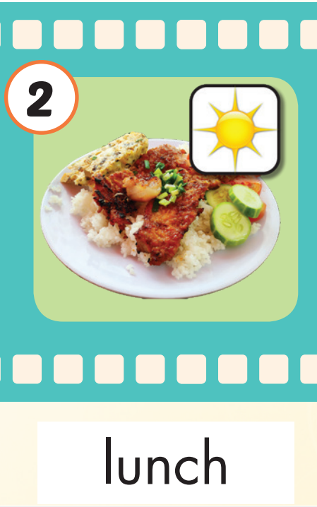
Click on the picture to hear the sound.
lunch (n)
/lʌntʃ/
bữa trưa
Practice

Slide 14
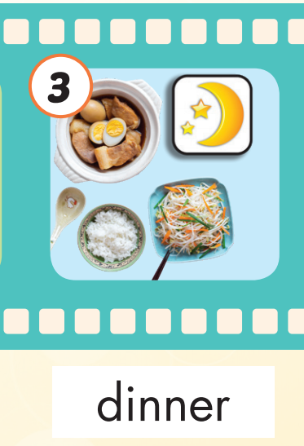
Click on the picture to hear the sound.
dinner (n)
/ˈdɪnər/
bữa tối
Practice

Slide 15
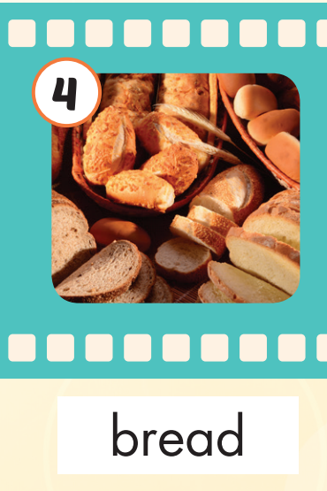
Click on the picture to hear the sound.
bread (n)
/bred/
bánh mì
Practice

Slide 16
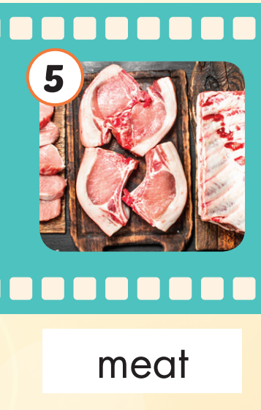
Click on the picture to hear the sound.
meat (n)
/miːt/
thịt
Practice

Slide 17
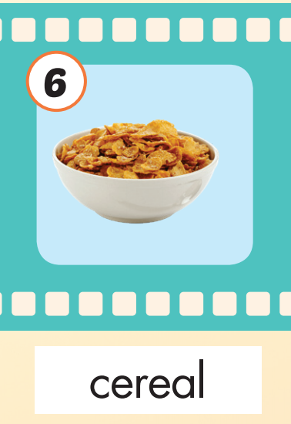
Click on the picture to hear the sound.
cereal (n)
/ˈsɪriəl/
ngũ cốc
Practice

Slide 18
Practice

Slide 19
Listen and choose. Then say.

Slide 20
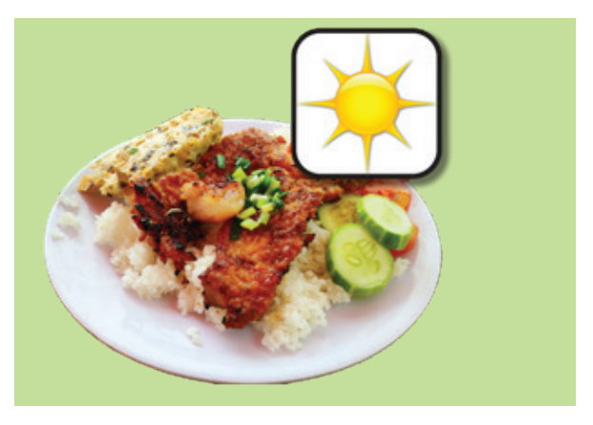
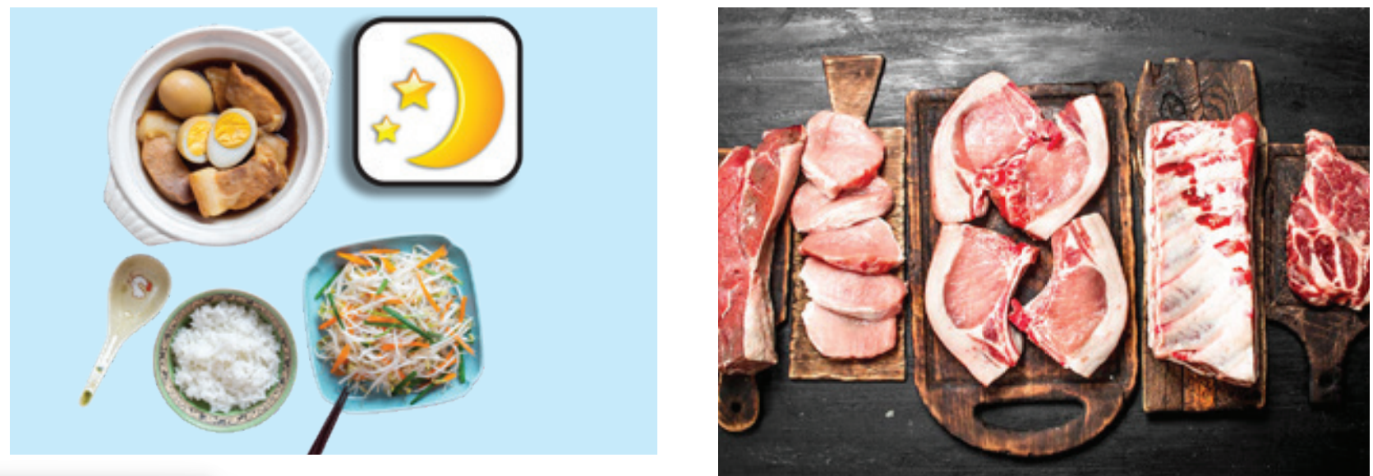

Listen and choose
A
B
C

Slide 21
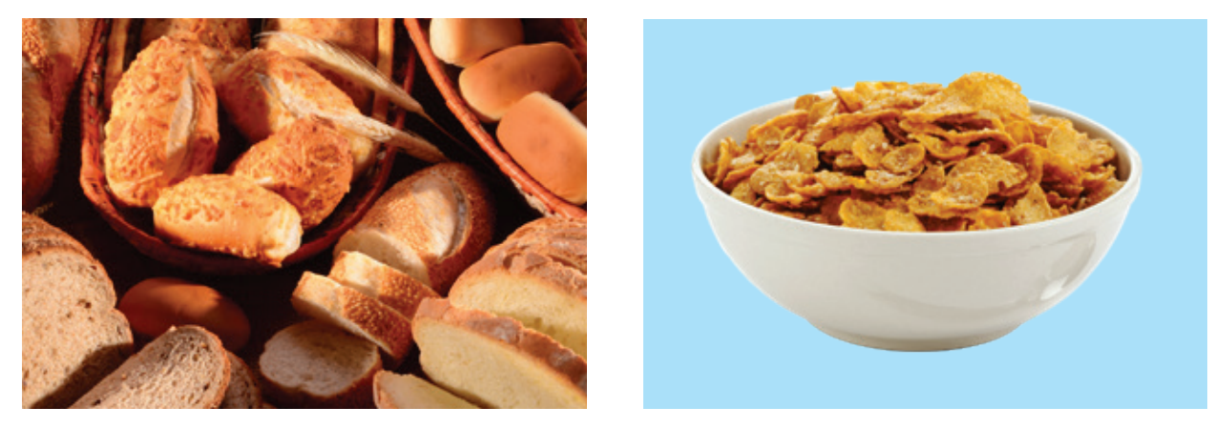

Listen and choose
A
B
C

Slide 22
Listen and choose
A
B
C

Slide 23
Listen and choose
A
C
A
B
B

Slide 24

