Slide 1

Unit 6: FOOD AND DRINKS
Lesson 1.1
Page 78

Slide 2
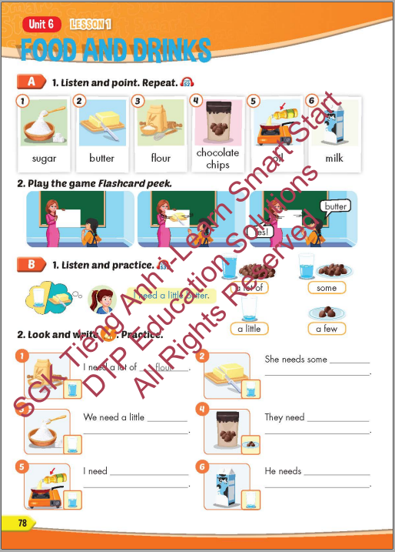
Lesson Outline
Warm-up
Vocabulary
Structure
Consolidation
Wrap-up

Slide 3
Objectives
By the end of this lesson, students will be able to recognize vocabulary expressing food and drinks and say what they need to cook something.
Vocabulary: sugar, butter, flour, chocolate chips, oil, milk.
Sentence pattern: I need a little butter.

Slide 4

WARM-UP

Slide 5
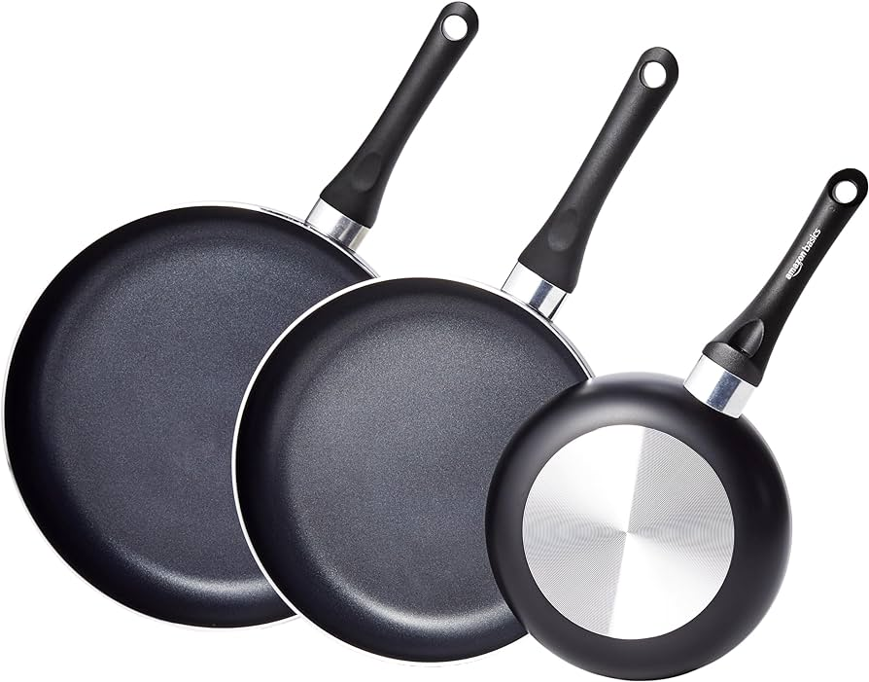
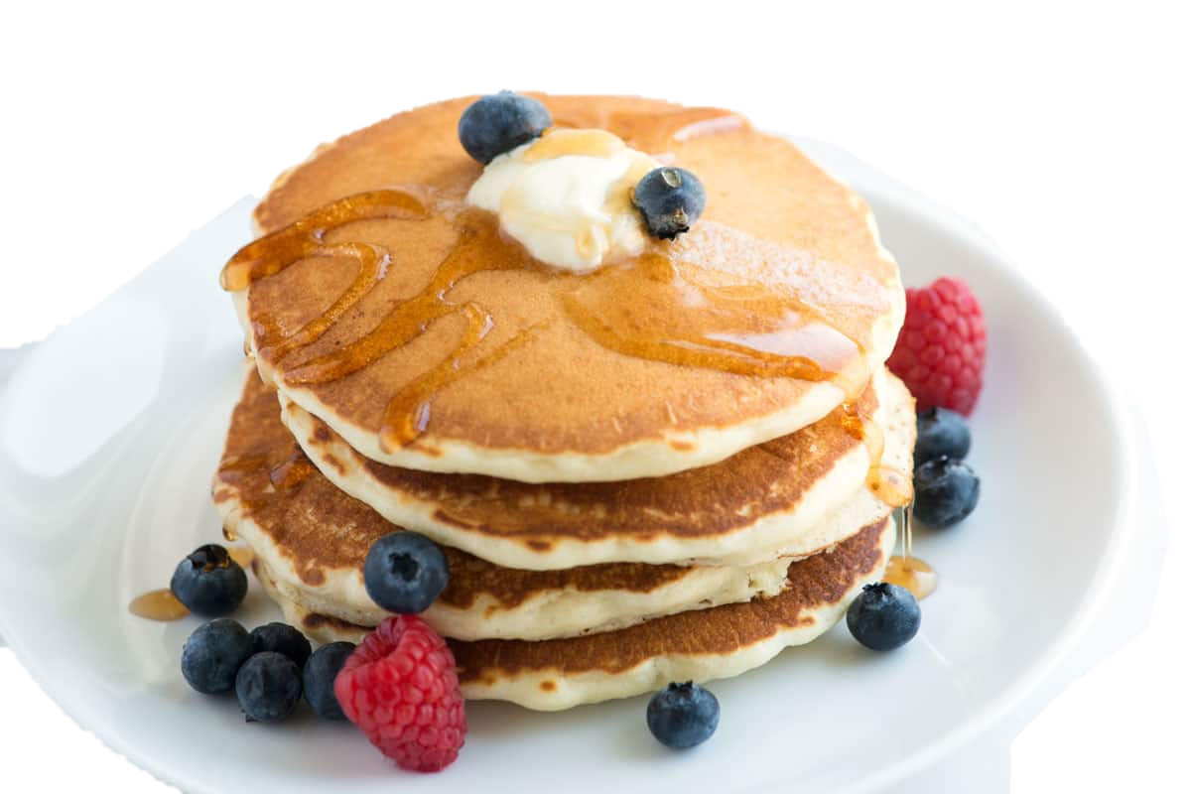
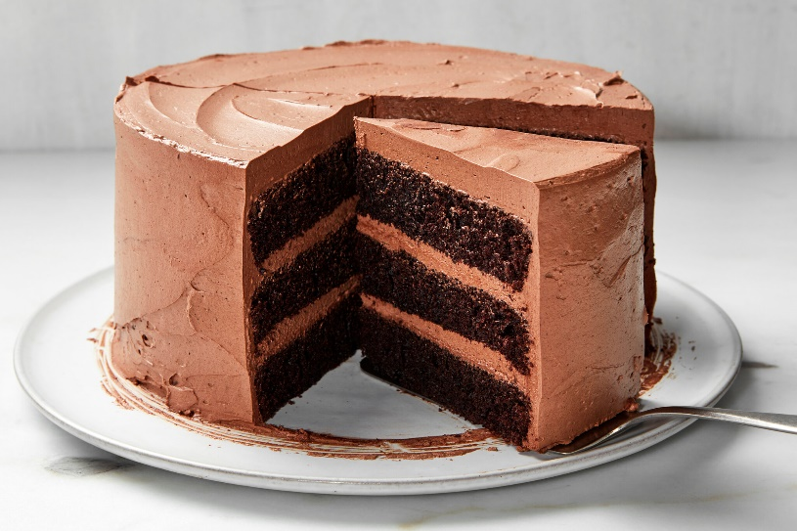
Catch the words
a pan
a cake
a pancake

Slide 6
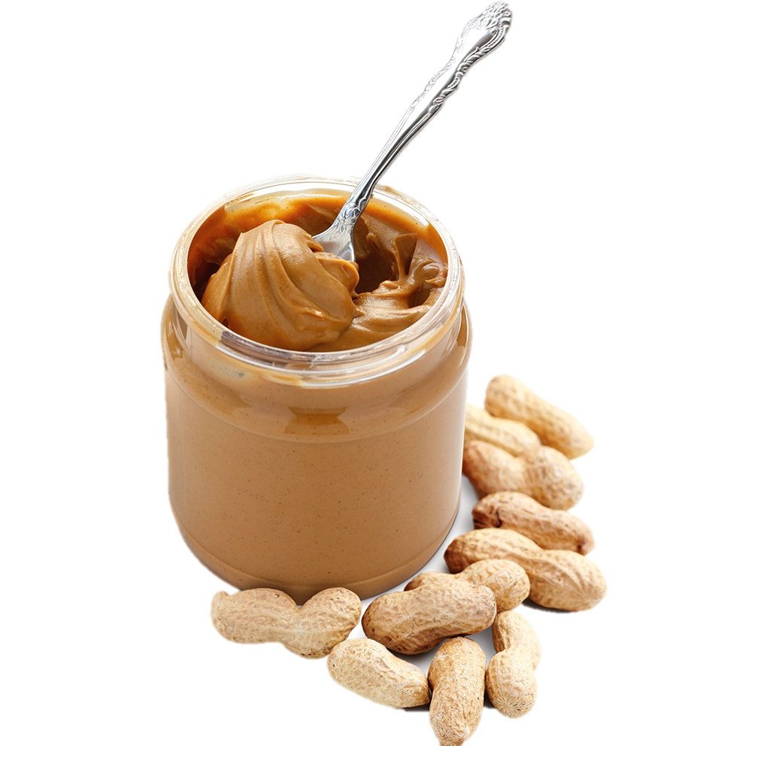
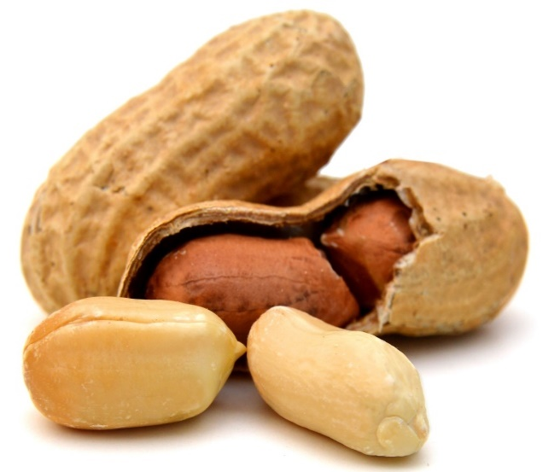
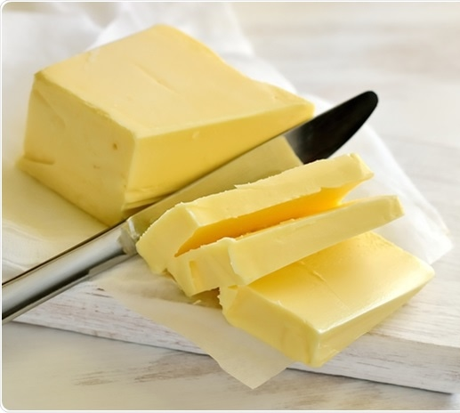
Catch the words
a peanut
butter
peanut butter

Slide 7

It’s time to learn …

Slide 8

New words
sugar, butter, flour, chocolate
chips, oil, milk.

Slide 9

Presentation

Slide 10


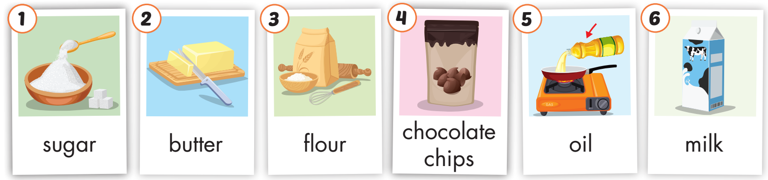
Click on A to hear the sound.
/ˈʃʊɡ.ɚ/
đường
/ˈbʌt̬.ɚ/
bơ
/ˈflaʊ.ɚ/
bột
/ˌtʃɑːk.lət ˈʧɪp/
kẹo viên socola
/ɔɪl/
dầu ăn
/mɪlk/
sữa
Notes:
Click vào hình A. 1. Listen and point. Repeat để cho cả audio full chạy

Slide 11

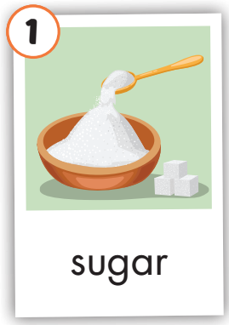
Click on the picture to hear the sound.
sugar
/ˈʃʊɡɚ/
đường

Slide 12
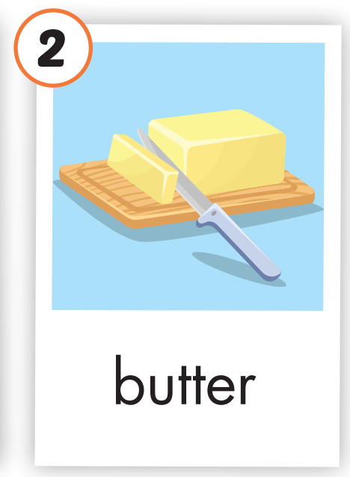
Click on the picture to hear the sound.
butter
/ˈbʌt̬.ɚ/
bơ

Slide 13
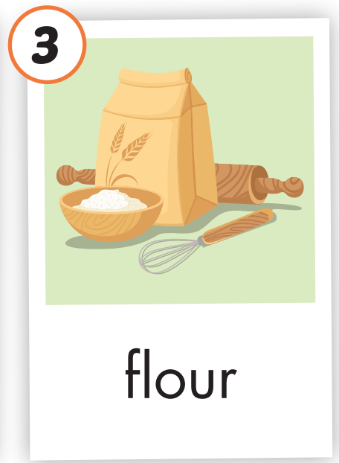
Click on the picture to hear the sound.
flour
/ˈflaʊ.ɚ/
bột

Slide 14
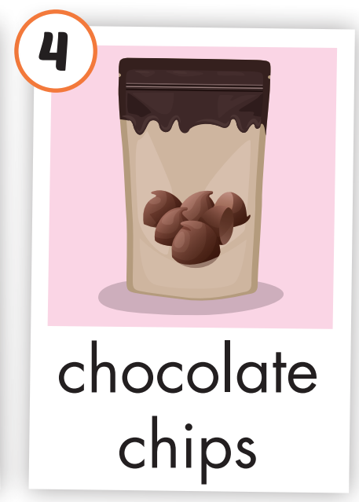
Click on the picture to hear the sound.
chocolate chips
/ˌtʃɑːk.lət ˈʧɪp/
kẹo viên socola

Slide 15
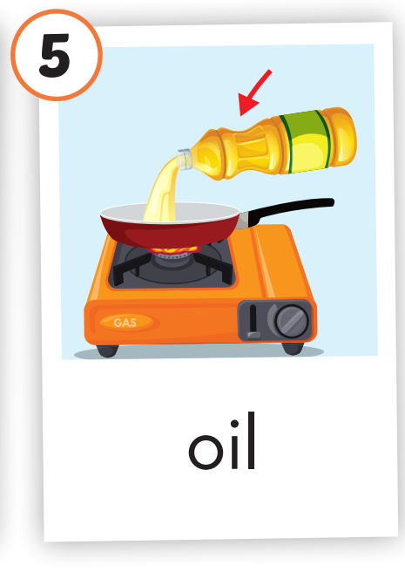
Click on the picture to hear the sound.
oil
/ɔɪl/
dầu ăn

Slide 16
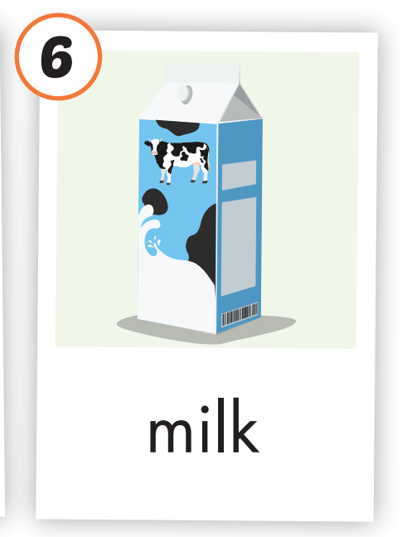
Click on the picture to hear the sound.
milk
/mɪlk/
sữa

Slide 17
Practice

