Slide 1

Unit 5: HEALTH
CLIL - Lesson 1
Page 73

Slide 2
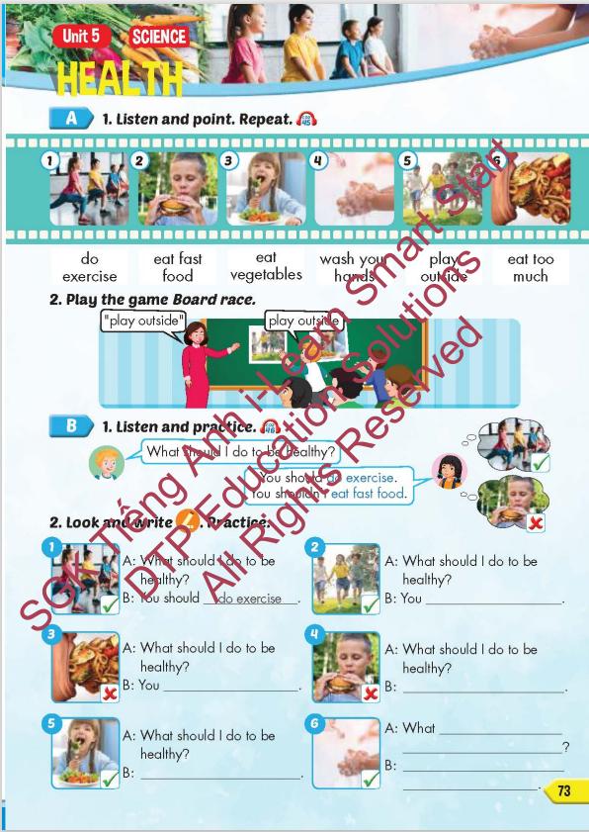
Lesson Outline
Warm-up
Vocabulary
Structure
Consolidation
Wrap-up

Slide 3
Objectives
By the end of this lesson, students will be able to give advice about how to be healthy.
Vocabulary: do exercise, eat fast food, eat vegetables, wash your hands, play outside, eat too much.
Structure: What should I do to be healthy?
You should do exercise.
You shouldn't eat fast food.

Slide 4

WARM UP

Slide 5
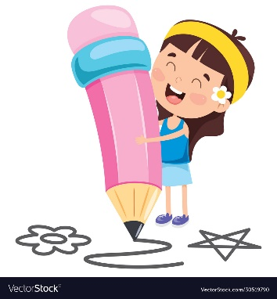





Guessing fast food restaurant’s logo
Domino’s pizza
McDonald’s
Popeyes
Jollibee
KFC

Slide 6

It’s time to learn …

Slide 7

New words
do exercise, eat fast food, eat vegetables, wash your hands, play outside, eat too much.

Slide 8

Presentation

Slide 9


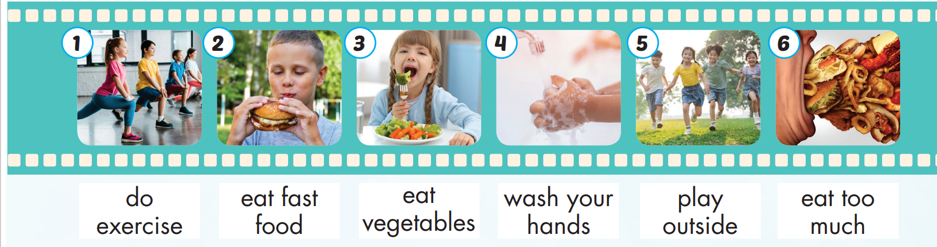
Click on A to hear the sound.
/duː/
/ˈek.sɚ.saɪz/
tập thể dục
/iːt/ /fæst/
/fuːd/
ăn thức ăn nhanh
/iːt/
/ˈvedʒ.tə.bəlz/
ăn rau củ quả
/wɑːʃ/ /jʊr/
/hændz/
rửa tay
/pleɪ/
/ˈaʊt.saɪd/
ra ngoài chơi
/iːt/ /tuː/
/mʌtʃ/
ăn quá nhiều
Notes:
Click vào hình A. 1. Listen and point. Repeat để cho cả audio full chạy

Slide 10
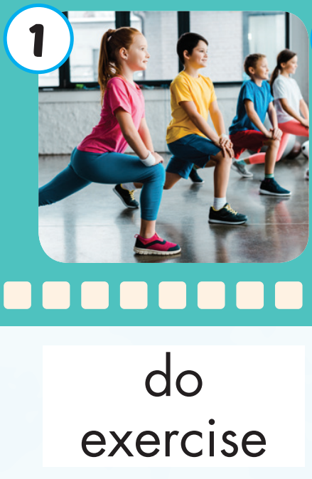
Click on the picture to hear the sound.
do exercise (v)
/duː/ /ˈek.sɚ.saɪz/
tập thể dục

Slide 11
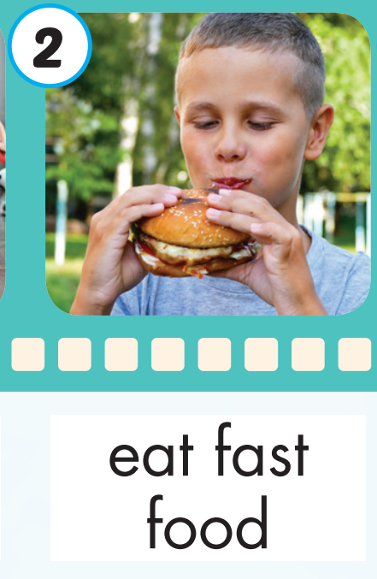
Click on the picture to hear the sound.
eat fast food (v)
/iːt/ /fæst/ /fuːd/
ăn thức ăn nhanh

Slide 12
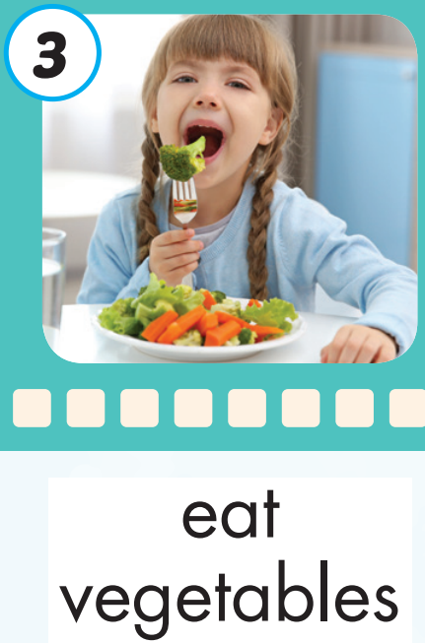
Click on the picture to hear the sound.
eat vegetables (v)
/iːt/ /ˈvedʒ.tə.bəlz/
ăn rau củ quả

Slide 13
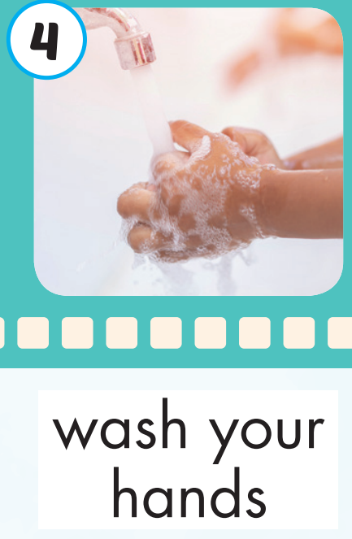
Click on the picture to hear the sound.
wash your hands (v)
/wɑːʃ/ /jʊr/ /hændz/
rửa tay

Slide 14

Click on the picture to hear the sound.
play outside(v)
/pleɪ/ /ˈaʊt.saɪd/
ra ngoài chơi

Slide 15
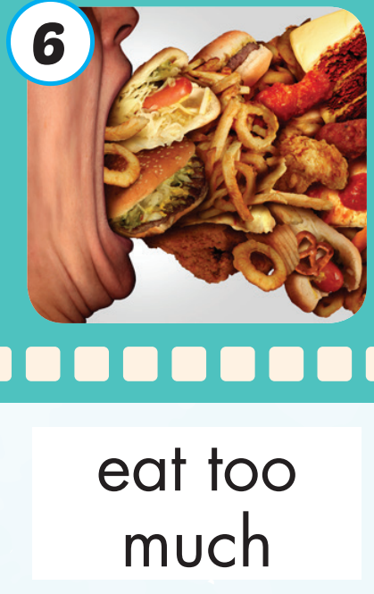
Click on the picture to hear the sound.
eat too much (v)
/iːt/ /tuː/ /mʌtʃ/
ăn quá nhiều

Slide 16
Practice

Slide 17
Listen and choose. Then say.

Slide 18
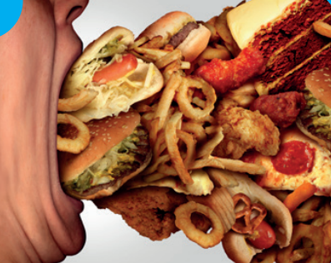
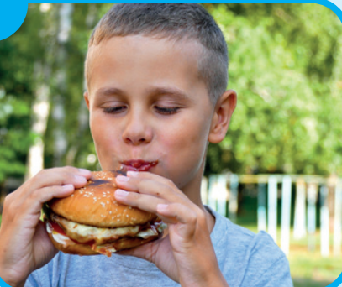


Listen and choose
A
B
C

Slide 19
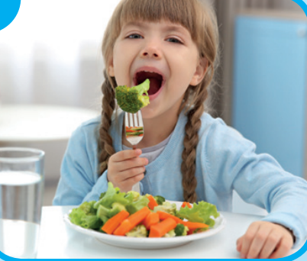
Listen and choose
A
C
A
B
B

Slide 20
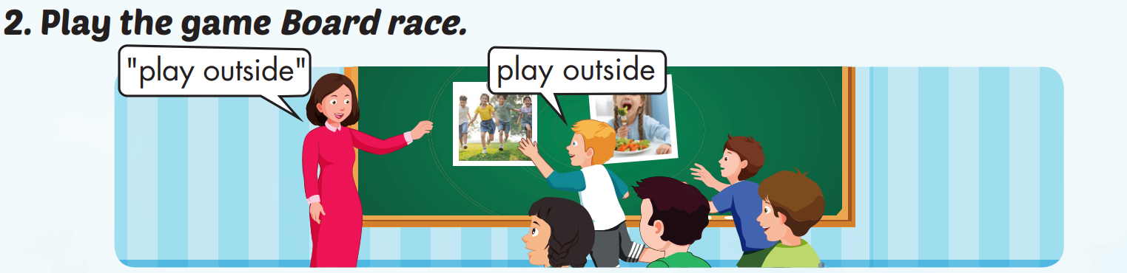

Slide 21
Structure
What should I do to be healthy?
You should do exercise.
You shouldn't eat fast food.

