Slide 1

Unit 1: HEALTH
Lesson 1.1
Page 64

Slide 2
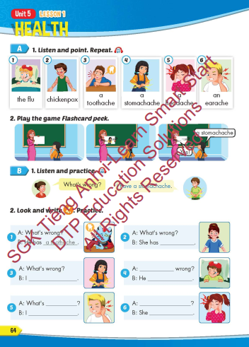
Lesson Outline
Warm-up
Vocabulary
Structure
Consolidation
Wrap-up

Slide 3
Objectives
By the end of this lesson, students will be able to recognize vocabulary expressing health problems and familiarize themselves with asking and answering about what’s wrong.
Vocabulary: the flu, chickenpox, a toothache, a stomachache, a headache, an earache.
Structure: What’s wrong? - I have a toothache.
- She has a headache.

Slide 4

WARM UP

Slide 5






Guessing pictures
Click on pictures to check the answer.
No smoking
Dental clinic
Hospital
Ambulance
Wash hands

Slide 6

It’s time to learn …

Slide 7

New words
the flu, chickenpox, a toothache, a stomachache, a headache, an earache.

Slide 8

Presentation

Slide 9
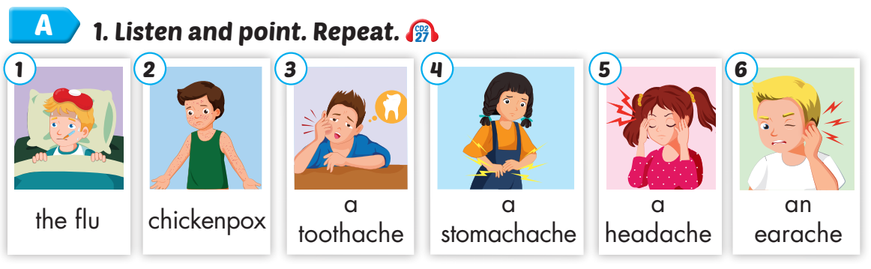

Click on A to hear the sound.
/fluː/
bệnh cúm
/ˈtʃɪkɪnpɑːks/
bệnh thuỷ đậu
/ˈtuːθeɪk/
sự đau răng
/ˈstʌməkeɪk/
sự đau bụng
/ˈhedeɪk/
sự đau đầu
/ˈɪreɪk/
sự đau tai
Notes:
Click vào hình A. 1. Listen and point. Repeat để cho cả audio full chạy

Slide 10
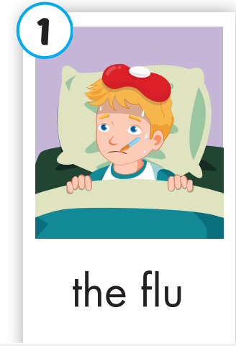
Click on the picture to hear the sound.
flu (n)
/fluː/
bệnh cúm

Slide 11
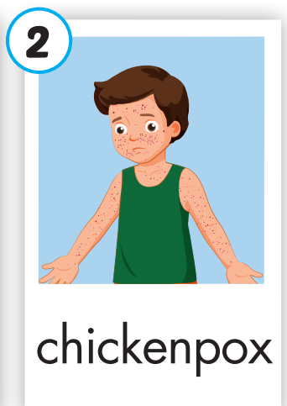
Click on the picture to hear the sound.
chickenpox (n)
/ˈtʃɪkɪnpɑːks/
bệnh thuỷ đậu

Slide 12
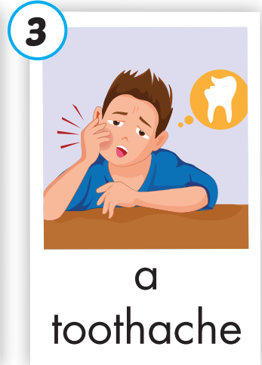
Click on the picture to hear the sound.
a toothache (n)
/ˈtuːθeɪk/
sự đau răng

Slide 13
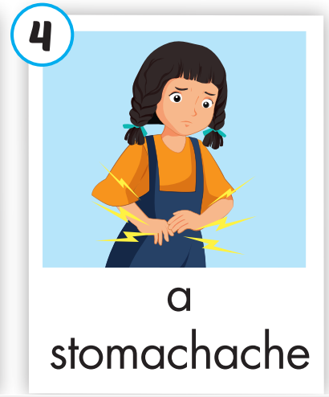
Click on the picture to hear the sound.
a stomachache (n)
/ˈstʌməkeɪk/
sự đau bụng

Slide 14
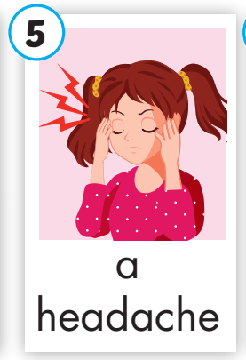
Click on the picture to hear the sound.
a headache (n)
/ˈhedeɪk/
sự đau đầu

Slide 15
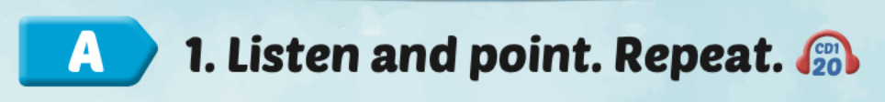
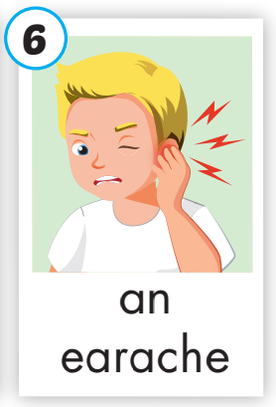
Click on the picture to hear the sound.
an earache (n)
/ˈɪreɪk/
sự đau tai

Slide 16
Practice

Slide 17
Listen and choose. Then say.

Slide 18
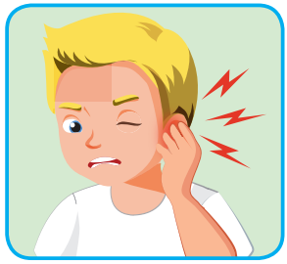
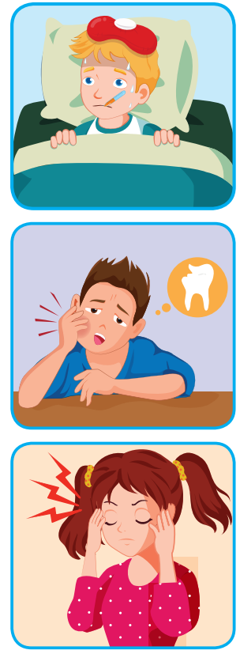

Listen and choose
A
B
C

Slide 19
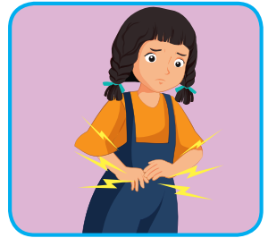
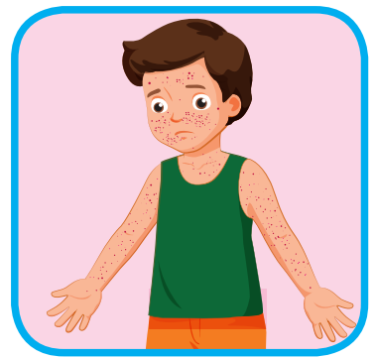
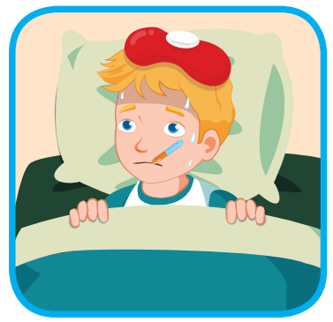
Listen and choose
A
B
C

Slide 20
Listen and choose
A
B
C

Slide 21
Listen and choose
A
B
C

Slide 22
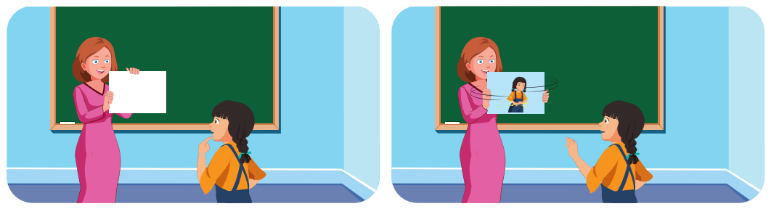
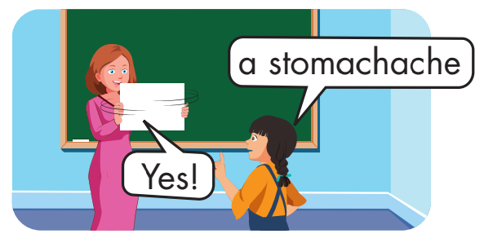

Slide 23
Structure
What’s wrong?
- I have a toothache - She has a headache

Slide 24
Presentation

Slide 25
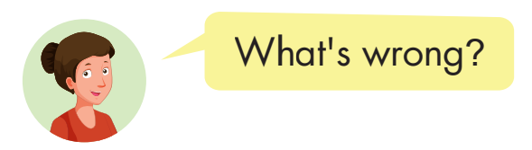
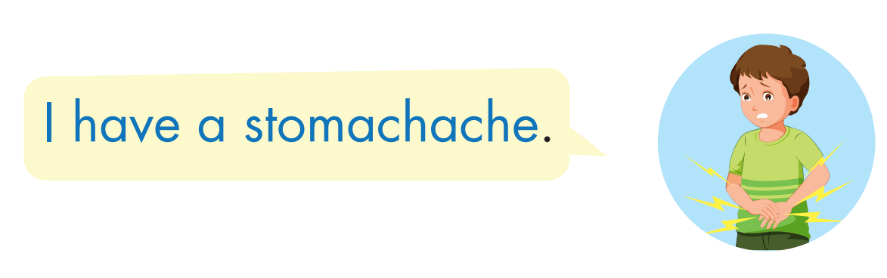
Structure

Slide 26

Structure
Click on B to hear the sound.
Click on the picture to hear the sound.

Slide 27

Practice

Slide 28

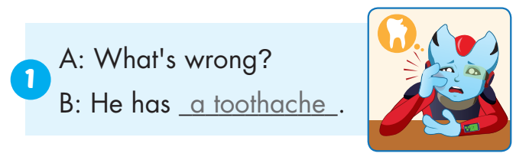
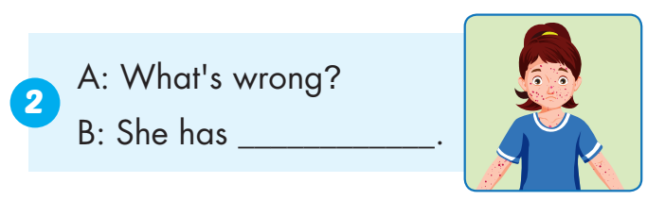
chickenpox

Slide 29
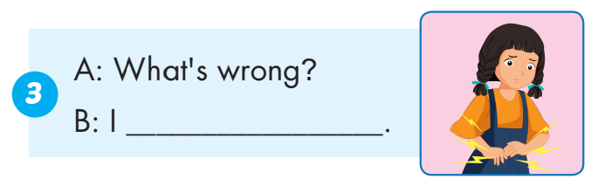
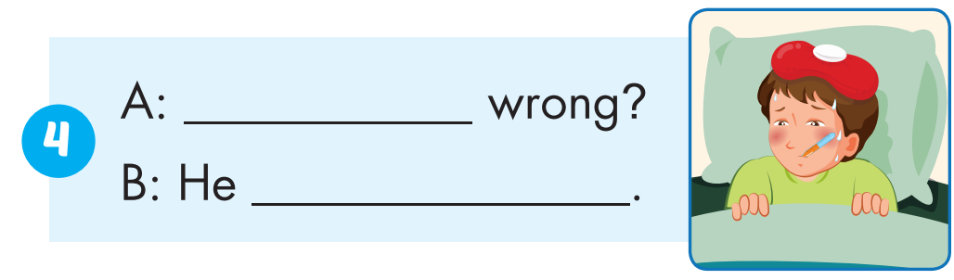
have a stomachache
What’s
has the flu

Slide 30
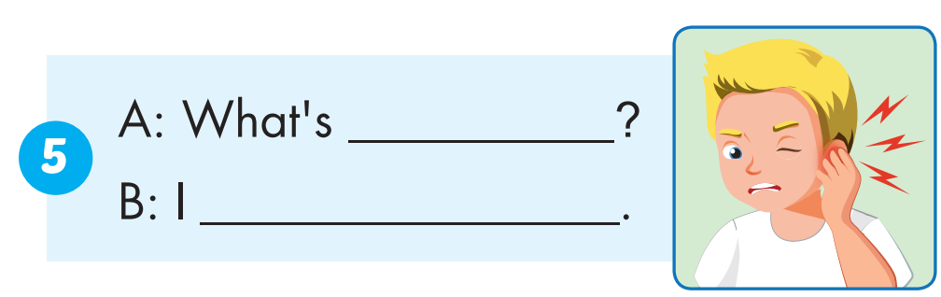
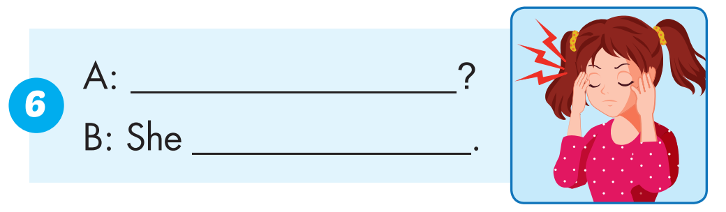
wrong
have an earache
What’s wrong
has a headache

Slide 31

Production

Slide 32
an earache
SHOW

Slide 33
a toothache
SHOW

Slide 34
chickenpox
SHOW

Slide 35
a stomachache
SHOW

Slide 36
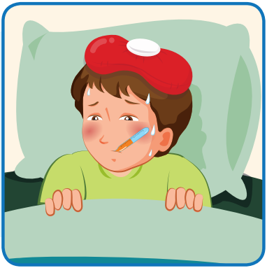
the flu
SHOW

Slide 37
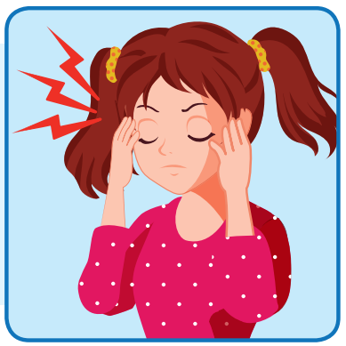
a headache
SHOW

Slide 38

CONSOLIDATION

Slide 39

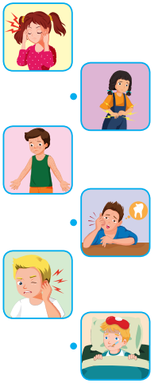
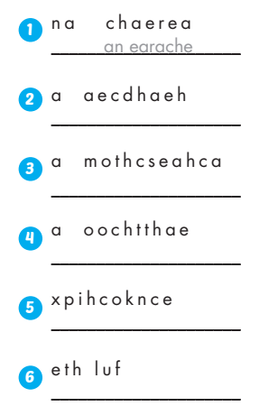
Extra Practice
WB, page 42
a headache
a stomachache
a toothache
chickenpox
the flu

