Slide 1

Unit 4: Travel
Lesson 1.1
Page 48

Slide 2
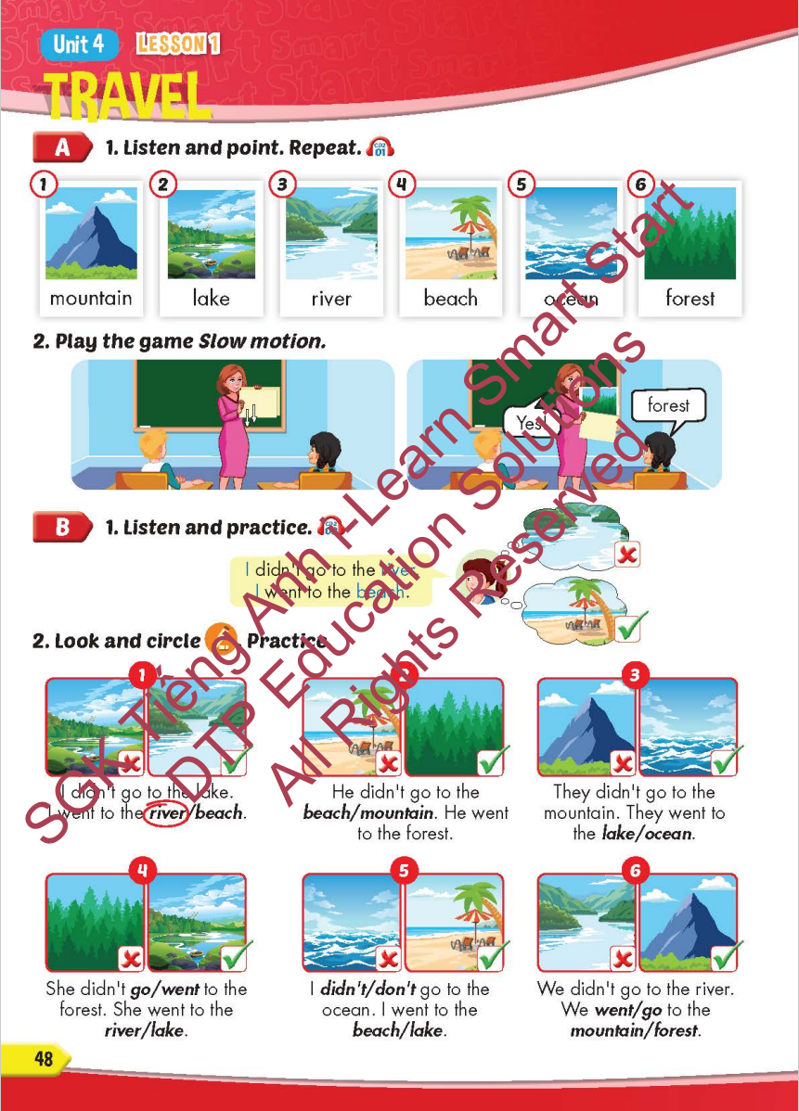
Lesson Outline
Warm-up
Vocabulary
Structure
Consolidation
Wrap-up

Slide 3
Objectives
By the end of this lesson, students will be able to…
Vocabulary: Pronounce and use the words related to the topic properly: mountain, lake, river, beach, ocean, forest New Year (Tết), Christmas, Teachers' Day, Children's Day.
Structure: Practise
I didn't go to the river. I went to the beach.

Slide 4

WARM-UP

Slide 5



Slide 6

New words
mountain, lake, river,
beach, ocean, forest

Slide 7


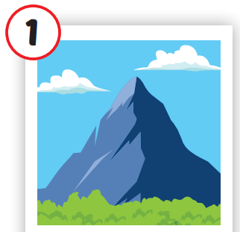
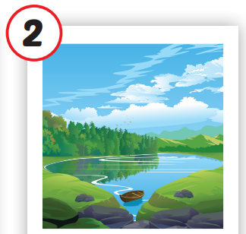
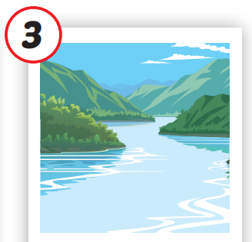
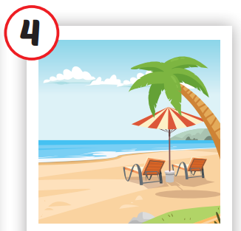
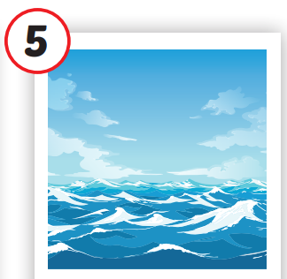
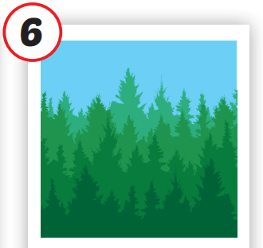






/ˌmaʊntən/
ngọn núi
/leɪk/
hồ
/ˈrɪvər/
sông
/biːtʃ/
bãi biển
/ˈoʊʃən/
đại dương
/ˈfɔrəst/
rừng
Notes:
Click vào hình A. 1. Listen and point. Repeat để cho cả audio full chạy

Slide 8

/ˌmaʊntən/
ngọn núi

Slide 9
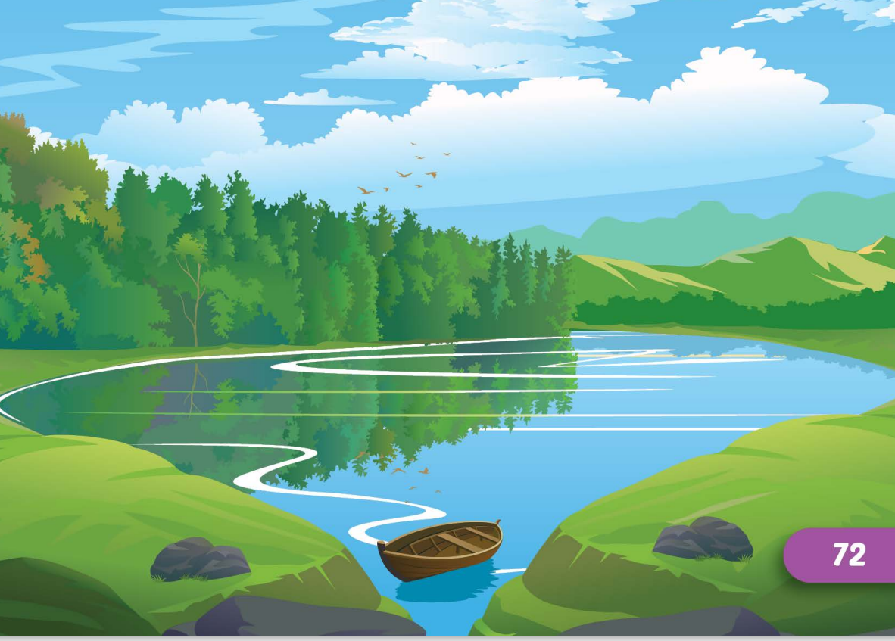
/leɪk/
hồ

Slide 10
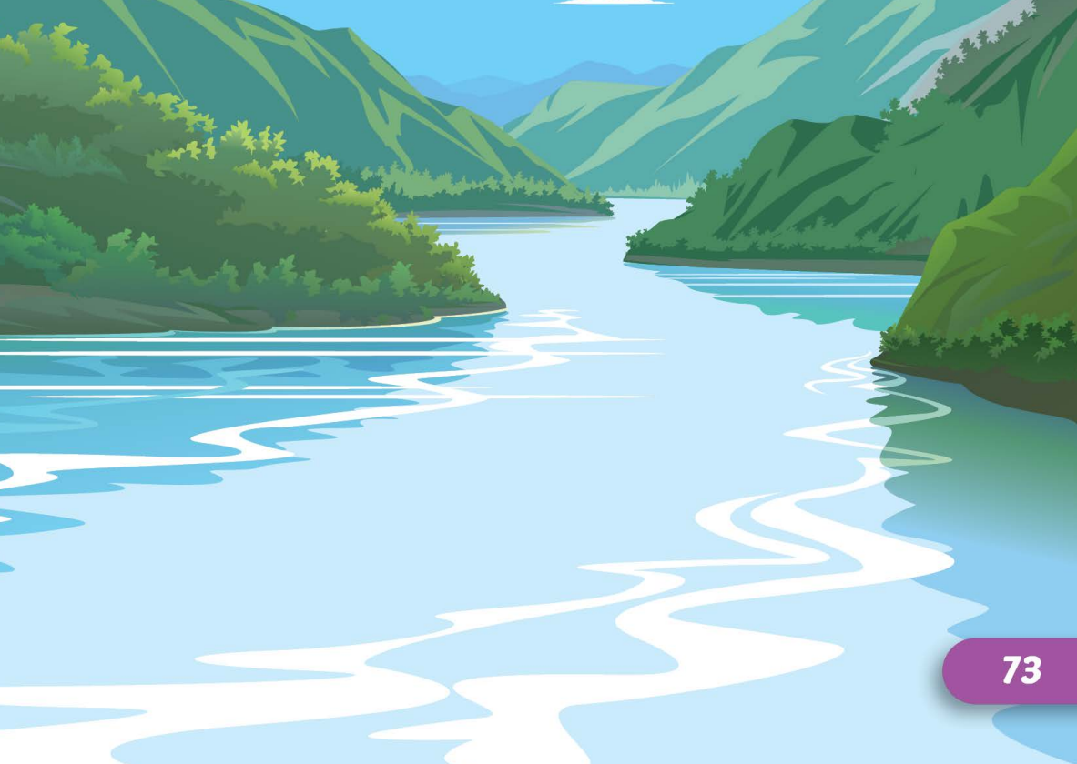
/ˈrɪvər/
sông

Slide 11
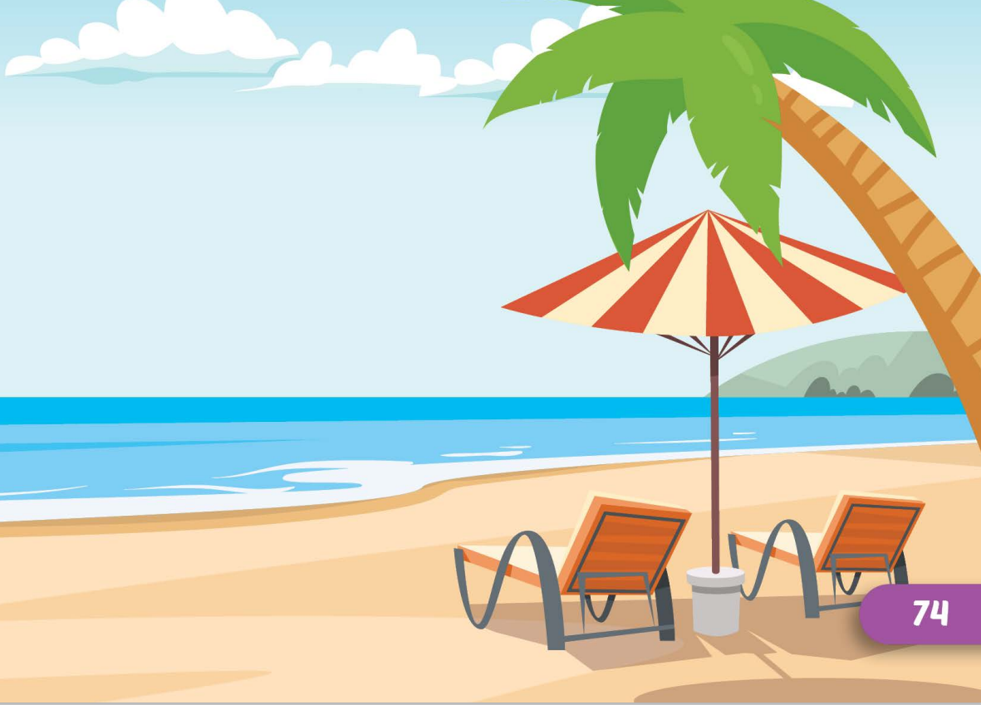
/biːtʃ/
bãi biển

Slide 12
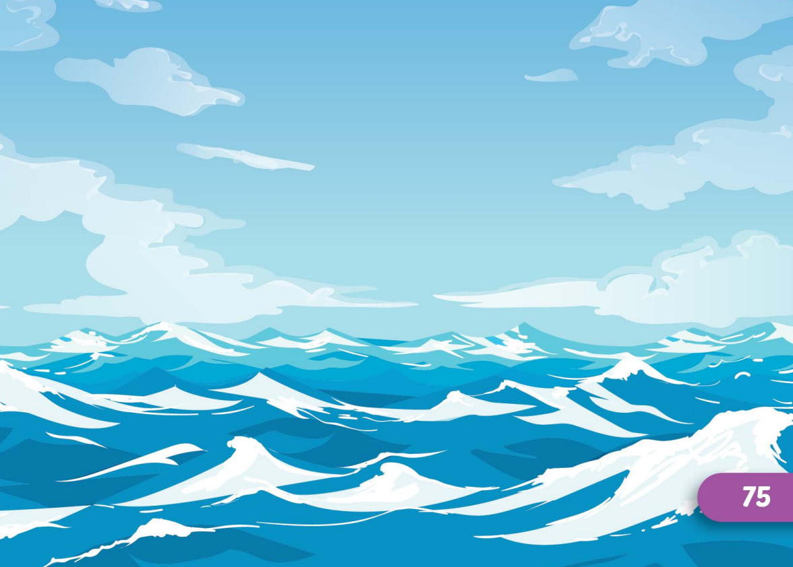
/ˈoʊʃən/
đại dương

Slide 13
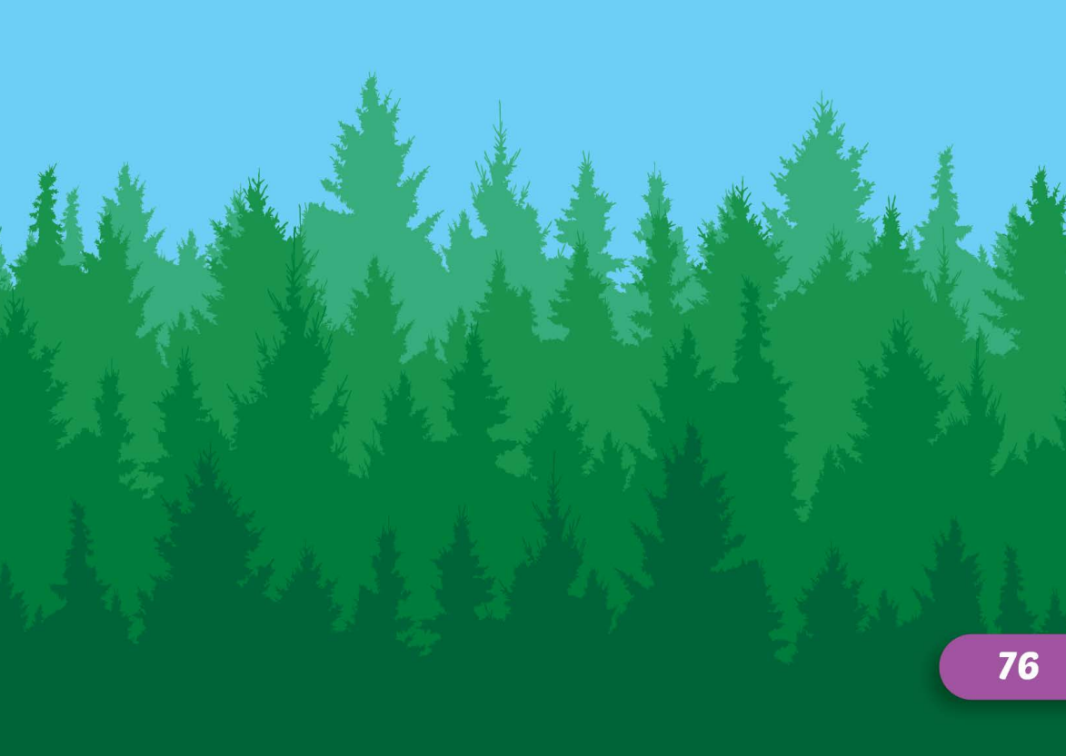
/ˈfɔrəst/
rừng

