Slide 1

Unit 3: MY FRIENDS AND I
Review 1
Page 46

Slide 2
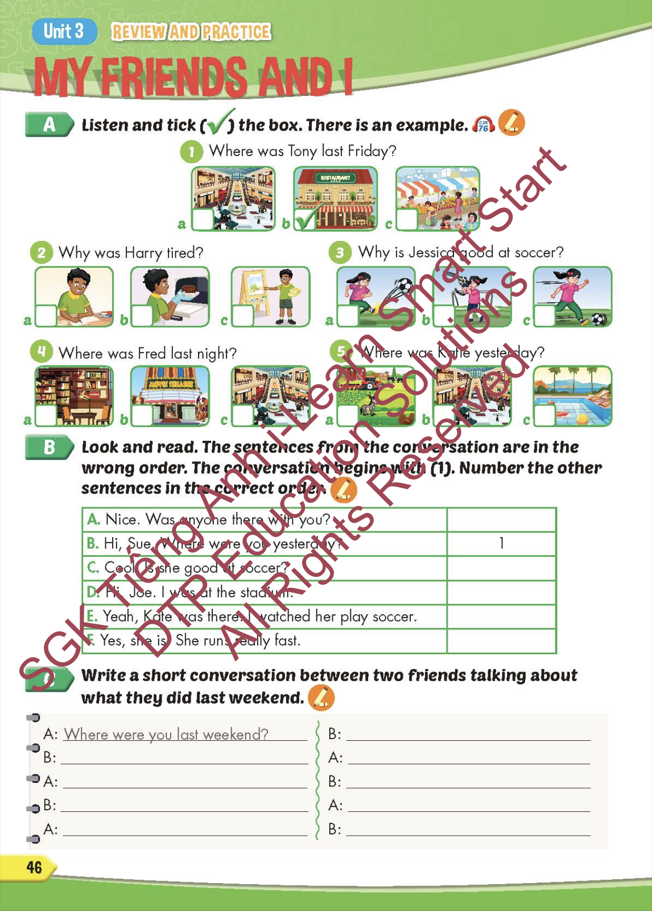
Lesson Outline
Warm-up
Listening
Reading
Writing
Wrap-up

Slide 3
Objectives
By the end of this lesson, students will be able to review the target language presented in unit 3 and practice Listening, Reading and Writing.
Vocabulary: unit 3
Structure: unit 3

Slide 4

WARM-UP

Slide 5
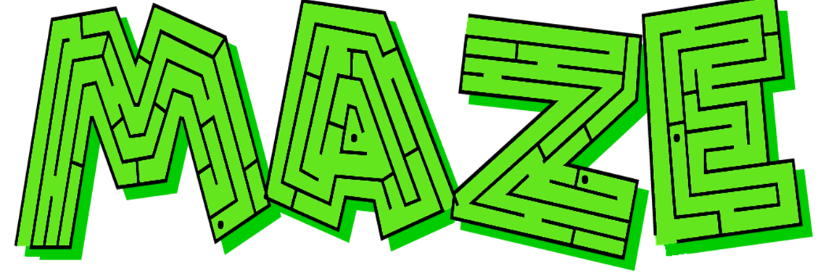


PLACES AROUND TOWN

Slide 6
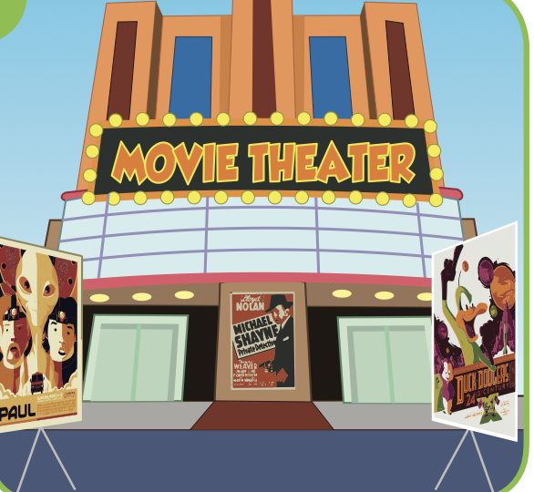

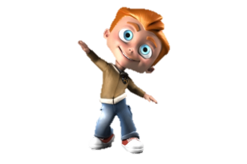
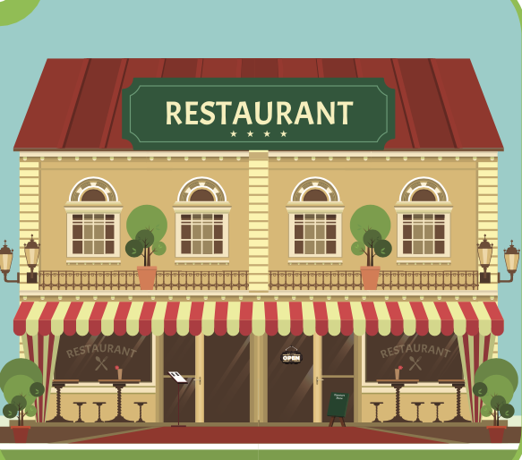
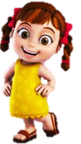
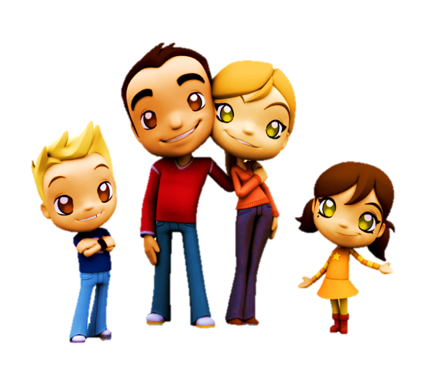
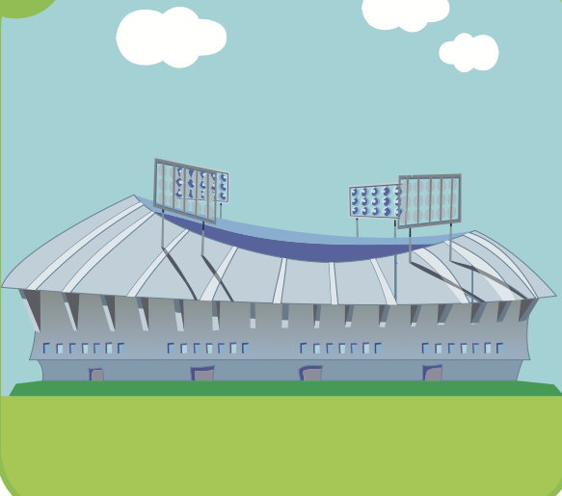
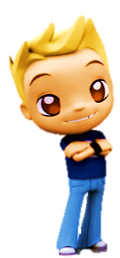
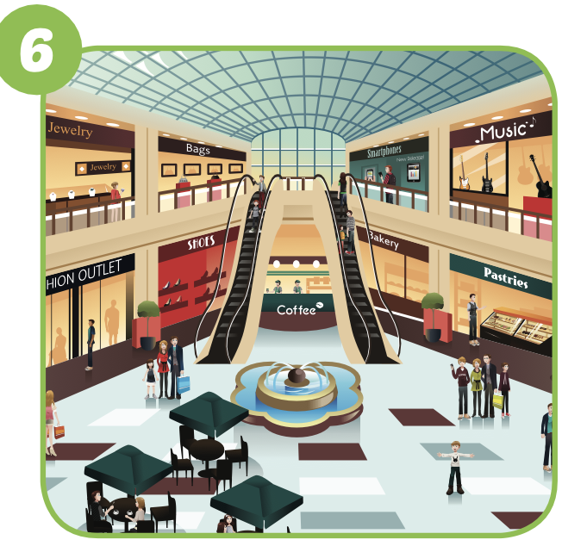
I was at the mall.
TIM
SUE
ANN
MALL
NEXT
Click on the right kid
TOM

Slide 7
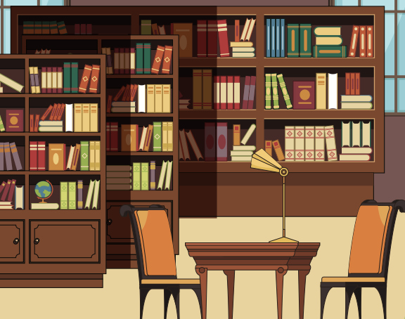
I was at the stadium.
TIM
SUE
stadium
ANN
NEXT
Click on the right kid
TOM

Slide 8
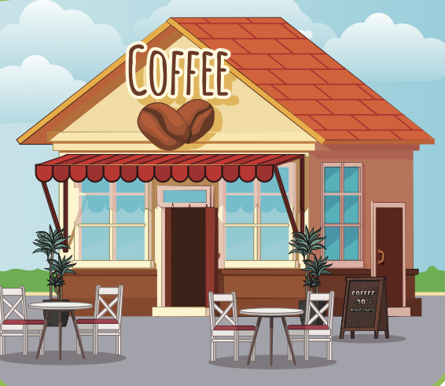
I was at the restaurant.
TIM
RESTAURANT
SUE
ANN
NEXT
TOM
Click on the right kid

Slide 9
I was at the movie theater.
MOVIE THEATER
TIM
SUE
ANN
END
Click on the right kid
TOM

Slide 10

It’s time to learn …

Slide 11

Practice

Slide 12
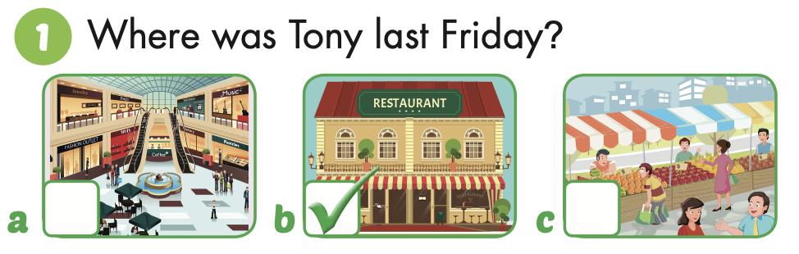
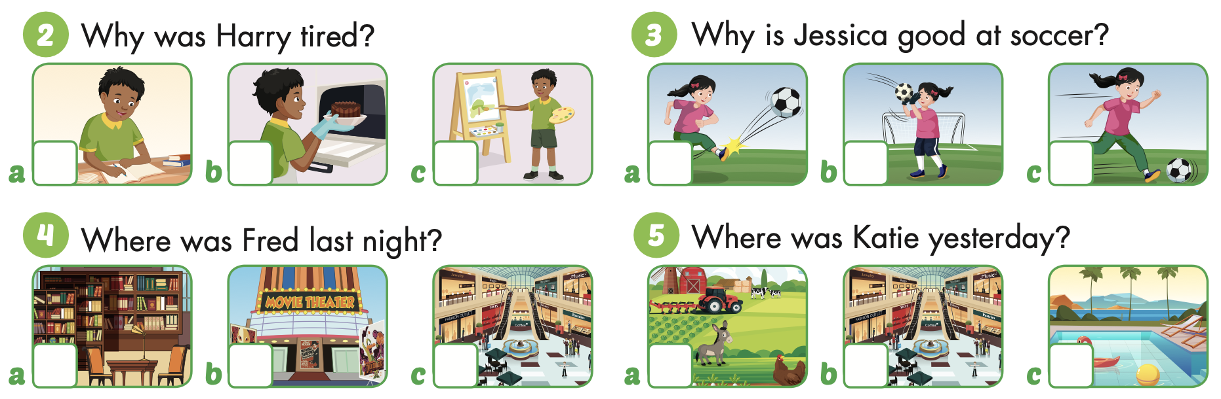
Point and say.

