Slide 1

Unit 3: MY FRIENDS AND I
Lesson 3.1
Page 40

Slide 2
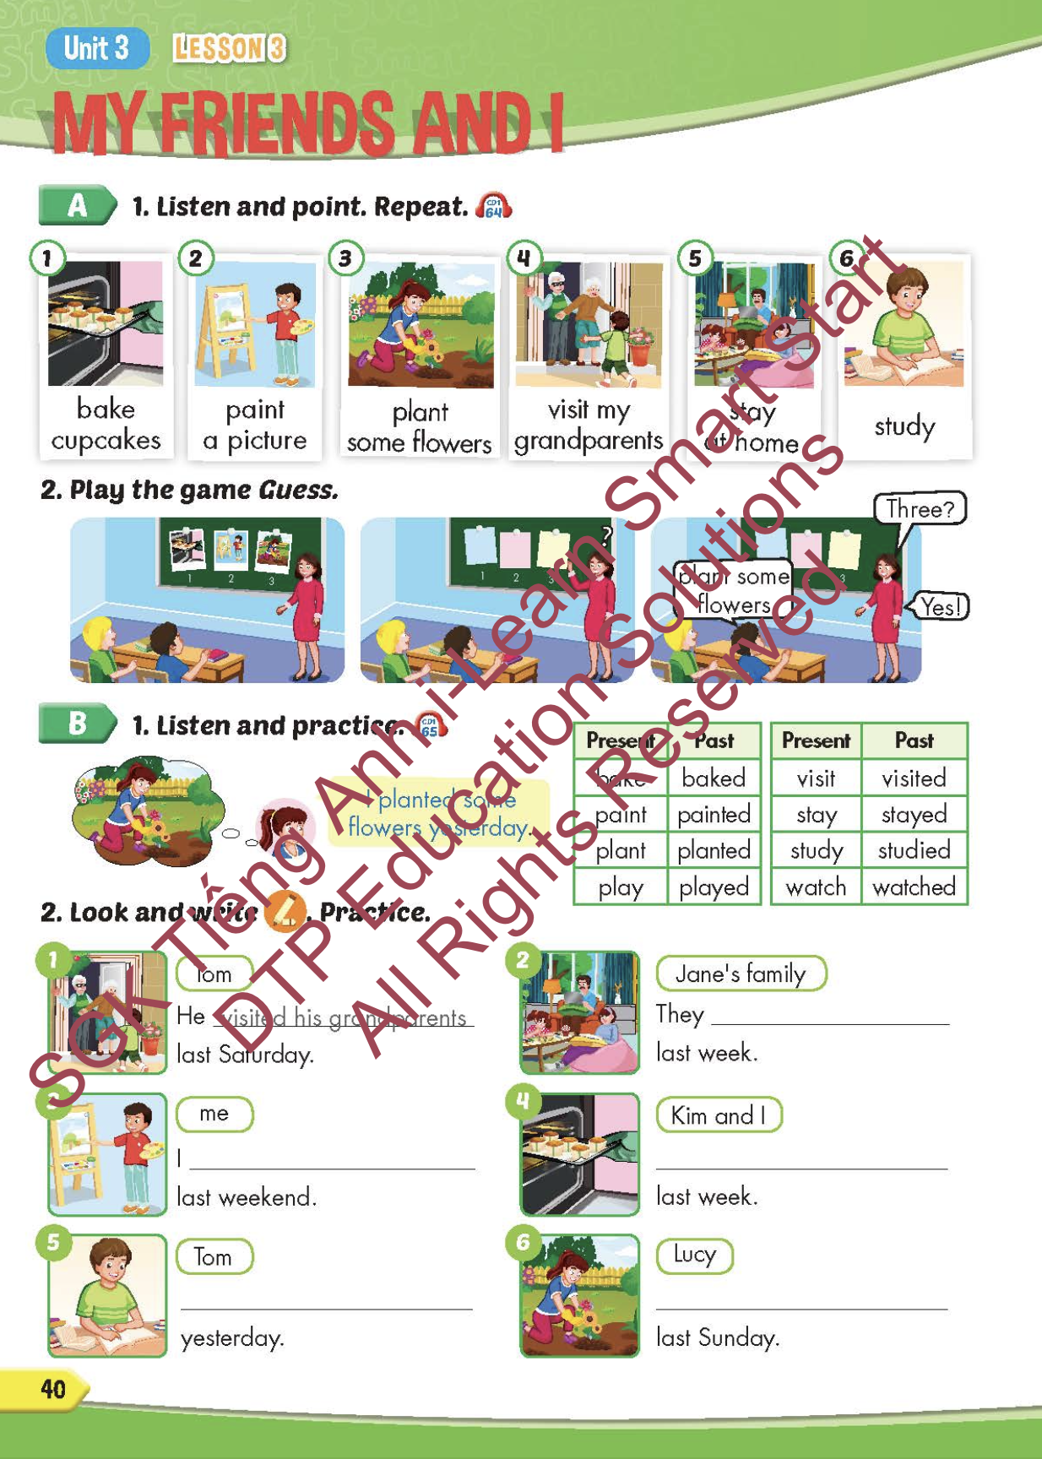
Lesson Outline
Warm-up
Vocabulary
Structure
Consolidation
Wrap-up

Slide 3
Objectives
By the end of this lesson, students will be able to point out and say different activities.
Vocabulary: bake cupcakes, paint a picture, plant some flowers, visit my grandparents, stay at home, study.
Structure: I planted some flowers yesterday.

Slide 4

WARM-UP

Slide 5




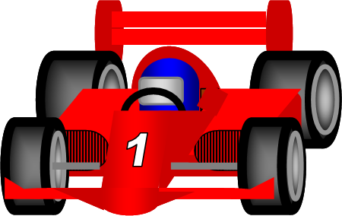

WAS - WERE

Slide 6

was
I _______ at home yesterday.
was
were
NEXT

Slide 7
were
The people _______ noisy.
was
were
NEXT

Slide 8
were
They _______ at home last Sunday.
was
were
NEXT

Slide 9
was
The food _______ delicious.
was
were
NEXT

Slide 10
were
The stores _______ busy last night.
was
were
END

Slide 11

It’s time to learn …

Slide 12

New words
bake cupcakes,
paint a picture,
plant some flowers,
visit my grandparents,
stay at home,
study.

Slide 13

Presentation

Slide 14


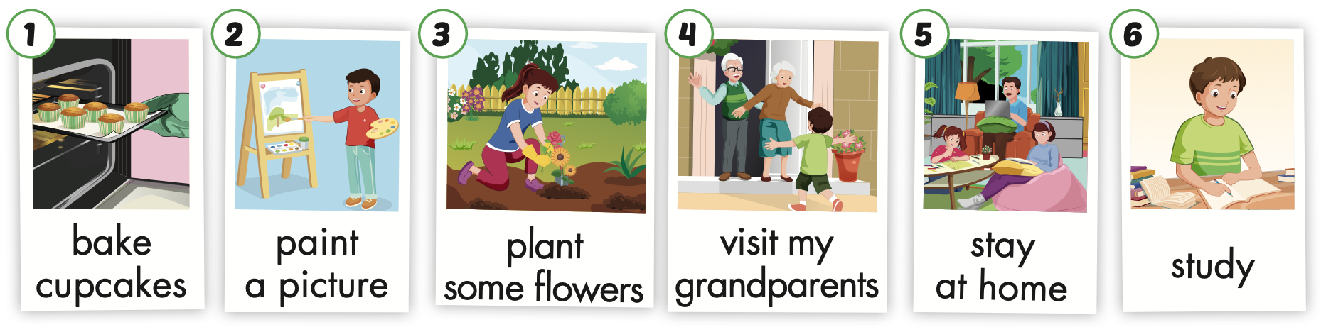
Notes:
Click vào hình A. 1. Listen and point. Repeat để cho cả audio full chạy

Slide 15
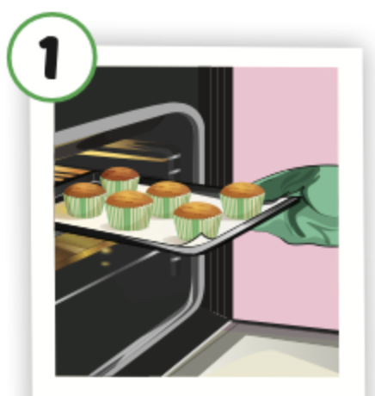
bake cupcakes
/beɪk ˈkʌpkeɪks/
nướng bánh ngọt nhỏ có kem

Slide 16
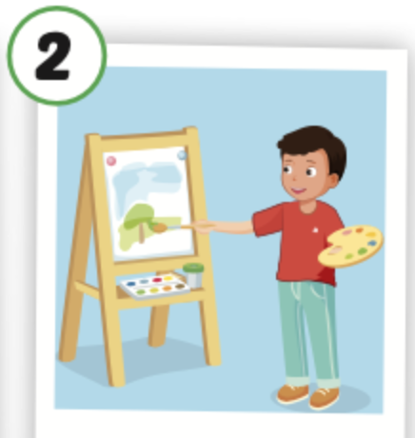
paint a picture
/peɪnt ə ˈpɪktʃər/
Vẽ tranh

Slide 17
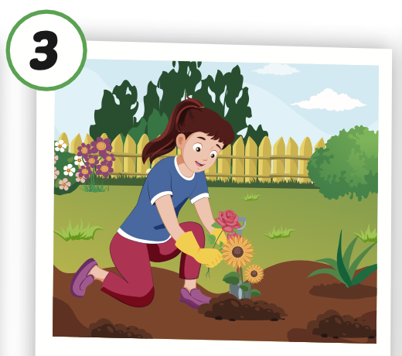
plant some flowers
/plænt səmˈflaʊərz/
trồng hoa

Slide 18
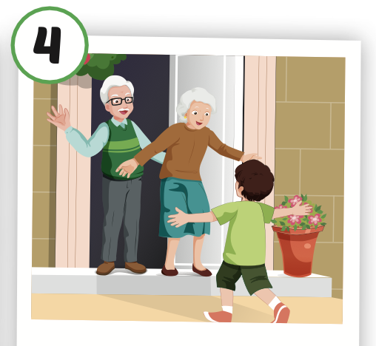
visit my grandparents
/ ˈvɪzɪt maɪ ˈɡrænperənts/
đến thăm ông bà

Slide 19
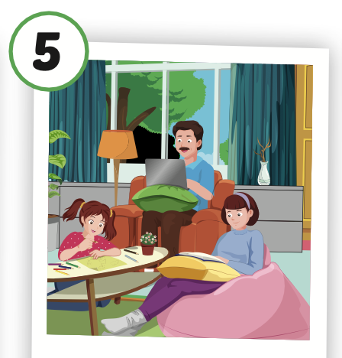
stay at home
/ steɪ ət hoʊm/
ở nhà

Slide 20
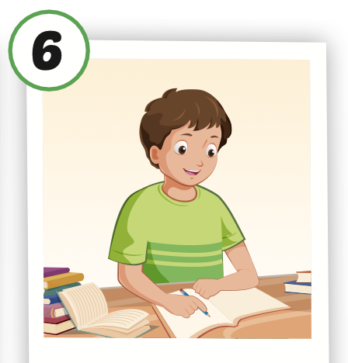
study
/ˈstʌdi/
học

Slide 21
Practice

Slide 22
Look, read and choose. Then say.

Slide 23

study
A
B
C

Slide 24
Plant some flowers
A
B
C

