Slide 1

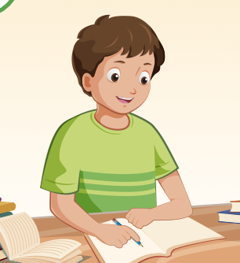
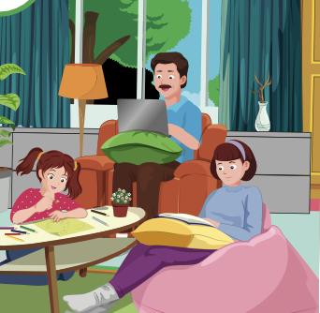
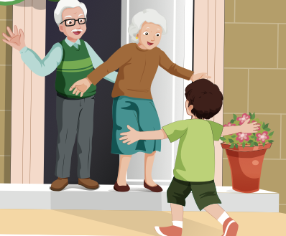
visit my grandparents
A
B
C

Slide 2
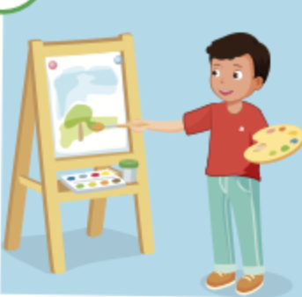
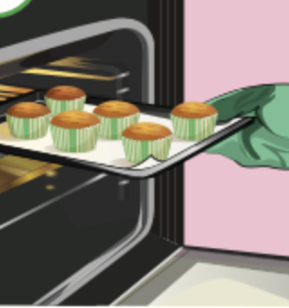
paint a picture
A
B
C

Slide 3

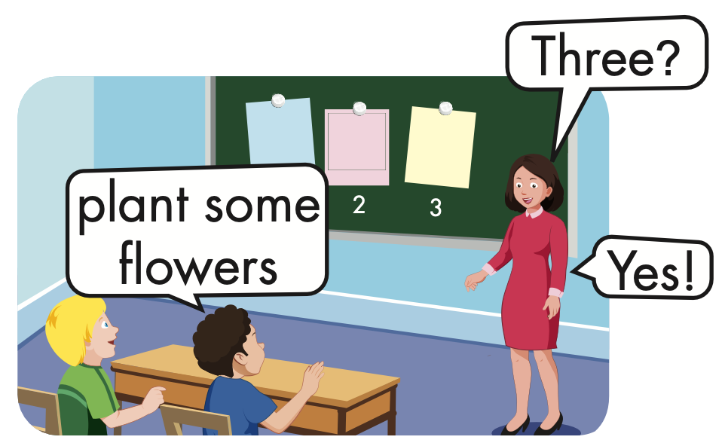
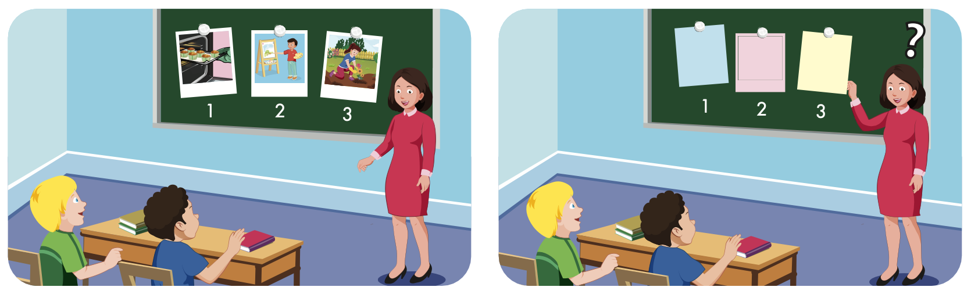

Slide 4

Structure
I planted some flowers yesterday.

Slide 5

Presentation

Slide 6

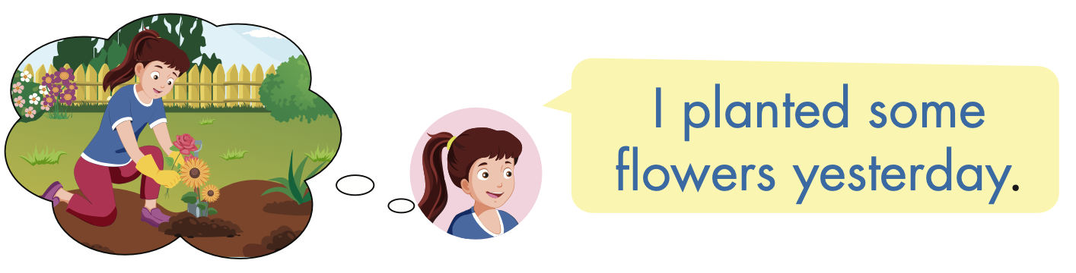
Structure

Slide 7
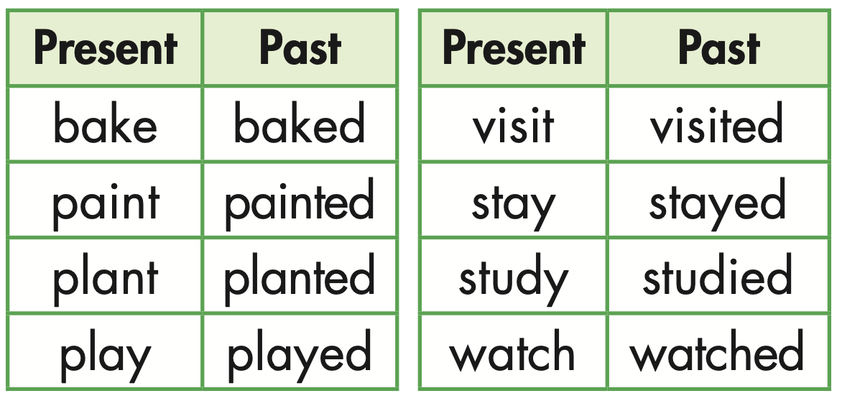

Slide 8

Practice

Slide 9



Slide 10
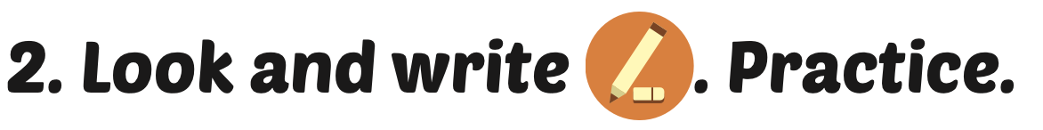
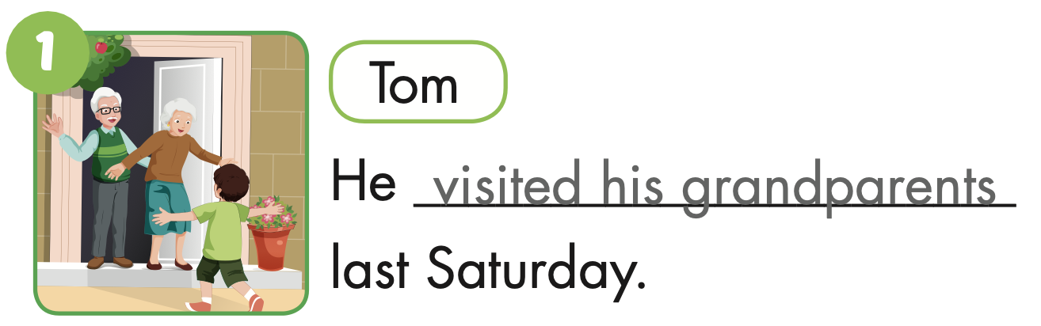
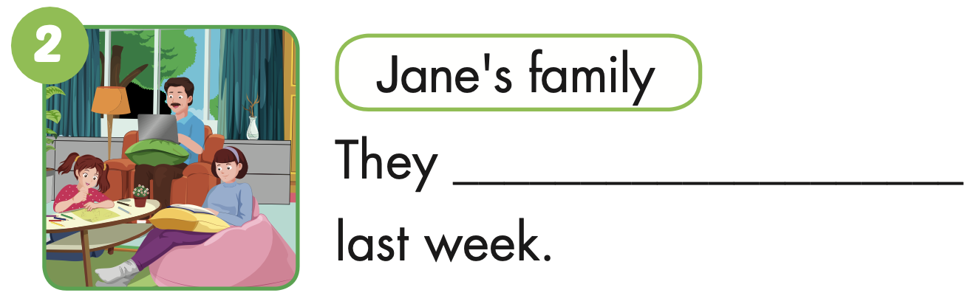
stayed at home

Slide 11
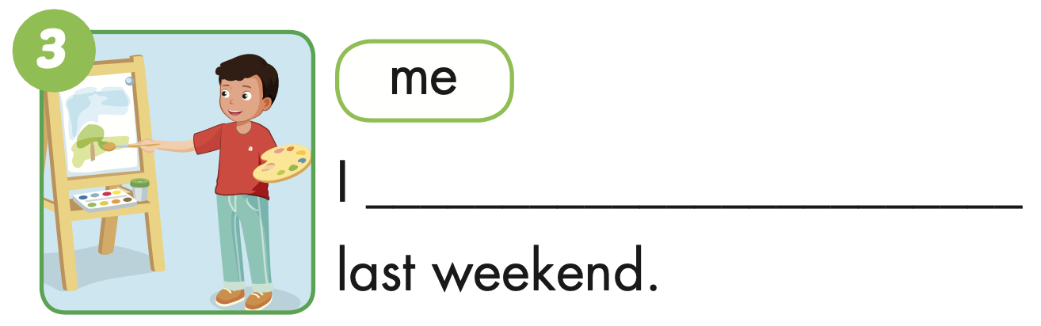
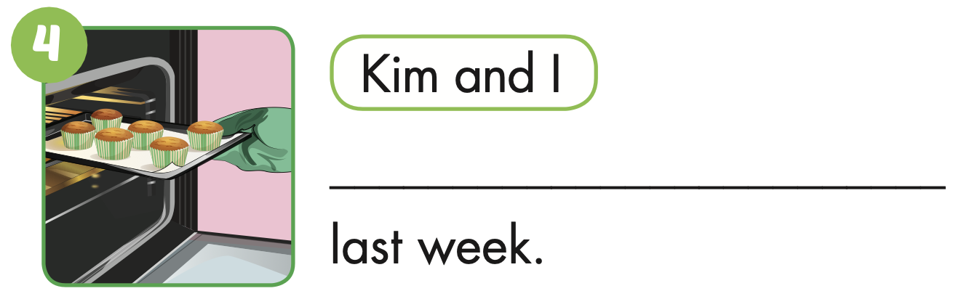
painted a picture
We baked some cupcakes

Slide 12
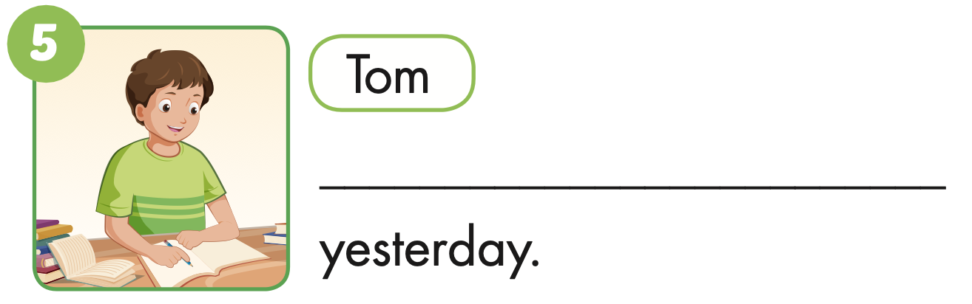
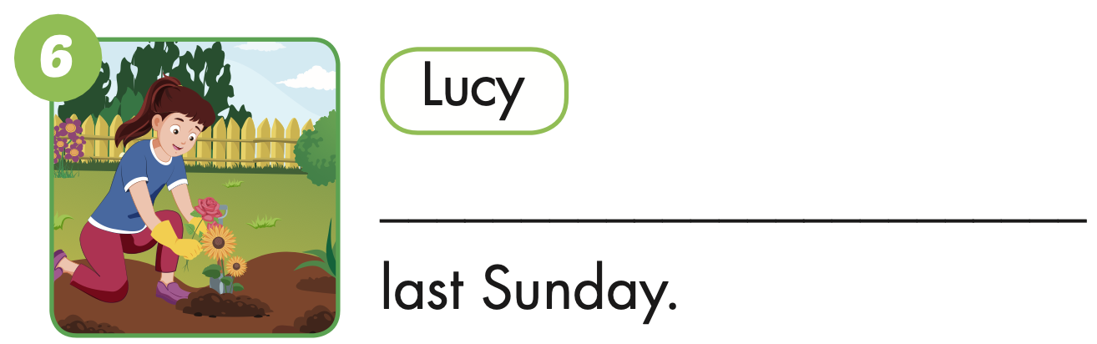
He studied
She planted some flowers

Slide 13

Production

Slide 14
Make sentences using these words. Then read your sentences to a partner.
I planted some flowers yesterday.

Slide 15

CONSOLIDATION

Slide 16

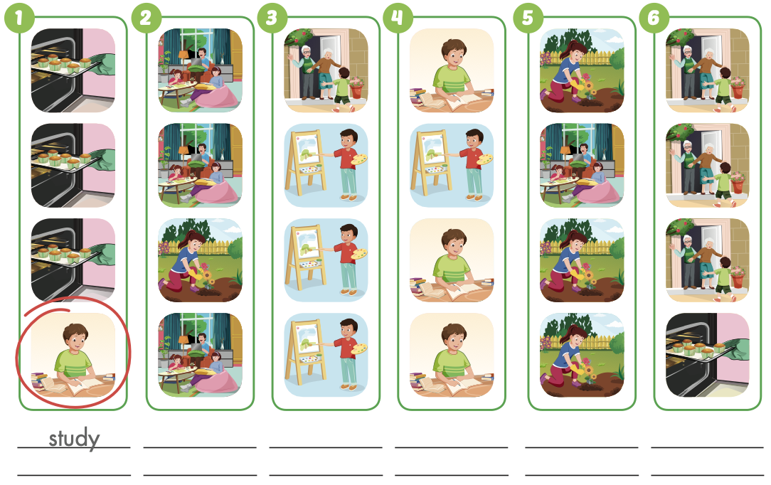
Extra Practice
WB, page 26

Slide 17
Extra Practice
WB, page 26
plant some flowers

Slide 18
Extra Practice
WB, page 26
visit my grandparents
paint a picture

Slide 19
Extra Practice
WB, page 26
stay at home
bake some cupcakes

Slide 20

WRAP-UP

Slide 21
Today’s lesson
Vocabularies
bake cupcakes,
paint a picture,
plant some flowers, visit my grandparents, stay at home,
study.
Structures/ Sentence patterns
I planted some flowers yesterday.

Slide 22
Homework
Practice the vocabularies and structure, and make sentences using them.
Do the exercises in Tiếng Anh 5 i-Learn Smart Start WB (page 26).
Do the exercises in Tiếng Anh 5 i-Learn Smart Start Notebook.
Prepare the next lesson (page 41 SB).
Play the consolidation games in Tiếng Anh 5 i-Learn Smart Start DHA App on www.eduhome.com.vn

Slide 23

Enjoy your day!

Slide 24

Lesson 3
Stay positive and have a nice day!

