Slide 1

Unit 3: WEATHER
Lesson 3.1
Page 40

Slide 2

WARM UP

Slide 3


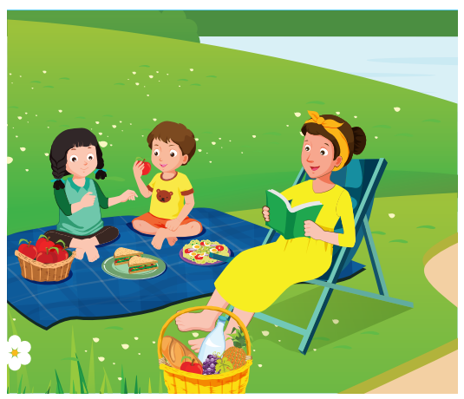
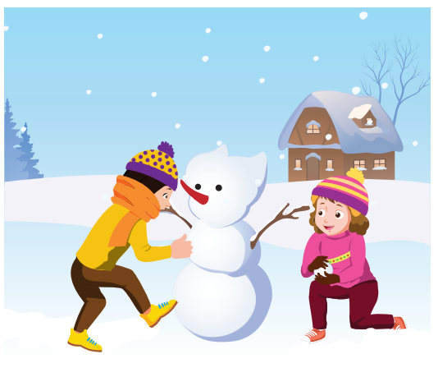
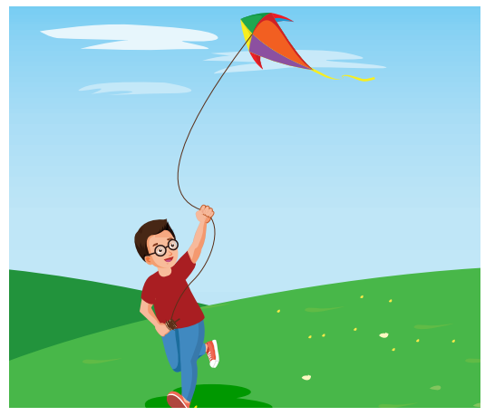

Look at the word and say the right number.
4
3
2
1
fly a kite

Slide 4
Look at the word and say the right number.
4
3
2
1
have a picnic

Slide 5
Look at the word and say the right number.
4
3
2
1
do arts and crafts

Slide 6
Look at the word and say the right number.
4
3
2
1
make a snowman

Slide 7
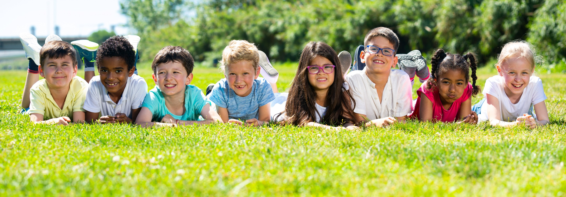
Have a nice day!

