Slide 1
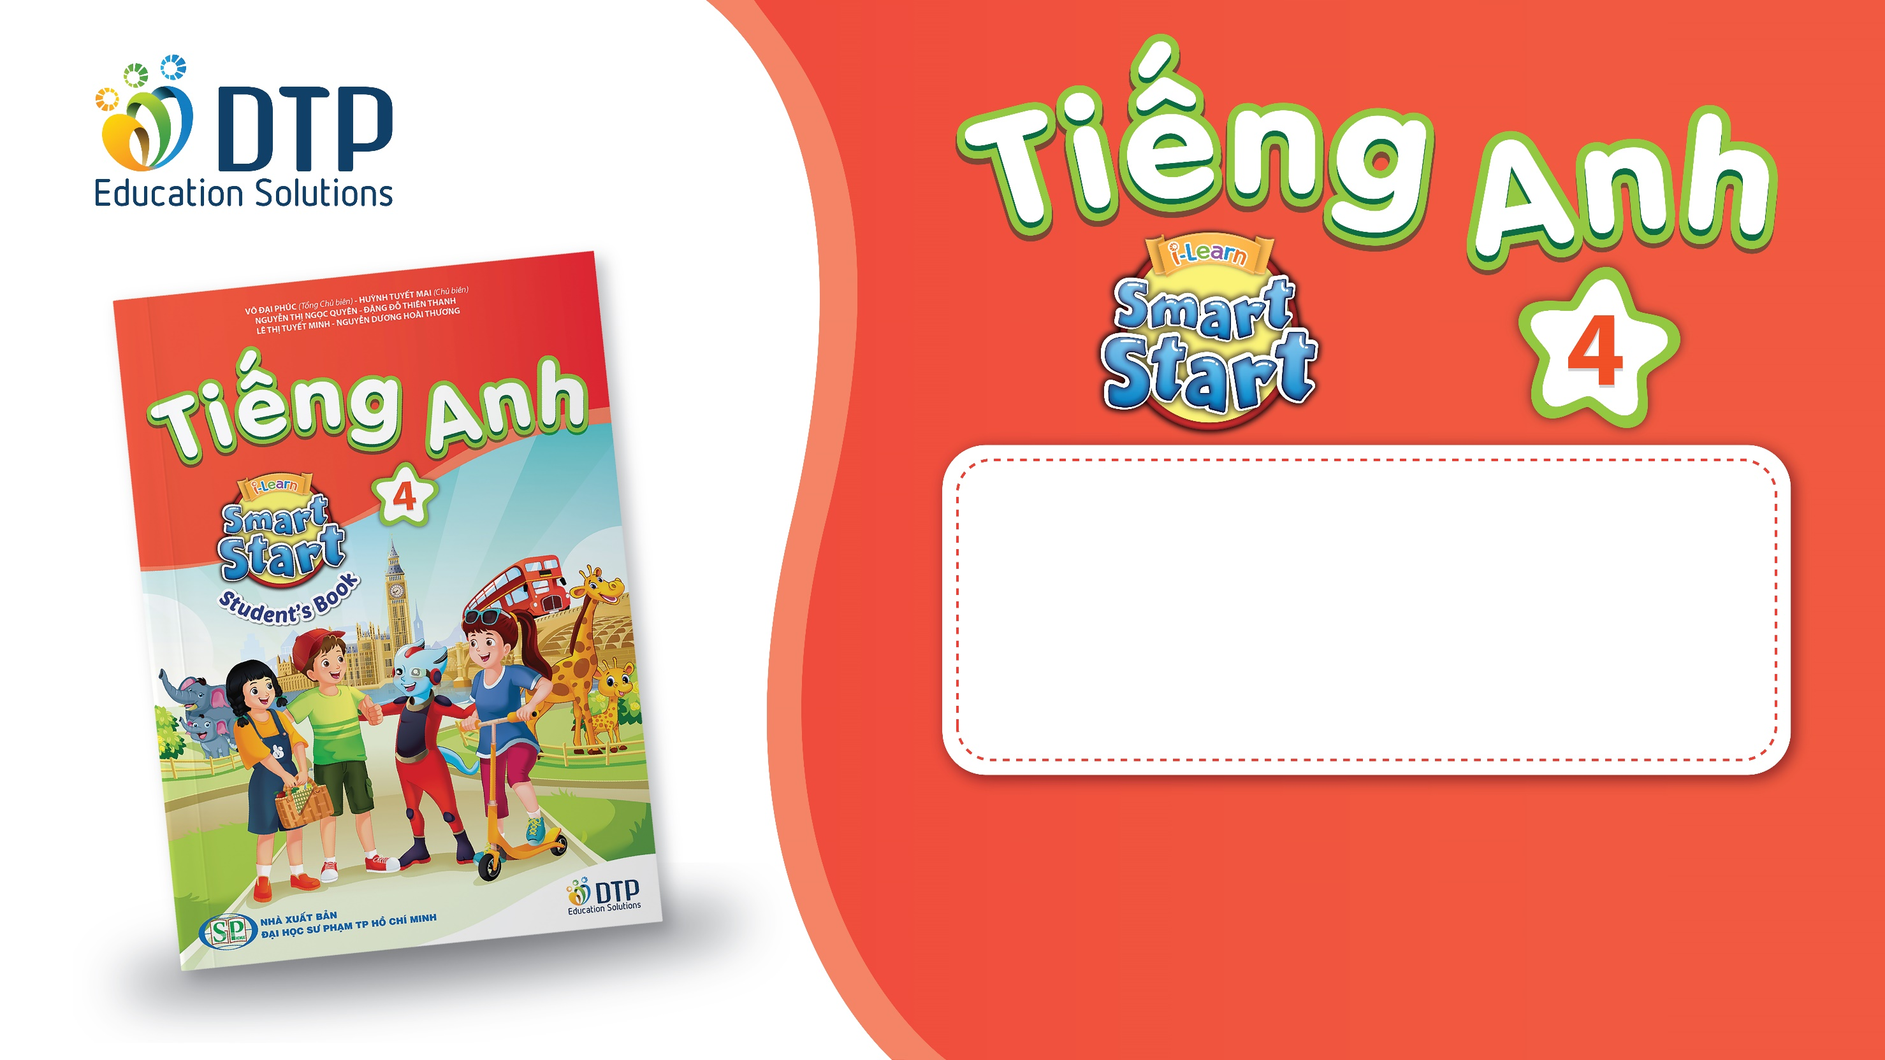
Unit 1: Animals
Lesson 1.1
Page 6

Slide 2
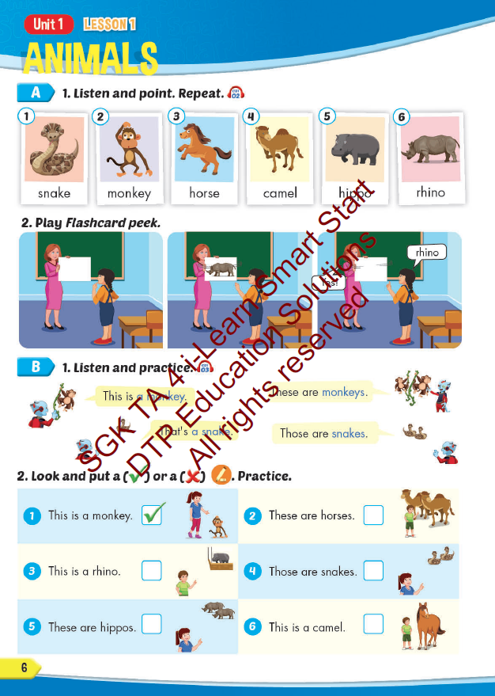
Lesson Outline
Warm-up
Vocabulary
Structure
Consolidation
Wrap-up

Slide 3
Objectives
By the end of this lesson, students will be able to…
Vocabulary: Pronounce and use the words related to the topic properly: snake, monkey, horse, camel, hippo, rhino.
Structure: This is a monkey. - These are monkeys.
That's a snake. - Those are snakes

Slide 4

WARM UP

Slide 5

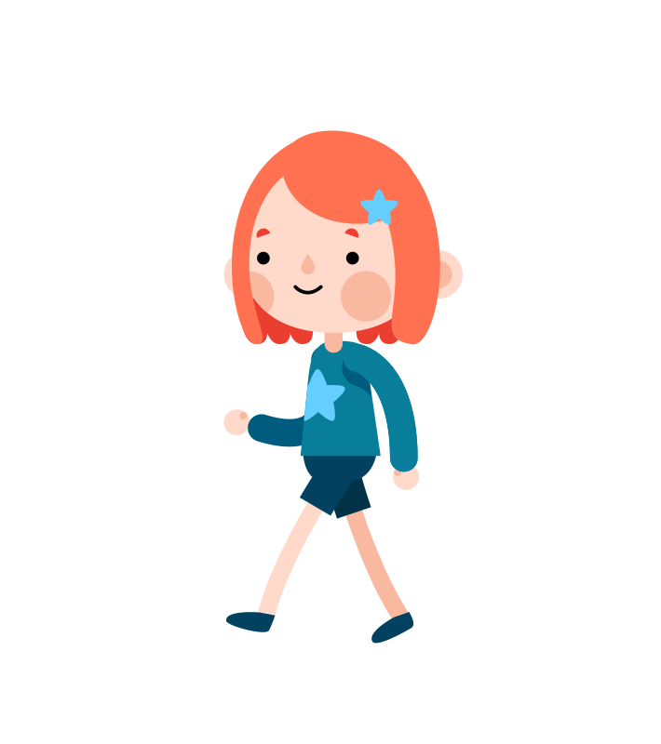
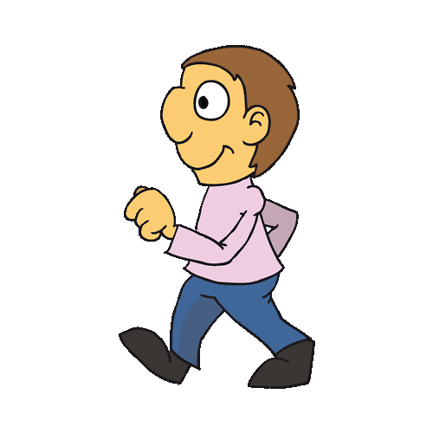
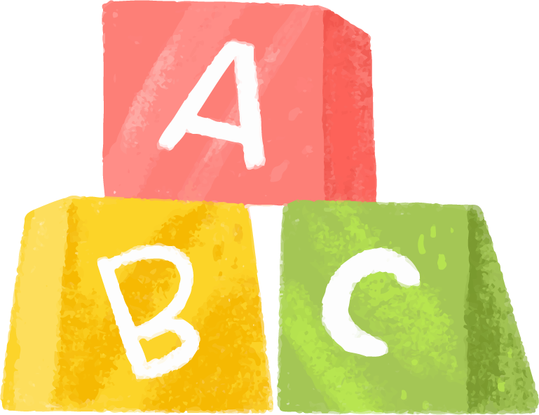

Click on the characters and choose the number to see the questions
Game: Finding the way home.

Slide 6




1
3
4
2
5
7
6
8

Slide 7

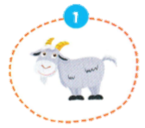
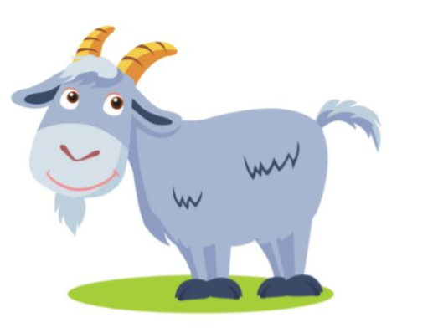

It’s a …..
It’s a goat.

Slide 8

It’s a …..
It’s a bird.

Slide 9
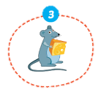
It’s a ….
It’s a mouse.

Slide 10
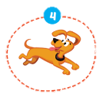
It’s a ….
It’s a dog.

Slide 11
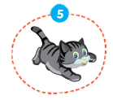
It’s a ….
It’s a cat.

Slide 12
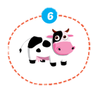
It’s a …..
It’s a cow.

Slide 13
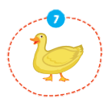
It’s a …..
It’s a duck.

Slide 14
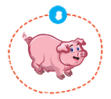
It’s a …..
It’s a pig.

Slide 15

Lesson 3
Stay positive and have a nice day!

