Slide 1

Unit 8: THE WEATHER
Review 2
Page 119

Slide 2
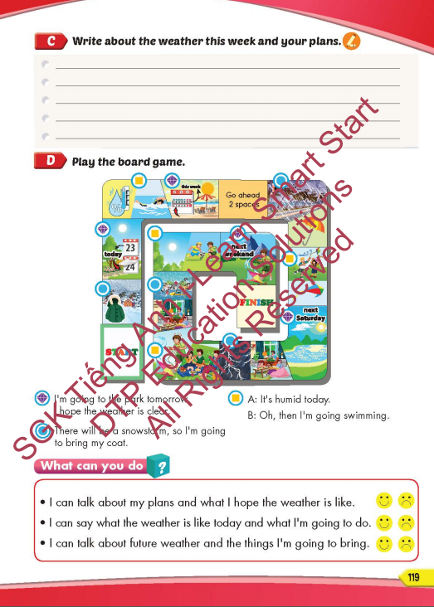
Lesson Outline
Warm-up
Listening
Reading
Writing
Wrap-up

Slide 3
Objectives
By the end of this lesson, students will be able to review and practice the target language and skills in unit 8.
Vocabulary: unit 8
Structure: unit 8

Slide 4

Writing

Slide 5
Extra Practice
Read and match the timeline in order
I want to visit the beach next week, I hope the weather is sunny and breezy because I want to go swimming and make sandcastles.
1
It’s going to rain tonight. I’m going to stay at home and watch movies with my family
2
This weekend is Lucy’s birthday, we’re going to visit the zoo and have a picnic there. I hope the weather is cool and clear.
3
4
There will be some sunshine tomorrow morning, so I’m going to the water park.

Slide 6
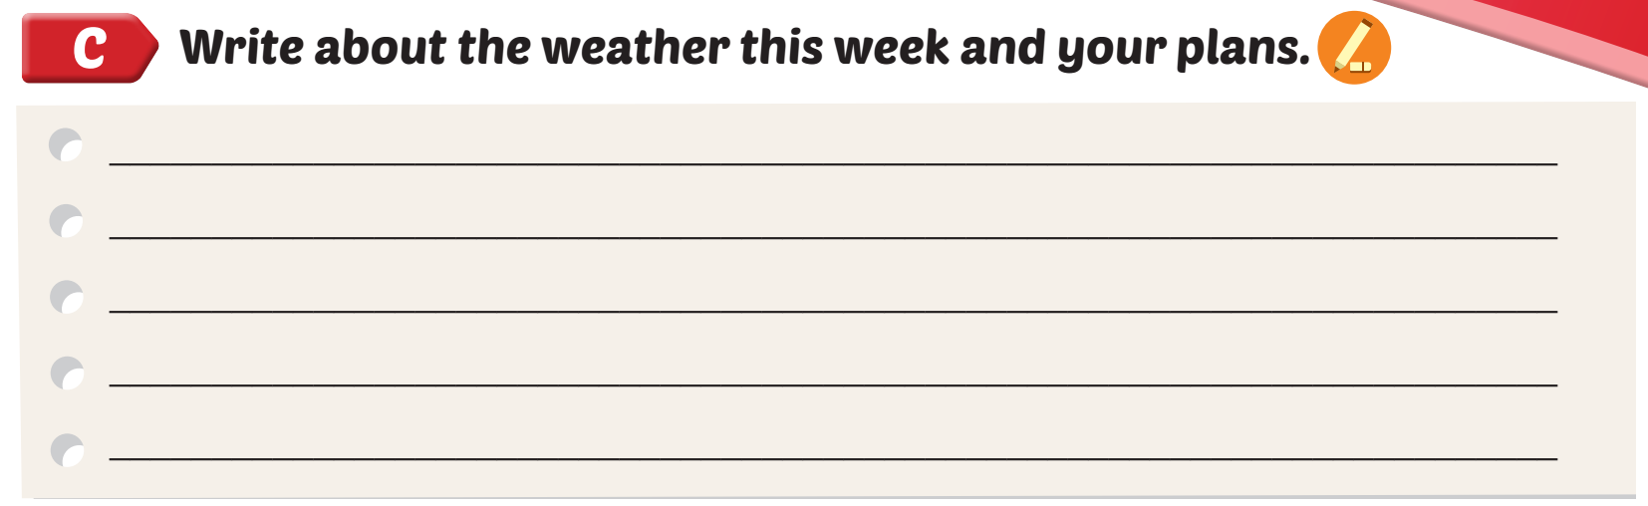
It's humid today. I'm going swimming. There will be a thunderstorm tonight, so I'm going to stay at home. I'm going to the park tomorrow morning. I hope the weather is clear and breezy

Slide 7

Speaking

Slide 8

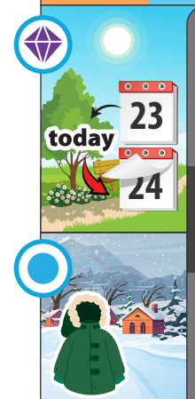
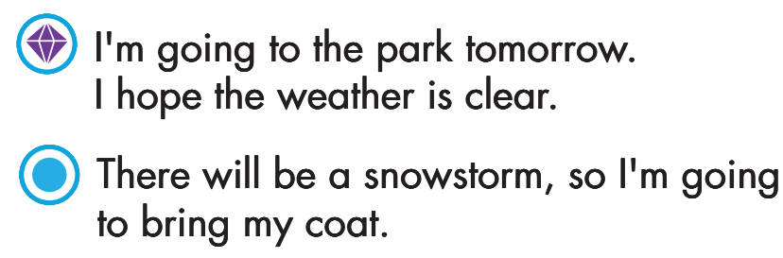



Slide 9
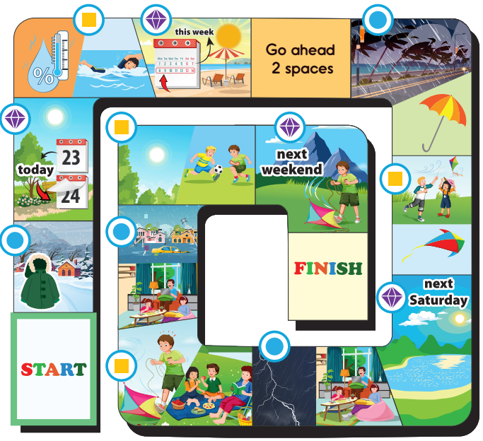

Slide 10
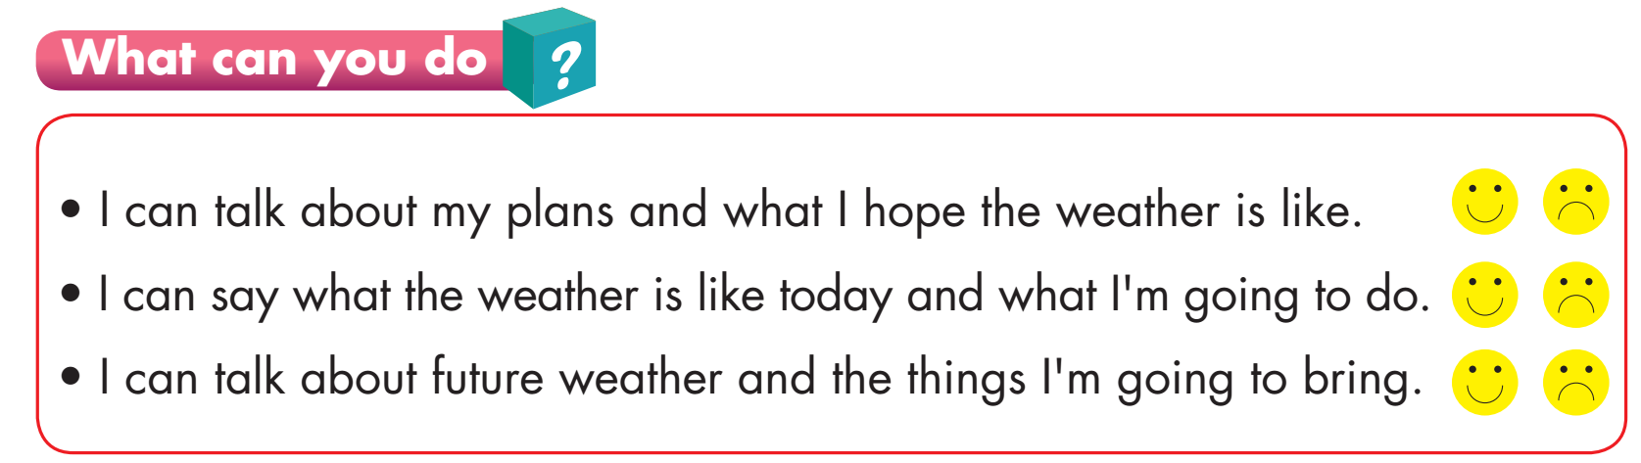

Slide 11

Lesson 3
Stay positive and have a nice day!

