Slide 1

Unit 8: THE WEATHER
Review 2
Page 119

Slide 2
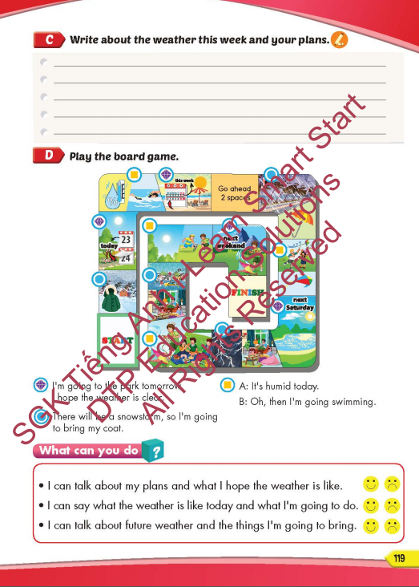
Lesson Outline
Warm-up
Listening
Reading
Writing
Wrap-up

Slide 3
Objectives
By the end of this lesson, students will be able to review and practice the target language and skills in unit 8.
Vocabulary: unit 8
Structure: unit 8

Slide 4

WARM-UP

Slide 5





Lucky Wheel
8
7
1
2
3
7
8
4
5
6
10
9
9
7
7
8
9
QUAY

Slide 6





What’s the weather like?
A. It’s sunny.
B. My favorite weather is cool.
C. I like swimming.
D. My favorite season is spring.
QUAY VỀ

Slide 7

What’s your favorite season?
A. It’s cloudy today
B. I like winter.
C. I enjoy going to the beach
D. I don’t like snowy.
QUAY VỀ

Slide 8

What are you going to do tomorrow?
A. I’m going to visit the mountains tomorrow.
B. I’m going to bring my umbrella.
C. There will be some showers.
D. It’s warm and dry.
QUAY VỀ
QUAY VỀ

Slide 9
What’s the weather like in Ho Chi Minh City in the summer?
A. I’m going to wear my coat
B. I’m going to the water park
C. It’s sunny and cool.
D. I hope the weather is warm
QUAY VỀ

Slide 10
It’s snowy today Oh, then I’m going to _________.
A. fly the kite
B. make snowmen
C. make a sandcastle
D. go to the beach
QUAY VỀ

Slide 11
I’m going to the beach tomorrow
I hope the weather is _________.
A. snowy
B. thunderstorm
C. rainy
D. sunny
QUAY VỀ

Slide 12
There will be some showers, so I’m going to bring ________________.
A. a hat
B. raincoat
C. sunglasses
D. coat
QUAY VỀ

Slide 13

What are you going to do tonight?
A. It’s thunderstorm tonight, so I’m going to stay at home.
B. I’m going to bring my sunglasses.
C. It’s going to rain tonight.
D. I hope the weather is warm and dry.
QUAY VỀ

Slide 14
There will be some sunshine.
Oh, then I’m going to bring my _____.
A. rain boots
B. raincoat
C. sunglasses
D. glasses
QUAY VỀ

Slide 15

Lesson 3
Stay positive and have a nice day!

